Slide 1

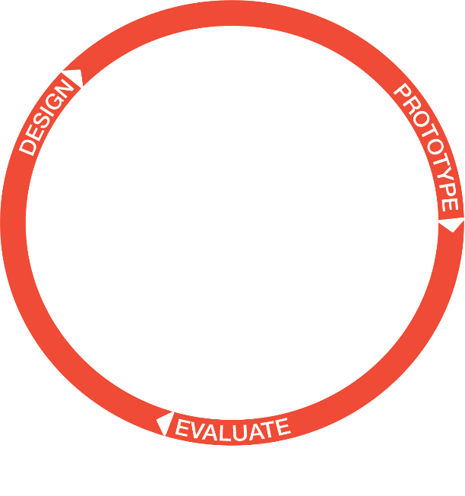
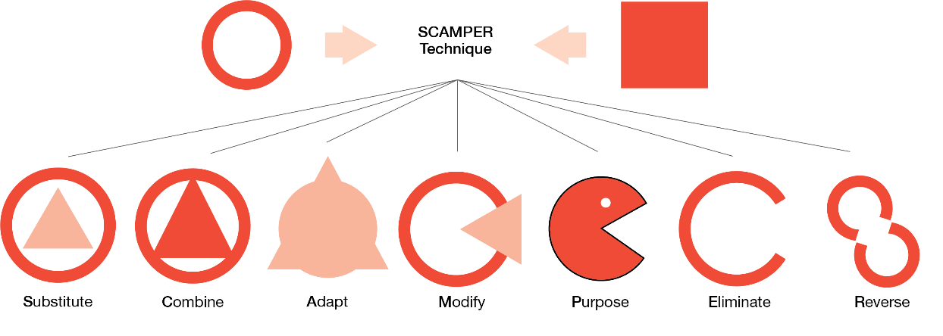
DESIGN AND TECHNOLOGY Year 7 - Problem Solving
1. Product Analysis keywords
Keyword | Meaning
End user | The person using the product.
Client | The company commissioning the design work.
Target market | Who the product is aimed at.
Form | The 2D and 3D aesthetics of a product What it looks like.
Function | What a product is designed to do.
Accessibility | Refers to who can use the product.
Ergonomics | Design for easy, efficient and safe use.
2. Problem Solving keywords
Keyword | Meaning
Qualitative | Data collected from a interview with a user.
Existing products | Product already in the market.
Product analysis | A detailed study of an existing product.
Focus Group | A group who are interviewed to get feedback on a product.
Iterative design | A design process which allows a cycle of prototyping, evaluation and redesign.
CAD | Computer Aided Design.
CAM | Computer Aided Manufacture.
USP | Unique Selling Point.
3. What is SCAMPER? This is a tool to support you when designing.
S | Substitute
C | Combine
A | Adapt
M | Modify, magnify, minify
P | Put to other uses
E | Eliminate
R | Reverse, rearrange
4. Iteration is a process of design; where you design, make a prototype and then evaluate. This will continue until the design is right.
Task
1. Learn/cover/write and self-check the different meaning of the keywords in section 1.
2. Learn /cover/write and self check the meaning of the key in section 2.
3. Learn/cover/identify the definition of SCAMPER.
4. 3. Learn/cover/identify the definition of Iterative design.

