Slide 1
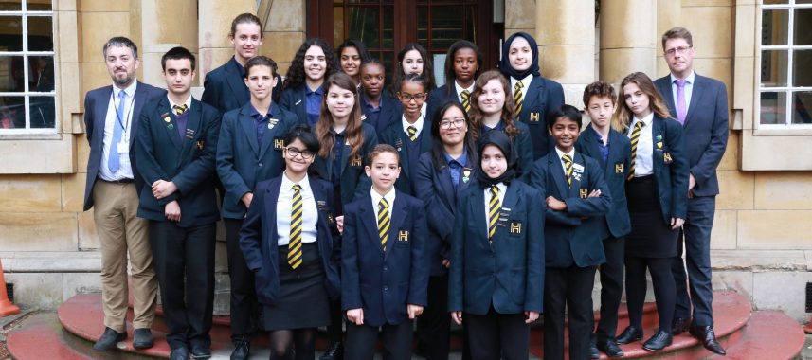


Harrow High School

Slide 2

School Beliefs
We believe in Excellence for All. This means:
Excellent Learning & Progress
Challenge and engagement, meeting and exceeding targets
Excellent Aspirations
Quality progression, passion for learning
Excellent Behaviour, Safety and Care for each other
Respectful challenge, showing empathy
Excellent Communication
Understanding each other, clarity of purpose
Everything we do as staff and learners will be true to these core values. We will talk about these values, we will promote these values and we will live these values.

Slide 3
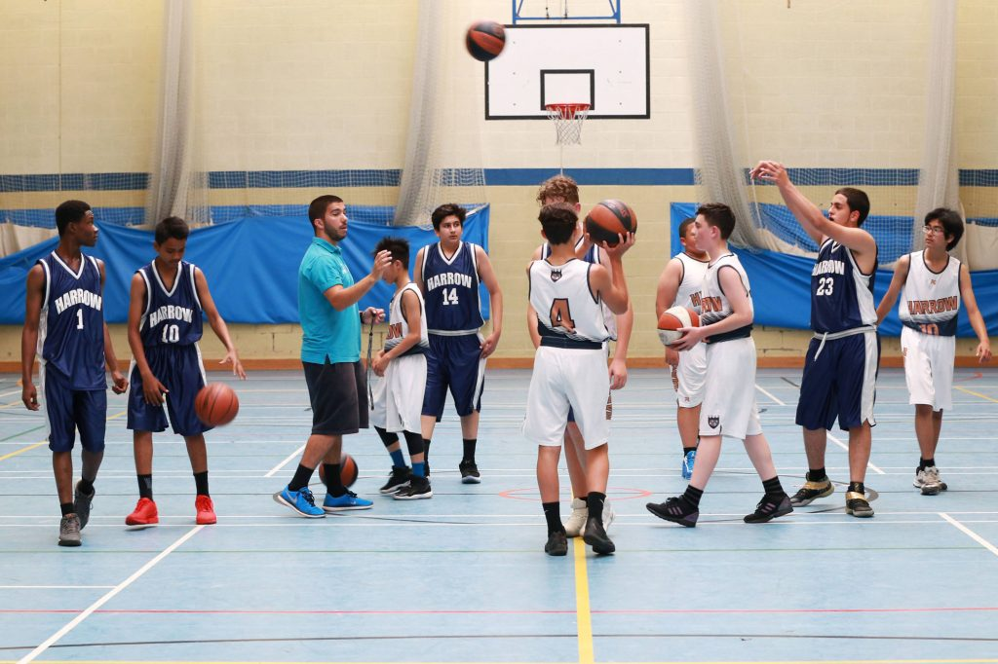
What’s great about Harrow High School?
Small, friendly school
Hard working, inspiring teachers.
Football and Basketball academies
High aspirations and standards, giving you the tools to succeed
Dedicated year seven transition team to support your child

Slide 4
Excellent Aspirations
All of our form groups are named after universities – we can all achieve
Inspirational tutor time sessions
Inspirational school excursions
Many opportunities to contribute to the school and wider community
Foreign travel

Slide 5
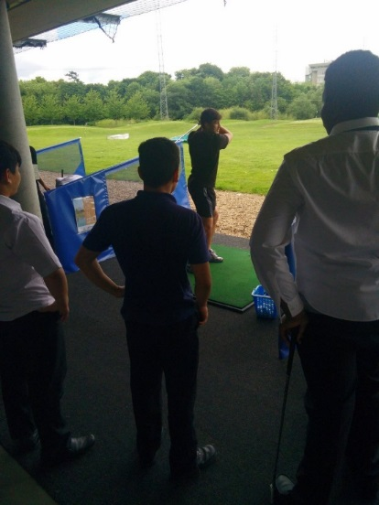
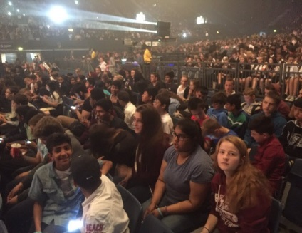
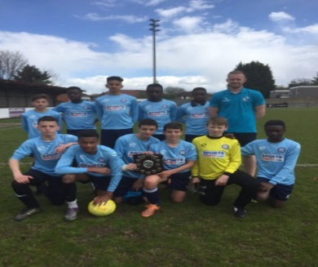

High aspirations through excursions
Three aspirational trips every year, minimum
University trips
Sporting trips across the country
Japan, Greece, Czech Republic, Belgium, Isle of Wight.
Rewards trip to acknowledge achievement from subjects, whole school and JP.

Slide 6


Paris
Year seven will go to Paris to support our curriculum plans
This will be a fantastic experience, that we hope will enhance learning experiences within the school and across a wide range of subjects

Slide 7
Induction Day
Four taster lessons
School tour
FAQs
Any questions please email ahallam3.310@harrowhigh.com

