Slide 1
Maths A2 Level Knowledge Organiser - Algebraic Methods
Define the term “Rational Number”
There are two main methods for solving Partial Fractions. What are they, and when would you use them?
1)
2)
Explain the general process for Proof by Contradiction

Slide 2
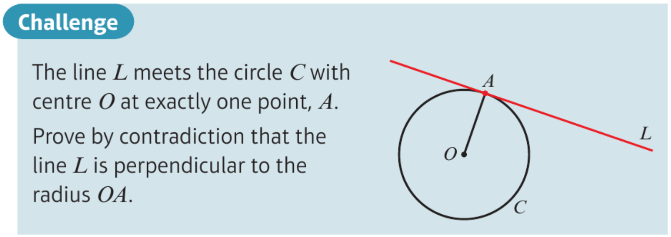
Maths A2 Level Knowledge Organiser - Algebraic Methods
Given an Algebraic fraction, describe the two methods by which you could turn in from an improper fraction into a mixed fraction
1)
2)

