Slide 1
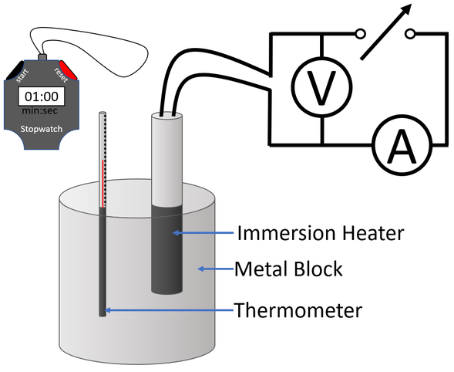
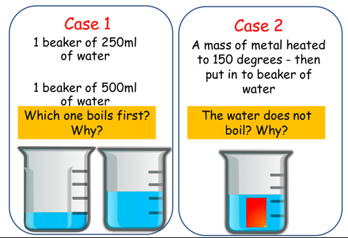
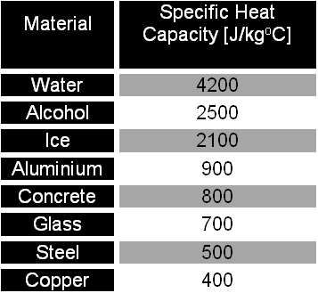
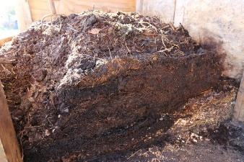
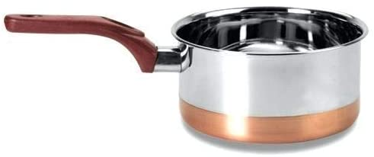

Thermal: The ‘Specifics’
Define Specific Heat Capacity and give the equation and the units..
What’s missing in the diagram?
Why does water have such a high SHC?
Explain which will have more energy, the large compost heap or the really hot coffee?
Why do pans have a copper base?

Slide 2
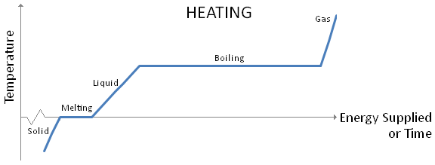
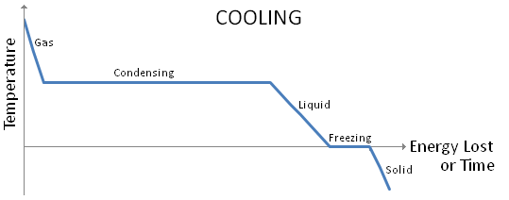
Thermal: The ‘Specifics’
Change of state: When a substance changes state there is no change in temperature. Using the words ‘heat transfer’, ‘vibrate’, ‘temperature’, ‘kinetic energy’, ‘potential energy’, describe what happens in the following….
When a solid is heated…
At melting point…
Define Specific Latent Heat, give equation and units.
In liquid form…
At boiling point…
What is SLH of fusion?
What is SLH of vaporisation?

