Slide 1
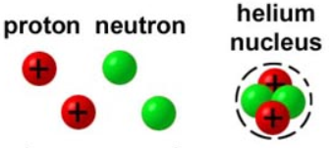
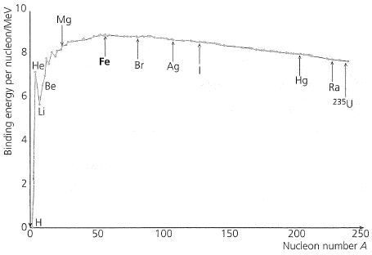
27) Nuclear Physics, Mass and Energy
What does the term mass defect, ∆m, mean?
Complete the table:
Particle | Mass (kg) | Mass (u)
Proton
Neutron
Electron | 9.11 x 10⁻³¹ | 0.00055
Use the nucleus of a Helium atom to demonstrate mass defect. It is made up of 2 protons and 2 neutrons:
What is the mass defect in atomic units?
Explain the equation:
What does the term binding energy mean?
What is and electron volt and why use it?
What does the binding energy graph, below, tell us??

Slide 2
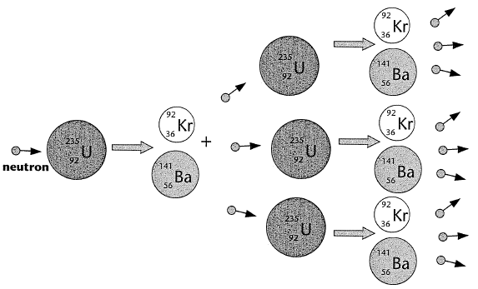
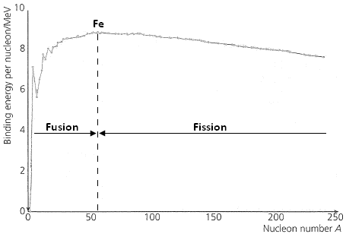
27) Nuclear Physics, Fission and Fusion
What is nuclear fission?
Show a possible equation for the fission of Uranium 235:
What is fusion? Give an example.
Describe and explain the term ‘chain reaction’ using the diagram below:
Using the graph, explain why nuclei lighter than Iron will undergo fusion
Using the graph, explain why nuclei heavier than Iron will undergo fission.
What is critical mass?

Slide 3
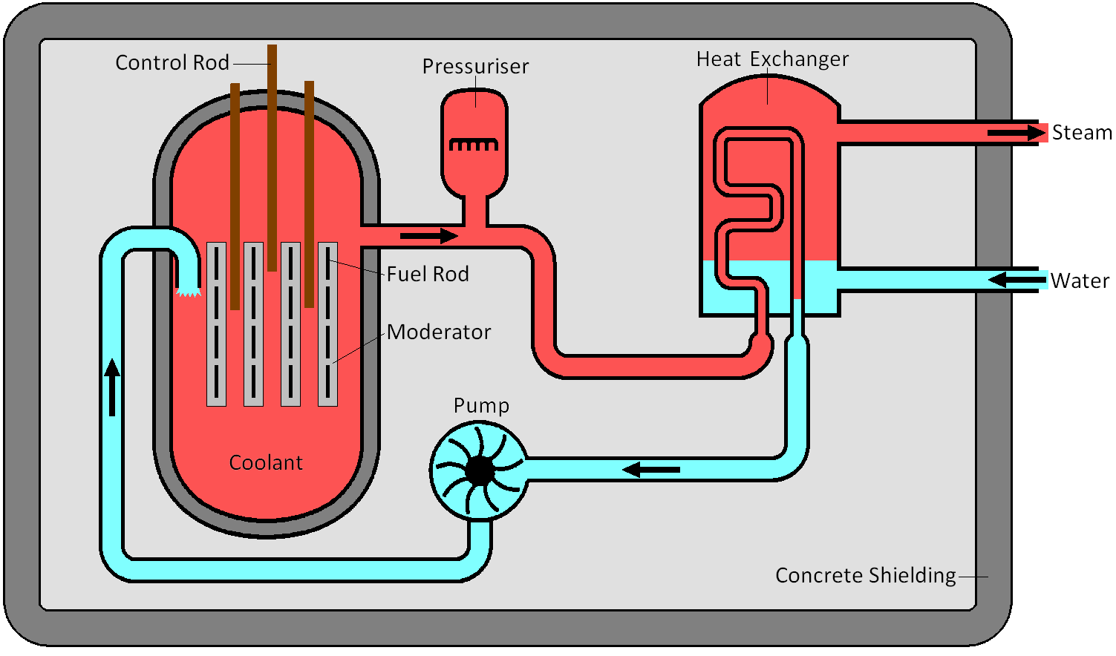
27) Nuclear Physics, Thermal nuclear reactor
Explain what each of the components of a nuclear reactor do.
Fuel Rods
Moderator
Coolant
Control rods

Slide 4
27) Nuclear Physics, Safety and waste
There are many safety features and controls in place designed to minimise the risk of harm to humans and the surrounding environment
Why are Fuel Rods solid?
Why is shielding used and describe its composition.
Why is there an emergency shutdown and what happens when it is used?
What is high-level radioactive waste and how do we get rid of it?
What is intermediate-level radioactive waste and how do we get rid of it?
What is low-level radioactive waste and how do we get rid of it?

