Slide 1
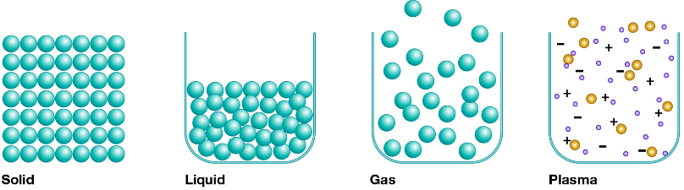
Thermal: Heat, Temperature and Internal Energy
Explain what the internal energy of a substance is.
Using the structure, explain the internal energy of a solid.
Using the structure, explain the internal energy of a liquid.
Using the structure, explain the internal energy of a gas.

Slide 2
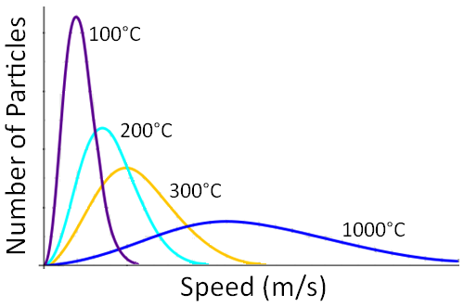
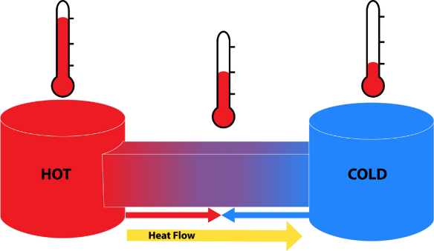
Thermal: Heat, Temperature and Internal Energy
What is Temperature? Explain using the diagram opposite.
What is heat? Use ‘thermal equilibrium’ in your description.
What happens to energy transfer when you get into a hot or cold bath?

Slide 3
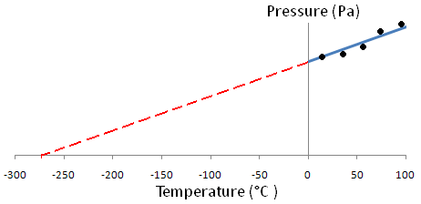
Thermal: Heat, Temperature and Internal Energy
What is the Celsius temperature scale?
Why use water for the Celsius scale?
What is absolute zero and who devised it? Use the diagram opposite to explain.
How can we measure absolute zero?

