Slide 1
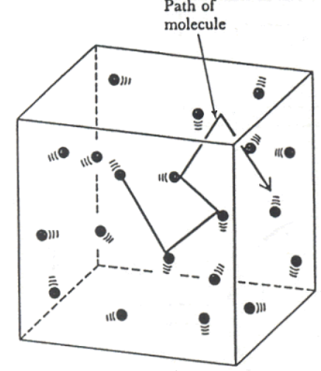
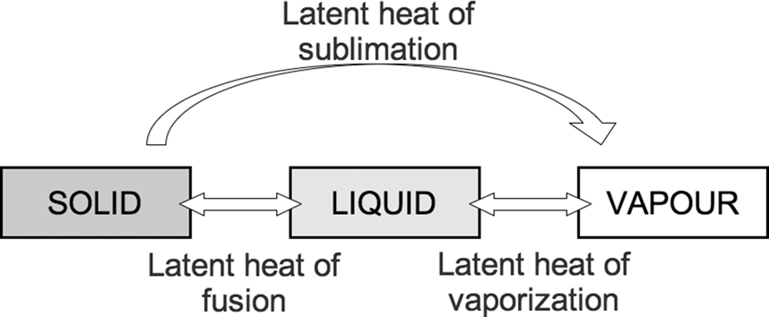
The Gas Laws
Gas properties: What is Volume, V, give units?
Gas Laws: To help us understand them we apply each one to a simple model. Image one ball in a box; the pressure is a measure of how many collisions between the ball and the box happen in a certain time, the volume is the area of the box and the temperature is the average speed of the ball. To simply things further let us assume it is only moving back and forth in the x direction. As shown in the diagram
Gas properties: What is Temperature, T, give units?
What is SLH of fusion?
Gas properties: What is Pressure, p, give units?
What is a Pascal in SI units?
What is SLH of vaporisation?
Which one is greater, SLH Fusion or vaporisation and why?

Slide 2
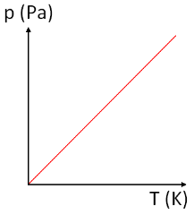
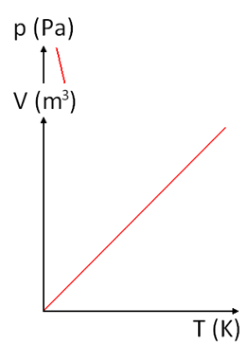
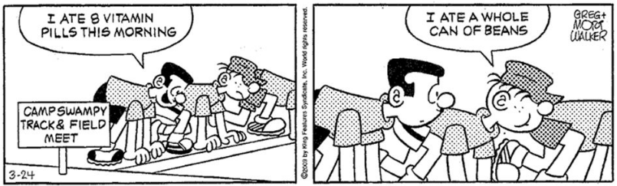
The Gas Laws
Gas Laws: To help us understand them we apply each one to a simple model. Image one ball in a box; the pressure is a measure of how many collisions between the ball and the box happen in a certain time, the volume is the area of the box and the temperature is the average speed of the ball. To simply things further let us assume it is only moving back and forth in the x direction. As shown in the diagram
State Boyle’s Law, give the equation.
Explain it using the graph below.
State the pressure law, give the equation.
Explain it using the graph on the right.
State Charles’ Law, give the equation.
Explain it using the graph below.

