Slide 1
Astrophysics: Lenses and Optical Telescopes
What is the principal focus F, of a lens?
What is normal adjustment for a refracting telescope? Draw the lens diagram.
What is the focal length f, of a lens?
What is angular magnification? Give the equation.
What is a Casseqrain telescope? Draw a lens diagram.
What is chromatic aberration?
What is spherical aberration?

Slide 2
Astrophysics: Reflector Vs Refractor telescopes
How does Chromatic Aberration effect the two different types of telescopes?
 | REFRACTORS | REFLECTORS
Chromatic Aberration
How does Spherical Aberration effect the two different types of telescopes?
Spherical Aberration
How does the light gathering power effect the two different types of telescopes?
Light gathering power
How does the resolving power effect the two different types of telescopes?
Resolving power
How is the lens manufacture different for both telescopes?
Manufacture
Explain one main disadvantage of reflective telescopes?
Disadvantage of reflectors

Slide 3
Astrophysics: Reflector Vs Refractor telescopes
Explain what the collective power of a telescope is.
What is the resolving power of a telescope? Give the equation.
How can we improve resolving power?
.
What is Rayleigh’s criterion and resolving power?
Sketch a diffraction patter from a circular aperture showing resolution
What is a CCD?
What is quantum efficiency?

Slide 4
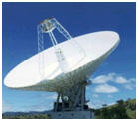
Astrophysics: Non-optical telescopes
What is the resolving power of a radio telescope?
Give some details about the dish structure itself:
.
Write some points about InfraRed telescopes.
Write some points about UV telescopes.
Write some points about X-Ray telescopes.

Slide 5
Astrophysics: Classification of stars by brightness
Using triangles/diagrams, show what a parsec and an arcsec are.
What is an Astronomical Unit? Give equation.

Slide 6
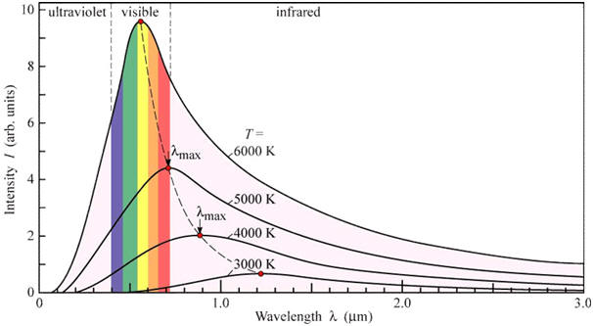
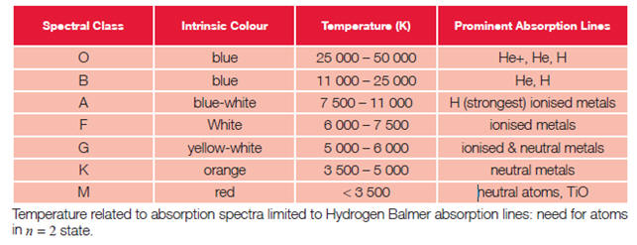

Astrophysics: Classification of stars by temperature
A black body is a perfect emitter and absorber of electromagnetic radiation. We assume that a star is a black body emitter.
A diagram for the Intensity / wavelength variation for stars of different temperature is given.
What is Wien’s law? Give the equation.
What is Stefan’s law? Give the equation.
Stellar spectral classes: O(hottest, blue) B A F G K M(coolest, red). Fill in the blank columns
Balmer absorption lines for hydrogen (which occur when hydrogen atoms in the star get excited to the n=2 level)
What does the intensity of the absorption lines depend on?

Slide 7
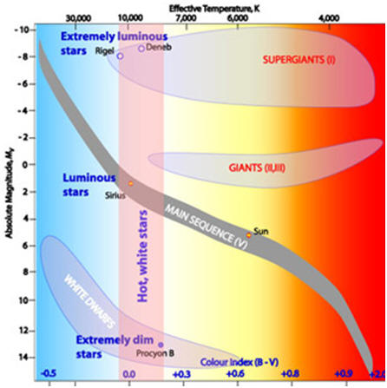
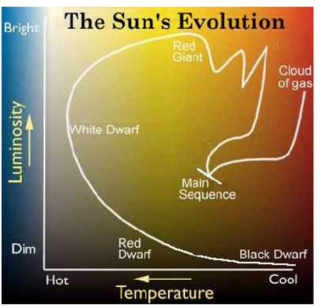
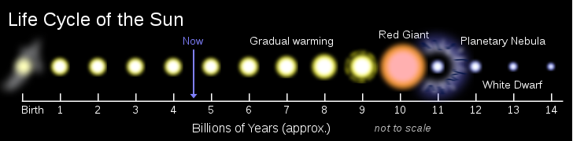
Astrophysics: Hertzsprung-Russell (HR) Diagram
Sketch a diagram for the Sun’s evolution using Luminosity and Temperature
What is a Hertzsprung-Russell (HR) Diagram and what does it show us?
Use the diagram below to describe and explain the life cycle of the Sun

Slide 8
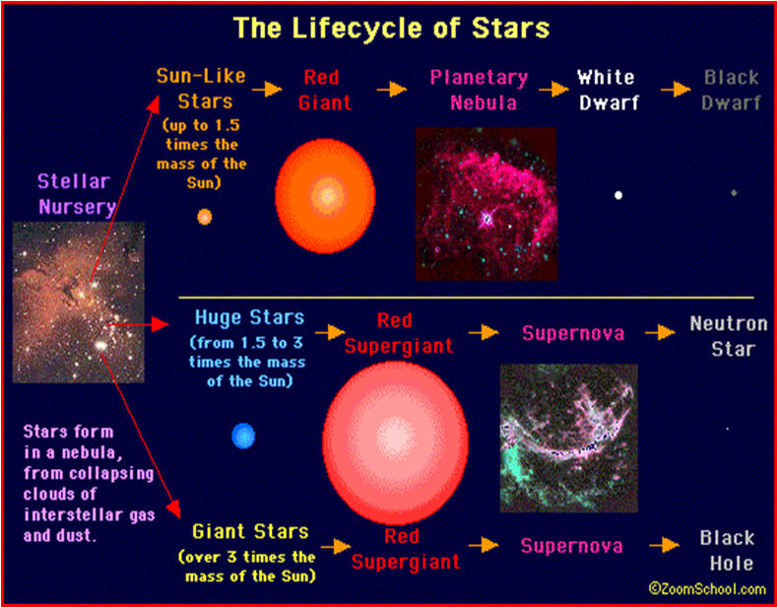
Astrophysics: Life cycle of a star
Using the diagram describe and explain the life cycle of a star giving descriptions of each stage of the matter, use the terms below to help..
neutron stars - the remains of a massive star consisting entirely of neutrons- extremely dense, escape velocity close to light speed.
black hole - remains of very massive star, absorbs all light that hits it, escape velocity > than speed of light. Supermassive black holes at the centre of galaxies.
Gamma ray bursts - due to the collapse of supergiant stars to form neutron stars or black holes.
type 1a supernovae used as standard candles to determine distances.

Slide 9
Astrophysics: Cosmology
What is doppler shift? Give equation and explain the terms
What evidence is there of the big bang theory?
What is Hubble’s Law:
What are Exoplanets and what are the detection methods?
What are Quasars?

