Slide 1
Kinetics II 3.1.1.9
What are the factors that affect rate of reaction?
Define the term rate equation.
State what a rate equation is.
Define the term rate constant of a rate equation
Draw a sketch to show how initial rate can be found?
Define the expressions order of reaction and overall order of reaction.
Draw a Maxwell-Boltzmann distribution and show how temperature affects the distribution.

Slide 2
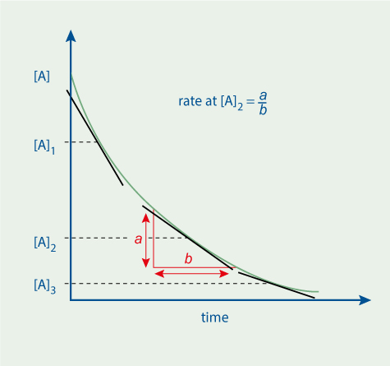
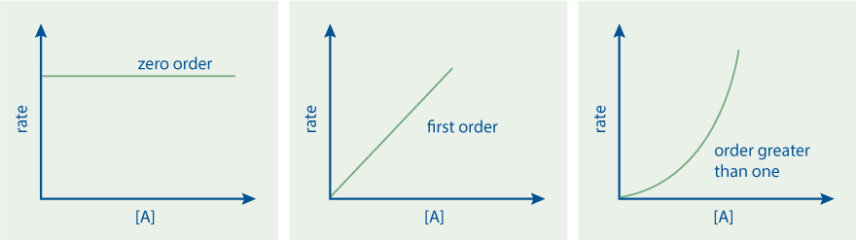
Kinetics II 3.1.1.9
k=Rate[X][Y]2
Calculate the units for K
Which order does this graph show WRT A?
For each graph below explain the shape
Describe how a change in concentration affects the value of the rate constant.
Describe how a change in temperature affects the value of the rate constant.

Slide 3
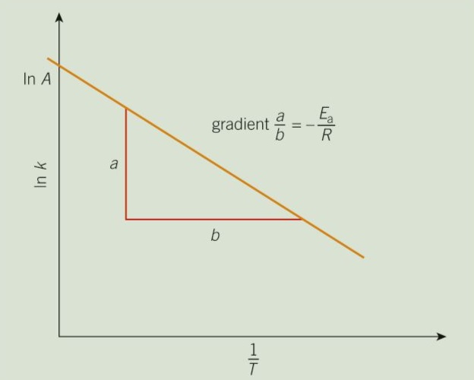
Kinetics II 3.1.1.9
Explain how the above graph is drawn using the Arrhenius Equation

Slide 4
Kinetics II 3.1.1.9
Describe the connection between the rate equation for a reaction and the reaction mechanism.
Define the expression rate-determining step of a reaction.
Describe the connection between the rate equation for a reaction and the reaction mechanism.

