Slide 1
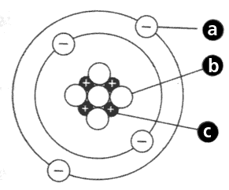
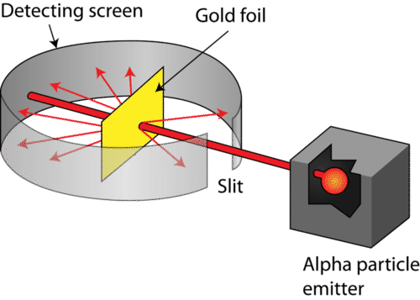
Atomic Structure
How many protons does uranium have?
How many neutrons does chlorine-35 have?
How many electrons does Na⁺ have?
Label each particle within the atom:
What happens if the number of protons changes?
Which three things were proved about the nucleus? How?
Who carried out the experiment?
Why were alpha particles used?
Particle | Where is it? | Charge | Mass
Neutron
Proton
Electron
What happens if the number of electrons changes?
What happens if the number of electrons changes?
Describe the model now used for the atom (6).
Describe how the gold foil experiment disproved the previous model of the atom.
Briefly describe each scientists model of the atom:
Democritus 400 BC
Dalton 1803
Thomson 1897
Rutherford
1911
Bohr
1913
Chadwick
1932

Slide 2
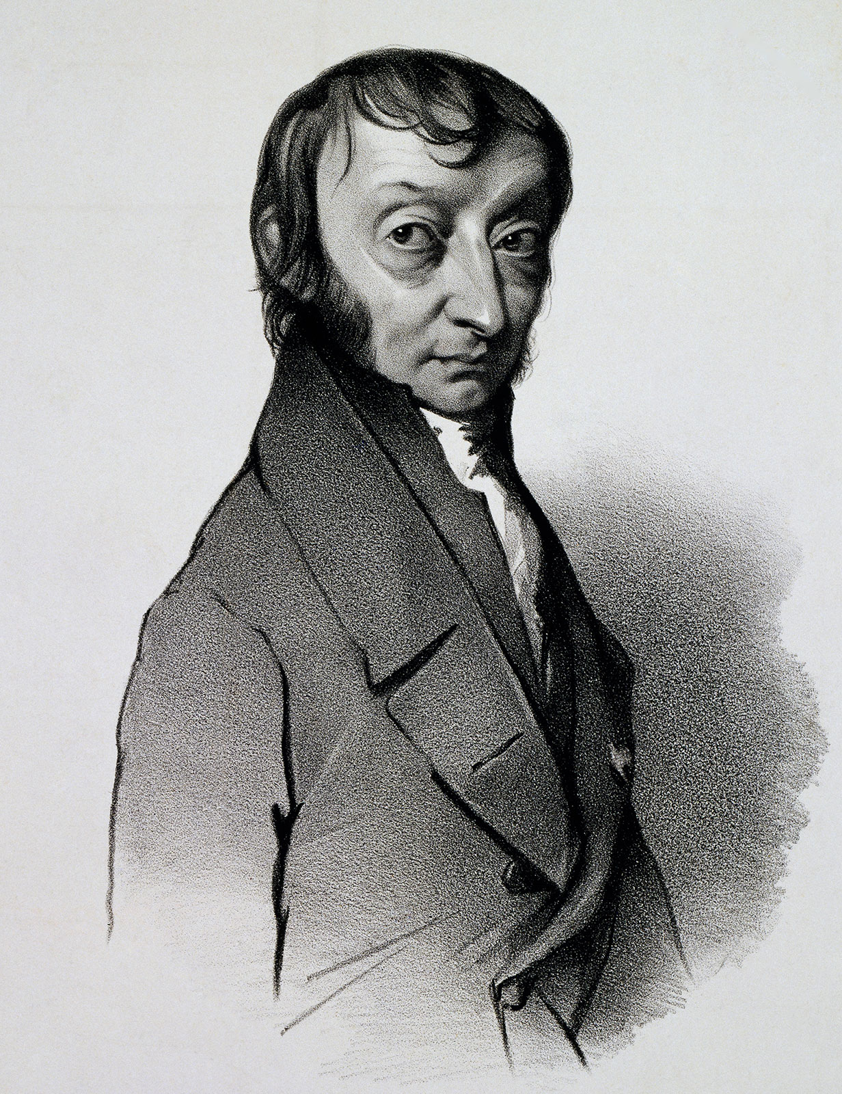
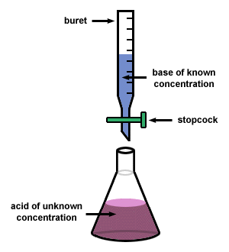
Amount of Substance
How many grams of Carbon-12 contain Avogadro’s number of atoms?
State Avogadro’s number
State Avogadro’s law
How many moles are there of copper sulphate in 5.00g?
How many cm³ are there in 1 dm³
What does the following unit represent
Mol dm⁻³
State the formula of chromium(III) carbonate
State the Ideal Gas Equation.
For each of the following give the S.I units.
Pressure:
Volume:
Temperature:
Gas constant:
What is the equation that links volume, concentration and moles?
Which equation links moles, mass and molar mass.
What is the mass of just one ion of ⁷⁹Br⁺
What is the meaning of concordant?
What is the name of this procedure
List all the apparatus used in the procedure
This Photo by Unknown Author is licensed under CC BY-SA

Slide 3

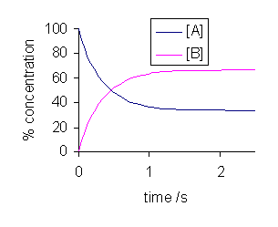
Equilibria and Le Chatelier’s Principle
Write the Kc Expression for the Haber process
What are the factors changed in a reaction?
Define Le Chatelier’s principle
What are the units for Kc in the Haber process
Five two possible units for temperature
How many tonnes of ammonia are manufactured in the UK every year?
What does this sign mean?
If temperature is decreased how does a reaction in Equilibria respond?
When does pressure of the gas not affect the position of equilibria?
If the forward reaction is endothermic, the reverse must be …………..
What is the economic importance of this reaction?
What is the name of this process?
.
Look at the following reaction
A and B are in Equilibria, how can you tell?
State the best temperature for the reaction
What time is equilibria established?
Why does high pressure improve yield?
What are the characteristics of a reaction at equilibria

Slide 4
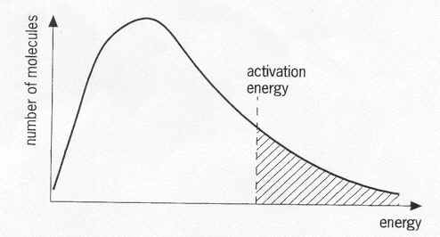
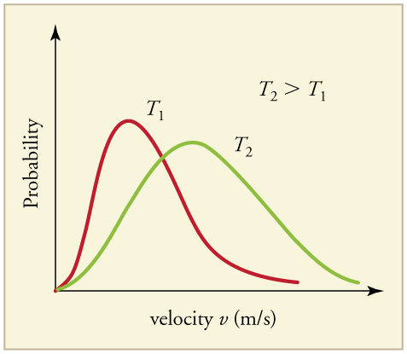
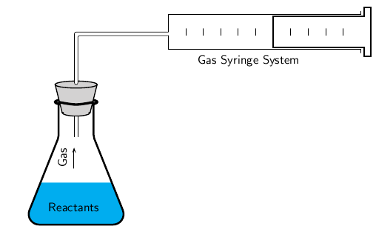
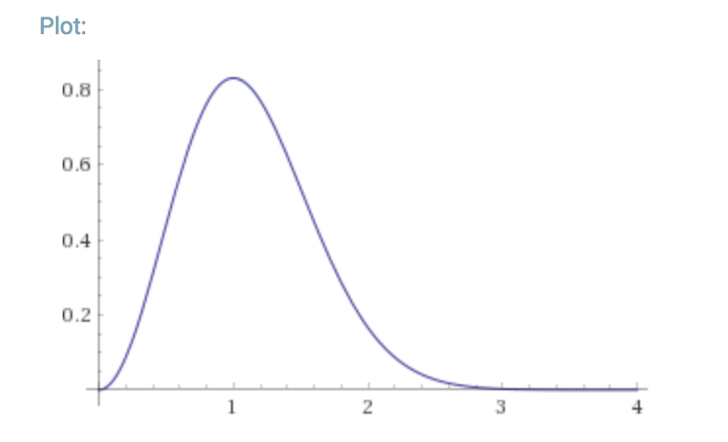
AS Kinetics
Why is this affected by temperature?
What is this called?
What does the area under the curve represent?
What is rate of reaction:
What is an example of a fast reaction?
Why must it start at the origin?
What does this graph represent?
What is activation energy?
What is this method called?
Where is the mean energy?
What does asymptotic mean?
Give an equation for a reaction that could be investigated this way
Label the axes
Why is the peak higher at T1?
Sketch the shape of a higher temp
Why is the graph shaped this way?
What is an alternative to the gas syringe?
Factors that affect rate of reaction
Describe in detail the effect of temperature on rate of reaction
List all factors
Create a pneumonic to remember the factors
Why does increasing pressure increase rate of reaction for gaseous reactions?

Slide 5
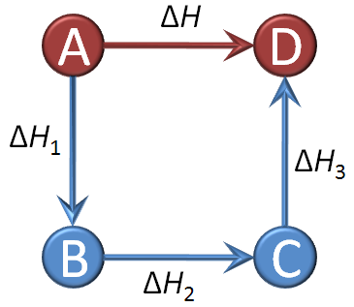
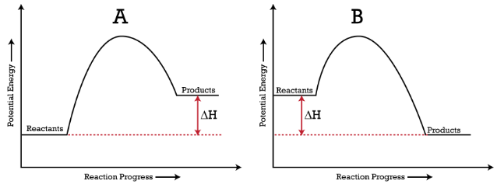
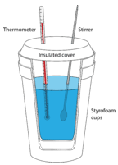
Thermodynamics I
Define Hess’ Law using this diagram
What are the common units used?
Which letter is exothermic?
Write an equation for the reaction that represents the standard enthalpy of formation of carbon dioxide. Include state symbols in your answer.
What do we call these diagrams?
Define the term activation energy
What is the difference between exothermic and endothermic reactions?
What makes a reaction endothermic in terms of bonds broken and made?
What is the significance of the sign for delta H?
Write down standard conditions
Calorimetery
What is the density of water?
Give an example of an endothermic reaction with an equation
Write the definition for enthalpy change of formation (3)
What is bond enthalpy?
State the equation used:
What are the units
What is the value for water?
Define the term
State the units used
Define the term specific heat capacity:

Slide 6
Transition Metals
Give examples of Variable Oxidation States
Link these physical properties to their everyday use
Transition metals act as catalysts, give examples of 3 processes and the name of the catalyst…
List some physical properties of Transition Metals
Transition metal species | Full electron configuration
Cu
Cr
Cu ⁺
Mn²⁺
Ti
V³⁺
Fe³⁺
What is a ligand?
Draw an octahedral complex ion
Physical and Chemical Properties of Transition Metals
Draw the tetrachloro copper (II) ion
Classify the three types of ligand…
What is the formula of Tollen’s?
Why do complex ions have colour?

Slide 7
Thermodynamics II
What are standard conditions
What are the units for enthalpy?
Enthalpy change | Definition and example
Standard enthalpy change of formation
Lattice enthalpy
Enthalpy of atomisation
First electron affinity
Second electron affinity
First ionisation energy
Second ionisation energy
What do we measure temperature in?
What is the unit of Gibb’s
Define enthalpy:
State Gibb’s Free energy equation
What is the significance of a negative G
What are the two types of reaction?
Why the discrepancy between some theoretical and experimental values for lattice enthalpy?
How do you calculate the point at which a reaction becomes just feasible?
What is the link with Hess’ Law
How do they help determine solubility?
What type of compound can we draw a Born Haber cycle for?
BORN HABER CYCLE
What is the significance of arrow direction?
The feasibility of a physical or a chemical change depends on the balance between the thermodynamic quantities of enthalpy change (ΔH), entropy change (ΔS), and temperature (T). Suggest how these quantities can be used to predict whether a change is feasible.

Slide 8
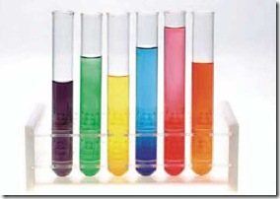
Acid Base Equilibria
Term: | Definition/Equation
Ka
Kw
pH
pKa
Equivalence point
Define the term Bronsted-Lowry Acid
Define the term Bronsted-Lowry base
How do we distinguish between strong and weak?
How do we distinguish between dilute and concentrated?
Why must a weak acid be used
Why does the body need a buffer system?
Describe 3 real life applications of Buffer’s
Why does every buffer reach saturation?
Define a buffer solution:
The value of K_{a} for ethanoic acid is 1.75 × 10⁻⁵ mol dm⁻³ at 25 °C.
Calculate the concentration of ethanoic acid in a solution of the acid that has a pH of 2.69.
What is the significance of Ka
What was the shape of the curve?
Describe an experiment that allows you to investigate pH changes
Why was an indicator not used?

Slide 9
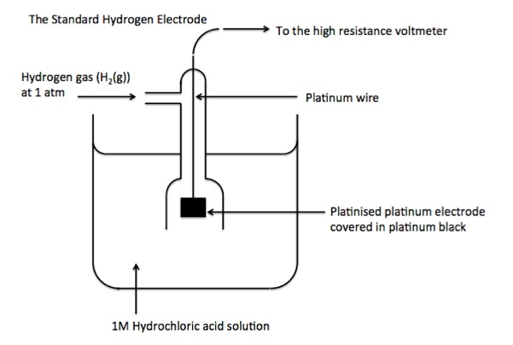
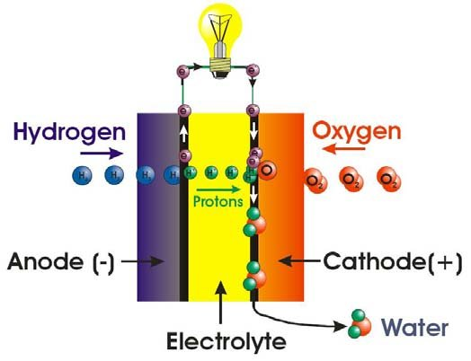
REDOX EQUILIBRIA
Explain why the concentration of H₂SO₄ used would be half of the HCl?
Define Standard E cell
State standard conditions
What is the significance of a highly negative E cell value?
What is the significance of a highly positive E cell value?
What is the pressure in kPa?
Why use platinum??
Balance the following
Draw a diagram below to help
A student diluted 25.0 cm³ of a solution of hydrogen peroxide to 250 cm³. When 20.0 cm³ of the diluted solution was acidified, it required 19.2 cm³ of 0.0210 mol dm^{–3} potassium manganate(VII) for oxidation.
Calculate the concentration (mol dm^{–3}) of the original hydrogen peroxide solution.
2MnO₄⁻ + 6H⁺ + 5H₂O₂ → 2Mn²⁺ + 8H₂O + 5O₂
Which species acts as a reducing agent?
Fe²⁺(aq) + HBrO₃(aq) → Fe³⁺(aq) + Br₂(l)
What is the name of this cell?
Describe 2 advantages of its’ use over fossil fuels?
Are there are any concerns about it’s use?

Slide 10
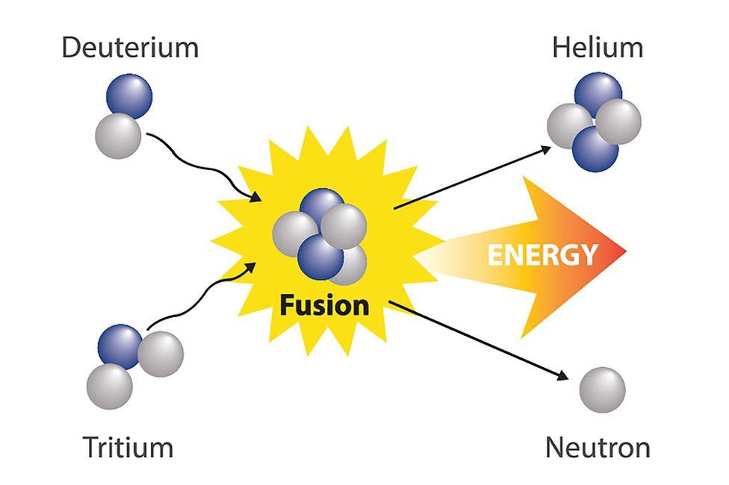
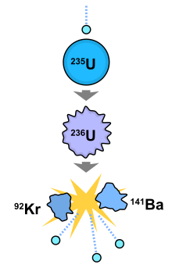
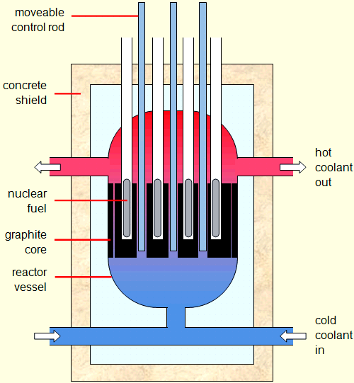
AS REDOX
Which two isotopes are generally used?
Why do we not use fusion on Earth for electricity generation?
Describe the image to explain nuclear fusion:
Describe the image to explain nuclear fission:
How do the mass of the products relate to the mass of the original isotope?
Where do we gain the products for fusion?
What happens to the daughter products?
What happens to the waste products of fusion?
Name three places where fusion naturally occurs:
Why is this known as an chain reaction?
Why are these rotated and administered from three sources?
Why are X-rays preferred to gamma rays?
What is the role of the control rods?
What happens to the water in the reactor?
When would we use brachytherapy instead of radiotherapy?
What is radiotherapy?
What happens when the control rods are lowered?
What properties must a tracer have to be suitable to be used in a human?
What is a radioactive tracer used for?
Describe three ways in which radiation can be used in medicine:
What happens when the control rods are raised?
How is contamination different to irradiation?

