Slide 1
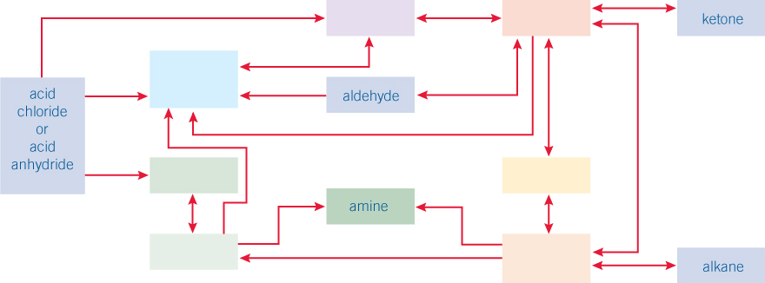
Carbonyl compounds
Complete as much of the synthetic pathway as possible

Slide 2
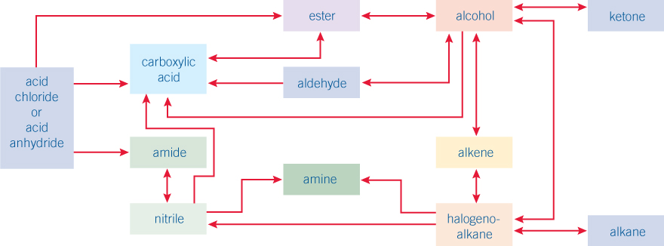
Carbonyl compounds
Complete as much of the synthetic pathway as possible - ANSWERS

