Slide 1
Topic 1 Atomic Structure 3.1.1.1
Give the mass and charge of each of these particles
Proton
Neutron
Electron
What is the overall charge on an atom and can you explain why?
Use the following information to identify the element:
Number of Neutrons is 10
Number of Protons is 9
Number of electrons is 9
Explain your answer.
How would you represent an isotope of chlorine with 20 neutrons?
Define the following:
“Relative Atomic Mass”
“Relative Isotopic Mass”

Slide 2
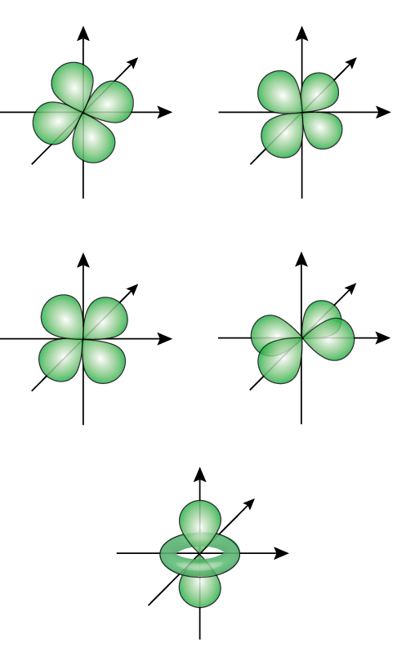
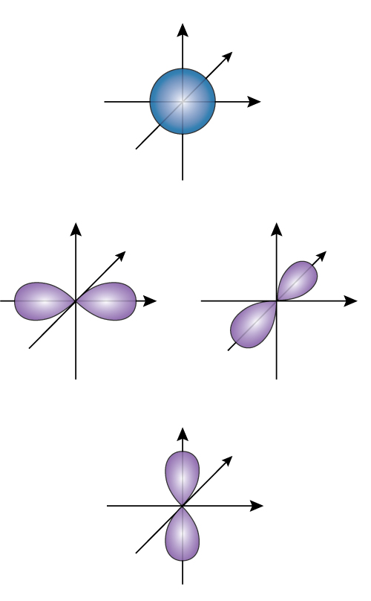
Topic 1 Atomic Structure 3.1.1.1
What information can be gained from a mass spectrum?
When is the term “relative formula mass” used?
Using the % Abundance and M/Z ratio, calculate the relative atomic mass of sulphur:
Label the following diagrams:
Is the following statement true or false, Isotopes of the same element have the same reactivity?
Calculate the relative molecular mass of calcium hydroxide :

Slide 3
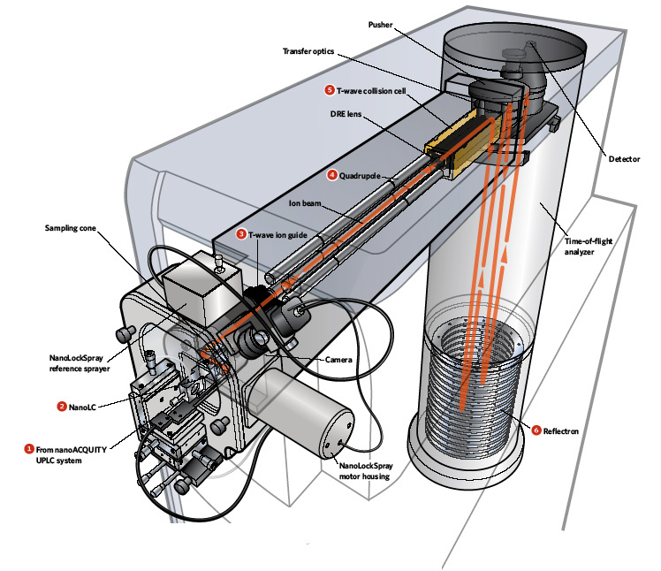
Topic 1 Atomic Structure 3.1.1.1
Can you explain the principles of a simple time of flight (TOF) mass spectrometer?
Write the full electron configuration of the following:
Calcium and Phosphorous

Slide 4
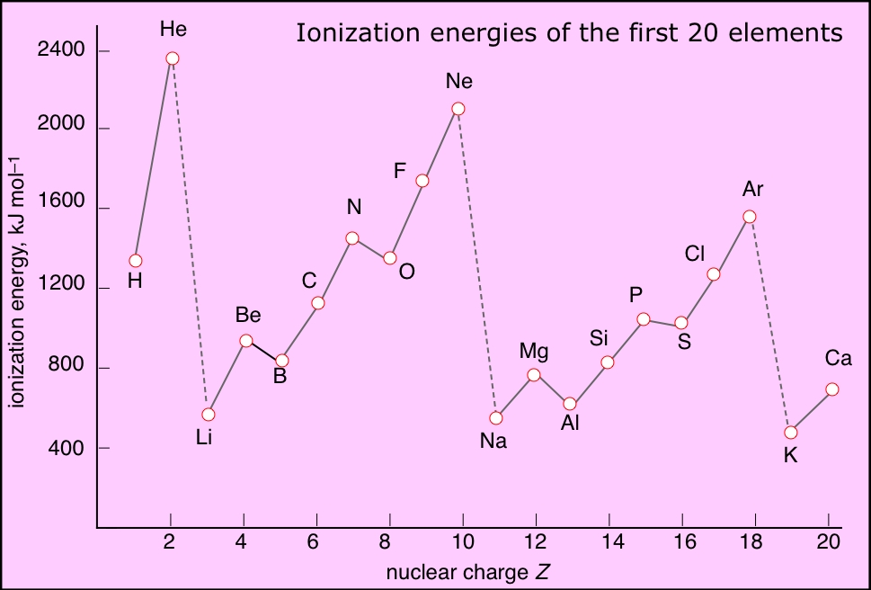
Topic 1 Atomic Structure 3.1.1.1
Can you define 1st ionisation energy?
Can you explain how first and successive ionisation energies in Period 3 (Na–Ar) and in Group 2 (Be–Ba) give evidence for electron configuration in sub-shells and in shells?
Use the diagram to help
Can you write equations for the first and successive ionisation energies of magnesium?

