Slide 1
Topic 2 Amount of Substance 3.1.2.1
Can you describe relative atomic mass and relative molecular mass in terms of ¹²C?
Can you describe how the term relative formula mass is used for ionic compounds – use Magnesium carbonate to illustrate your answer
State the ideal gas equation with the variables in SI units?
Can you explain the relationship between empirical formula and molecular formula?
Define the following:
Relative molecular mass
Avogadro’s constant

Slide 2
Topic 2 Amount of Substance 3.1.2.1
Write a full ionic equation for the formation of silver chloride from silver nitrate and hydrochloric acid solutions
What is the formula of barium sulphate?
Which state symbol should be used for a substance that is dissolved in water?
Give the formula of an ammonium ion
What is the name given to the OH- ion?
One mole of a compound has a molar mass of 40g/mol suggest the identity of the compound?
Answer the following question
How many cm³ in 1M³
How many cm³ in 1dm³
How many dm³ in 1M³
What factors determine the volume of a gas?

Slide 3
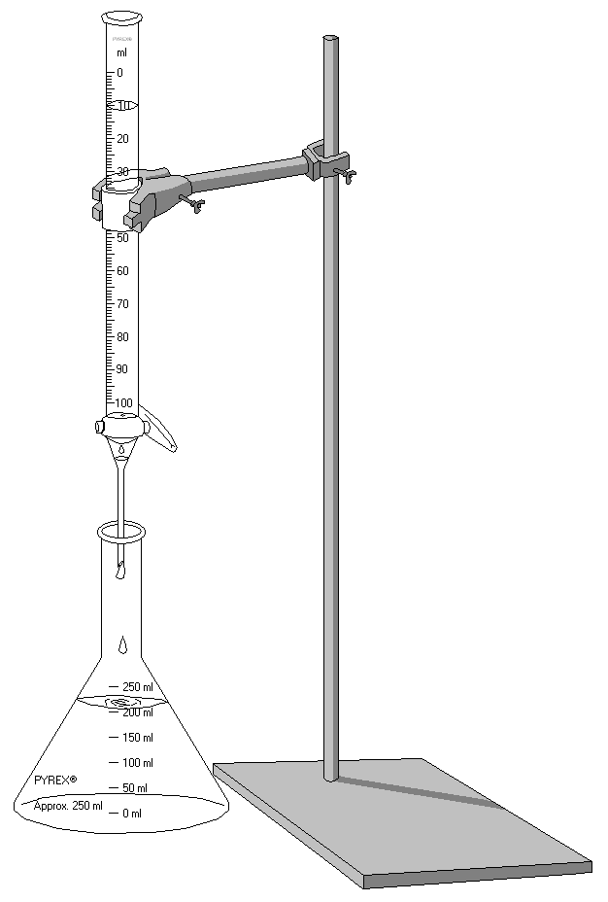
Topic 2 Amount of Substance 3.1.2.1
Can you explain the principles of a titration procedure?
What is the name given to water molecules that are present in the crystal structure of a hydrated salt?

Slide 4
Topic 2 Amount of Substance 3.1.2.1
What is the equation for calculating percentage yield?
Answer the following question
Answer the following question:

