Slide 1
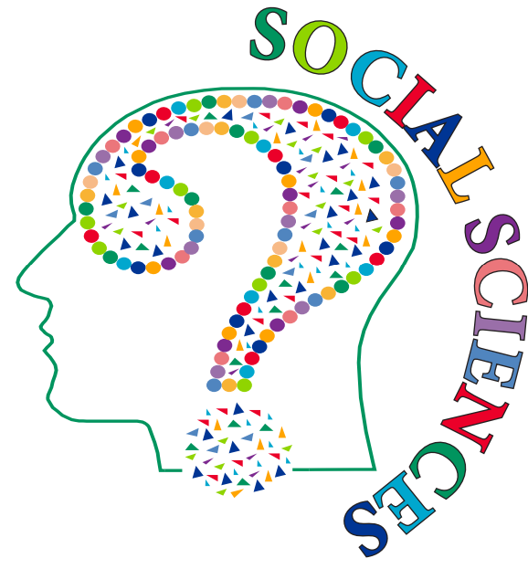
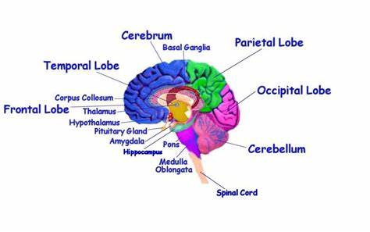
Paper 2
Biological Psychology Knowledge Organiser
Describe the effect of recreational drugs on the CNS
CNS
Axon
Axon terminals
Cell body
Dendrites
Myelin sheath
Node ranvier
Nucleus
Schwann cells
Action Potential
Synaptic transmission
Functions
Brain structure
Aggression
cerebral cortex
Frontal lobe
Parietal lobe
Temporal lobe
Occipital lobe
Cerebellum
Corpus callosum
Amygdala
Thalamus
Limbic system
Amygdala damage
Hypothalamus

Slide 2
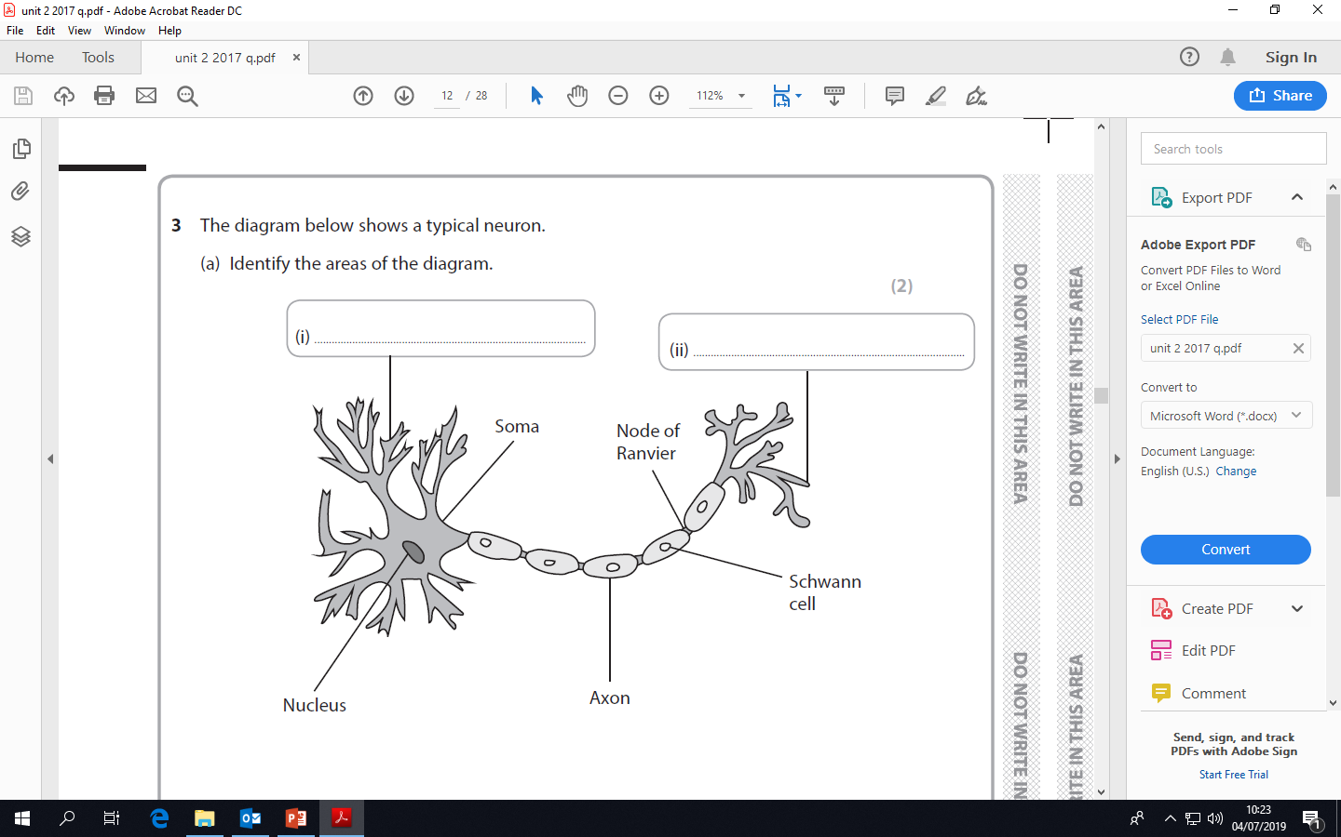
Complete the labels

Slide 3
Aggression
Role of evolution and natural selection to explain human behaviour
Role of hormones
Genotypes
Phenotypes
Endocrine
Psychodynamic explanation of aggression
Model of the mind
Preconscious
Conscious
Unconscious
Thanatos
Eros
Hormones and aggression
Evolutionary
Structure of personality
Id
Ego
Superego
Defense mechanisms

Slide 4
Studies
Classic study Raine
Contemporary Study-Brendgen
Aim/Procedure
Results/Conclusion
Describe the APRC
Evaluate Brendgen
Strengths
Weaknesses

Slide 5
Twin and Adoption research methods
Gottesman and Shields-Twin Study
Heston- adoption study
Aim/procedure
Results/Conclusion
Describe the study
Evaluate Heston’s study
Strengths
Weaknesses

Slide 6
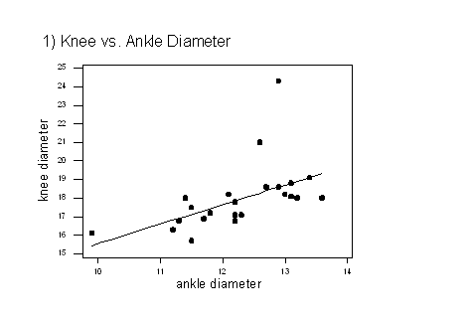
Methods
Spearman’s rank test
Correlations
Positive
Negative
No correlation
AO3:
Brain scanning
Why choose a Spearman's rank test?
CAT scan
PET scan
fMRI
Use of scanning to investigate aggression
Pick the outlier
Types of data
Nominal
Ordinal
Interval

Slide 7
List the concepts to cover
Key Question Is autism an extreme male brain condition?
Application of concepts to explain question
Exaggeration of male brain
Brain structure
Brain functions
Hormones
Characteristics of autism
Genetics

