Slide 1

Agency theory
Paper 1
Social Psychology Obedience Knowledge Organiser
Agentic state
Autonomous state
Agentic shift
Moral strain
Socialisation
AO3
Factors affecting obedience
Milgram’s research
Situational
Personality
AO1
AO3
Social Impact theory
Milgram’s Variations
Strength
Immediacy
numbers
AO3
Culture
Gender
Experiment 7-telephonic instructions
Experiment 10- rundown office building
Experiment 13- ordinary man gives orders

Slide 2
Social Identity theory
Prejudice
Individual differences
Social categorisation
Social identification
Social comparison
AO3
Factors affecting prejudice
Personality
Situational
Developmental Psychology
Realistic conflict theory
AO1
AO3
Culture

Slide 3
Studies
Classic study Sherif
Contemporary Study-Reicher and Haslam 2006
Aim/Procedure
Results/Conclusion
Describe the APRC
Evaluate Reicher and Haslam
Strengths
Weaknesses

Slide 4
Methods
What is self-report data?
Interviews
Structured :
Semi-structured:
Unstructured:
brain
AO3:
Hypothesis
Alternative- give examples
Null- give examples
Qualitative vs quantitative data
Questionnaires
Sampling
Open questions
Closed questions
AO3
Random
Opportunity
Stratified
Volunteer

Slide 5
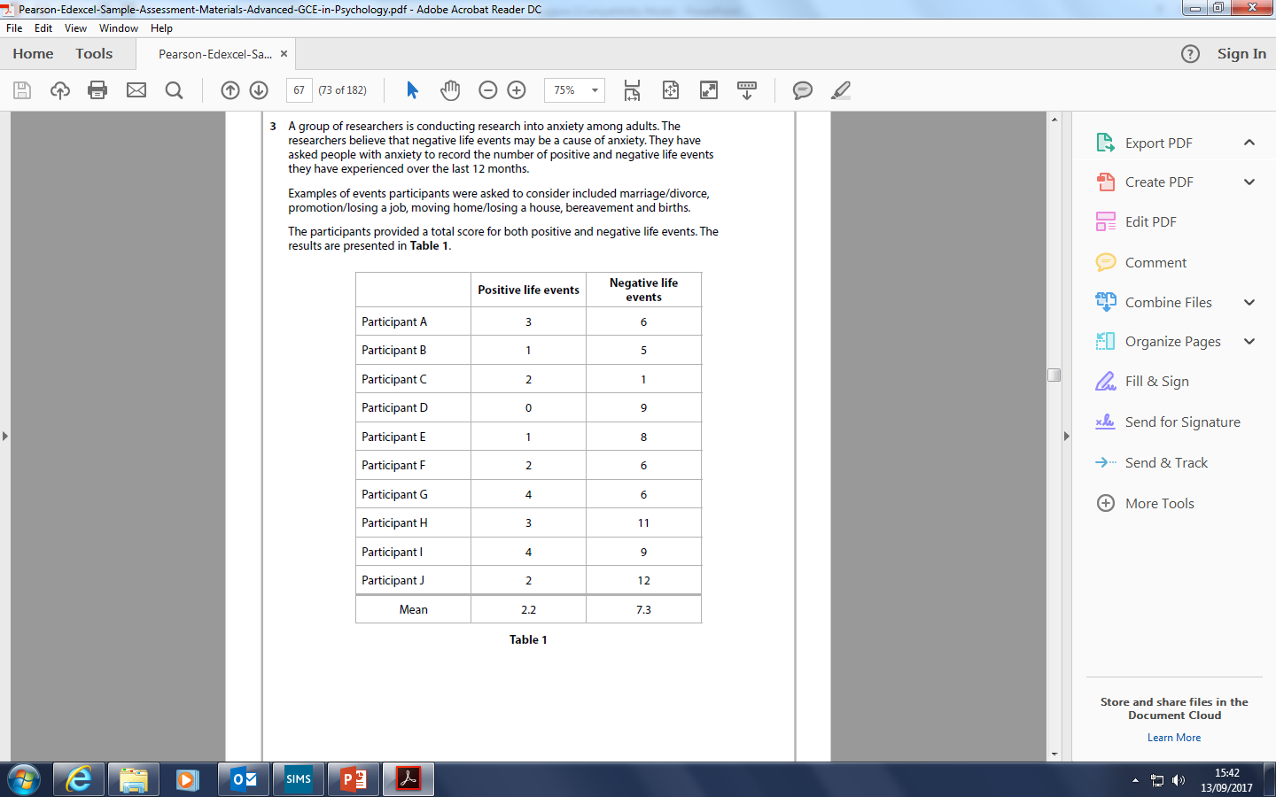
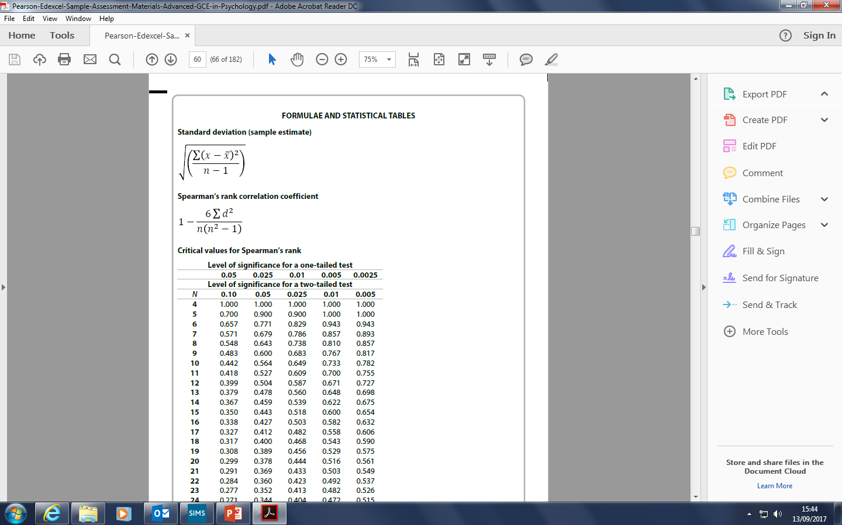
Measures of dispersion or variability
Why do we use Standard deviation?
Ethics BPS guidelines
Work out negative life events SD
Respect
Competence
Integrity
Informed consent
Debrief
Protection
Deception
Confidentiality
right to withdraw
Draw distribution curves
Central tendency
Normal
Skewed
mean
mode
Median
Range

Slide 6
List the theories to cover
Key Question
Why did the Rwandan people fight against each other?
Application of concepts to explain question
Key study to refer to
Other studies to use

