Slide 1
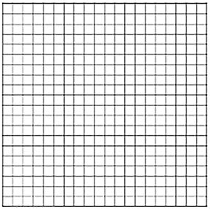
Leo, an 80 Kg climber, is attached to a cliﬀ by two 1.5 m lengths of rope. To stabilise him, these are attached to the rock such that Leo and the two pieces of rope lie in a vertical plane. One piece of rope is on Leo’s left and one is on his right; both are at an angle θ to the horizontal.
(a) Draw a free-body diagram for the climber. Mark on your diagram the tension in the ropes (T), the climber’s weight (W) and the angle between each rope and the horizontal (θ).
For each of the following values of θ (90º, 60º and 30º), calculate the tension that the rope must be able to withstand if Joe is not to fall.
6.2 Balanced forces
[3] By calculating several more intermediate points, plot a graph showing the variation of the tension in a single rope (T) with the angle (θ), for values of θ from 0-90◦.
Leo thinks that it would be sensible to avoid exerting a force greater than his own weight onto each strand of rope. Using your graph, approximately what value of θ should he not exceed?

Slide 2
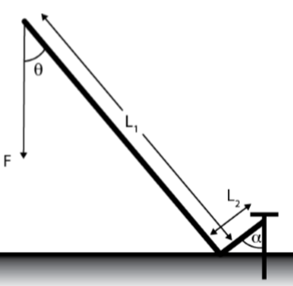
Olivia is using a 90◦ crowbar to extract a large nail from a piece of wood, as is shown schematically below. The nail is embedded such that a vertically resolved force of x N, or more, is required to remove it. By considering the moments abut the pivot point, express x in terms of the force applied (F), the lengths of the crowbar arms (L1 and L2) and the angles (θ and α).
To reduce the eﬀort required, should Olivia try to minimise the angle θ or not? If not, what should she do?
6.3 The principle of moments
A child is stood on a ladder placed against the smooth wall of the house. Draw a free-body diagram for the ladder.
Could this equilibrium persist if the ﬂoor were to lose its rough surface? If not, why not? Explain in the context of the balance/imbalance of the forces.

Slide 3
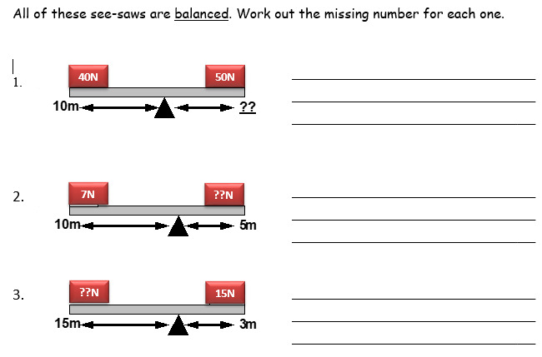
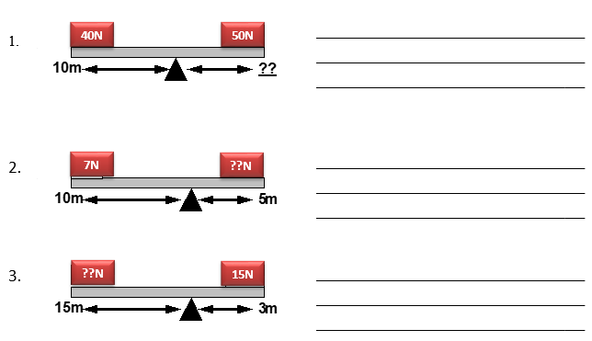
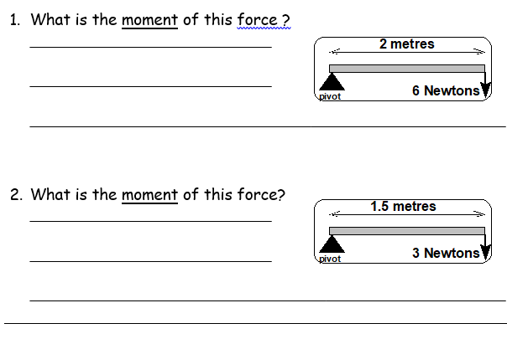
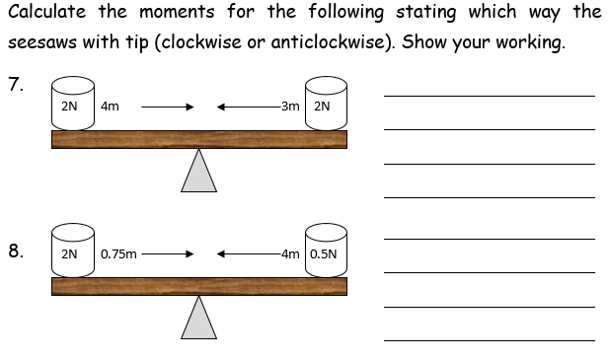
6.4 More on moments

Slide 4
Mirja is pulling her 50 kg dinghy up a smooth, sloped beach with the help of her father, Niila. Mirja pulls on her rope with a force of Fm N at an angle θm away from the line of greatest slope whilst Niila pulls on his with a force of Fn N at an angle θn on the other side of the line. The slope of the beach is 10◦.
Calculate the minimum force Mirja and Niila must each exert to make upward progress. To do this you will need to balance forces in two perpendicular directions in the plane of the slope.
6.5 Stability
Draw free-body diagrams for the dinghy from each of the following directions:
In a vertical plane showing the boat’s weight (W), the normal reaction (R) and the combined tug of both people (F) and…
…..in the plane of the slope, showing the component of the weight acting downslope (Wslope), and the pulls from Niila and Mirja (Fn and Fm, respectively).

Slide 5
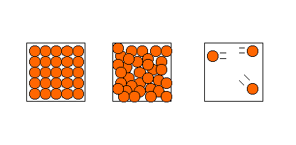
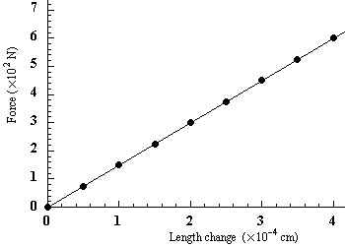
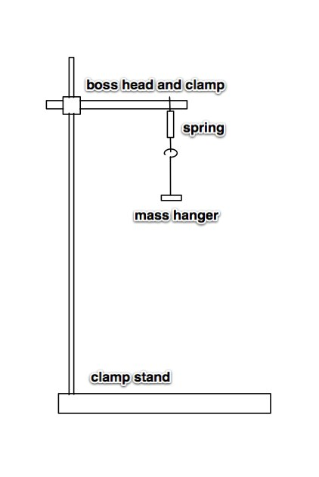
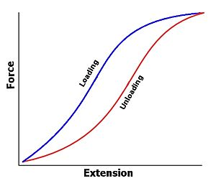
Density
What is mass?
Write down the formula for density and define all terms.
What are the usual units for density?
Describe the conditions under which an object can float in water.
Stretch: How could you work out the mass of water displaced?
Hooke’s Law - basics
What two forces act on a stretching wire?
Write down Hooke’s Law and define all terms (and units):
What does ‘tensile force’ mean?
What does anti-phase mean?
How can you tell if a material obeys Hooke’s Law?
Stretch: What would this graph look like with
    a stiffer spring?
Elasticity
What is the different between an elastic deformation and a plastic deformation? (Give examples)
Define elastic limit and limit of proportionality
How can you tell this material has been
deformed elastically?
Hooke’s Law - practical
Describe the equipment and measurements you would take to measure the spring constant of a spring.
What does the gradient of the F-e graph show?
What does the area under the graph represent?
How can you use a formula to work out the energy stored in a graph?

Slide 6
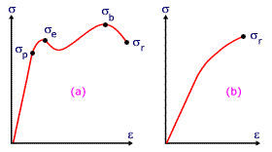
Stress and Strain
What is tensile stress? (words, formula, and units)
What is tensile strain? (words, formula, and units
Combine these two formula to derive a formula for Young’s Modulus (= stress / strain)
Young’s Modulus - practical
Write down the quantities needed to find the Young’s Modulus of a wire.
How would you find the Young’s Modulus
How will you ensure the error in the experiment is reduced to a minimum?
Stress and strain - graphs
Label the axes and describe what is happening at each part of the graph?
What is ultimate tensile stress?
Stretching materials – extra notes
Describe the energy changes a material goes through as it is stretched
How does this affect transport design?
What does brittle mean? How would its stress-strain graph look? (Give some examples)
Explain how something is brittle or ductile with reference to its atomic structure

Slide 7
Stress and Strain
What is tensile stress? (words, formula, and units)
What is tensile strain? (words, formula, and units
Combine these two formula to derive a formula for Young’s Modulus (= stress / strain)
Young’s Modulus - practical
Write down the quantities needed to find the Young’s Modulus of a wire.
How would you find the Young’s Modulus
How will you ensure the error in the experiment is reduced to a minimum?
Stress and strain - graphs
Label the axes and describe what is happening at each part of the graph?
What is ultimate tensile stress?
Stretching materials – extra notes
Describe the energy changes a material goes through as it is stretched
How does this affect transport design?
What does brittle mean? How would its stress-strain graph look? (Give some examples)
Explain how something is brittle or ductile with reference to its atomic structure

Slide 8
Glossary
Density
Hooke’s Law
Spring constant
Tensile stress
Tensile strain
Young’s Modulus
Elastic deformation
Plastic deformation
Ultimate tensile stress
Breaking stress
Brittle
Ductile

