Slide 1

1) Matter and Radiation, Inside the Atom
Describe the nuclear model of an atom
Complete the table
Constituent | Charge (C) | Mass (kg)
Proton
Neutron
Electron
Explain the notation and include the neutron in it.
What is an isotope? Use chlorine as an example
How can chlorine have a mass of 35.5? Use abundance in the explanation
What is an ion? Explain using actual charge value
What is meant by Specific charge? Explain and complete the table

Slide 2
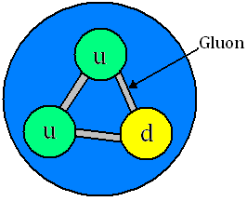
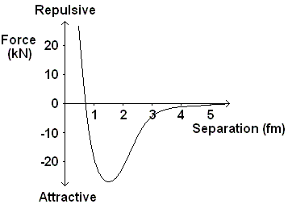
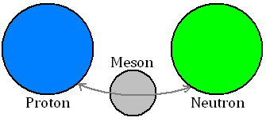
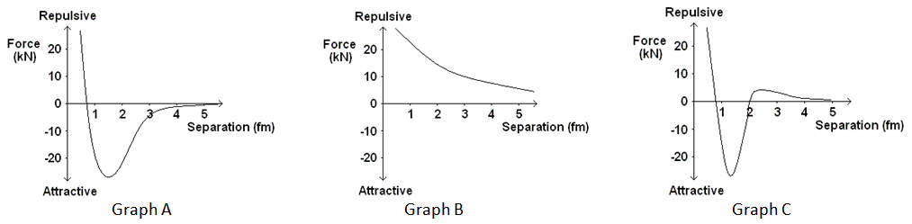

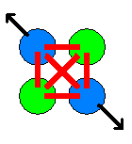
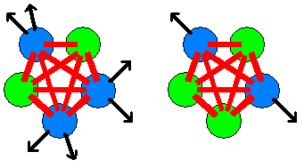
1) Matter and Radiation, Stable and unstable nuclei
What is the strong interaction?
Explain the force graph shown below for proton-neutron interaction
the residual strong nuclear force?
For a Proton-proton interaction, explain the graphs, A, B, and C
Nuclear-nuclear cement.
What happens when more protons are added to the nucleus?
What happens when more neutrons are added to the nucleus?

Slide 3
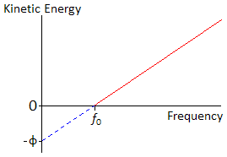
1) Matter and Radiation, Photons
What happens when light falls on a metal?
What are the energy equation for a photon
What happen if the intensity or frquency of light is varied?
What is the pho-electric effect?
Why can’t it be explained if light wave a wave?
What is the Work Function, φ ?
Explain the graph on the left

Slide 4
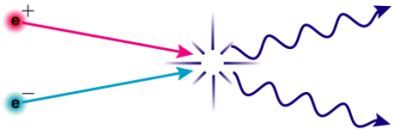

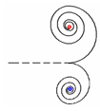
1) Matter and Radiation, Particles and Antiparticles
What is an antiparticle?
What does particle annihilation mean?
What is a positron?
Mass and energy are interchangeable. Give the equation with units.
Explain conservation of energy
What is rest mass?
What is a photon? What is the energy of a photon –equation?
What is rest energy?
What is pair production?
What is the definition of one electron volt?
Explain the diagram shown using the words kinetic energy, nucleus, recoil and magnetic field.

Slide 5
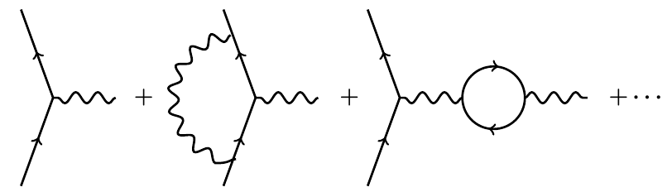
1) Matter and Radiation, Forces and exchange particles
There are four forces in the universe. Complete the sentences making sure the words from the bank are used.
The electromagnetic interaction causes___________________________________________________
The gravitational interaction causes _____________________________________________________
The strong nuclear interaction causes ____________________________________________________
The weak nuclear interaction does not cause ______________________________________________
WORD BANK
Forces, attractive, repulsive, quarks, hadrons, nuclear, weak, decay, masses, charges.
Complete the table below
What are exchange particles? Give examples.
Interaction/Force | Range | Relative Strength
Strong Nuclear |  | 1 | (1)
Electromagnetic |  | ~10^{–2} | (0.01)
Weak Nuclear |  | ~10^{–7}
Gravitational |  | ~10^{–36}
The interactions/forces between two particles were caused by ‘virtual particles’ being exchanged between the two particles.
Strong nuclear force which keep protons and neutrons together exchange a particle back and forth that ‘carried’ the force and keeps them together. This is true of all the fundamental interactions.
The general term for exchange particles is bosons and they are fundamental particles like quarks and leptons.
Which particle, which force?
Interaction/Force | Exchange Particle |  |  |  | What is acts upon
Strong Nuclear
Electromagnetic
Weak Nuclear
Gravitational
Planck’s Constant, h = 6.63 x 10⁻³⁴ J s

Slide 6
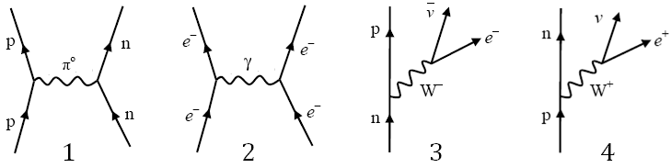
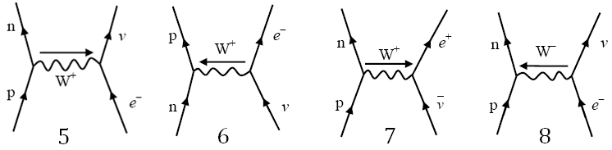
1) Matter and Radiation, Particle interaction
What do each of the interaction diagrams represent?
What do each of the interaction diagrams represent?

