Slide 1
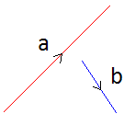
6 Forces in equilibrium, 6.1 Vectors and scalars
What is a Vector?
Give some examples of Vectors:
Vector Diagrams
Using the two vectors draw the triangle that shows the resultant of a and b.
What is a Scalar?
Give some examples of Scalars
Vector Diagrams
Using the two vectors draw the triangle that shows the resultant of a and -b.
Scale Drawing
Draw the scale diagrams of the resultants of a + b, b – a, a – b, – a – b

Slide 2
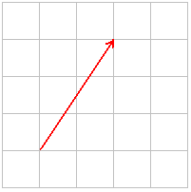
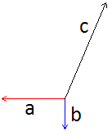
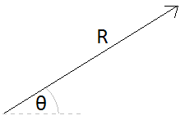
6 Forces in equilibrium, 6.1+2 Vectors and scalars
Resolving Vectors
A vector can be ‘broken down’ or resolved into its vertical and horizontal components.
Draw the two components for the resultant vector given
Resolve the vector c and find the resultant R of a, b and c
We can calculate the vertical and horizontal components if we know the magnitude and direction of the vector.
Using the sine and cosine rules, draw the components giving their lengths.
Balanced forces: Draw a vector diagram that shows Equilibrium of forces. Choose an example of your choice such as a static book on an incline or a moving aeroplane. Show the resolved forces in the diagram

Slide 3
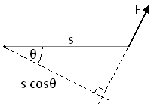
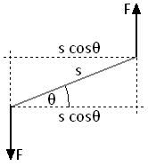
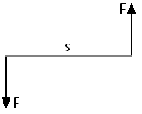

6 Forces in equilibrium, 6.3 + 6.4 Moments and couples
Describe what a moment is.
Give an example of a moment and state the equation.
Calculate the moment of the force F around the point given
What is a couple?
What is the torque in the couple below?
What is the torque in the couple below?
What is the centre of mass?
What is the centre of Gravity?
Assuming this is a balanced system, write out the full equation of the moments

Slide 4
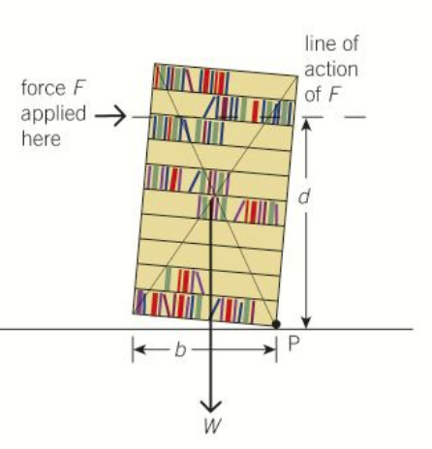
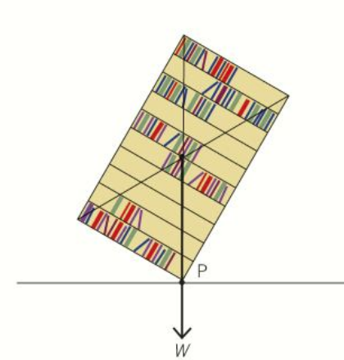
6 Forces in equilibrium, 6.5 + 6.6 Stability and rules
When is a body in stable equilibrium?
What is unstable equilibrium? Give an example.
Explain why do skittles easily top over when hit by a rolling ball?
Explain tilting using the diagram below and moments.
Explain toppling using the diagram below and moments.
What happens if the equilibrium of a body is disturbed?

Slide 5
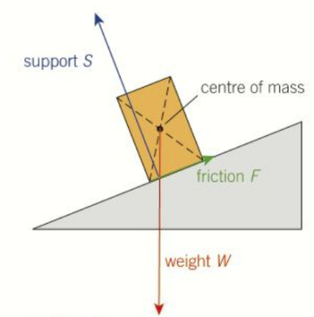
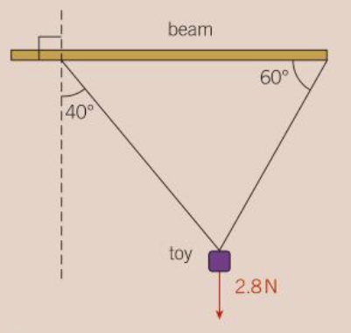
6 Forces in equilibrium, 6.5 + 6.6 Stability and rules
Explain what condition must apply to the forces on an object in equilibrium
Draw the triangle of forces for the diagram below:
Calculate the tension in the cord below.
Explain how you can find the centre of mass for a regular object, such as an equilateral triangle a, and an irregular object such as a semicircular dustbin lid.

