Slide 1
Electricity: Current, Charge, Voltage, Resistance
What is the definition of Current, I? State the equation for it.
What is the definition of Charge, Q? State the equation for it.
What is the definition of Voltage/Potential Difference, V? State the equation for it.
What is the definition of Resistance, R? State the equation that defines it.
What is definition of Time, t

Slide 2
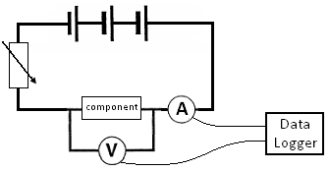
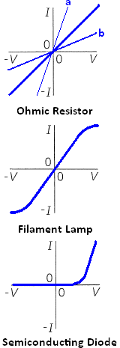
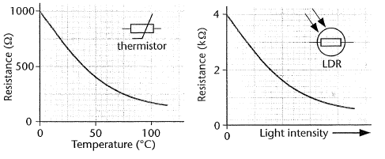
Electricity: Ohm’s law and I/V graphs
What is Ohm’s Law and what does it tell us on a graph?
Using the circuit diagram, explain how we get the I V characteristics of a component..
Explain the I V graphs of the three components shown on the right.
What is a Variable Resistor?
What is a thermistor Thermistor and explain its I V graph?
What is aLight Dependant Resistor (L.D.R) and explain its I V graph?

Slide 3
Electricity: Resistivity
What factors affect Resistance? Explain briefly how.
What is Resistivity, ρ? Give the equation.
Using the circuit diagram give, explain how we can measure resistivity.

