Slide 1
7. On the Move. Velocity and Acceleration
For the five quantities below, state whether a scalar or vector . Explain why
1) Distance
What do positive and negative acceleration mean? Explain using the word velocity in the answer.
2) Displacement
Write the equation that connects all of these If the object accelerates from a velocity of u to a velocity of v, and it takes t seconds to do it.
3) Speed
What is uniform acceleration?
What is non-uniform acceleration? Use the empty box below to give 3 examples of both.
4) Velocity
5) Acceleration

Slide 2
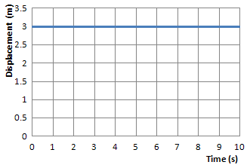
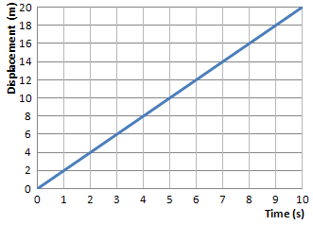
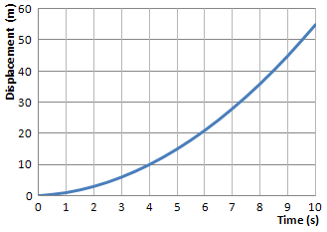
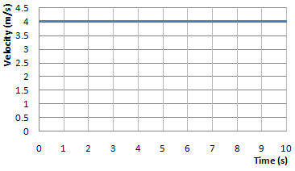
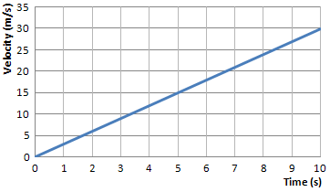
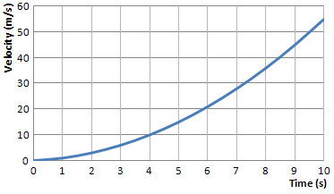
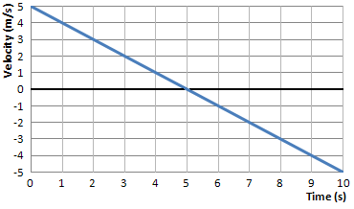
7. On the Move. Motion Graphs
Displacement-time graphs A
Displacement-time graphs B
Displacement-time graphs C
Velocity-time graphs A
Velocity-time graphs B
graph show the velocity decreasing in one direction and increasing in the opposite direction. If we decide that ←is negative and →is positive then what does the graph tells us:
What does the gradient represent on a displacement-time graph?
What does the gradient represent on a displacement-time graph?

Slide 3
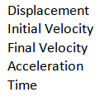
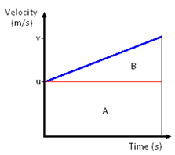
7. On the Move. Equations of Motion
Give the symbols for each the following along with their units
Equations of motion ‘suvat’
Equation 1) Show how you get the equation
Equation 3) Show how you get the equation
Equation 2) Show how you get the equation use the graph
Equation 4) Show how you get the equation
Top Tip:
Any question can be solved as long as three of the variables are given in the question.
Write down all the variables you have and the one you are asked to find, then see which equation you can use.
These equations can only be used for motion with UNIFORM ACCELERATION.

Slide 4
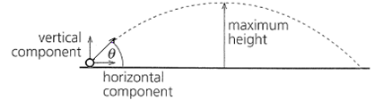
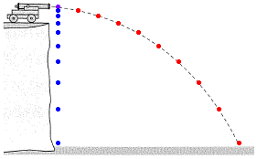
7. On the Move. Terminal velocity and Projectile motion
Explain acceleration due to gravity, giving examples
What is the type of path called for an object thrown in the air?
If the object had an initial velocity of u, this can be resolved into its horizontal and vertical velocity . Give the horizontal and vertical components of the velocity.
What is mass? Give units
What is weight? Give units
Explain why both cannon balls reach the ground at the same time.
What is meant by terminal velocity? Use a parachutist as an example.

