Slide 1

AQA GCSE
Year 11 Triple Physics
Knowledge Organiser

Slide 2
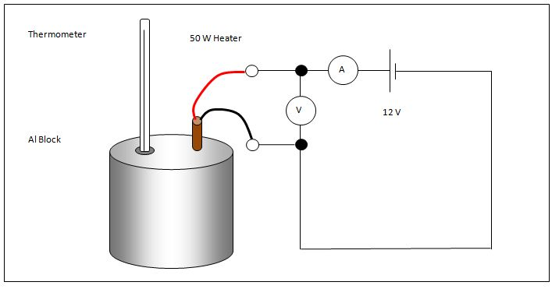
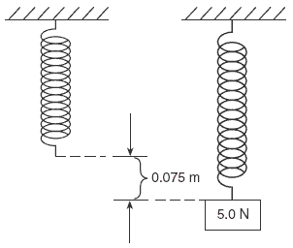
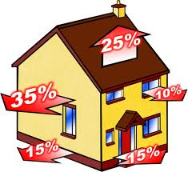
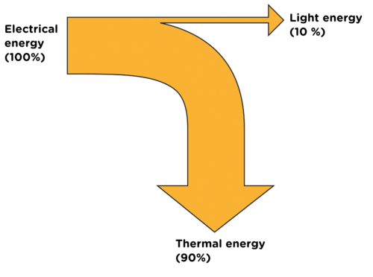
Mechanical | Force acts upon an object
Electrical | Electric current flow
Heat | Temperature difference between objects
Radiation | Electromagnetic waves or sound
Energy pathways
Change in thermal energy = mass X specific heat capacity X temperature change
∆E= m X c X ∆θ
Specific Heat Capacity | Energy needed to raise 1kg of substance by 1°C | Depends on: mass of substance, what the substance is and energy put into the system.
HIGHER: efficiency can be increased using machines.
Efficiency = Useful power output
Total power input
Kinetic energy | Energy stored by a moving object | ½ X mass X (speed)² ½ mv²
Elastic Potential energy | Energy stored in a stretched spring, elastic band | ½ X spring constant X (extension)² ½ ke² (Assuming the limit of proportionality has not been exceeded)
Gravitational Potential energy | Energy gained by an object raised above the ground | Mass X gravitational field strength X height mgh
Efficiency = Useful output energy transfer
Total input energy transfer
Energy stores and changes
Efficiency | How much energy is usefully transferred
Energy Conservation and Dissipation
Dissipate | To scatter in all directions or to use wastefully | When energy is ‘wasted’, it dissipates into the surroundings as internal (thermal) energy.
System | An object or group of objects that interact together | EG: Kettle boiling water.
Energy stores | Kinetic, chemical, internal (thermal), gravitational potential, elastic potential, magnetic, electrostatic, nuclear | Energy is gained or lost from the object or device.
Ways to transfer energy | Light, sound, electricity, thermal, kinetic are ways to transfer from one store to another store of energy. | EG: electrical energy transfers chemical energy into thermal energy to heat water up.
Unit | Joules (J)
AQA
ENERGY – part 1
Ways to reduce ‘wasted’ energy | Energy transferred usefully | Insulation, streamline design, lubrication of moving parts.
Closed system | No change in total energy in system
Open system | Energy can dissipate
Principle of conservation of energy | The amount of energy always stays the same. | Energy cannot be created or destroyed, only changed from one store to another.
Work | Doing work transfers energy from one store to another | By applying a force to move an object the energy store is changed. | Work done = Force X distance moved W = Fs
Power | The rate of energy transfer | 1 Joule of energy per second = 1 watt of power | Power = energy transfer ÷ time P = E ÷ t Power = work done ÷ time, P = W ÷ t
 | Units
Energy (KE, EPE, GPE, thermal) | Joules (J)
Velocity | Metres per second (m/s)
Spring constant | Newton per metre (N/m)
Extension | Metres (m)
Mass | Kilogram (Kg)
Gravitational field strength | Newton per kilogram (N/Kg)
Height | Metres (m)
HIGHER: When an object is moved, energy is transferred by doing work.
 | Units
Specific Heat Capacity | Joules per Kilogram degree Celsius (J/Kg°C)
Temperature change | Degrees Celsius ( °C)
Work done | Joules (J)
Force | Newton (N)
Distance moved | Metre (m)
Power | Watts (W)
Time | Seconds (s)
Useful energy | Energy transferred and used
Wasted energy | Dissipated energy, stored less usefully
Work done = Force X distance moved
Prefix | Multiple | Standard form
Kilo | 1000 | 10³
Mega | 1000 000 | 10⁶
Giga | 100 000 000 | 10⁹
Frictional forces cause energy to be transferred as thermal energy. This is wasted.
Reducing friction - using wheels, applying lubrication. Reducing air resistance – travelling slowly, streamlining.

Slide 3
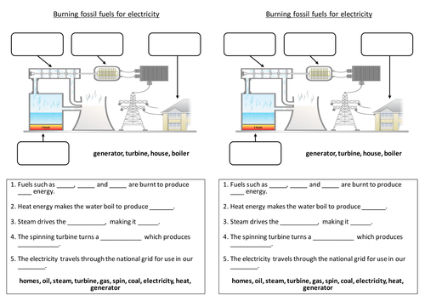
Transport | Petrol, diesel, kerosene produced from oil | Used in cars, trains and planes.
Heating | Gas and electricity | Used in buildings.
Electricity | Most generated by fossil fuels | Used to power most devices.
Power station – NB: You need to understand the principle behind generating electricity. An energy resource is burnt to make steam to drive a turbine which drives the generator.
Using renewable energy will need to increase to meet demand.
Power station | Generates electricity | Fuel burnt releasing thermal energy | Water boils into steam | Steam turns turbine | Turbine turns generator | Generator induces voltage
National Grid | Transports electricity across UK | Power station | Step-up transformer | Pylons | Step-down transformer | House, factory
Renewable energy makes up about 20% of energy consumption.
Fossil fuel reserves are running out.
Energy demand is increasing as population increases.
Non-renewable energy resource | These will run out. It is a finite reserve. It cannot be replenished. | e.g. Fossil fuels (coal, oil and gas) and nuclear fuels.
Renewable energy resource | These will never run out. It is an infinite reserve. It can be replenished. | e.g. Solar, Tides, Waves, Wind, Geothermal, Biomass, Hydroelectric
Using fuels
AQA
ENERGY – part 2
Global Energy Resources
National Grid
Energy resources
Energy resource | How it works | Uses | Positive | Negative
Fossil Fuels (coal, oil and gas) | Burnt to release thermal energy used to turn water into steam to turn turbines | Generating electricity, heating and transport | Provides most of the UK energy. Large reserves. Cheap to extract. Used in transport, heating and making electricity. Easy to transport. | Non-renewable. Burning coal and oil releases sulfur dioxide. When mixed with rain makes acid rain. Acid rain damages building and kills plants. Burning fossil fuels releases carbon dioxide which contributes to global warming. Serious environmental damage if oil spilt.
Nuclear | Nuclear fission process | Generating electricity | No greenhouse gases produced. Lots of energy produced from small amounts of fuel. | Non-renewable. Dangers of radioactive materials being released into air or water. Nuclear sites need high levels of security. Start up costs and decommission costs very expensive. Toxic waste needs careful storing.
Biofuel | Plant matter burnt to release thermal energy | Transport and generating electricity | Renewable. As plants grow, they remove carbon dioxide. They are ‘carbon neutral’. | Large areas of land needed to grow fuel crops. Habitats destroyed and food not grown. Emits carbon dioxide when burnt thus adding to greenhouse gases and global warming.
Tides | Every day tides rise and fall, so generation of electricity can be predicted | Generating electricity | Renewable. Predictable due to consistency of tides. No greenhouse gases produced. | Expensive to set up. A dam like structure is built across an estuary, altering habitats and causing problems for ships and boats.
Waves | Up and down motion turns turbines | Generating electricity | Renewable. No waste products. | Can be unreliable depends on wave output as large waves can stop the pistons working.
Hydroelectric | Falling water spins a turbine | Generating electricity | Renewable. No waste products. | Habitats destroyed when dam is built.
Wind | Movement causes turbine to spin which turns a generator | Generating electricity | Renewable. No waste products. | Unreliable – wind varies. Visual and noise pollution. Dangerous to migrating birds.
Solar | Directly heats objects in solar panels or sunlight captured in photovoltaic cells | Generating electricity and some heating | Renewable. No waste products. | Making and installing solar panels expensive. Unreliable due to light intensity.
Geothermal | Hot rocks under the ground heats water to produce steam to turn turbine | Generating electricity and heating | Renewable. Clean. No greenhouse gases produced. | Limited to a small number of countries. Geothermal power stations can cause earthquake tremors.

Slide 4
Electrons carry current. Electrons are free to move in metal.
Cell | Battery | Switch | Lamp | Ammeter | Volt meter
Store of chemical energy | Two or more cells in series | Breaks circuit, turning current off | Lights when current flows | Measures current | Measures potential difference
Diode | LED | LDR | Fuse | Resistor | Variable resistor | Thermistor
Current flows one way | Emits light when current flows | Resistance low in bright light | Melts when current is too high | Affects the size of current flowing | Allows current to be varied | Resistance low at high temp
Current | Flow of electrical charge | Ampere (A)
Potential difference (p.d.) | How much electrical work is done by a cell | Volts (V)
Charge | Amount of electricity travelling in a circuit | Coulombs (C)
Circuit symbols
Series and parallel circuits
Series circuit | Current is the same in all components. | Total p.d. from battery is shared between all the components. | Total resistance is the sum of each component’s resistance.
Parallel circuit | Total current is the sum of each component’s current. | p.d. across all components is the same. | Total resistance is less than the resistance value of the smallest individual resistor.
Series | Parallel
A circuit with one loop | A circuit with two or more loops
Current and Charge
Current, potential difference and resistance
Total p.d | If cells are joined in series, add up individual cell values
Charge = Current X time
Q = I X t
Controlling current
Changing current | Change the p.d. of the cells
 | Add more components
Energy transfers
Power (W) = potential difference X current
R = V X I
AQA
Electricity
Work is done when charge flowing.
Power = (current)² X resistance
P = I² X R
Energy transferred = Power X time
E = P X t
Ammeter | Set up in series with components
Voltmeter | Set up parallel to components
R = V ÷ I
Step-up transformers | Step-down transformers
Increase voltage, decrease current | Decrease voltage, increase current
Increases efficiency, reduces heat loss. | Makes safer for houses.
Resistance = Potential difference ÷ Current
Domestic uses and safety
National Grid | Distributes electricity generated in power stations around UK
Resistance (Ω) | A measurement of how much current flow is reduced
The higher the resistance, the more difficult it is for current to flow.
Increasing resistance, reduces current.
Increasing voltage, increases current.
Thermistor | LDR
Resistance varies with temperature | Resistance varies with light intensity
Resistance decreases as temperature increases. | Resistance decreases as light increases.
Alternating current | Direct current
p.d. switches direction many times a second, current switches direction | p.d. remains in one direction, current flows the same direction
Generator. | Cell or battery.
Static electricity
PHYSICS only
Static electricity | Electrical charge is stationary | When two insulating material are rubbed together, electrons move from one material to the other.
Ohmic conductor | At a constant temperature, current is directly proportional to the p.d. across the resistor.
Filament lamp | As current increases, the resistance increases. The temperature increases as current flows.
Diode | Current flows when p.d. flows forward. Very high resistance in reverse.
‘Earthing’ a safety device; Earth wire joins the metal case.
Mains supply
Frequency 50Hz, 230V
Current – Potential difference graphs
Like charges | Repel
Unlike charges | Attract
Shocks | Walking on carpet causes friction. Electrons move to the person and charge builds up. When the person touches a metal object, the electrons conduct away, making a spark.
3 pin plug | Live - Brown | Carries p.d from mains supply. | p.d between live and earth = 230V
 | Neutral - Blue | Completes the circuit. | p.d. = OV
 | Earth – Green and Yellow stripes | Only carries current if there is a fault. | p.d. = 0V
Electric fields | Charged objects create electric fields around them. Strongest closest to the object. The field direction is the direction of force on a positive charge. Add more charge increases field strength.

Slide 5
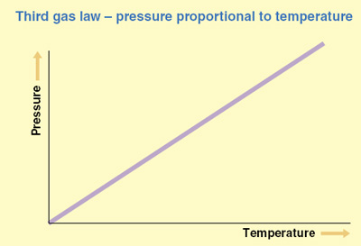
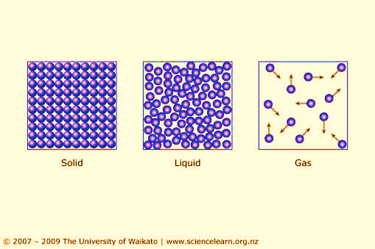
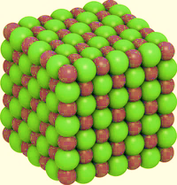
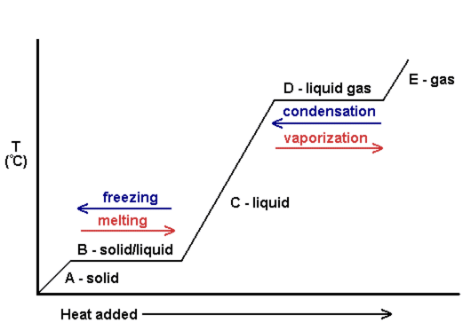
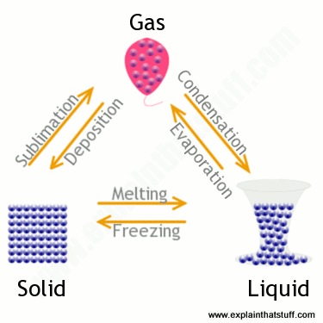
State | Particle arrangement | Properties
Solid | Packed in a regular structure. Strong forces hold in place so cannot move. | Difficult to change shape.
Liquid | Close together, forces keep contact but can move about. | Can change shape but difficult to compress.
Gas | Separated by large distances. Weak forces so constantly randomly moving. | Can expand to fill a space, easy to compress.
 | Units
Density | Kilograms per metre cubed (kg/m³)
Mass | Kilograms (kg)
Volume | Metres cubed (m³)
Energy needed | Joules (J)
Specific latent heat | Joule per kilogram (J/kg)
Change in thermal energy | Joules (J)
Specific heat capacity | Joule per kilogram degrees Celsius (J/kg°C)
Temperature change | Degrees Celsius ( °C)
Pressure | Pascals (Pa)
Pressure of a fixed volume of gas increases as temperature increases (temperature increases, speed increases, collisions occur more frequently and with more force so pressure increases).
Temperature of gas is linked to the average kinetic energy of the particles.
Kinetic theory of gases
Particle model
If kinetic energy increases so does the temperature of gas.
PHYSICS ONLY: when you do work the temperature increases e.g. pump air quickly into a ball, the air gets hot because as the piston in the pump moves the particles bounce off increasing kinetic energy, which causes a temperature rise. | Reducing the volume of a fixed mass of gas increases the pressure.
 | Halving the volume doubles the pressure.
PV = constant.
Pressure
No kinetic energy is lost when gas particles collide with each other or the container.
P₁V₁ = P₂V₂
AQA
PARTICLE MODEL OF MATTER
Gas particles are in a constant state of random motion.
Specific Heat Capacity | Energy needed to raise 1kg of substance by 1°C | Depends on: Mass of substance What the substance is Energy put into the system.
Change in thermal energy = mass X specific heat capacity X temperature change.
P = m ÷ V
Density = mass ÷ volume.
∆E= m X c X ∆θ
Density | Mass of a substance in a given volume
Internal energy and energy transfers
Internal energy | Energy stored inside a system by particles | Internal energy is the total kinetic and potential energy of all the particles (atoms and molecules) in a system.
 | Heating changes the energy stored within a system | Heating causes a change in state. As particles separate, potential energy stored increases. Heating increases the temperature of a system. Particles move faster so kinetic energy of particles increases.
Change of state
Freezing | Liquid turns to a solid. Internal energy decreases.
Melting | Solid turns to a liquid. Internal energy increases.
Boiling / Evaporating | Liquid turns to a gas. Internal energy increases.
Condensation | Gas turns to a liquid. Internal energy decreases.
Sublimation | Solid turns directly into a gas. Internal energy increases.
Conservation of mass | When substances change state, mass is conserved.
Physical change | No new substance is made, process can be reversed.
Specific Latent Heat | Energy needed to change 1kg of a substance’s state
Specific Latent Heat of Fusion | Energy needed to change 1kg of solid into 1 kg of liquid at the same temperature
Specific Latent Heat of Vaporisation | Energy needed to change 1kg of liquid into 1 kg of gas at the same temperature
Energy needed = mass X specific latent heat.
∆E= m X L

Slide 6
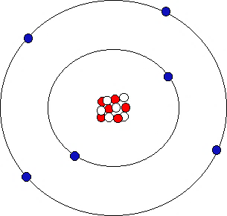
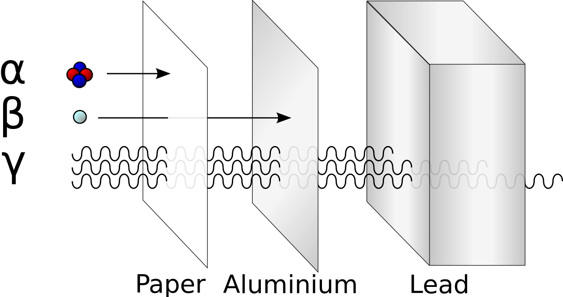
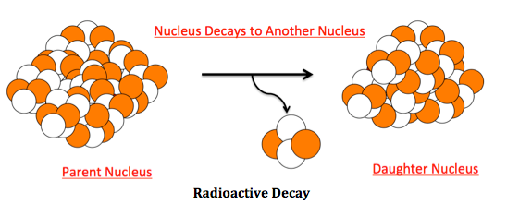
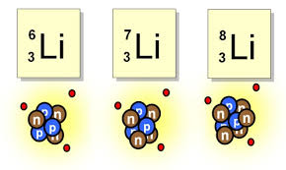
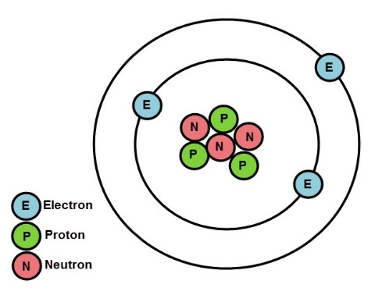
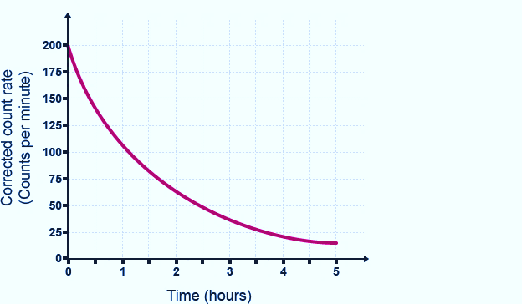
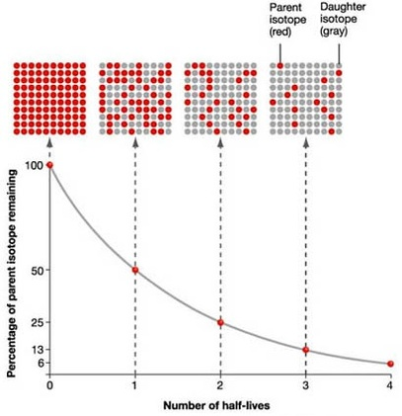
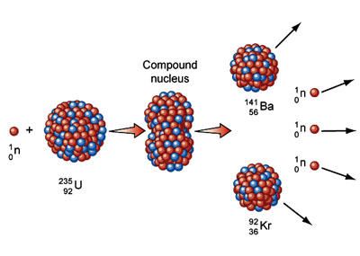
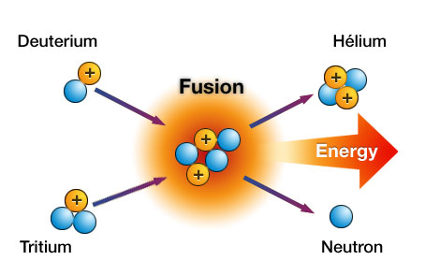

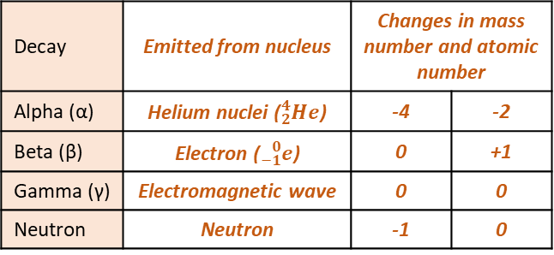


Radius of an atom 1 X 10⁻¹⁰m
Electrons gained
Electrons lost
Decay | Range in air | Ionising power | Penetration power
Alpha | Few cm | Very strong | Stopped by paper
Beta | Few m | Medium | Stopped by Aluminium
Gamma | Great distances | Weak | Stopped by thick lead
Negative ion
Positive ion
Atom | Same number of protons and electrons
Ion | Unequal number of electrons to protons
Mass number | Number of protons and neutrons
Atomic number | Number of protons
Radioactive decay | Unstable atoms randomly emit radiation to become stable
Detecting | Use Geiger Muller tube
Unit | Becquerel
Ionisation | All radiation ionises
Decay | Emitted from nucleus | Changes in mass number and atomic number
Alpha (α) | Helium nuclei (${}_{2}^{4}{He}$) | -4 | -2
Beta (β) | Electron (${}_{−1}^{0}e$) | 0 | +1
Gamma (γ) | Electromagnetic wave | 0 | 0
Neutron | Neutron | -1 | 0
Particle | Charge | Size | Found
Neutron | None | 1 | In the nucleus
Proton | + | 1
Electron | - | Tiny | Orbits the nucleus
Atom structure
$${}_{92}^{238}U→ {}_{90}^{234}{Th+ {}_{2}^{4}{He}}$$
$${}_{6}^{14}C→ {}_{7}^{14}{N+ {}_{−1}^{0}e}$$
Atoms and Nuclear Radiation
$${}_{43}^{99}{Tc}→ {}_{43}^{99}{Tc+ γ}$$
Isotope
Different forms of an element with the same number of protons but different number of neutrons
Atoms and Isotopes
Contamination | Unwanted presence of radioactive atoms
Irradiation | Person is in exposed to radioactive source
AQA
ATOMIC STRUCTURE
PHYSICS ONLY: Hazards and uses of Radioactive emissions and of background radiation
Half life | The time taken to lose half of its initial radioactivity
Discovery of the nucleus
Democritus | Suggested idea of atoms as small spheres that cannot be cut.
J J Thomson (1897) | Discovered electrons– emitted from surface of hot metal. Showed electrons are negatively charged and that they are much less massive than atoms.
Thomson (1904) | Proposed ‘plum pudding’ model – atoms are a ball of positive charge with negative electrons embedded in it.
Geiger and Marsden (1909) | Directed beam of alpha particles (He²⁺)at a thin sheet of gold foil. Found some travelled through, some were deflected, some bounced back.
Rutherford (1911) | Used above evidence to suggest alpha particles deflected due to electrostatic interaction between the very small charged nucleus, nucleus was massive. Proposed mass and positive charge contained in nucleus while electrons found outside the nucleus which cancel the positive charge exactly.
Bohr (1913) | Suggested modern model of atom – electrons in circular orbits around nucleus, electrons can change orbits by emitting or absorbing electromagnetic radiation. His research led to the idea of some particles within the nucleus having positive charge; these were named protons.
Chadwick (1932) | Discovered neutrons in nucleus – enabling other scientists to account for mass of atom.
Sievert | Unit measuring dose of radiation
Background | Constant low level environmental radiation, e.g. from nuclear testing, nuclear power, waste
Nuclear fission and fusion
Uses | Different isotopes have different half lives | Short half-lives used in high doses, long half lives used in low doses.
Tracers | Used within body | Isotope with short half life injected, allowed to circulate and collect in damaged areas. PET scanner used to detect emitting radiation. Must be beta or gamma as alpha does not penetrate the body.
Radiation therapy | Used to treat illnesses e.g. cancer | Cancer cells killed by gamma rays. High dose used to kill cells. Damage to healthy cells prevented by focussed gamma ray gun.
Fuel rods | Made of U-238, ‘enriched’ with U-235 (3%). Long and thin to allow neutrons to escape, hitting nuclei.
Control rods | Made of Boron. Controls the rate of reaction. Boron absorbs excess neutrons.
Concrete | Neutrons hazardous to humans – thick concreate shield protects workers.
PHYSICS ONLY: Nuclear energy
Nuclear fission | One large unstable nucleus splits to make two smaller nuclei | Neutron hits U-235 nucleus, nucleus absorbs neutron, splits emitting two or three neutrons and two smaller nuclei. Process also releases energy. | Process repeats, chain reaction formed
 |  |  | Used in nuclear power stations
Nuclear fusion | Two small nuclei join to make one larger nucleus | Difficult to do on Earth – huge amounts of pressure and temperature needed. | Occurs in stars

Slide 7
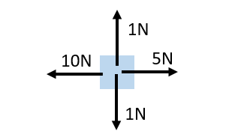
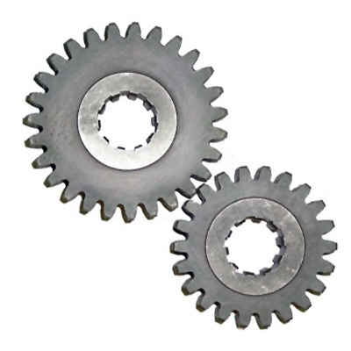

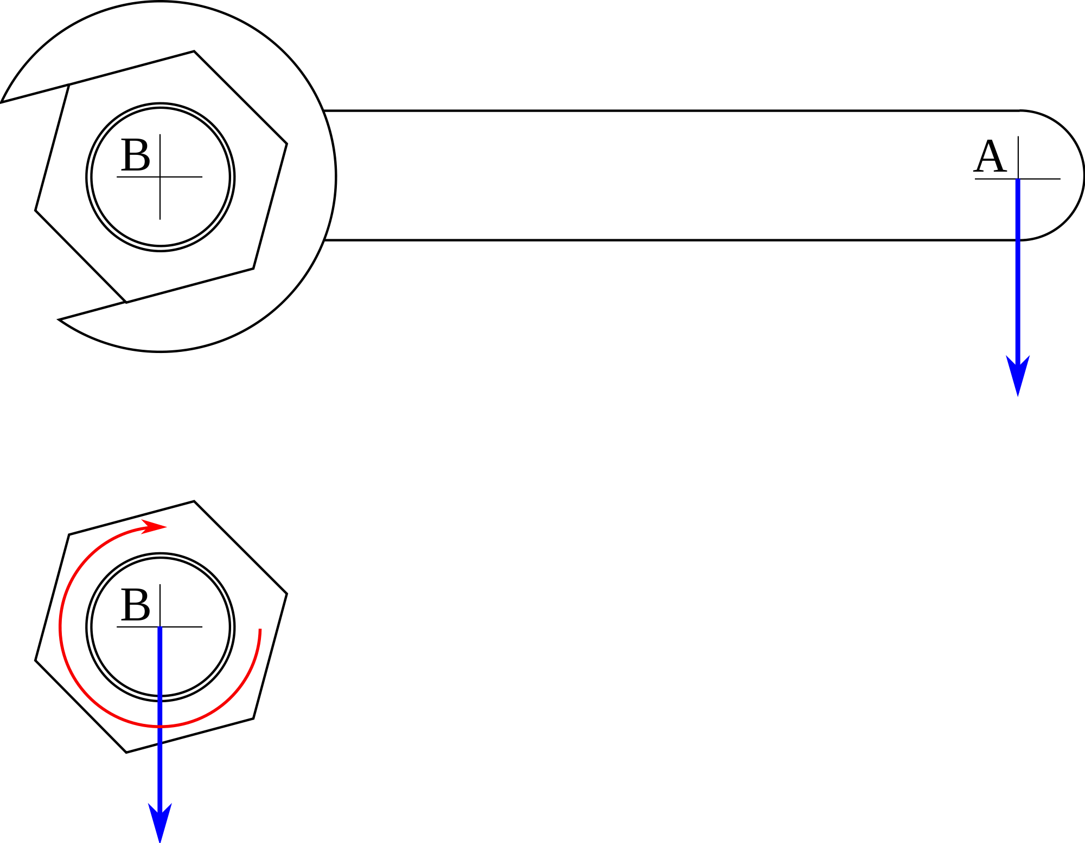
Each Kg has a gravitational pull of 9.8N.
Unit | Newton (N) | 1N
Kilo | Kilonewton (KN) = 1000 | 1X 10³
Mega | Meganewton (MN) = 1000,000 | 1 X 10⁶
Force | Push or pull | Stretch, squash, turn.
Contact force | Exerted between two objects when they touch | Friction, air resistance, tension.
Non-contact force | Exerted between two objects without touching | Gravity, electrostatic forces, magnetic forces.
Resolving forces | An object pulled with a force at an angle | A single force can be split into two components acting at right angles to each other.
Gravitational field strength | Gravity exerted around an object. | Earth’s gfs = 9.8N/kg
The component forces combined have the same effect.
Centre of mass | The weight of an object acts through a single point
Weight = mass X gravitational field strength
W = m X g
Resultant force | The overall effect of all of the forces acting upon an object | Two forces acting in the same direction are added.
 |  | Two forces acting in the opposite direction are taken away.
HIGHER ONLY
Free body diagram | Show magnitude and direction of all forces upon an object
Weight | Force acting upon an object due to gravity | Newton (N)
Mass | How much matter | Kilograms (Kg)
Gravity
Work done against frictional forces, temperature of object rises.
Object moves left with a force of 5N
Forces and their interactions
Contact and Resultant forces
Scalar | A quantity that only has magnitude (size) | e.g. mass, time, speed, temperature, energy,
Vector | A quantity that only has magnitude and direction | e.g. force, velocity, momentum
AQA FORCES – part 1
If force is at right angles to direction of movement, NO work is done.
Work done and energy transfer
Work done | When work is done, energy is transferred | Work done = force X distance moved W = F X s
 | 1J of work is done when 1N of force moves an object through a distance of 1m, in the direction of the force.
Scalar and vector quantities
An arrow can be used to show vectors | Length of arrow = magnitude of vector
 | Direction of arrow = direction of vector
Moments, levers and gears
PHYSICS ONLY
M = F X d
Forces and elasticity
One force | The object changes speed or direction
More than one force | The object changes shape
Two balanced forces can stretch a object.
Two balanced forces can compress an object.
Three balanced forces can bend an object.
Moment = force X distance
Velocity | Speed + direction | The speed of a car is 30m/s. A car moves forward with a velocity of 30m/s
Distance | How far | The table is 1m long
Displacement | Distance + direction | The beach is 1km due east of the town
Moment | Turning effect of a force about a pivot
Elastic deformation | The object has been stretched but returns to its original length
Inelastic deformation | The object has been stretched but does not return to its original length
Extension | The difference between stretched and unstretched lengths
Lever | A small force exerted with a long lever applies a large force
Limit of proportionality
Beyond this point the spring is permanently deformed
Area | Metres squares (m²)
Weight | Newton (N)
Mass | Kilograms (kg)
Gravitational field strength | Newton per kilogram (N/Kg)
Force | Newton (N)
Work done | Joules (J)
Distance | Metres (m)
Moment | Newton-metres (Nm)
Gears | Increase or decrease the rotational effect of a force
Principle of moments
In a balanced system, the sum of the clockwise moments = the sum of the anti-clockwise moments
Stretching a spring | Force = spring constant X extension, F = k X e
 | EPE = ½ X spring constant X (extension)², EPE = ½ ke²
Pressure
HIGHER ONLY
Pressure = Force ÷ Area
Fluid | A liquid or gas
Flows and changes shape to fill a container.
Elastic Potential energy (EPE) | Energy stored in a stretched spring
Pressure and depth
Pressure on divers depends on weight of water above
P = F ÷ A
Force | Newton (N)
Spring constant | Newton per metre (N/m)
Extension | Metres (m)
EPE | Joules (J)
Upthrust
Resultant force exerted by a fluid
Hydraulic machine | Use liquids to transmit pressure
Atmospheric pressure
Caused by billions of air particles colliding with a surface.
Pressure = height X density X gfs

Slide 8
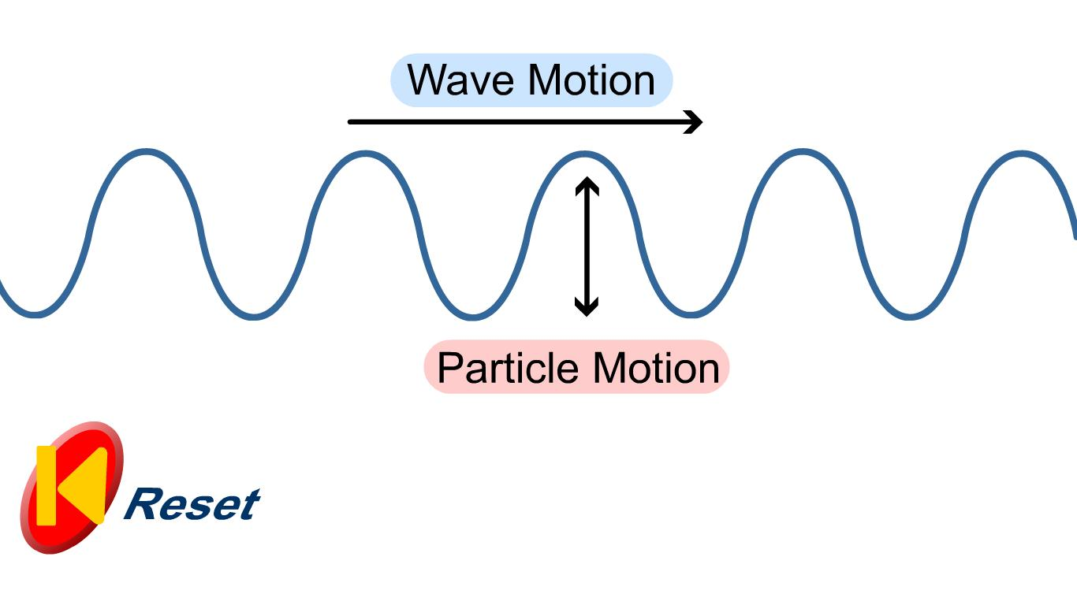
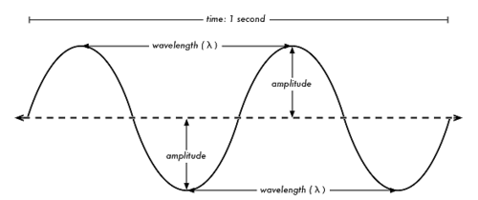
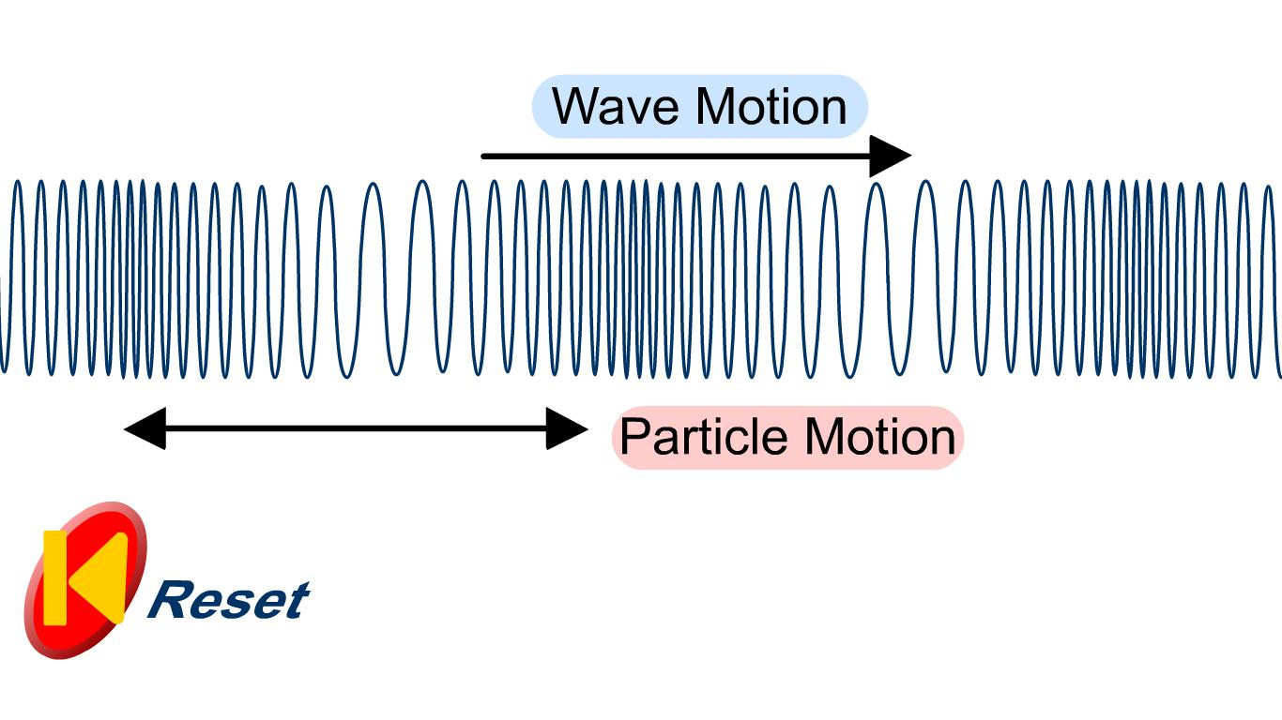
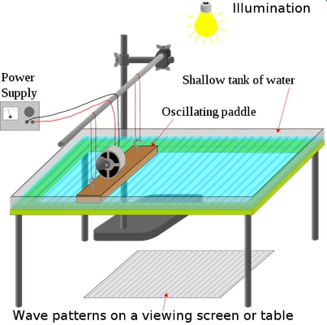
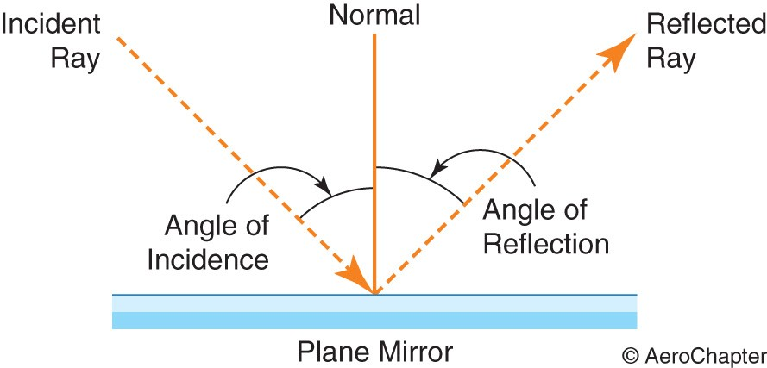
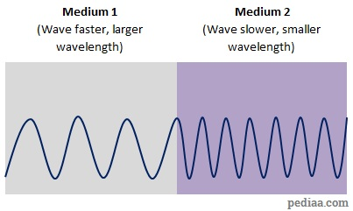
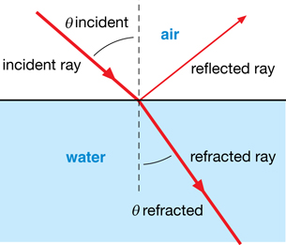
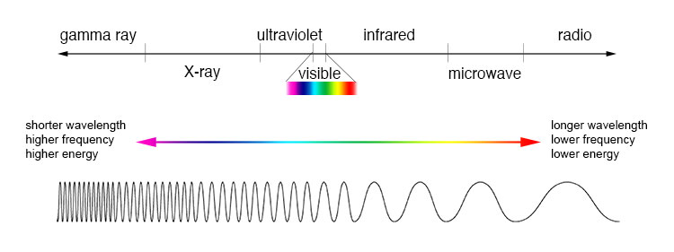
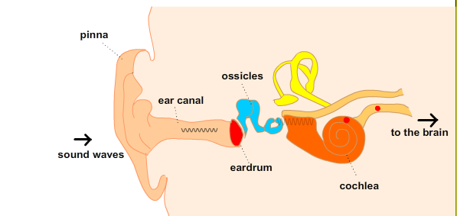
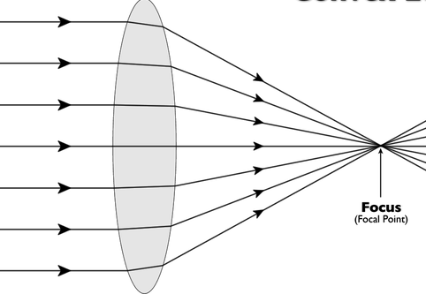
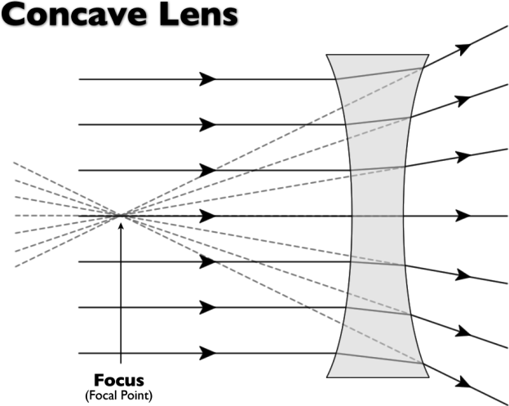
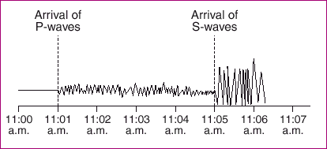
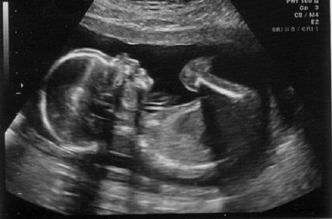
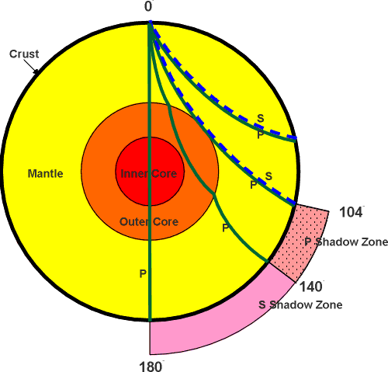
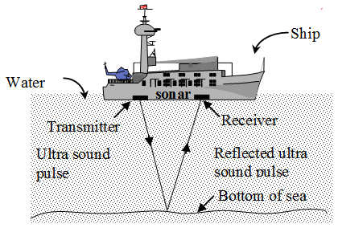
Wave speed | Wave speed = frequency X wavelength | V = $f X λ$
Wave period | Wave period = 1 ÷ frequency | T = 1 ÷ f
Speed | Speed = distance ÷ time | v = d ÷ t
Transverse wave | Vibration causing the wave is at right angles to the direction of energy transfer | Energy is carried outwards by the wave. | Water and light waves, S waves.
Longitudinal wave | Vibration causing the wave is parallel to the direction of energy transfer | Energy is carried along the wave. | Sound waves, P waves.
Wavelength | Distance from one point on a wave to the same point of the next wave
Amplitude | The maximum disturbance from its rest position
Frequency | Number of waves per second
Period | Time taken to produce 1 complete wave
Transverse and Longitudinal waves
Ultraviolet, visible light, infra-red radiation penetrate atmosphere and heat up Earth’s surface.
Energy lost is not at the same rate as energy being absorbed so Earth heats up.
Waves in air, fluids and solids
Black body radiation
PHYSICS ONLY
Earth and Global warming
In water, use a ripple tank.
Measuring speed
Properties
Longer wavelengths are radiated back, trapped by atmosphere.
In air, use echoes.
Sound waves travelling through different mediums, the frequency stay constant.
Air Water
AQA Waves
Black body radiation | All objects absorb or reflect infrared radiation | Hotter objects emit more infrared radiation.
Constant temperature | Rate of absorption = rate of radiation | Intensity and wavelength of energy affects temperature.
PHYSICS ONLY
Angle of incidence = angle of reflection (i) = (r)
e.g. Gamma
Electromagnetic waves
Short wavelengths have high frequency and high energy.
Reflection | Wave bounces off the surface.
Refraction | Waves changes direction at boundary.
Transmitted | Passes through the object.
Absorbed | Passes into but not out of, transfers energy and heats up the object.
Light refracts as it slows down in a denser substance
PHYSICS ONLY
 | Units
Distance | Metres (m)
Wave speed | Metres per second (m/s)
Wavelength | Metres (m)
Frequency | Hertz (Hz)
Period | Seconds (s)
Electromagnetic wave | Continuous spectrum of transverse waves
Magnification = image size ÷ object size
PHYSICS HIGHER ONLY
HIGHER: Lenses
Absorbed light changes into thermal energy store.
HIGHER: Properties
Convex | Real or virtual images.
Concave | Only virtual images.
Hearing | Frequencies between 20 – 20,000 Hz | Longitudinal waves cause ear drum to vibrate, amplified by three ossicles which creates pressure in the cochlea.
2F | Image same size, upside down, real.
2F - F | Image larger, upside down, real.
< F | Image bigger, right way, virtual.
Specular | Flat surface reflection.
Diffuse | Rough surface reflection.
Seismic waves
Black surfaces | Good emitters, good absorbers
White surfaces | Poor emitters, poor absorbers
Shiny surfaces | Good reflectors
P wave | S wave | Seismograph
Longitudinal | Transverse | Shows P and S waves arriving at different times.
Fast | Slow
Travel through solids and liquids | Travels through solids | By using the times the waves arrive at the monitoring centres, the epicentre of earthquake can be found. (v = x ÷ t).
Produced by earthquakes.
EM wave | Danger | Use
Radio | Safe. | Communications, TV, radio.
Microwave | Burning if concentrated. | Mobile phones, cooking, satellites.
Infrared |  | Heating, remote controls, cooking.
Visible | Damage to eyes. | Illumination, photography, fibre optics.
Ultra violet | Sunburn, cancer. | Security marking, disinfecting water.
X-ray | Cell destruction, mutation, cancer. | Broken bones, airport security.
Gamma |  | Sterilising, detecting and killing cancer.
Low frequency, long wavelength.
White | Wave lengths reflected
Black | Wave lengths absorbed
EM waves refract
Ultra sound | Partially reflected off boundary | Used for medical and foetal scans.
Sonar | Reflected off objects | Used to determine depth of objects under the sea.
High frequency, short wavelength

Slide 9
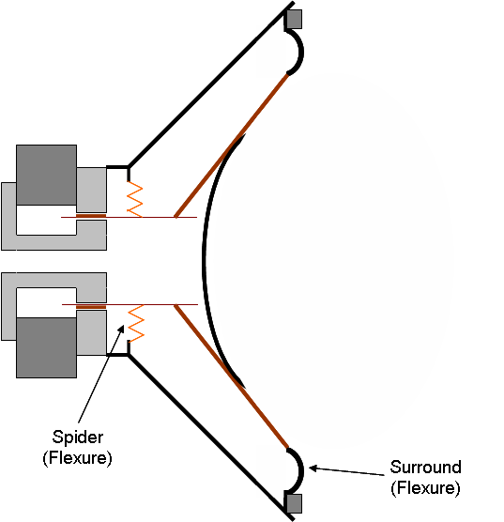
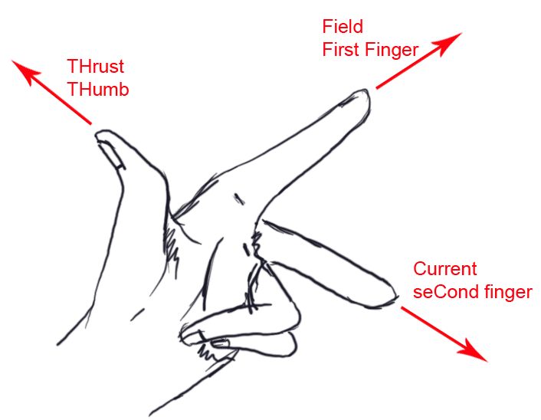
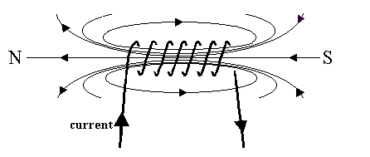
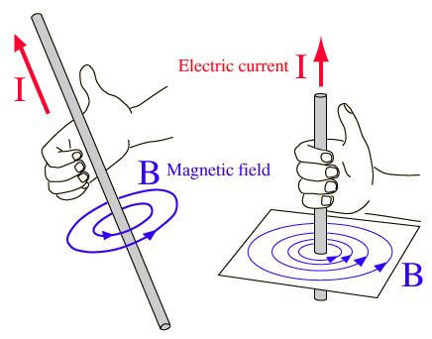
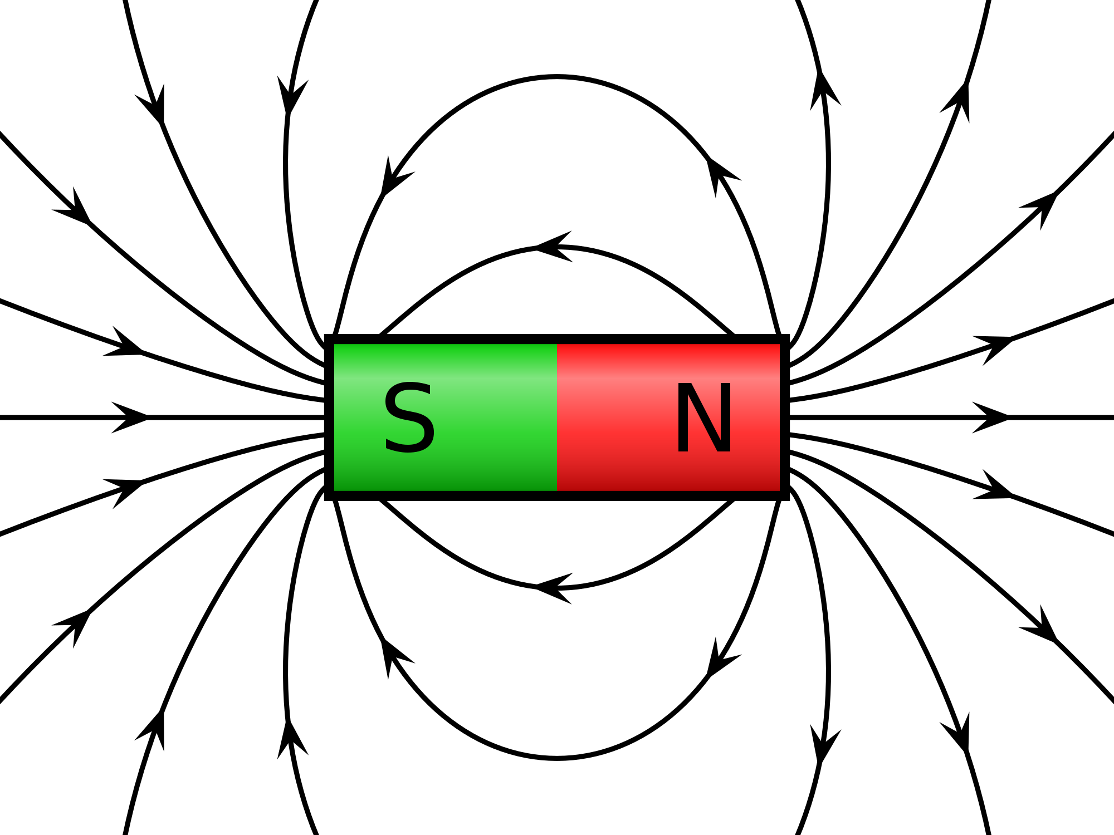
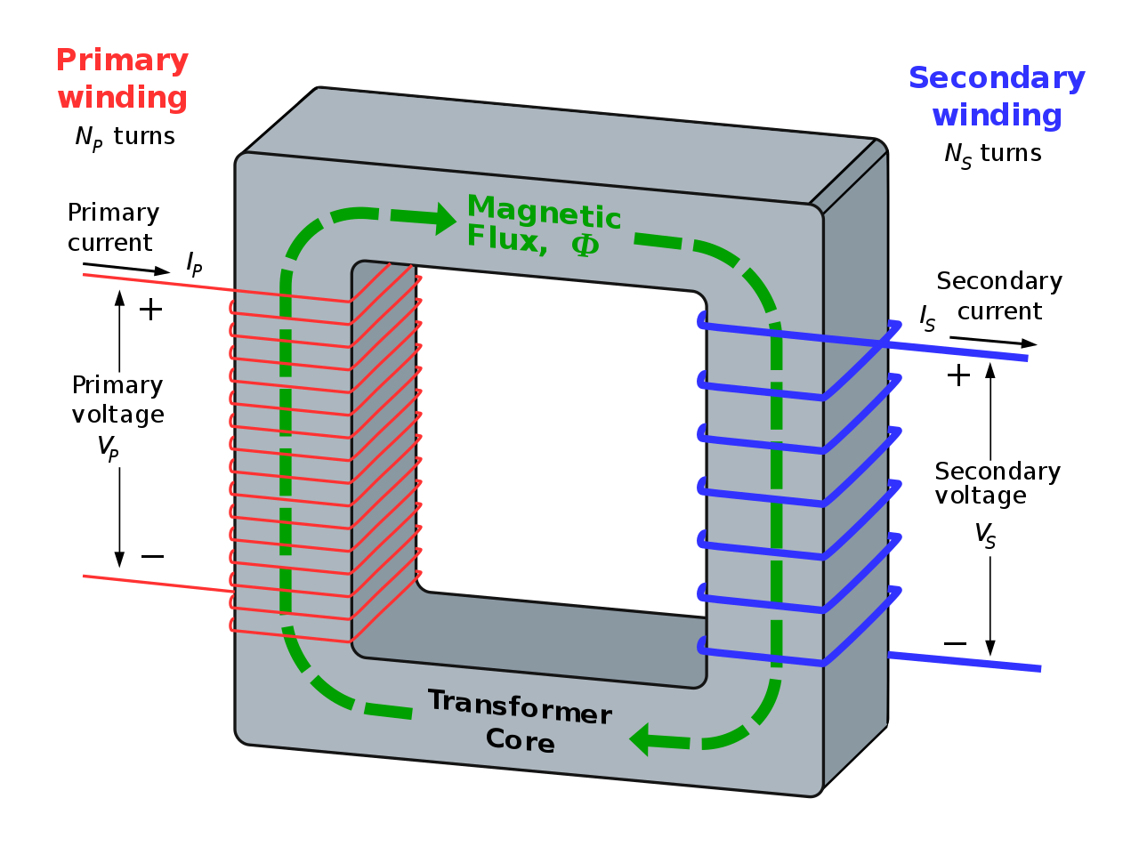
Relay | A device using a small current to control a larger current in another circuit | Solenoid is wound around an iron core. Small current magnetises the solenoid. This attracts to electrical contacts, making a complete circuit. Current flows from battery to starter motor.
Split-ring commutator | Split ring touching two carbon brush contacts
Loud speakers | Converts variations in electrical current into sound waves . | Varying current flows through a coil that is in a magnetic field. A force on the wire moves backwards and forwards as current varies. Coil connected to a diaphragm. Diaphragm movements produce sound waves.
Thumb | Direction of movement.
First finger | Direction of magnetic field.
Second finger | Direction of current.
Generators | Coil of wire rotating inside a magnetic field. The end of the coil is connected to slip rings. | Produces altering current.
Microphones | Converts pressure variations in sound waves into variations in current in electrical circuits.
Fleming’s left-hand rule
Electromagnet | Lots of turns of wire increase the magnetising effect when current flows
 | Turn current off, magnetism lost.
Increase strength of magnetic field | Use larger current
 | Use more turns of wire
 | Put turns of wire closer together
 | Use iron core in middle
To predict the direction a straight conductor moves in a magnetic field.
Electric motor | Coil of wire rotates about an axle | Current flows through the wire causing a downward movement on one side and an upward movement on the other side.
Solenoid | A long coil of wire | Magnetic field from each loop adds to the next.
Thumb | Direction of current.
Fingers | Direction of magnetic field.
Right hand rule
Magnetic field around a wire
F = B X I X l
If current and magnetic field are parallel to each other , no force on wire.
Motor effect
HIGHER only
Magnetic fields from the permanent magnet and current in the foil interact. This is called the motor effect.
Force = magnetic flux density X current X length
Reverse current, magnetic field direction reverses.
AQA
MAGNETISM AND ELECTROMAGNETISM
Reverse the current , foil moves upwards.
Magnetic flux | Lines drawn to show magnetic field | Lots of lines = stronger magnets.
Magnetic flux density | Number of lines of magnetic flux in a given area | Measures the strength of magnetic force.
Further away from the wire, magnetic field is weaker.
Aluminium foil placed between two poles of a strong magnet, will move downwards when current flows through the foil.
Current large enough, iron filings show circular magnetic field.
Electric current flowing in a wire produces a magnetic field around it.
Induced potential, transformers and National Grid
Size of force acting on foil depends on magnetic flux density between poles, size of current, length of foil between poles.
If current is small, magnetic field is very weak.
Permanent and Induced Magnetism
Magnets
National Grid | Distributes electricity generated in power stations around UK
Induced potential | When a conducting wire moves through a magnetic field, p.d. is produced
Generator effect | Generates electricity by inducing current or p.d.
Magnetic | Materials attracted by magnets | Uses non-contact force to attract magnetic materials.
North seeking pole | End of magnet pointing north | Compass needle is a bar magnet and points north.
South seeking pole | End of magnet pointing south | Like poles (N – N) repel, unlike poles (N – S) attract.
Magnetic field | Region of force around magnet | Strong field, force big. Weak field, force small. Field is strongest at the poles.
Permanent | A magnet that produces its own magnetic field | Will repel or attract other magnets and magnetic materials.
Induced | A temporary magnet | Becomes magnet when placed in a magnetic field.
PHYSICS HIGHER only
Transformer | Two coils of wire onto an iron core | Alternating current supplied to primary coil, making magnetic field change. Iron core becomes magnetised, carries changing magnetic field to secondary coil. This induces p.d.
Uses of the generator effect | Dynamo, Microphones
Power lost = Potential difference X Current
Power supplied to primary coil = power supplied to secondary coil
V_{p} X I_{p} = V_{s} X I_{s}
Force | Newton (N)
Magnetic flux density | Tesla (T)
Current | Amperes (A)
Length | Metres (m)
Power | Watts (W)
p.d. | Voltage (V)
Step-up transformers | Step-down transformers
Increase voltage, decrease current | Decrease voltage, increase current
Increases efficiency by reducing amount of heat lost from wires. | Makes safer value of voltage for houses and factories.
Voltage across the coil X number of coils (primary) = Voltage across the coil X number of coils (secondary)
V_{p} ÷ V_{s} = n_{p} ÷ n_{s}

Slide 10
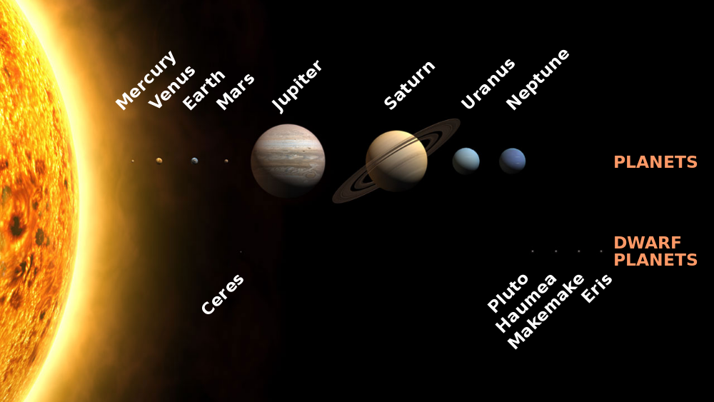
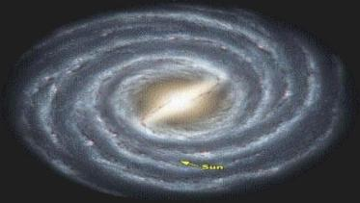
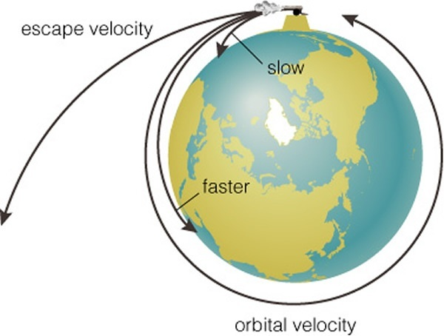
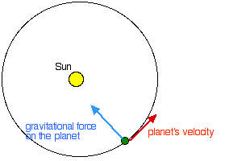
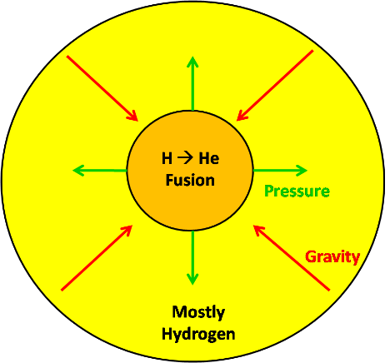
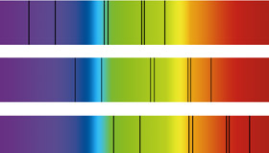
Planet | A large body orbiting the Sun
Moon | A natural satellite orbiting a planet
Dwarf planet | A body large enough to have its own gravity which caused a spherical shape
Solar system | Any object orbiting the Sun due to gravity
Galaxy | Collection of billions of stars
Universe | Collection of galaxies
Effect of gravity.
Gravity causes moons to orbit planets, planets to orbit the Sun, stars to orbit galaxy centres.
Too fast = disappears into Space.
Correct speed = steady orbit around Earth.
Force of gravity changes the moon’s direction not its speed.
Too slow = falls to Earth.
The life cycle of a star.
Comets, asteroids, satellites.
Gravity pulls objects towards the ground.
HIGHER: Circular orbits.
To calculate speed of Orbit: distance object moves in 1 orbit, Distance = 2∏r, then average speed = distance ÷ time.
Milky Way our galaxy.
Other objects.
Speed of Orbit.
Solar system
Orbital motions
AQA
SPACE PHYSICS
PHYSICS ONLY
HIGHER:
Velocity = a vector.
Planets close to the Sun, gravity pull is strong. Planets move quickly.
Nebula | A cloud of cold hydrogen gas and dust | Cloud collapses due to gravity, particles move very fast colliding with each other, kinetic energy transfers into internal energy and the temperature increases.
Protostar | The large ball of gas contracts to form a star | High temperature causes Hydrogen nuclei to collide and nuclear fusion begins. A star is ‘born’.
Main sequence | Stable period of star | Gravity tries to collapse the star but enormous pressure of fusion energy expands and balances the inward force.
A planet’s velocity changes but speed remains constant.
Planets further away from the Sun, gravity pull is weaker. So speed of planet is slower.
Due to the Sun’s gravity, planets accelerate towards the Sun and so changes direction.
When ambulances go past the sound changes from a high pitch to a low pitch.
Frequency of sound wave decreases, wavelength increases.
Red shift
Stars the same size as our Sun.
Understanding models.
Red-shift | The observed increase in wavelength of light from most distance galaxies. Light moves towards the red end of the spectrum.
Hubble (1929) | He studied light from distant galaxies; found as frequency decreases, wavelength increases.
 |  | Light from star in our galaxy.
 |  | Light from star in nearby galaxy.
 |  | Light from star in distant galaxy.
Galaxies are moving away from us in all directions.
Red giant | A large star that fuses Helium into heavier elements | Hydrogen runs out, star becomes unstable, pressure inside drops causing star to collapse. Atoms now closer together results in atoms fusing and temperature increases. This increase in temperature causes the core to swell.
White dwarf | Star collapses | Nuclear fuel runs out, fusion stops, dense very hot core.
Black dwarf | Cold dark star | White dwarf cools down.
Light from distant galaxies is red-shifted, so galaxy is moving away from us.
Galaxies further away have bigger red-shift so are moving faster away.
The Big Bang | Universe began 13.8 billion years ago
All matter and space expanded violently from a single point. |  | Red—shift provides evidence for expansion.
Stars larger than our Sun.
Red super giant | Star swells greatly | Nuclear fuel begins to run out and star swells (more matter = bigger size).
Supernova | Gigantic explosion due to run away fusion reactions | Rapid collapse, heats to very high temperatures causing run away nuclear reactions, star explodes, flinging remnants out into space. Large gravitational forces collapse the core into a tiny space. Remains of supernova form heavier elements (Iron and above)
Neutron star | Very dense star | Made out of neutrons.
Aristotle (ancient Greek) | Earth at the centre, other heavenly bodies move around the Earth.
Copernicus (1473 - 1543) | Sun at the centre, other heavenly bodies move around the Sun.
Galileo (1610) | Made a telescope, looked at Jupiter, found four moons rotating around planet.
Planets and moons moved at different speeds to stars = reason for different positions.
OR if collapse is into a really tiny space.
Black hole | No light escapes | Gravitational forces so strong everything is pulled in.

