Slide 1

AQA GCSE
Year 11 Triple Chemistry
Knowledge Organiser

Slide 2
Atom | The smallest part of an element that can exist | Have a radius of around 0.1 nanometres and have no charge (0).
Element | Contains only one type of atom | Around 100 different elements each one is represented by a symbol e.g. O, Na, Br.
Compound | Two or more elements chemically combined | Compounds can only be separated into elements by chemical reactions.
Pre 1900 |  | Tiny solid spheres that could not be divided | Before the discovery of the electron, John Dalton said the solid sphere made up the different elements.
1897 ‘plum pudding’ |  | A ball of positive charge with negative electrons embedded in it | JJ Thompson ‘s experiments showed that showed that an atom must contain small negative charges (discovery of electrons).
1909 nuclear model |  | Positively charge nucleus at the centre surrounded negative electrons | Ernest Rutherford's alpha particle scattering experiment showed that the mass was concentrated at the centre of the atom.
1913 Bohr model |  | Electrons orbit the nucleus at specific distances | Niels Bohr proposed that electrons orbited in fixed shells; this was supported by experimental observations.
Atoms, elements and compounds
Central nucleus | Contains protons and neutrons
Electron shells | Contains electrons
Electronic shell | Max number of electrons
1 | 2
2 | 8
3 | 8
4 | 2
Name of Particle | Relative Charge | Relative Mass
Proton | +1 | 1
Neutron | 0 | 1
Electron | -1 | Very small
Electronic structures
The development of the model of the atom
James Chadwick | Provided the evidence to show the existence of neutrons within the nucleus
AQA GCSE
Atomic structure and periodic table part 1
Rutherford's scattering experiment | A beam of alpha particles are directed at a very thin gold foil | Most of the alpha particles passed right through. A few (+) alpha particles were deflected by the positive nucleus. A tiny number of particles reflected back from the nucleus.
Relative electrical charges of subatomic particles
7
Li
3
Mass number | The sum of the protons and neutrons in the nucleus
Atomic number | The number of protons in the atom | Number of electrons = number of protons
Mixtures | Two or more elements or compounds not chemically combined together | Can be separated by physical processes.
Chemical equations | Show chemical reactions - need reactant(s) and product(s) energy always involves and energy change | Law of conservation of mass states the total mass of products = the total mass of reactants.
Method | Description | Example
Filtration | Separating an insoluble solid from a liquid | To get sand from a mixture of sand, salt and water.
Crystallisation | To separate a solid from a solution | To obtain pure crystals of sodium chloride from salt water.
Simple distillation | To separate a solvent from a solution | To get pure water from salt water.
Fractional distillation | Separating a mixture of liquids each with different boiling points | To separate the different compounds in crude oil.
Chromatography | Separating substances that move at different rates through a medium | To separate out the dyes in food colouring.
Word equations | Uses words to show reaction reactants → products magnesium + oxygen → magnesium oxide | Does not show what is happening to the atoms or the number of atoms.
Symbol equations | Uses symbols to show reaction reactants → products 2Mg + O₂ → 2MgO | Shows the number of atoms and molecules in the reaction, these need to be balanced.
Isotopes | Atoms of the same element with the same number of protons and different numbers of neutrons | ³⁵Cl (75%) and ³⁷Cl (25%) Relative abundance = (% isotope 1 x mass isotope 1) + (% isotope 2 x mass isotope 2) ÷ 100 e.g. (25 x 37) + (75x 35) ÷ 100 = 35.5
Relative atomic mass

Slide 3
Alkali metals
Halogens
Noble gases
Elements arranged in order of atomic number | Elements with similar properties are in columns called groups | Elements in the same group have the same number of outer shell electrons and elements in the same period (row) have the same number of electron shells.
1
2
3
4
5
6
7
0
H
Transition metals
He
Li
Be
B
C
N
O
F
Ne
Before discovery of protons, neutrons and electrons | Elements arranged in order of atomic weight | Early periodic tables were incomplete, some elements were placed in inappropriate groups if the strict order atomic weights was followed.
Mendeleev | Left gaps for elements that hadn’t been discovered yet | Elements with properties predicted by Mendeleev were discovered and filled in the gaps. Knowledge of isotopes explained why order based on atomic weights was not always correct.
Na
Mg
Al
Si
P
S
Cl
Ar
The Periodic table
K
Ca
Sc
Ti
V
Cr
Mn
Fe
Co
Ni
Cu
Zn
Ga
Ge
As
Se
Br
Kr
Rb
Sr
Y
Zr
Nb
Mo
Tc
Ru
Rh
Pd
Ag
Cd
In
Sn
Sb
Te
I
Xe
Cs
Ba
La
Hf
Ta
W
Re
Os
Ir
Pt
Au
Hg
Tl
Pb
Bi
Po
At
Rn
Development
of the Periodic table
Fr
Ra
Ac
Rf
Db
Sg
Bh
Hs
Mt
?
?
?
Metals to the left of this line, non metals to the right
Metals | To the left of the Periodic table | Form positive ions. Conductors, high melting and boiling points, ductile, malleable.
Non metals | To the right of the Periodic table | Form negative ions. Insulators, low melting and boiling points.
Metals and non metals
Alkali metals | Very reactive with oxygen, water and chlorine | Only have one electron in their outer shell. Form +1 ions.
 | Reactivity increases down the group | Negative outer electron is further away from the positive nucleus so is more easily lost.
Group
7
AQA GCSE
Atomic structure and periodic table part 2
Group 1
Halogens | Consist of molecules made of a pair of atoms | Have seven electrons in their outer shell. Form -1 ions.
 | Melting and boiling points increase down the group (gas → liquid → solid) | Increasing atomic mass number.
 | Reactivity decreases down the group | Increasing proton number means an electron is more easily gained
With oxygen | Forms a metal oxide | Metal + oxygen → metal oxide | e.g. 4Na + O₂ → 2Na₂O
With water | Forms a metal hydroxide and hydrogen | Metal + water → metal hydroxide + hydrogen | e.g. 2Na + 2H₂O → 2NaOH + H₂
With chlorine | Forms a metal chloride | Metal + chlorine → metal chloride | e.g. 2Na + Cl₂ → 2NaCl
Group 0
Transition metals (Chemistry only)
Noble gases | Unreactive, do not form molecules | This is due to having full outer shells of electrons.
 | Boiling points increase down the group | Increasing atomic number.
With metals | Forms a metal halide | Metal + halogen → metal halide e.g. Sodium + chlorine → sodium chloride | e.g. NaCl metal atom loses outer shell electrons and halogen gains an outer shell electron
With hydrogen | Forms a hydrogen halide | Hydrogen + halogen → hydrogen halide e.g. Hydrogen + bromine → hydrogen bromide | e.g. Cl₂ + H₂ → 2HCl
With aqueous solution of a halide salt | A more reactive halogen will displace the less reactive halogen from the salt | Chlorine + potassium bromide → potassium chloride + bromine | e.g. Cl₂ +2KBr →2KCl + Br₂
Compared to group 1 | Less reactive Harder Denser Higher melting points | Cu²⁺ is blue Ni²⁺ is pale green, used in the manufacture of margarine Fe²⁺ is green, used in the Haber process Fe³⁺ is reddish-brown Mn²⁺ is pale pink
Typical properties | Many have different ion possibilities with different charges Used as catalysts Form coloured compounds

Slide 4
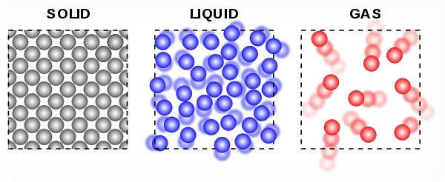
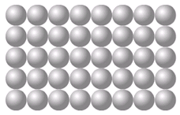
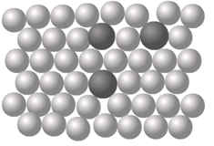
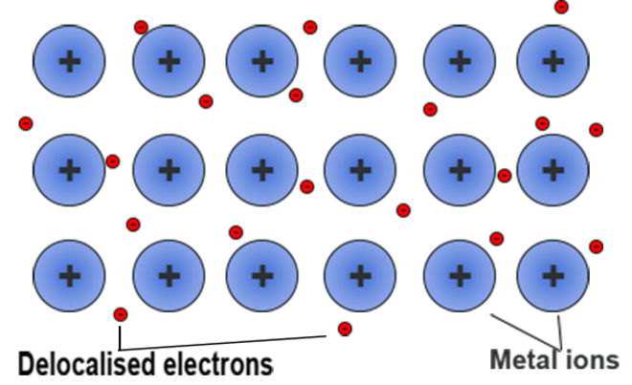
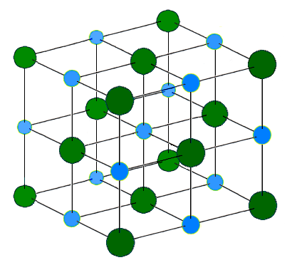
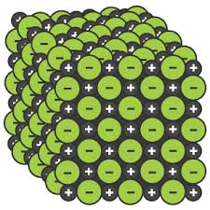
Ionic | Particles are oppositely charged ions | Occurs in compounds formed from metals combined with non metals.
Covalent | Particles are atoms that share pairs of electrons | Occurs in most non metallic elements and in compounds of non metals.
Metallic | Particles are atoms which share delocalised electrons | Occurs in metallic elements and alloys.
Solid, liquid, gas | Melting and freezing happen at melting point, boiling and condensing happen at boiling point. | The amount of energy needed for a state change depends on the strength of forces between particles in the substance. | (HT only) Limitations of simple model: There are no forces in the model All particles are shown as spheres Spheres are solid
s | solid
l | liquid
g | gas
High melting and boiling points | Large amounts of energy needed to break the bonds.
Do not conduct electricity when solid | Ions are held in a fixed position in the lattice and cannot move.
Do conduct electricity when molten or dissolved | Lattice breaks apart and the ions are free to move.
Good conductors of electricity | Delocalised electrons carry electrical charge through the metal.
Good conductors of thermal energy | Energy is transferred by the delocalised electrons.
Chemical bonds
The three states of matter
High melting and boiling points | This is due to the strong metallic bonds.
Pure metals can be bent and shaped | Atoms are arranged in layers that can slide over each other.
Properties of ionic compounds
AQA
BONDING, STRUCTURE AND THE PROPERTIES OF MATTER 1
Metals as conductors
Alloys | Mixture of two or more elements at least one of which is a metal | Harder than pure metals because atoms of different sizes disrupt the layers so they cannot slide over each other.
Properties of metals and alloys
Ionic bonding
Electrons are transferred so that all atoms have a noble gas configuration (full outer shells). | Metal atoms lose electrons and become positively charged ions | Group 1 metals form +1 ions Group 2 metals form +2 ions
 | Non metals atoms gain electrons to become negatively charged ions | Group 6 non metals form -2 ions Group 7 non metals form -1 ions
Pure metal Alloy
Metallic bonding
[
]
[
-
+
]
Dot and cross diagram
Giant structure
x
x
x
Ionic compounds
x
x
Na
x
Cl
Na
x
Cl
Giant structure of atoms arranged in a regular pattern |  | Electrons in the outer shell of metal atoms are delocalised and free to move through the whole structure. This sharing of electrons leads to strong metallic bonds.
x
x
x
x
x
x
x
(2, 8, 1)
(2, 8, 7)
(2, 8)
(2, 8, 8)
Structure | Held together by strong electrostatic forces of attraction between oppositely charged ions Forces act in all directions in the lattice
Na⁺
Cl⁻

Slide 5
M_{r} | The sum of the relative atomic masses of the atoms in the numbers shown in the formula | The sum of the M_{r} of the reactants in the quantities shown equals the sum of the M_{r} of the products in the quantities shown. | 2Mg + O₂ → 2MgO 48g + 32g = 80g 80g = 80g
The reactant that is completely used up | Limits the amount of product that is made | Less moles of product are made.
Whenever a measurement is taken, there is always some uncertainty about the result obtained | Can determine whether the mean value falls within the range of uncertainty of the result | Calculate the mean Calculate the range of the results Estimate of uncertainty in mean would be half the range
Mass appears to increase during a reaction | One of the reactants is a gas | Magnesium + oxygen → magnesium oxide
Mass appears to decrease during a reaction | One of the products is a gas and has escaped | Calcium carbonate → carbon dioxide + calcium oxide
Limiting reactants
(HT only)
Relative formula mass (M_{r})
Chemical measurements
Concentration of solutions
Example: Mean value is 46.5s Range of results is 44s to 49s = 5s Time taken was 46.5s $±$2.5s
Mass changes when a reactant or product is a gas
Conservation of mass | No atoms are lost or made during a chemical reaction | Mass of the products equals the mass of the reactants.
AQA GCSE
QUANTITATIVE CHEMISTRY 1
Measured in mass per given volume of solution (g/dm³) | Conc. = mass (g) . volume (dm³) | HT only Greater mass = higher concentration. Greater volume = lower concentration.
Balanced symbol equations | Represent chemical reactions and have the same number of atoms of each element on both sides of the equation | H₂ + Cl₂ → 2HCl Subscript numbers show the number of atoms of the element to its left. Normal script numbers show the number of molecules.
Amounts of substances in equations (HT only)
Subscript Normal script
Conservation of mass and balanced symbol equations
Using moles to balance equations (HT only)
The balancing numbers in a symbol equation can be calculated from the masses of reactants and products | Convert the masses in grams to amounts in moles and convert the number of moles to simple whole number ratios.
Moles (HT only)
Chemical amounts are measured in moles (mol) | Mass of one mole of a substance in grams = relative formula mass | One mole of H₂O = 18g (1 + 1 + 16) One mole of Mg = 24g
Chemical equations show the number of moles reacting and the number of moles made | Mg + 2HCl → MgCl₂ + H₂ One mole of magnesium reacts with two moles of hydrochloric acid to make one mole of magnesium chloride and one mole of hydrogen | If you have a 60g of Mg, what mass of HCl do you need to convert it to MgCl₂? A_{r} : Mg =24 so mass of 1 mole of Mg = 24g M_{r} : HCl (1 + 35.5) so mass of 1 mole of HCl = 36.5g So 60g of Mg is 60/24 = 2.5 moles Balanced symbol equation tells us that for every one mole of Mg, you need two moles of HCl to react with it. So you need 2.5x2 = 5 moles of HCl You will need 5 x 36.5g of HCl= 182.5g
Avogadro constant | One mole of any substance will contain the same number of particles, atoms, molecules or ions. | 6.02 x 10²³ per mole One mole of H₂O will contain 6.02 x 10²³ molecules One mole of NaCl will contain 6.02 x 10²³ Na⁺ ions
Number of moles = mass (g) or mass (g) A_{r} M_{r} | How many moles of sulfuric acid molecules are there in 4.7g of sulfuric acid (H₂SO₄)? Give your answer to 1 significant figure. 4.7 = 0.05 mol 98 (M_{r} of H₂SO₄)

Slide 6
A measure of the amount of starting materials that end up as useful products | Atom economy = Relative formula mass of desired product from equation x 100 Sum of relative formula mass of all reactants from equation | High atom economy is important or sustainable development and economic reasons
Calculate the atom economy for making hydrogen by reacting zinc with hydrochloric acid: Zn + 2HCl → ZnCl₂ + H₂ M_{r} of H₂ = 1 + 1 = 2 M_{r} of Zn + 2HCl = 65 + 1 + 1 + 35.5 + 35.5 = 138 Atom economy = ²∕₁₃₈ × 100 = ²∕₁₃₈ × 100 = 1.45% This method is unlikely to be chosen as it has a low atom economy.
Concentration of a solution is the amount of solute per volume of solution | Concentration = amount (mol) (mol/dm³) volume (dm³) | What is the concentration of a solution that has 35.0g of solute in 0.5dm³ of solution? 35/0.5 = 70 g/dm³
Using concentrations of solutions in mol/dm³
(HT only, chemistry only)
Titration | If the volumes of two solutions that react completely are known and the concentrations of one solution is known, the concentration of the other solution can be calculated. | 2NaOH(aq) + H₂SO₄(aq)→ Na₂S0₄(aq) + 2H₂O(l) It takes 12.20cm³ of sulfuric acid to neutralise 24.00cm³ of sodium hydroxide solution, which has a concentration of 0.50mol/dm³. Calculate the concentration of the sulfuric acid in mol/dm³: 0.5 mol/dm³ x (24/1000) dm³ = 0.012 mol of NaOH The equation shows that 2 mol of NaOH reacts with 1 mol of H₂SO₄, so the number of moles in 12.20cm³ of sulfuric acid is (0.012/2) = 0.006 mol of sulfuric acid Calculate the concentration of sulfuric acid in mol/ dm³ 0.006 mol x (1000/12.2) dm³ =0.49mol/dm³
Atom economy
AQA
QUANTITATIVE CHEMISTRY 2
HT only: 200g of calcium carbonate is heated. It decomposes to make calcium oxide and carbon dioxide. Calculate the theoretical mass of calcium oxide made. CaCO₃ → CaO + CO₂ M_{r} of CaCO₃ = 40 + 12 + (16x3) = 100 M_{r} of CaO = 40 + 16 = 56 100g of CaCO₃ would make 56 g of CaO So 200g would make 112g
Percentage yield
Use of amount of substance in relation to volumes of gases
(HT only, chemistry only)
Calculate the concentration of sulfuric acid in g/ dm³: H₂SO₄ = (2x1) + 32 + (4x16) = 98g 0.49 x 98g = 48.2g/dm³
Yield is the amount of product obtained | It is not always possible to obtain the calculated amount of a product | The reaction may not go to completion because it is reversible.
 |  | Some of the product may be lost when it is separated from the reaction mixture.
 |  | Some of the reactants may react in ways different to the expected reaction.
Equal amounts of moles or gases occupy the same volume under the same conditions of temperature and pressure | The volume of one mole of any gas at room temperature and pressure (20°C and 1 atmospheric pressure) is 24 dm³ | No. of moles of gas = vol of gas (dm³) 24dm³
Percentage yield is comparing the amount of product obtained as a percentage of the maximum theoretical amount | % Yield = Mass of product made x 100 Max. theoretical mass | A piece of sodium metal is heated in chlorine gas. A maximum theoretical mass of 10g for sodium chloride was calculated, but the actual yield was only 8g. Calculate the percentage yield. Percentage yield = 8/10 x 100 =80%
What is the volume of 11.6 g of butane (C₄H₁₀) gas at RTP? M_{r} : (4 x 12) + (10 x 1) = 58 11.6/58 = 0.20 mol Volume = 0.20 x 24 = 4.8 dm³
6g of a hydrocarbon gas had a volume of 4.8 dm³. Calculate its molecular mass. 1 mole = 24 dm³, so 4.8/24 = 0.2 mol M_{r} = 6 / 0.2 = 30 If 6g = 0.2 mol, 1 mol equals 30 g

Slide 7
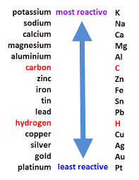
Oxidation Is Loss (of electrons) Reduction Is Gain (of electrons)
HT ONLY: Reactions between metals and acids are redox reactions as the metal donates electrons to the hydrogen ions. This displaces hydrogen as a gas while the metal ions are left in the solution.
Ionic half equations (HT only)
For displacement reactions | Ionic half equations show what happens to each of the reactants during reactions | For example: The ionic equation for the reaction between iron and copper (II) ions is: Fe + Cu²⁺ → Fe²⁺ + Cu The half-equation for iron (II) is: Fe → Fe²⁺ + 2e⁻ The half-equation for copper (II) ions is: Cu²⁺ + 2e⁻ → Cu
Reactions with acids | metal + acid → metal salt + hydrogen | magnesium + hydrochloric acid → magnesium chloride + hydrogen zinc + sulfuric acid → zinc sulfate + hydrogen
Acids react with some metals to produce salts and hydrogen.
Extraction using carbon
Metals less reactive than carbon can be extracted from their oxides by reduction. | For example: zinc oxide + carbon → zinc + carbon dioxide
Reactions of acids and metals
Reactions of acids
Acid name | Salt name
Hydrochloric acid | Chloride
Sulfuric acid | Sulfate
Nitric acid | Nitrate
Oxidation and reduction in terms of electrons (HT ONLY)
Extraction of metals and reduction
Unreactive metals, such as gold, are found in the Earth as the metal itself. They can be mined from the ground.
AQA Chemical Changes 1
 | Reactions with water | Reactions with acid
Group 1 metals | Reactions get more vigorous as you go down the group | Reactions get more vigorous as you go down the group
Group 2 metals | Do not react with water | Observable reactions include fizzing and temperature increases
Zinc, iron and copper | Do not react with water | Zinc and iron react slowly with acid. Copper does not react with acid.
Neutralisation of acids and salt production
Reactivity of metals
sodium hydroxide + hydrochloric acid → sodium chloride + water
calcium carbonate + sulfuric acid → calcium sulfate, + carbon dioxide + water
The reactivity series
Neutralisation | Acids can be neutralised by alkalis and bases | An alkali is a soluble base e.g. metal hydroxide. A base is a substance that neutralises an acid e.g. a soluble metal hydroxide or a metal oxide.
Metal oxides
Metals form positive ions when they react | The reactivity of a metal is related to its tendency to form positive ions | The reactivity series arranges metals in order of their reactivity (their tendency to form positive ions).
Carbon and hydrogen | Carbon and hydrogen are non-metals but are included in the reactivity series | These two non-metals are included in the reactivity series as they can be used to extract some metals from their ores, depending on their reactivity.
Displacement | A more reactive metal can displace a less reactive metal from a compound. | Silver nitrate + Sodium chloride → Sodium nitrate + Silver chloride
Metals and oxygen | Metals react with oxygen to form metal oxides | magnesium + oxygen → magnesium oxide 2Mg + O₂ → 2MgO
Reduction | This is when oxygen is removed from a compound during a reaction | e.g. metal oxides reacting with hydrogen, extracting low reactivity metals
Oxidation | This is when oxygen is gained by a compound during a reaction | e.g. metals reacting with oxygen, rusting of iron

Slide 8
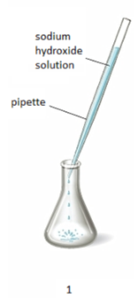
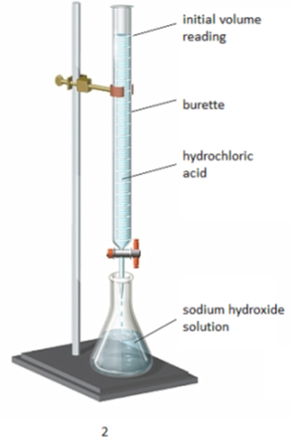
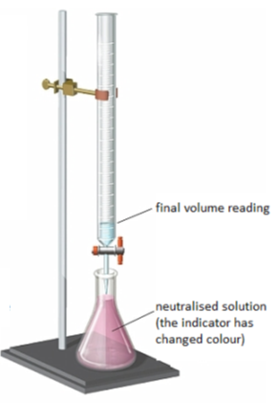
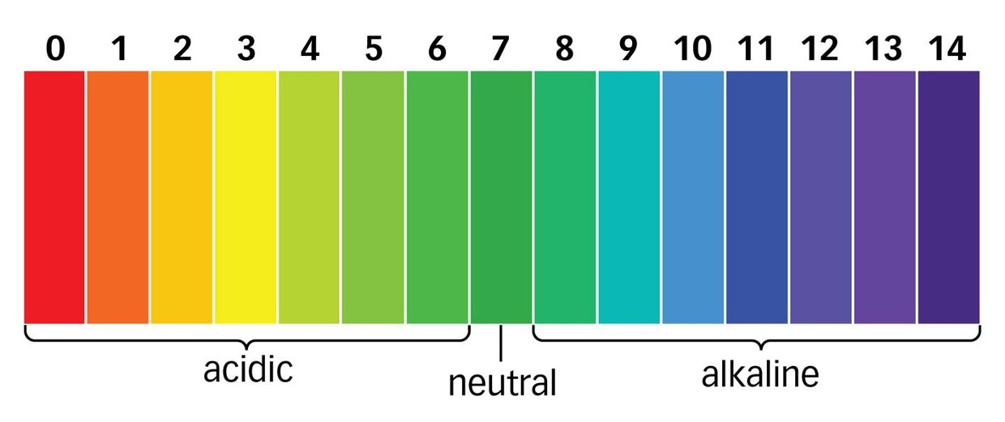
The ions discharged when an aqueous solution is electrolysed using inert electrodes depend on the relative reactivity of the elements involved.
Process of electrolysis | Splitting up using electricity | When an ionic compound is melted or dissolved in water, the ions are free to move. These are then able to conduct electricity and are called electrolytes. Passing an electric current though electrolytes causes the ions to move to the electrodes.
Electrode | Anode Cathode | The positive electrode is called the anode. The negative electrode is called the cathode.
Where do the ions go? | Cations Anions | Cations are positive ions and they move to the negative cathode. Anions are negative ions and they move to the positive anode.
Extracting metals using electrolysis | Metals can be extracted from molten compounds using electrolysis.
 | This process is used when the metal is too reactive to be extracted by reduction with carbon.
 | The process is expensive due to large amounts of energy needed to produce the electrical current. Example: aluminium is extracted in this way.
At the negative electrode | Metal will be produced on the electrode if it is less reactive than hydrogen. Hydrogen will be produced if the metal is more reactive than hydrogen.
At the positive electrode | Oxygen is formed at positive electrode. If you have a halide ion (Cl⁻, I⁻, Br⁻) then you will get chlorine, bromine or iodine formed at that electrode.
Electrolysis of aqueous solutions
Electrolysis
Higher tier: You can display what is happening at each electrode using half-equations:
At the cathode: Pb²⁺ + 2e⁻ → Pb
At the anode: 2Br⁻ → Br₂ + 2e⁻
Strong acids | Completely ionised in aqueous solutions e.g. hydrochloric, nitric and sulfuric acids.
Weak acids | Only partially ionised in aqueous solutions e.g. ethanoic acid, citric acid.
Hydrogen ion concentration | As the pH decreases by one unit (becoming a stronger acid), the hydrogen ion concentration increases by a factor of 10.
AQA Chemical Changes 2
Strong and weak acids (HT ONLY)
Reactions of acids
 | 1. Use the pipette to add 25 cm³ of alkali to a conical flask and add a few drops of indicator.
 | 2. Fill the burette with acid and note the starting volume. Slowly add the acid from the burette to the alkali in the conical flask, swirling to mix.
 | 3. Stop adding the acid when the end-point is reached (the appropriate colour change in the indicator happens). Note the final volume reading. Repeat steps 1 to 3 until you get consistent readings.
Titrations (Chemistry only)
Soluble salts | Soluble salts can be made from reacting acids with solid insoluble substances (e.g. metals, metal oxides, hydroxides and carbonates).
Production of soluble salts | Add the solid to the acid until no more dissolves. Filter off excess solid and then crystallise to produce solid salts.
Titrations are used to work out the precise volumes of acid and alkali solutions that react with each other.
Soluble salts
Calculating the chemical quantities in titrations involving concentrations in mol/dm³ and in g/dm³ (HT ONLY): 2NaOH(aq) + H₂SO₄(aq)→ Na₂S0₄(aq) + 2H₂O(l) It takes 12.20cm³ of sulfuric acid to neutralise 24.00cm³ of sodium hydroxide solution, which has a concentration of 0.50mol/dm³. Calculate the concentration of the sulfuric acid in g/dm³ 0.5 mol/dm³ x (24/1000) dm³ = 0.012 mol of NaOH | The equation shows that 2 mol of NaOH reacts with 1 mol of H₂SO₄, so the number of moles in 12.20cm³ of sulfuric acid is (0.012/2) = 0.006 mol of sulfuric acid Calculate the concentration of sulfuric acid in mol/ dm³ 0.006 mol x (1000/12.2) dm³ =0.49mol/dm³ Calculate the concentration of sulfuric acid in g/ dm³ H₂SO₄ = (2x1) + 32 + (4x16) = 98g 0.49 x 98g = 48.2g/dm³
You can use universal indicator or a pH probe to measure the acidity or alkalinity of a solution against the pH scale.
The pH scale and neutralisation
Acids | Acids produce hydrogen ions (H⁺) in aqueous solutions.
Alkalis | Aqueous solutions of alkalis contain hydroxide ions (OH⁻).
In neutralisation reactions, hydrogen ions react with hydroxide ions to produce water:
H⁺ + OH⁻ → H₂O

Slide 9
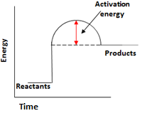
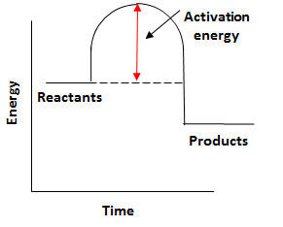
Endothermic | Energy is taken in from the surroundings so the temperature of the surroundings decreases | Thermal decomposition Sports injury packs
Exothermic | Energy is transferred to the surroundings so the temperature of the surroundings increases | Combustion Hand warmers Neutralisation
Ionic half equations | Negative electrode: 2H₂ (g) + 4OH⁻ (aq) → 4H₂O (l) + 4e⁻ | Positive electrode: O₂ (g) + 2H₂O (l) + 4e⁻ → 4OH⁻ (aq)
Hydrogen fuel cells | Word equation: hydrogen + oxygen → water | Symbol equation: 2H₂ + O₂ → 2H₂O
 | Advantages: No pollutants produced Can be a range of sizes | Disadvantages: Hydrogen is highly flammable Hydrogen is difficult to store
Reaction profiles | Show the overall energy change of a reaction
Types of reaction
Fuel cells (Chemistry only)
Breaking bonds in reactants | Endothermic process
Making bonds in products | Exothermic process
The energy change of reactions
(HT only)
AQA GCSE
Energy changes
Activation energy | Chemical reactions only happen when particles collide with sufficient energy | The minimum amount of energy that colliding particles must have in order to react is called the activation energy.
Reaction profiles
Overall energy change of a reaction | Exothermic | Energy released making new bonds is greater than the energy taken in breaking existing bonds.
 | Endothermic | Energy needed to break existing bonds is greater than the energy released making new bonds.
Cells and batteries
(Chemistry only)
Simple cell | Make a simple cell by connecting two different metals in contact with an electrolyte | Increase the voltage by increasing the reactivity difference between the two metals.
Batteries | Consist of two or more cells connected together in series to provide a greater voltage.
Endothermic |  | Products are at a higher energy level than the reactants. As the reactants form products, energy is transferred from the surroundings to the reaction mixture. The temperature of the surroundings decreases because energy is taken in during the reaction.
Exothermic |  | Products are at a lower energy level than the reactants. When the reactants form products, energy is transferred to the surroundings. The temperature of the surroundings increases because energy is released during the reaction.
Bond energy calculation | Calculate the overall energy change for the forward reaction N₂ + 3H₂ $⇌$ 2NH₃ Bond energies (in kJ/mol): H-H 436, H-N 391, N$≡$N 945
 | Bond breaking: 945 + (3 x 436) = 945 + 1308 = 2253 kJ/mol Bond making: 6 x 391 = 2346 kJ/mol Overall energy change = 2253 - 2346 = -93kJ/mol Therefore reaction is exothermic overall.
Non-rechargeable cells | Stop when one of the reactants has been used up | Alkaline batteries
Rechargeable cells | Can be recharged because the chemical reactions are reversed when an external electrical current is supplied | Rechargeable batteries

Slide 10
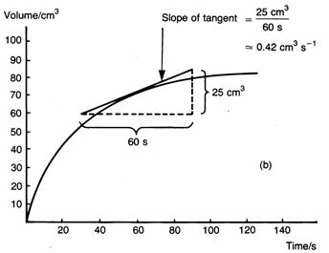
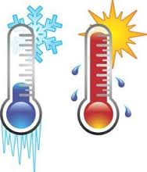
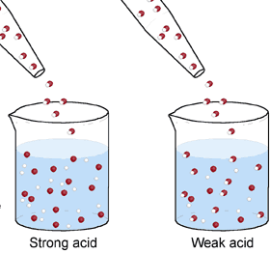
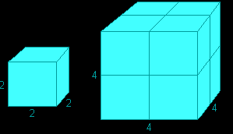
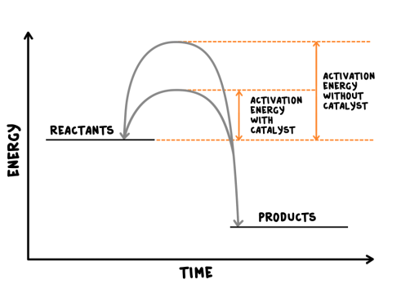
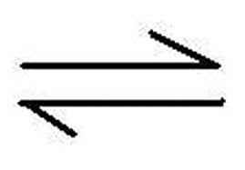
Rate of chemical reaction | This can be calculated by measuring the quantity of reactant used or product formed in a given time. | Rate = quantity of reactant used time taken Rate = quantity of product formed time taken
Factors affecting the rate of reaction
Temperature | The higher the temperature, the quicker the rate of reaction.
Concentration | The higher the concentration, the quicker the rate of reaction.
Surface area | The larger the surface area of a reactant solid, the quicker the rate of reaction.
Pressure (of gases) | When gases react, the higher the pressure upon them, the quicker the rate of reaction.
Quantity | Unit
Mass | Grams (g)
Volume | cm³
Rate of reaction | Grams per cm³ (g/cm³) HT: moles per second (mol/s)
Calculating rates of reactions
Factors affecting rates
Rate of reaction
Collision theory and activation energy
AQA GCSE
The rate and extent of chemical change
Catalyst | A catalyst changes the rate of a chemical reaction but is not used in the reaction.
Enzymes | These are biological catalysts.
How do they work? | Catalysts provide a different reaction pathway where reactants do not require as much energy to react when they collide.
Collision theory | Chemical reactions can only occur when reacting particles collide with each other with sufficient energy. | Increasing the temperature increases the frequency of collisions and makes the collisions more energetic, therefore increasing the rate of reaction. Increasing the concentration, pressure (gases) and surface area (solids) of reactions increases the frequency of collisions, therefore increasing the rate of reaction.
Activation energy | This is the minimum amount of energy colliding particles in a reaction need in order to react.
Catalysts
If a catalyst is used in a reaction, it is not shown in the word equation.
Reversible reactions and dynamic equilibrium
Reversible reactions
Reversible reactions | In some chemical reactions, the products can react again to re-form the reactants.
Representing reversible reactions | A + B C + D
The direction | The direction of reversible reactions can be changed by changing conditions: heat A + B C + D cool
Changing conditions and equilibrium (HT)
Le Chatelier’s Principles | States that when a system experiences a disturbance (change in condition), it will respond to restore a new equilibrium state.
Changing concentration | If the concentration of a reactant is increased, more products will be formed . If the concentration of a product is decreased, more reactants will react.
Changing temperature | If the temperature of a system at equilibrium is increased: Exothermic reaction = products decrease Endothermic reaction = products increase
Changing pressure (gaseous reactions) | For a gaseous system at equilibrium: Pressure increase = equilibrium position shifts to side of equation with smaller number of molecules. Pressure decrease = equilibrium position shifts to side of equation with larger number of molecules.
Equilibrium
The relative amounts of reactants and products at equilibrium depend on the conditions of the reaction.
Equilibrium in reversible reactions | When a reversible reaction occurs in apparatus which prevents the escape of reactants and products, equilibrium is reached when the forward and reverse reactions occur exactly at the same rate.
Energy changes and reversible reactions
If one direction of a reversible reaction is exothermic, the opposite direction is endothermic. The same amount of energy is transferred in each case.
For example: _{endothermic}
Hydrated copper Anhydrous copper + Water
sulfate ^{exothermic} sulfate

Slide 11
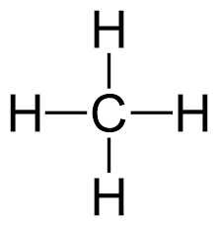
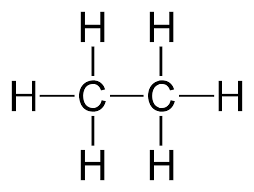
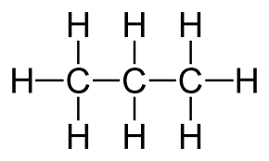
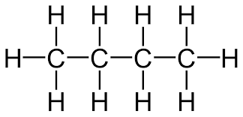
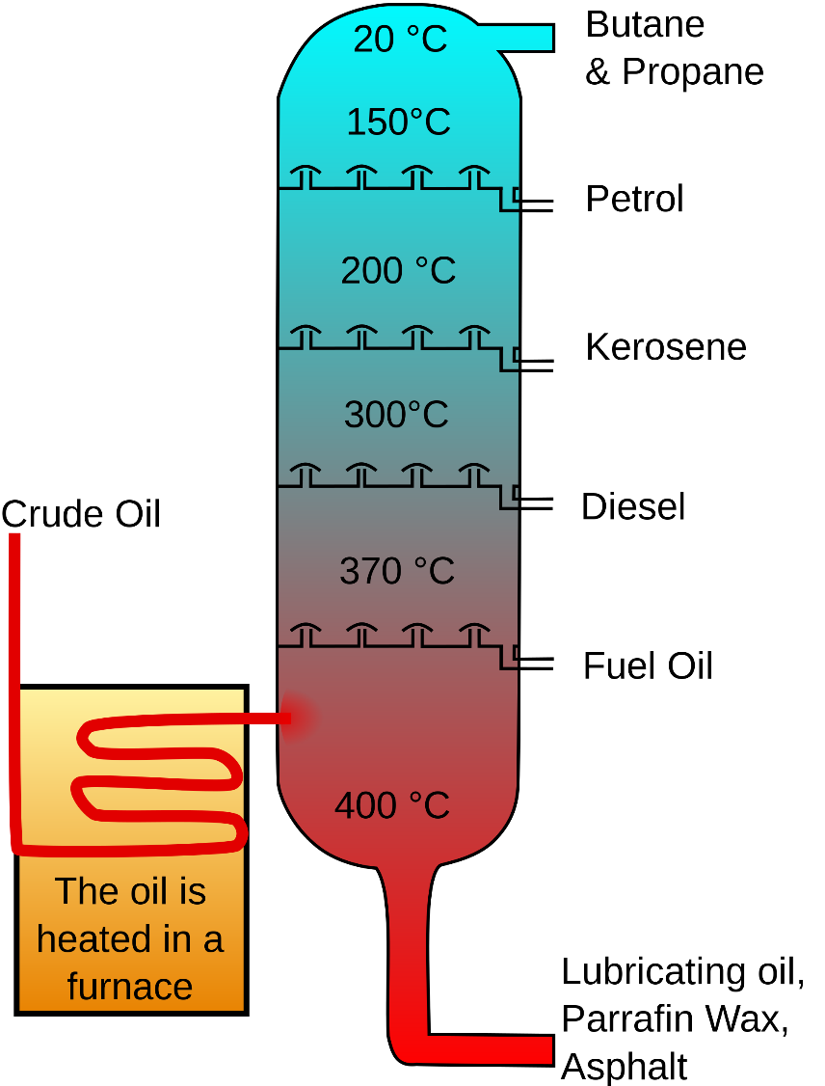
Display formula for first four alkanes
Fractions | The hydrocarbons in crude oil can be split into fractions | Each fraction contains molecules with a similar number of carbon atoms in them. The process used to do this is called fractional distillation.
Using fractions | Fractions can be processed to produce fuels and feedstock for petrochemical industry | We depend on many of these fuels; petrol, diesel and kerosene. Many useful materials are made by the petrochemical industry; solvents, lubricants and polymers.
Crude oil | A finite resource | Consisting mainly of plankton that was buried in the mud, crude oil is the remains of ancient biomass.
Hydrocarbons | These make up the majority of the compounds in crude oil | Most of these hydrocarbons are called alkanes.
General formula for alkanes | C_{n}H_{2n+2} | For example: C₂H₆ C₆H₁₄
Crude oil, hydrocarbons and alkanes
Methane (CH₄)
Ethane (C₂H₆)
Propane (C₃H₈)
Butane (C₄H₁₀)
Carbon compounds as fuels and feedstock
AQA GCSE
Organic chemistry 1
Fractional distillation and petrochemicals
Alkanes to alkenes | Long chain alkanes are cracked into short chain alkenes.
Alkenes | Alkenes are hydrocarbons with a double bond (some are formed during the cracking process).
Properties of alkenes | Alkenes are more reactive that alkanes and react with bromine water. Bromine water changes from orange to colourless in the presence of alkenes.
Hydrocarbon chains | In oil | Hydrocarbon chains in crude oil come in lots of different lengths.
 | Boiling points | The boiling point of the chain depends on its length. During fractional distillation, they boil and separate at different temperatures due to this.
Carbon compounds as fuels and feedstock
Cracking and alkenes
Properties of hydrocarbons
Combustion | During the complete combustion of hydrocarbons, the carbon and hydrogen in the fuels are oxidised, releasing carbon dioxide, water and energy.
Cracking | The breaking down of long chain hydrocarbons into smaller chains | The smaller chains are more useful. Cracking can be done by various methods including catalytic cracking and steam cracking.
Catalytic cracking | The heavy fraction is heated until vaporised | After vaporisation, the vapour is passed over a hot catalyst forming smaller, more useful hydrocarbons.
Steam cracking | The heavy fraction is heated until vaporised | After vaporisation, the vapour is mixed with steam and heated to a very high temperature forming smaller, more useful hydrocarbons.
Decane → pentane + propene + ethane
C₁₀H₂₂ → C₅H₁₂ + C₃H₆ + C₂H₄
Complete combustion of methane:
Methane + oxygen → carbon dioxide + water + energy
CH₄ (g) + 2O₂ (g) → CO₂ (g) + 2 H₂O (l)
Alkenes and uses as polymers | Used to produce polymers. They are also used as the starting materials of many other chemicals, such as alcohol, plastics and detergents.
Why do we crack long chains? | Without cracking, many of the long hydrocarbons would be wasted as there is not much demand for these as for the shorter chains.
Boiling point (temperature at which liquid boils) | As the hydrocarbon chain length increases, boiling point increases.
Viscosity (how easily it flows) | As the hydrocarbon chain length increases, viscosity increases.
Flammability (how easily it burns) | As the hydrocarbon chain length increases, flammability decreases.

Slide 12
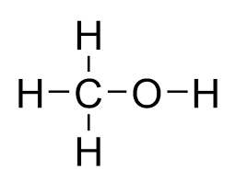
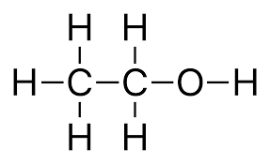
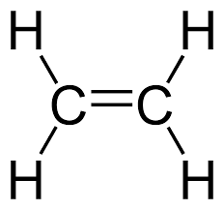
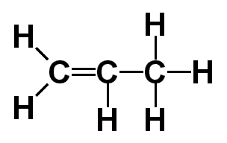
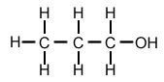
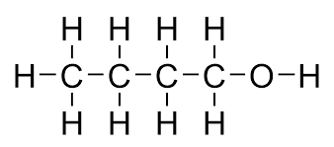
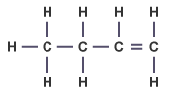
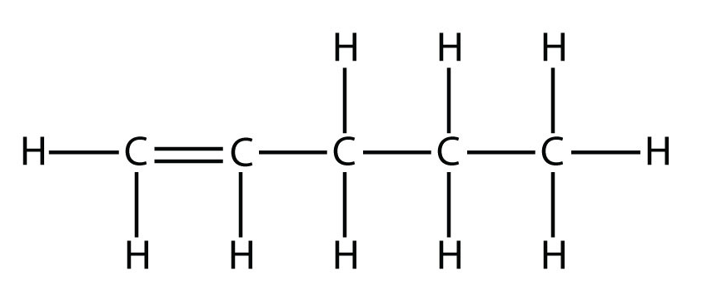
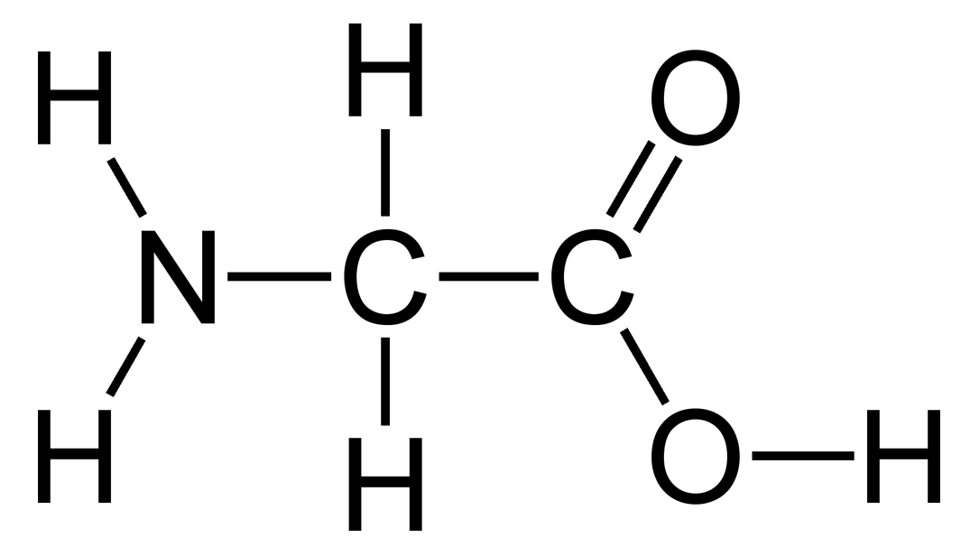
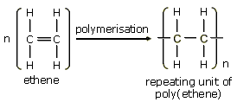
Functional group | Alkenes are hydrocarbons in the functional group C=C. | The functional group of an organic compound determined their reactions.
Alkene reactions | Alkenes react with oxygen in the same way as other hydrocarbons, just with a smoky flame due to incomplete combustion. | Alkenes also react with hydrogen, water and the halogens. The C=C bond allows for the addition of other atoms.
Alkenes | Hydrocarbons with a double carbon-carbon bond.
Unsaturated | Alkenes are unsaturated because they contain two fewer hydrogen atoms than their alkane counterparts.
General formula for alkenes | C_{n}H_{2n}
Ethene C₂H₄
Methanol
Ethanol
Propene C₃H₆
Structure and formula of alkenes
Propanol
Butanol
Reactions of alkenes
Functional group | -OH For example: CH₃CH₂OH | Methanol, ethanol, propanol and butanol are the first four of the homologous series.
Alcohol reactions | Alcohols react with sodium, air and water. | Alcohols and sodium: bubbling, hydrogen gas given off and salt formed. Alcohols and air: alcohols burn in air releasing carbon dioxide and water. Alcohols and water: alcohols dissolve in water to form a neutral solution.
Fermentation | Ethanol is produced from fermentation. | When sugar solutions are fermented using yeast, aqueous solutions of ethanol are produced. The conditions needed for this process include a moderate temperature (25 – 50⁰C), water (from sugar solution) and an absence of oxygen.
Butene C₄H₈
Reactions of alkenes and alcohols
Alcohols
Pentene C₅H₁₀
AQA GCSE Organic chemistry 2
(CHEMISTRY ONLY)
Functional group | -COOH For example: CH₃COOH | Methanoic acid, ethanoic acid, propanoic acid and butanoic acid are the first four of the homologous series.
Carboxylic acid reactions | Carboxylic acids react with carbonates, water and alcohols. | Carboxylic acids and carbonates: These acids are neutralised by carbonates
 |  | Carboxylic acids and water: These acids dissolve in water.
 |  | Carboxylic acids and alcohols: The acids react with alcohols to form esters.
Strength (HT only) | Carboxylic acids are weak acids | Carboxylic acids only partially ionise in water. An aqueous solution of a weak acid with have a high pH (but still below 7).
Carboxylic acids
Synthetic and naturally occurring polymers
Amino acids
Amino acids have two functional groups in a molecule. They react by condensation polymerisation to produce peptides.
Addition polymerisation
DNA | Deoxyribonucleic acid is a large molecule essential for life. DNA gives the genetic instructions to ensure development and functioning of living organisms and viruses.
DNA structure | Most DNA molecules are two polymer chains made from four different monomers, called nucleotides. They are in the double helix formation.
Natural polymers | Other naturally occurring polymers include proteins, starch and cellulose and are all important for life.
Condensation polymerisation (HT only)
DNA and naturally occurring polymers
Polymers | Alkenes are used to make polymers by addition polymerisation. | Many small molecules join together to form polymers (very large molecules).
Displaying polymers | In addition polymers, the repeating unit has the same atoms as the monomer. | It can be displayed like this:
Glycine
Condensation polymerisation | Condensation polymerisation involves monomers with two functional groups | When these types of monomers react they join together and usually lose small molecules, such as water. This is why they are called condensation reactions.

Slide 13
Pure substances | A pure substances is a single element or compound, not mixed with any other substance. | Pure substances melt and boil at specific temperatures. Heating graphs can be used to distinguish pure substances from impure.
Element | Colour flames
Lithium | Crimson
Sodium | Yellow
Potassium | Lilac
Calcium | Orange-red
Copper | Green
Sodium hydroxide | Is added to solutions to identify metal ions.
White precipitates | Aluminium, calcium and magnesium ions form this with sodium hydroxide solution.
Coloured precipitates | Copper (II) = blue Iron (II) = green Iron (III) = brown
Pure substances
Metal hydroxides (chem only)
Purity, formulations and chromatography
Melting point of a pure substance
Melting point of an impure substance
Flame tests (chem only)
Carbonates, halides and sulfates
(chem only)
Formulation | A formulation is a mixture that has been designed as a useful product.
How are formulations made? | By mixing chemicals that have a particular purpose in careful quantities.
Examples of formulations. | Fuels, cleaning agents, paints, medicines and fertilisers.
Chromatography
Formulations
AQA Chemical analysis
Identification of ions (CHEMISTRY ONLY)
Position solvent reaches
Carbonates | React with dilute acids to form carbon dioxide.
Halide ions | When in a solution, they produce precipitates with silver nitrate solution in the presence of nitric acid.
Sulfate ions | When in a solutions they produce a white precipitate with barium chloride solutions in the presence of hydrochloric acid.
Mixture separated
Identification of common gases
Flame emission spectroscopy
Instrumental methods
Mixture
Gas | Test | Positive result
Hydrogen | Burning splint | ‘Pop’ sound.
Oxygen | Glowing splint | Re-lights the splint.
Chlorine | Litmus paper (damp) | Bleaches the paper white.
Carbon dioxide | Limewater | Goes cloudy (as a solid calcium carbonate forms).
Solvent
Chromatography | Can be used to separate mixtures and help identify substances. | Involves a mobile phase (e.g. water or ethanol) and a stationary phase (e.g. chromatography paper).
R_{f} Values | The ratio of the distance moved by a compound to the distance moved by solvent. | R_{f} = distance moved by substance distance moved by solvent
Pure substances | The compounds in a mixture separate into different spots. | This depends on the solvent used. A pure substance will produce a single spot in all solvents whereas an impure substance will produce multiple spots.
Instrumental methods | Methods that rely on machines | Can be used to identify elements and compounds. These methods are accurate, sensitive and rapid.
Flame emission spectroscopy | An instrumental method used to analyse metal ions. | The sample solution is put into a flame and the light that is given out is put through a spectroscope. The output line spectrum, can be analysed to identify the metal ions in the solution. It can also be used to measure concentrations.

Slide 14
Gas | Percentage
Nitrogen | ~80%
Oxygen | ~20%
Argon | 0.93%
Carbon dioxide | 0.04%
Proportions of gases in the atmosphere
Algae and plants | These produced the oxygen that is now in the atmosphere, through photosynthesis. | carbon dioxide + water → glucose + oxygen 6CO₂ + 6H₂O → C₆H₁₂O₆ + 6O₂
Oxygen in the atmosphere | First produced by algae 2.7 billion years ago. | Over the next billion years plants evolved to gradually produce more oxygen. This gradually increased to a level that enabled animals to evolve.
Volcano activity 1st Billion years | Billions of years ago there was intense volcanic activity | This released gases (mainly CO₂) that formed to early atmosphere and water vapour that condensed to form the oceans.
Other gases | Released from volcanic eruptions | Nitrogen was also released, gradually building up in the atmosphere. Small proportions of ammonia and methane also produced.
Reducing carbon dioxide in the atmosphere | When the oceans formed, carbon dioxide dissolved into it | This formed carbonate precipitates, forming sediments. This reduced the levels of carbon dioxide in the atmosphere.
How oxygen increased
Reducing carbon dioxide in the atmosphere | Algae and plants | These gradually reduced the carbon dioxide levels in the atmosphere by absorbing it for photosynthesis.
Formation of sedimentary rocks and fossil fuels | These are made out of the remains of biological matter, formed over millions of years | Remains of biological matter falls to the bottom of oceans. Over millions of years layers of sediment settled on top of them and the huge pressures turned them into coal, oil, natural gas and sedimentary rocks. The sedimentary rocks contain carbon dioxide from the biological matter.
How carbon dioxide decreased
Composition and evolution of the atmosphere
The Earth’s early atmosphere
AQA GCSE Chemistry of the atmosphere
CO₂ and methane as greenhouse gases
Greenhouse gases
Carbon dioxide, water vapour and methane | Examples of greenhouse gases that maintain temperatures on Earth in order to support life
The greenhouse effect | Radiation from the Sun enters the Earth’s atmosphere and reflects off of the Earth. Some of this radiation is re-radiated back by the atmosphere to the Earth, warming up the global temperature.
Common atmospheric pollutants
Carbon footprints
Atmospheric pollutants from fuels
The total amount of greenhouse gases emitted over the full life cycle of a product/event. This can be reduced by reducing emissions of carbon dioxide and methane.
Global climate change
Combustion of fuels | Source of atmospheric pollutants. Most fuels may also contain some sulfur.
Gases from burning fuels | Carbon dioxide, water vapour, carbon monoxide, sulfur dioxide and oxides of nitrogen.
Particulates | Solid particles and unburned hydrocarbons released when burning fuels.
Properties and effects of atmospheric pollutants
Human activities and greenhouse gases
Carbon monoxide | Toxic, colourless and odourless gas. Not easily detected, can kill.
Sulfur dioxide and oxides of nitrogen | Cause respiratory problems in humans and acid rain which affects the environment.
Particulates | Cause global dimming and health problems in humans.
Effects of climate change
Rising sea levels
Extreme weather events such as severe storms
Change in amount and distribution of rainfall
Changes to distribution of wildlife species with some becoming extinct
Carbon dioxide | Human activities that increase carbon dioxide levels include burning fossil fuels and deforestation.
Methane | Human activities that increase methane levels include raising livestock (for food) and using landfills (the decay of organic matter released methane).
Climate change | There is evidence to suggest that human activities will cause the Earth’s atmospheric temperature to increase and cause climate change.

Slide 15
Gas | Percentage
Nitrogen | ~80%
Oxygen | ~20%
Argon | 0.93%
Carbon dioxide | 0.04%
Proportions of gases in the atmosphere
Algae and plants | These produced the oxygen that is now in the atmosphere, through photosynthesis. | carbon dioxide + water → glucose + oxygen 6CO₂ + 6H₂O → C₆H₁₂O₆ + 6O₂
Oxygen in the atmosphere | First produced by algae 2.7 billion years ago. | Over the next billion years plants evolved to gradually produce more oxygen. This gradually increased to a level that enabled animals to evolve.
Volcano activity 1st Billion years | Billions of years ago there was intense volcanic activity | This released gases (mainly CO₂) that formed to early atmosphere and water vapour that condensed to form the oceans.
Other gases | Released from volcanic eruptions | Nitrogen was also released, gradually building up in the atmosphere. Small proportions of ammonia and methane also produced.
Reducing carbon dioxide in the atmosphere | When the oceans formed, carbon dioxide dissolved into it | This formed carbonate precipitates, forming sediments. This reduced the levels of carbon dioxide in the atmosphere.
How oxygen increased
Reducing carbon dioxide in the atmosphere | Algae and plants | These gradually reduced the carbon dioxide levels in the atmosphere by absorbing it for photosynthesis.
Formation of sedimentary rocks and fossil fuels | These are made out of the remains of biological matter, formed over millions of years | Remains of biological matter falls to the bottom of oceans. Over millions of years layers of sediment settled on top of them and the huge pressures turned them into coal, oil, natural gas and sedimentary rocks. The sedimentary rocks contain carbon dioxide from the biological matter.
How carbon dioxide decreased
Composition and evolution of the atmosphere
The Earth’s early atmosphere
AQA GCSE Chemistry of the atmosphere
CO₂ and methane as greenhouse gases
Greenhouse gases
Carbon dioxide, water vapour and methane | Examples of greenhouse gases that maintain temperatures on Earth in order to support life
The greenhouse effect | Radiation from the Sun enters the Earth’s atmosphere and reflects off of the Earth. Some of this radiation is re-radiated back by the atmosphere to the Earth, warming up the global temperature.
Common atmospheric pollutants
Carbon footprints
Atmospheric pollutants from fuels
The total amount of greenhouse gases emitted over the full life cycle of a product/event. This can be reduced by reducing emissions of carbon dioxide and methane.
Global climate change
Combustion of fuels | Source of atmospheric pollutants. Most fuels may also contain some sulfur.
Gases from burning fuels | Carbon dioxide, water vapour, carbon monoxide, sulfur dioxide and oxides of nitrogen.
Particulates | Solid particles and unburned hydrocarbons released when burning fuels.
Properties and effects of atmospheric pollutants
Human activities and greenhouse gases
Carbon monoxide | Toxic, colourless and odourless gas. Not easily detected, can kill.
Sulfur dioxide and oxides of nitrogen | Cause respiratory problems in humans and acid rain which affects the environment.
Particulates | Cause global dimming and health problems in humans.
Effects of climate change
Rising sea levels
Extreme weather events such as severe storms
Change in amount and distribution of rainfall
Changes to distribution of wildlife species with some becoming extinct
Carbon dioxide | Human activities that increase carbon dioxide levels include burning fossil fuels and deforestation.
Methane | Human activities that increase methane levels include raising livestock (for food) and using landfills (the decay of organic matter released methane).
Climate change | There is evidence to suggest that human activities will cause the Earth’s atmospheric temperature to increase and cause climate change.

Slide 16
Alloys | A mixture of two elements, one of which must be a metal e.g. Bronze is an alloy of copper and tin and Brass is an alloy of copper and zinc.
Gold carats | Gold jewellery is usually an alloy with silver, copper and zinc. The carat of the jewellery is a measure of the amount of gold in it e.g. 18 carat is 75% gold, 24 carat is 100% gold.
Steels | Alloys of iron, carbon and other metals.
 | High carbon steel is strong but brittle.
 | Low carbon steel is softer and easily shaped.
 | Steel containing chromium and nickel (stainless) are hard and corrosion resistant.
 | Aluminium alloys are low density.
Corrosion | The destruction of materials by chemical reactions with substances in the environment | An example of this is iron rusting; iron reacts with oxygen from the air to form iron oxide (rust) water needs to be present for iron to rust.
Preventing corrosion | Coatings can be added to metals to act as a barrier | Examples of this are greasing, painting and electroplating. Aluminium has an oxide coating that protects the metal from further corrosion.
Sacrificial corrosion | When a more reactive metal is used to coat a less reactive metal | This means that the coating will react with the air and not the underlying metal. An example of this is zinc used to galvanise iron.
Corrosion and its prevention
Alloys are useful materials
Ceramics, polymers and composites
Polymers | Thermosetting | polymers that do not melt when they are heated.
 | Thermosoftening | polymers that melt when they are heated.
NPK fertilisers | These contain nitrogen, phosphorous and potassium | Formulations of various salts containing appropriate percentages of the elements.
Fertiliser examples | Potassium chloride, potassium sulfate and phosphate rock are obtained by mining | Phosphate rock needs to be treated with an acid to produce a soluble salt which is then used as a fertiliser. Ammonia can be used to manufacture ammonium salts and nitric acid.
Using materials
AQA GCSE Using resources 2
(CHEM ONLY)
Composite materials | A mixture of materials put together for a specific purpose e.g. strength | Soda-lime glass, made by heating sand, sodium carbonate and limestone.
 |  | Borosilicate glass, made from sand and boron trioxide, melts at higher temperatures than soda-lime glass.
 |  | MDF wood (woodchips, shavings, sawdust and resin)
 |  | Concrete (cement, sand and gravel)
Ceramic materials | Made from clay | Made by shaping wet clay and then heating in a furnace, common examples include pottery and bricks.
Polymers | Many monomers can make polymers | These factors affect the properties of the polymer. Low density (LD) polymers and high density (HD) polymers are produced from ethene. These are formed under different conditions.
Production and uses of NPK fertilisers
The Haber process and the use of NPK fertilisers
The Haber process – conditions and equilibrium
Pressure | The reactants side of the equation has more molecules of gas. This means that if pressure is increased, equilibrium shifts towards the production of ammonia (Le Chatelier’s principle). The pressure needs to be as high as possible.
Temperature | The forward reaction is exothermic. Decreasing temperature increases ammonia production at equilibrium. The exothermic reaction that occurs releases energy to surrounding, opposing the temperature decreases. Too low though and collisions would be too infrequent to be financially viable.
Phosphate rock
Treatment | Products
Nitric acid | The acid is neutralised with ammonia to produce ammonium phosphate, a NPK fertiliser.
Sulfuric acid | Calcium phosphate and calcium sulfate (a single superphosphate).
Phosphoric acid | Calcium phosphate (a triple superphosphate).
The Haber process
The Haber process | Used to manufacture ammonia | Ammonia is used to produce fertilisers Nitrogen + hydrogen ammonia
Raw materials | Nitrogen from the air while hydrogen from natural gas | Both of these gases are purified before being passed over an iron catalyst. This is completed under high temperature (about 450⁰C) and pressure (about 200 atmospheres).
Catalyst | Iron | The catalyst speeds up both directions of the reaction, therefore not actually increasing the amount of valuable product.

