Slide 1

AQA GCSE
Year 11 H Chemistry
Knowledge Organiser

Slide 2
Atom | The smallest part of an element that can exist | Have a radius of around 0.1 nanometres and have no charge (0).
Element | Contains only one type of atom | Around 100 different elements each one is represented by a symbol e.g. O, Na, Br.
Compound | Two or more elements chemically combined | Compounds can only be separated into elements by chemical reactions.
Pre 1900 |  | Tiny solid spheres that could not be divided | Before the discovery of the electron, John Dalton said the solid sphere made up the different elements.
1897 ‘plum pudding’ |  | A ball of positive charge with negative electrons embedded in it | JJ Thompson ‘s experiments showed that showed that an atom must contain small negative charges (discovery of electrons).
1909 nuclear model |  | Positively charge nucleus at the centre surrounded negative electrons | Ernest Rutherford's alpha particle scattering experiment showed that the mass was concentrated at the centre of the atom.
1913 Bohr model |  | Electrons orbit the nucleus at specific distances | Niels Bohr proposed that electrons orbited in fixed shells; this was supported by experimental observations.
Atoms, elements and compounds
Central nucleus | Contains protons and neutrons
Electron shells | Contains electrons
Electronic shell | Max number of electrons
1 | 2
2 | 8
3 | 8
4 | 2
Name of Particle | Relative Charge | Relative Mass
Proton | +1 | 1
Neutron | 0 | 1
Electron | -1 | Very small
Electronic structures
The development of the model of the atom
James Chadwick | Provided the evidence to show the existence of neutrons within the nucleus
AQA GCSE
Atomic structure and periodic table part 1
Rutherford's scattering experiment | A beam of alpha particles are directed at a very thin gold foil | Most of the alpha particles passed right through. A few (+) alpha particles were deflected by the positive nucleus. A tiny number of particles reflected back from the nucleus.
Relative electrical charges of subatomic particles
7
Li
3
Mass number | The sum of the protons and neutrons in the nucleus
Atomic number | The number of protons in the atom | Number of electrons = number of protons
Mixtures | Two or more elements or compounds not chemically combined together | Can be separated by physical processes.
Chemical equations | Show chemical reactions - need reactant(s) and product(s) energy always involves and energy change | Law of conservation of mass states the total mass of products = the total mass of reactants.
Method | Description | Example
Filtration | Separating an insoluble solid from a liquid | To get sand from a mixture of sand, salt and water.
Crystallisation | To separate a solid from a solution | To obtain pure crystals of sodium chloride from salt water.
Simple distillation | To separate a solvent from a solution | To get pure water from salt water.
Fractional distillation | Separating a mixture of liquids each with different boiling points | To separate the different compounds in crude oil.
Chromatography | Separating substances that move at different rates through a medium | To separate out the dyes in food colouring.
Word equations | Uses words to show reaction reactants → products magnesium + oxygen → magnesium oxide | Does not show what is happening to the atoms or the number of atoms.
Symbol equations | Uses symbols to show reaction reactants → products 2Mg + O₂ → 2MgO | Shows the number of atoms and molecules in the reaction, these need to be balanced.
Isotopes | Atoms of the same element with the same number of protons and different numbers of neutrons | ³⁵Cl (75%) and ³⁷Cl (25%) Relative abundance = (% isotope 1 x mass isotope 1) + (% isotope 2 x mass isotope 2) ÷ 100 e.g. (25 x 37) + (75x 35) ÷ 100 = 35.5
Relative atomic mass

Slide 3
Alkali metals
Halogens
Noble gases
Elements arranged in order of atomic number | Elements with similar properties are in columns called groups | Elements in the same group have the same number of outer shell electrons and elements in the same period (row) have the same number of electron shells.
1
2
3
4
5
6
7
0
H
Transition metals
He
Li
Be
B
C
N
O
F
Ne
Before discovery of protons, neutrons and electrons | Elements arranged in order of atomic weight | Early periodic tables were incomplete, some elements were placed in inappropriate groups if the strict order atomic weights was followed.
Mendeleev | Left gaps for elements that hadn’t been discovered yet | Elements with properties predicted by Mendeleev were discovered and filled in the gaps. Knowledge of isotopes explained why order based on atomic weights was not always correct.
Na
Mg
Al
Si
P
S
Cl
Ar
The Periodic table
K
Ca
Sc
Ti
V
Cr
Mn
Fe
Co
Ni
Cu
Zn
Ga
Ge
As
Se
Br
Kr
Rb
Sr
Y
Zr
Nb
Mo
Tc
Ru
Rh
Pd
Ag
Cd
In
Sn
Sb
Te
I
Xe
Cs
Ba
La
Hf
Ta
W
Re
Os
Ir
Pt
Au
Hg
Tl
Pb
Bi
Po
At
Rn
Development
of the Periodic table
Fr
Ra
Ac
Rf
Db
Sg
Bh
Hs
Mt
?
?
?
Metals to the left of this line, non metals to the right
Metals | To the left of the Periodic table | Form positive ions. Conductors, high melting and boiling points, ductile, malleable.
Non metals | To the right of the Periodic table | Form negative ions. Insulators, low melting and boiling points.
Metals and non metals
Alkali metals | Very reactive with oxygen, water and chlorine | Only have one electron in their outer shell. Form +1 ions.
 | Reactivity increases down the group | Negative outer electron is further away from the positive nucleus so is more easily lost.
Group
7
AQA GCSE
Atomic structure and periodic table part 2
Group 1
Halogens | Consist of molecules made of a pair of atoms | Have seven electrons in their outer shell. Form -1 ions.
 | Melting and boiling points increase down the group (gas → liquid → solid) | Increasing atomic mass number.
 | Reactivity decreases down the group | Increasing proton number means an electron is more easily gained
With oxygen | Forms a metal oxide | Metal + oxygen → metal oxide | e.g. 4Na + O₂ → 2Na₂O
With water | Forms a metal hydroxide and hydrogen | Metal + water → metal hydroxide + hydrogen | e.g. 2Na + 2H₂O → 2NaOH + H₂
With chlorine | Forms a metal chloride | Metal + chlorine → metal chloride | e.g. 2Na + Cl₂ → 2NaCl
Group 0
Noble gases | Unreactive, do not form molecules | This is due to having full outer shells of electrons.
 | Boiling points increase down the group | Increasing atomic number.
With metals | Forms a metal halide | Metal + halogen → metal halide e.g. Sodium + chlorine → sodium chloride | e.g. NaCl metal atom loses outer shell electrons and halogen gains an outer shell electron
With hydrogen | Forms a hydrogen halide | Hydrogen + halogen → hydrogen halide e.g. Hydrogen + bromine → hydrogen bromide | e.g. Cl₂ + H₂ → 2HCl
With aqueous solution of a halide salt | A more reactive halogen will displace the less reactive halogen from the salt | Chlorine + potassium bromide → potassium chloride + bromine | e.g. Cl₂ +2KBr →2KCl + Br₂

Slide 4
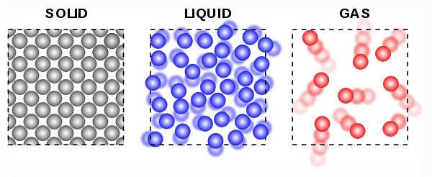
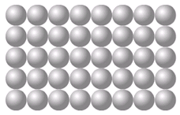
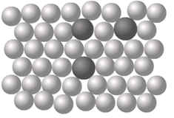
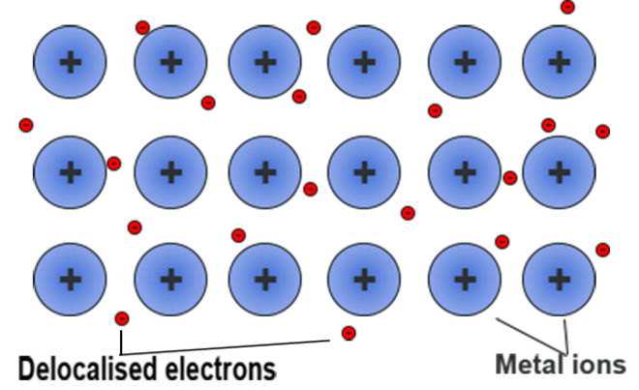
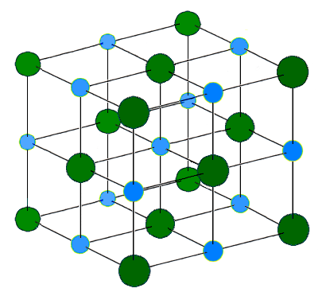
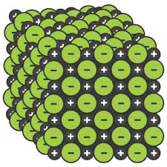
Ionic | Particles are oppositely charged ions | Occurs in compounds formed from metals combined with non metals.
Covalent | Particles are atoms that share pairs of electrons | Occurs in most non metallic elements and in compounds of non metals.
Metallic | Particles are atoms which share delocalised electrons | Occurs in metallic elements and alloys.
Solid, liquid, gas | Melting and freezing happen at melting point, boiling and condensing happen at boiling point. | The amount of energy needed for a state change depends on the strength of forces between particles in the substance. | (HT only) Limitations of simple model: There are no forces in the model All particles are shown as spheres Spheres are solid
s | solid
l | liquid
g | gas
High melting and boiling points | Large amounts of energy needed to break the bonds.
Do not conduct electricity when solid | Ions are held in a fixed position in the lattice and cannot move.
Do conduct electricity when molten or dissolved | Lattice breaks apart and the ions are free to move.
Good conductors of electricity | Delocalised electrons carry electrical charge through the metal.
Good conductors of thermal energy | Energy is transferred by the delocalised electrons.
Chemical bonds
The three states of matter
High melting and boiling points | This is due to the strong metallic bonds.
Pure metals can be bent and shaped | Atoms are arranged in layers that can slide over each other.
Properties of ionic compounds
AQA
BONDING, STRUCTURE AND THE PROPERTIES OF MATTER 1
Metals as conductors
Alloys | Mixture of two or more elements at least one of which is a metal | Harder than pure metals because atoms of different sizes disrupt the layers so they cannot slide over each other.
Properties of metals and alloys
Ionic bonding
Electrons are transferred so that all atoms have a noble gas configuration (full outer shells). | Metal atoms lose electrons and become positively charged ions | Group 1 metals form +1 ions Group 2 metals form +2 ions
 | Non metals atoms gain electrons to become negatively charged ions | Group 6 non metals form -2 ions Group 7 non metals form -1 ions
Pure metal Alloy
Metallic bonding
[
]
[
-
+
]
Dot and cross diagram
Giant structure
x
x
x
Ionic compounds
x
x
Na
x
Cl
Na
x
Cl
Giant structure of atoms arranged in a regular pattern |  | Electrons in the outer shell of metal atoms are delocalised and free to move through the whole structure. This sharing of electrons leads to strong metallic bonds.
x
x
x
x
x
x
x
(2, 8, 1)
(2, 8, 7)
(2, 8)
(2, 8, 8)
Structure | Held together by strong electrostatic forces of attraction between oppositely charged ions Forces act in all directions in the lattice
Na⁺
Cl⁻

Slide 5
M_{r} | The sum of the relative atomic masses of the atoms in the numbers shown in the formula | The sum of the M_{r} of the reactants in the quantities shown equals the sum of the M_{r} of the products in the quantities shown. | 2Mg + O₂ → 2MgO 48g + 32g = 80g 80g = 80g
The reactant that is completely used up | Limits the amount of product that is made | Less moles of product are made.
Whenever a measurement is taken, there is always some uncertainty about the result obtained | Can determine whether the mean value falls within the range of uncertainty of the result | Calculate the mean Calculate the range of the results Estimate of uncertainty in mean would be half the range
Mass appears to increase during a reaction | One of the reactants is a gas | Magnesium + oxygen → magnesium oxide
Mass appears to decrease during a reaction | One of the products is a gas and has escaped | Calcium carbonate → carbon dioxide + calcium oxide
Limiting reactants
(HT only)
Relative formula mass (M_{r})
Chemical measurements
Concentration of solutions
Example: Mean value is 46.5s Range of results is 44s to 49s = 5s Time taken was 46.5s $±$2.5s
Mass changes when a reactant or product is a gas
Conservation of mass | No atoms are lost or made during a chemical reaction | Mass of the products equals the mass of the reactants.
AQA GCSE
QUANTITATIVE CHEMISTRY 1
Measured in mass per given volume of solution (g/dm³) | Conc. = mass (g) . volume (dm³) | HT only Greater mass = higher concentration. Greater volume = lower concentration.
Balanced symbol equations | Represent chemical reactions and have the same number of atoms of each element on both sides of the equation | H₂ + Cl₂ → 2HCl Subscript numbers show the number of atoms of the element to its left. Normal script numbers show the number of molecules.
Amounts of substances in equations (HT only)
Subscript Normal script
Conservation of mass and balanced symbol equations
Using moles to balance equations (HT only)
The balancing numbers in a symbol equation can be calculated from the masses of reactants and products | Convert the masses in grams to amounts in moles and convert the number of moles to simple whole number ratios.
Moles (HT only)
Chemical amounts are measured in moles (mol) | Mass of one mole of a substance in grams = relative formula mass | One mole of H₂O = 18g (1 + 1 + 16) One mole of Mg = 24g
Chemical equations show the number of moles reacting and the number of moles made | Mg + 2HCl → MgCl₂ + H₂ One mole of magnesium reacts with two moles of hydrochloric acid to make one mole of magnesium chloride and one mole of hydrogen | If you have a 60g of Mg, what mass of HCl do you need to convert it to MgCl₂? A_{r} : Mg =24 so mass of 1 mole of Mg = 24g M_{r} : HCl (1 + 35.5) so mass of 1 mole of HCl = 36.5g So 60g of Mg is 60/24 = 2.5 moles Balanced symbol equation tells us that for every one mole of Mg, you need two moles of HCl to react with it. So you need 2.5x2 = 5 moles of HCl You will need 5 x 36.5g of HCl= 182.5g
Avogadro constant | One mole of any substance will contain the same number of particles, atoms, molecules or ions. | 6.02 x 10²³ per mole One mole of H₂O will contain 6.02 x 10²³ molecules One mole of NaCl will contain 6.02 x 10²³ Na⁺ ions
Number of moles = mass (g) or mass (g) A_{r} M_{r} | How many moles of sulfuric acid molecules are there in 4.7g of sulfuric acid (H₂SO₄)? Give your answer to 1 significant figure. 4.7 = 0.05 mol 98 (M_{r} of H₂SO₄)

Slide 6
A measure of the amount of starting materials that end up as useful products | Atom economy = Relative formula mass of desired product from equation x 100 Sum of relative formula mass of all reactants from equation | High atom economy is important or sustainable development and economic reasons
Calculate the atom economy for making hydrogen by reacting zinc with hydrochloric acid: Zn + 2HCl → ZnCl₂ + H₂ M_{r} of H₂ = 1 + 1 = 2 M_{r} of Zn + 2HCl = 65 + 1 + 1 + 35.5 + 35.5 = 138 Atom economy = ²∕₁₃₈ × 100 = ²∕₁₃₈ × 100 = 1.45% This method is unlikely to be chosen as it has a low atom economy.
Atom economy
AQA
QUANTITATIVE CHEMISTRY 2
HT only: 200g of calcium carbonate is heated. It decomposes to make calcium oxide and carbon dioxide. Calculate the theoretical mass of calcium oxide made. CaCO₃ → CaO + CO₂ M_{r} of CaCO₃ = 40 + 12 + (16x3) = 100 M_{r} of CaO = 40 + 16 = 56 100g of CaCO₃ would make 56 g of CaO So 200g would make 112g
Percentage yield
Yield is the amount of product obtained | It is not always possible to obtain the calculated amount of a product | The reaction may not go to completion because it is reversible.
 |  | Some of the product may be lost when it is separated from the reaction mixture.
 |  | Some of the reactants may react in ways different to the expected reaction.
Percentage yield is comparing the amount of product obtained as a percentage of the maximum theoretical amount | % Yield = Mass of product made x 100 Max. theoretical mass | A piece of sodium metal is heated in chlorine gas. A maximum theoretical mass of 10g for sodium chloride was calculated, but the actual yield was only 8g. Calculate the percentage yield. Percentage yield = 8/10 x 100 =80%

Slide 7
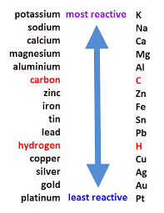
Oxidation Is Loss (of electrons) Reduction Is Gain (of electrons)
HT ONLY: Reactions between metals and acids are redox reactions as the metal donates electrons to the hydrogen ions. This displaces hydrogen as a gas while the metal ions are left in the solution.
Ionic half equations (HT only)
For displacement reactions | Ionic half equations show what happens to each of the reactants during reactions | For example: The ionic equation for the reaction between iron and copper (II) ions is: Fe + Cu²⁺ → Fe²⁺ + Cu The half-equation for iron (II) is: Fe → Fe²⁺ + 2e⁻ The half-equation for copper (II) ions is: Cu²⁺ + 2e⁻ → Cu
Reactions with acids | metal + acid → metal salt + hydrogen | magnesium + hydrochloric acid → magnesium chloride + hydrogen zinc + sulfuric acid → zinc sulfate + hydrogen
Acids react with some metals to produce salts and hydrogen.
Extraction using carbon
Metals less reactive than carbon can be extracted from their oxides by reduction. | For example: zinc oxide + carbon → zinc + carbon dioxide
Reactions of acids and metals
Reactions of acids
Acid name | Salt name
Hydrochloric acid | Chloride
Sulfuric acid | Sulfate
Nitric acid | Nitrate
Oxidation and reduction in terms of electrons (HT ONLY)
Extraction of metals and reduction
Unreactive metals, such as gold, are found in the Earth as the metal itself. They can be mined from the ground.
AQA Chemical Changes 1
 | Reactions with water | Reactions with acid
Group 1 metals | Reactions get more vigorous as you go down the group | Reactions get more vigorous as you go down the group
Group 2 metals | Do not react with water | Observable reactions include fizzing and temperature increases
Zinc, iron and copper | Do not react with water | Zinc and iron react slowly with acid. Copper does not react with acid.
Neutralisation of acids and salt production
Reactivity of metals
sodium hydroxide + hydrochloric acid → sodium chloride + water
calcium carbonate + sulfuric acid → calcium sulfate, + carbon dioxide + water
The reactivity series
Neutralisation | Acids can be neutralised by alkalis and bases | An alkali is a soluble base e.g. metal hydroxide. A base is a substance that neutralises an acid e.g. a soluble metal hydroxide or a metal oxide.
Metal oxides
Metals form positive ions when they react | The reactivity of a metal is related to its tendency to form positive ions | The reactivity series arranges metals in order of their reactivity (their tendency to form positive ions).
Carbon and hydrogen | Carbon and hydrogen are non-metals but are included in the reactivity series | These two non-metals are included in the reactivity series as they can be used to extract some metals from their ores, depending on their reactivity.
Displacement | A more reactive metal can displace a less reactive metal from a compound. | Silver nitrate + Sodium chloride → Sodium nitrate + Silver chloride
Metals and oxygen | Metals react with oxygen to form metal oxides | magnesium + oxygen → magnesium oxide 2Mg + O₂ → 2MgO
Reduction | This is when oxygen is removed from a compound during a reaction | e.g. metal oxides reacting with hydrogen, extracting low reactivity metals
Oxidation | This is when oxygen is gained by a compound during a reaction | e.g. metals reacting with oxygen, rusting of iron

Slide 8
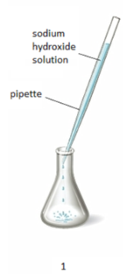
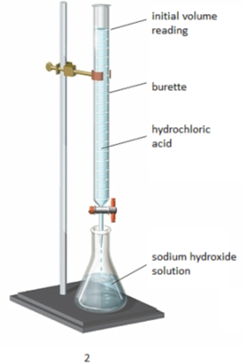
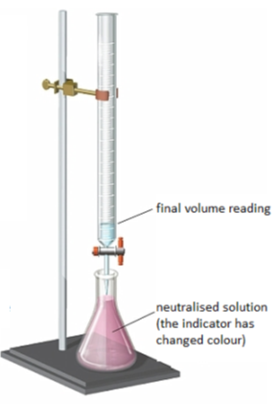
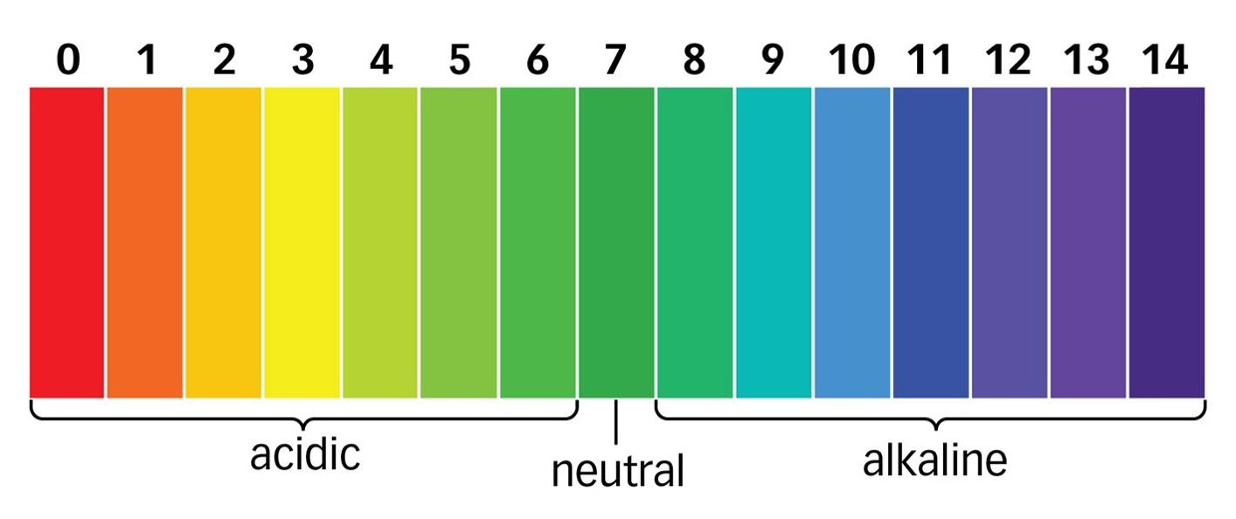
The ions discharged when an aqueous solution is electrolysed using inert electrodes depend on the relative reactivity of the elements involved.
Process of electrolysis | Splitting up using electricity | When an ionic compound is melted or dissolved in water, the ions are free to move. These are then able to conduct electricity and are called electrolytes. Passing an electric current though electrolytes causes the ions to move to the electrodes.
Electrode | Anode Cathode | The positive electrode is called the anode. The negative electrode is called the cathode.
Where do the ions go? | Cations Anions | Cations are positive ions and they move to the negative cathode. Anions are negative ions and they move to the positive anode.
Extracting metals using electrolysis | Metals can be extracted from molten compounds using electrolysis.
 | This process is used when the metal is too reactive to be extracted by reduction with carbon.
 | The process is expensive due to large amounts of energy needed to produce the electrical current. Example: aluminium is extracted in this way.
At the negative electrode | Metal will be produced on the electrode if it is less reactive than hydrogen. Hydrogen will be produced if the metal is more reactive than hydrogen.
At the positive electrode | Oxygen is formed at positive electrode. If you have a halide ion (Cl⁻, I⁻, Br⁻) then you will get chlorine, bromine or iodine formed at that electrode.
Electrolysis of aqueous solutions
Electrolysis
Higher tier: You can display what is happening at each electrode using half-equations:
At the cathode: Pb²⁺ + 2e⁻ → Pb
At the anode: 2Br⁻ → Br₂ + 2e⁻
Strong acids | Completely ionised in aqueous solutions e.g. hydrochloric, nitric and sulfuric acids.
Weak acids | Only partially ionised in aqueous solutions e.g. ethanoic acid, citric acid.
Hydrogen ion concentration | As the pH decreases by one unit (becoming a stronger acid), the hydrogen ion concentration increases by a factor of 10.
AQA Chemical Changes 2
Strong and weak acids (HT ONLY)
Reactions of acids
Soluble salts | Soluble salts can be made from reacting acids with solid insoluble substances (e.g. metals, metal oxides, hydroxides and carbonates).
Production of soluble salts | Add the solid to the acid until no more dissolves. Filter off excess solid and then crystallise to produce solid salts.
Soluble salts
You can use universal indicator or a pH probe to measure the acidity or alkalinity of a solution against the pH scale.
The pH scale and neutralisation
Acids | Acids produce hydrogen ions (H⁺) in aqueous solutions.
Alkalis | Aqueous solutions of alkalis contain hydroxide ions (OH⁻).
In neutralisation reactions, hydrogen ions react with hydroxide ions to produce water:
H⁺ + OH⁻ → H₂O

Slide 9
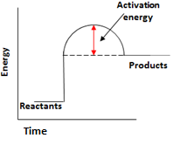
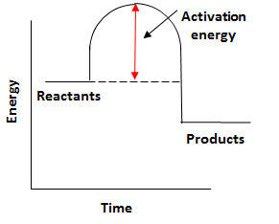
Endothermic | Energy is taken in from the surroundings so the temperature of the surroundings decreases | Thermal decomposition Sports injury packs
Exothermic | Energy is transferred to the surroundings so the temperature of the surroundings increases | Combustion Hand warmers Neutralisation
Reaction profiles | Show the overall energy change of a reaction
Types of reaction
Breaking bonds in reactants | Endothermic process
Making bonds in products | Exothermic process
The energy change of reactions
(HT only)
AQA GCSE
Energy changes
Activation energy | Chemical reactions only happen when particles collide with sufficient energy | The minimum amount of energy that colliding particles must have in order to react is called the activation energy.
Reaction profiles
Overall energy change of a reaction | Exothermic | Energy released making new bonds is greater than the energy taken in breaking existing bonds.
 | Endothermic | Energy needed to break existing bonds is greater than the energy released making new bonds.
Endothermic |  | Products are at a higher energy level than the reactants. As the reactants form products, energy is transferred from the surroundings to the reaction mixture. The temperature of the surroundings decreases because energy is taken in during the reaction.
Exothermic |  | Products are at a lower energy level than the reactants. When the reactants form products, energy is transferred to the surroundings. The temperature of the surroundings increases because energy is released during the reaction.
Bond energy calculation | Calculate the overall energy change for the forward reaction N₂ + 3H₂ $⇌$ 2NH₃ Bond energies (in kJ/mol): H-H 436, H-N 391, N$≡$N 945
 | Bond breaking: 945 + (3 x 436) = 945 + 1308 = 2253 kJ/mol Bond making: 6 x 391 = 2346 kJ/mol Overall energy change = 2253 - 2346 = -93kJ/mol Therefore reaction is exothermic overall.

Slide 10
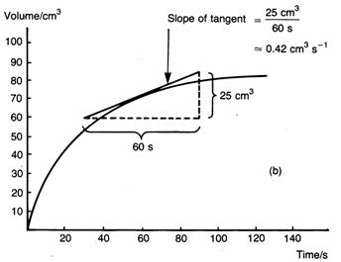
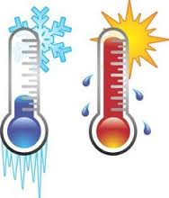
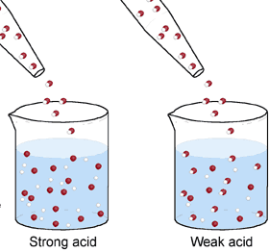
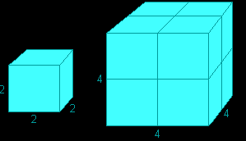
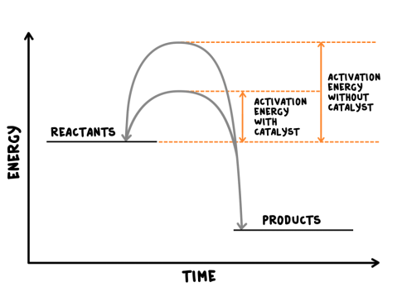
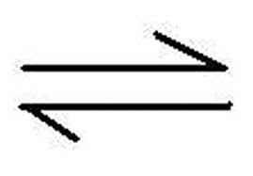
Rate of chemical reaction | This can be calculated by measuring the quantity of reactant used or product formed in a given time. | Rate = quantity of reactant used time taken Rate = quantity of product formed time taken
Factors affecting the rate of reaction
Temperature | The higher the temperature, the quicker the rate of reaction.
Concentration | The higher the concentration, the quicker the rate of reaction.
Surface area | The larger the surface area of a reactant solid, the quicker the rate of reaction.
Pressure (of gases) | When gases react, the higher the pressure upon them, the quicker the rate of reaction.
Quantity | Unit
Mass | Grams (g)
Volume | cm³
Rate of reaction | Grams per cm³ (g/cm³) HT: moles per second (mol/s)
Calculating rates of reactions
Factors affecting rates
Rate of reaction
Collision theory and activation energy
AQA GCSE
The rate and extent of chemical change
Catalyst | A catalyst changes the rate of a chemical reaction but is not used in the reaction.
Enzymes | These are biological catalysts.
How do they work? | Catalysts provide a different reaction pathway where reactants do not require as much energy to react when they collide.
Collision theory | Chemical reactions can only occur when reacting particles collide with each other with sufficient energy. | Increasing the temperature increases the frequency of collisions and makes the collisions more energetic, therefore increasing the rate of reaction. Increasing the concentration, pressure (gases) and surface area (solids) of reactions increases the frequency of collisions, therefore increasing the rate of reaction.
Activation energy | This is the minimum amount of energy colliding particles in a reaction need in order to react.
Catalysts
If a catalyst is used in a reaction, it is not shown in the word equation.
Reversible reactions and dynamic equilibrium
Reversible reactions
Reversible reactions | In some chemical reactions, the products can react again to re-form the reactants.
Representing reversible reactions | A + B C + D
The direction | The direction of reversible reactions can be changed by changing conditions: heat A + B C + D cool
Changing conditions and equilibrium (HT)
Le Chatelier’s Principles | States that when a system experiences a disturbance (change in condition), it will respond to restore a new equilibrium state.
Changing concentration | If the concentration of a reactant is increased, more products will be formed . If the concentration of a product is decreased, more reactants will react.
Changing temperature | If the temperature of a system at equilibrium is increased: Exothermic reaction = products decrease Endothermic reaction = products increase
Changing pressure (gaseous reactions) | For a gaseous system at equilibrium: Pressure increase = equilibrium position shifts to side of equation with smaller number of molecules. Pressure decrease = equilibrium position shifts to side of equation with larger number of molecules.
Equilibrium
The relative amounts of reactants and products at equilibrium depend on the conditions of the reaction.
Equilibrium in reversible reactions | When a reversible reaction occurs in apparatus which prevents the escape of reactants and products, equilibrium is reached when the forward and reverse reactions occur exactly at the same rate.
Energy changes and reversible reactions
If one direction of a reversible reaction is exothermic, the opposite direction is endothermic. The same amount of energy is transferred in each case.
For example: _{endothermic}
Hydrated copper Anhydrous copper + Water
sulfate ^{exothermic} sulfate

Slide 11
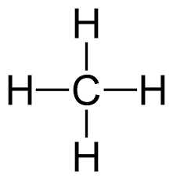
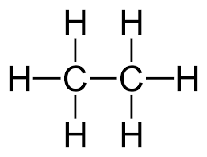
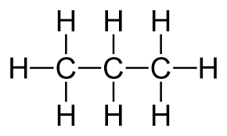
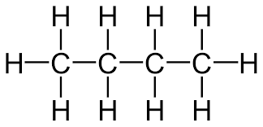
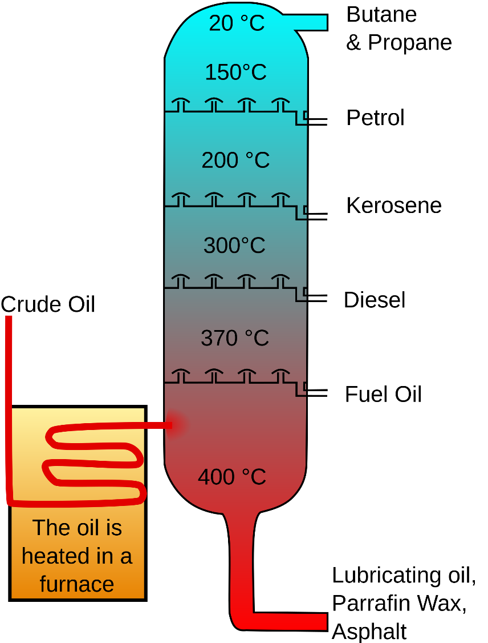
Display formula for first four alkanes
Fractions | The hydrocarbons in crude oil can be split into fractions | Each fraction contains molecules with a similar number of carbon atoms in them. The process used to do this is called fractional distillation.
Using fractions | Fractions can be processed to produce fuels and feedstock for petrochemical industry | We depend on many of these fuels; petrol, diesel and kerosene. Many useful materials are made by the petrochemical industry; solvents, lubricants and polymers.
Crude oil | A finite resource | Consisting mainly of plankton that was buried in the mud, crude oil is the remains of ancient biomass.
Hydrocarbons | These make up the majority of the compounds in crude oil | Most of these hydrocarbons are called alkanes.
General formula for alkanes | C_{n}H_{2n+2} | For example: C₂H₆ C₆H₁₄
Crude oil, hydrocarbons and alkanes
Methane (CH₄)
Ethane (C₂H₆)
Propane (C₃H₈)
Butane (C₄H₁₀)
Carbon compounds as fuels and feedstock
AQA GCSE
Organic chemistry 1
Fractional distillation and petrochemicals
Alkanes to alkenes | Long chain alkanes are cracked into short chain alkenes.
Alkenes | Alkenes are hydrocarbons with a double bond (some are formed during the cracking process).
Properties of alkenes | Alkenes are more reactive that alkanes and react with bromine water. Bromine water changes from orange to colourless in the presence of alkenes.
Hydrocarbon chains | In oil | Hydrocarbon chains in crude oil come in lots of different lengths.
 | Boiling points | The boiling point of the chain depends on its length. During fractional distillation, they boil and separate at different temperatures due to this.
Carbon compounds as fuels and feedstock
Cracking and alkenes
Properties of hydrocarbons
Combustion | During the complete combustion of hydrocarbons, the carbon and hydrogen in the fuels are oxidised, releasing carbon dioxide, water and energy.
Cracking | The breaking down of long chain hydrocarbons into smaller chains | The smaller chains are more useful. Cracking can be done by various methods including catalytic cracking and steam cracking.
Catalytic cracking | The heavy fraction is heated until vaporised | After vaporisation, the vapour is passed over a hot catalyst forming smaller, more useful hydrocarbons.
Steam cracking | The heavy fraction is heated until vaporised | After vaporisation, the vapour is mixed with steam and heated to a very high temperature forming smaller, more useful hydrocarbons.
Decane → pentane + propene + ethane
C₁₀H₂₂ → C₅H₁₂ + C₃H₆ + C₂H₄
Complete combustion of methane:
Methane + oxygen → carbon dioxide + water + energy
CH₄ (g) + 2O₂ (g) → CO₂ (g) + 2 H₂O (l)
Alkenes and uses as polymers | Used to produce polymers. They are also used as the starting materials of many other chemicals, such as alcohol, plastics and detergents.
Why do we crack long chains? | Without cracking, many of the long hydrocarbons would be wasted as there is not much demand for these as for the shorter chains.
Boiling point (temperature at which liquid boils) | As the hydrocarbon chain length increases, boiling point increases.
Viscosity (how easily it flows) | As the hydrocarbon chain length increases, viscosity increases.
Flammability (how easily it burns) | As the hydrocarbon chain length increases, flammability decreases.

Slide 12
Pure substances | A pure substances is a single element or compound, not mixed with any other substance. | Pure substances melt and boil at specific temperatures. Heating graphs can be used to distinguish pure substances from impure.
Pure substances
Purity, formulations and chromatography
Melting point of a pure substance
Melting point of an impure substance
Formulation | A formulation is a mixture that has been designed as a useful product.
How are formulations made? | By mixing chemicals that have a particular purpose in careful quantities.
Examples of formulations. | Fuels, cleaning agents, paints, medicines and fertilisers.
Chromatography
Formulations
AQA Chemical analysis
Position solvent reaches
Mixture separated
Identification of common gases
Mixture
Gas | Test | Positive result
Hydrogen | Burning splint | ‘Pop’ sound.
Oxygen | Glowing splint | Re-lights the splint.
Chlorine | Litmus paper (damp) | Bleaches the paper white.
Carbon dioxide | Limewater | Goes cloudy (as a solid calcium carbonate forms).
Solvent
Chromatography | Can be used to separate mixtures and help identify substances. | Involves a mobile phase (e.g. water or ethanol) and a stationary phase (e.g. chromatography paper).
R_{f} Values | The ratio of the distance moved by a compound to the distance moved by solvent. | R_{f} = distance moved by substance distance moved by solvent
Pure substances | The compounds in a mixture separate into different spots. | This depends on the solvent used. A pure substance will produce a single spot in all solvents whereas an impure substance will produce multiple spots.

Slide 13
Gas | Percentage
Nitrogen | ~80%
Oxygen | ~20%
Argon | 0.93%
Carbon dioxide | 0.04%
Proportions of gases in the atmosphere
Algae and plants | These produced the oxygen that is now in the atmosphere, through photosynthesis. | carbon dioxide + water → glucose + oxygen 6CO₂ + 6H₂O → C₆H₁₂O₆ + 6O₂
Oxygen in the atmosphere | First produced by algae 2.7 billion years ago. | Over the next billion years plants evolved to gradually produce more oxygen. This gradually increased to a level that enabled animals to evolve.
Volcano activity 1st Billion years | Billions of years ago there was intense volcanic activity | This released gases (mainly CO₂) that formed to early atmosphere and water vapour that condensed to form the oceans.
Other gases | Released from volcanic eruptions | Nitrogen was also released, gradually building up in the atmosphere. Small proportions of ammonia and methane also produced.
Reducing carbon dioxide in the atmosphere | When the oceans formed, carbon dioxide dissolved into it | This formed carbonate precipitates, forming sediments. This reduced the levels of carbon dioxide in the atmosphere.
How oxygen increased
Reducing carbon dioxide in the atmosphere | Algae and plants | These gradually reduced the carbon dioxide levels in the atmosphere by absorbing it for photosynthesis.
Formation of sedimentary rocks and fossil fuels | These are made out of the remains of biological matter, formed over millions of years | Remains of biological matter falls to the bottom of oceans. Over millions of years layers of sediment settled on top of them and the huge pressures turned them into coal, oil, natural gas and sedimentary rocks. The sedimentary rocks contain carbon dioxide from the biological matter.
How carbon dioxide decreased
Composition and evolution of the atmosphere
The Earth’s early atmosphere
AQA GCSE Chemistry of the atmosphere
CO₂ and methane as greenhouse gases
Greenhouse gases
Carbon dioxide, water vapour and methane | Examples of greenhouse gases that maintain temperatures on Earth in order to support life
The greenhouse effect | Radiation from the Sun enters the Earth’s atmosphere and reflects off of the Earth. Some of this radiation is re-radiated back by the atmosphere to the Earth, warming up the global temperature.
Common atmospheric pollutants
Carbon footprints
Atmospheric pollutants from fuels
The total amount of greenhouse gases emitted over the full life cycle of a product/event. This can be reduced by reducing emissions of carbon dioxide and methane.
Global climate change
Combustion of fuels | Source of atmospheric pollutants. Most fuels may also contain some sulfur.
Gases from burning fuels | Carbon dioxide, water vapour, carbon monoxide, sulfur dioxide and oxides of nitrogen.
Particulates | Solid particles and unburned hydrocarbons released when burning fuels.
Properties and effects of atmospheric pollutants
Human activities and greenhouse gases
Carbon monoxide | Toxic, colourless and odourless gas. Not easily detected, can kill.
Sulfur dioxide and oxides of nitrogen | Cause respiratory problems in humans and acid rain which affects the environment.
Particulates | Cause global dimming and health problems in humans.
Effects of climate change
Rising sea levels
Extreme weather events such as severe storms
Change in amount and distribution of rainfall
Changes to distribution of wildlife species with some becoming extinct
Carbon dioxide | Human activities that increase carbon dioxide levels include burning fossil fuels and deforestation.
Methane | Human activities that increase methane levels include raising livestock (for food) and using landfills (the decay of organic matter released methane).
Climate change | There is evidence to suggest that human activities will cause the Earth’s atmospheric temperature to increase and cause climate change.

Slide 14
Gas | Percentage
Nitrogen | ~80%
Oxygen | ~20%
Argon | 0.93%
Carbon dioxide | 0.04%
Proportions of gases in the atmosphere
Algae and plants | These produced the oxygen that is now in the atmosphere, through photosynthesis. | carbon dioxide + water → glucose + oxygen 6CO₂ + 6H₂O → C₆H₁₂O₆ + 6O₂
Oxygen in the atmosphere | First produced by algae 2.7 billion years ago. | Over the next billion years plants evolved to gradually produce more oxygen. This gradually increased to a level that enabled animals to evolve.
Volcano activity 1st Billion years | Billions of years ago there was intense volcanic activity | This released gases (mainly CO₂) that formed to early atmosphere and water vapour that condensed to form the oceans.
Other gases | Released from volcanic eruptions | Nitrogen was also released, gradually building up in the atmosphere. Small proportions of ammonia and methane also produced.
Reducing carbon dioxide in the atmosphere | When the oceans formed, carbon dioxide dissolved into it | This formed carbonate precipitates, forming sediments. This reduced the levels of carbon dioxide in the atmosphere.
How oxygen increased
Reducing carbon dioxide in the atmosphere | Algae and plants | These gradually reduced the carbon dioxide levels in the atmosphere by absorbing it for photosynthesis.
Formation of sedimentary rocks and fossil fuels | These are made out of the remains of biological matter, formed over millions of years | Remains of biological matter falls to the bottom of oceans. Over millions of years layers of sediment settled on top of them and the huge pressures turned them into coal, oil, natural gas and sedimentary rocks. The sedimentary rocks contain carbon dioxide from the biological matter.
How carbon dioxide decreased
Composition and evolution of the atmosphere
The Earth’s early atmosphere
AQA GCSE Chemistry of the atmosphere
CO₂ and methane as greenhouse gases
Greenhouse gases
Carbon dioxide, water vapour and methane | Examples of greenhouse gases that maintain temperatures on Earth in order to support life
The greenhouse effect | Radiation from the Sun enters the Earth’s atmosphere and reflects off of the Earth. Some of this radiation is re-radiated back by the atmosphere to the Earth, warming up the global temperature.
Common atmospheric pollutants
Carbon footprints
Atmospheric pollutants from fuels
The total amount of greenhouse gases emitted over the full life cycle of a product/event. This can be reduced by reducing emissions of carbon dioxide and methane.
Global climate change
Combustion of fuels | Source of atmospheric pollutants. Most fuels may also contain some sulfur.
Gases from burning fuels | Carbon dioxide, water vapour, carbon monoxide, sulfur dioxide and oxides of nitrogen.
Particulates | Solid particles and unburned hydrocarbons released when burning fuels.
Properties and effects of atmospheric pollutants
Human activities and greenhouse gases
Carbon monoxide | Toxic, colourless and odourless gas. Not easily detected, can kill.
Sulfur dioxide and oxides of nitrogen | Cause respiratory problems in humans and acid rain which affects the environment.
Particulates | Cause global dimming and health problems in humans.
Effects of climate change
Rising sea levels
Extreme weather events such as severe storms
Change in amount and distribution of rainfall
Changes to distribution of wildlife species with some becoming extinct
Carbon dioxide | Human activities that increase carbon dioxide levels include burning fossil fuels and deforestation.
Methane | Human activities that increase methane levels include raising livestock (for food) and using landfills (the decay of organic matter released methane).
Climate change | There is evidence to suggest that human activities will cause the Earth’s atmospheric temperature to increase and cause climate change.

