Slide 1
BTEC Applied Sciences
Unit 1
Knowledge Organiser

Slide 2
Biology

Slide 3
B1 - Cell structure and function

Slide 4
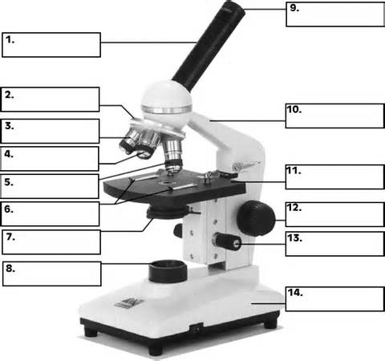
What is cell theory?
Outline the main events that occurred during the development of cell theory
Compare and contrast the light and electron microscope
Label this microscope
What are the different types of microscopes?
What is the formula for calculating magnification?

Slide 5
What is resolution?
What is the purpose of the following:
cytoplasm?
Rough ER?
Golgi apparatus?
Lysosomes?
Draw and label an animal cell
What are the different types of cells?
What are eukaryotic cells?
What are prokaryotic cells?

Slide 6
Draw and label a plant cell
What is the purpose of the following:
Chloroplast?
Tonoplast?
Amyloplast?
Plasmodesmata?
Pits?
Draw and label a bacterial cell

Slide 7
1 kilometre (km) = __________ metres (m)
1 m = __________ centimetres (cm)
1 cm = __________ millimetres (mm)
1 mm = __________ micrometre (um)
1 um = __________ nanometre (nm)
1 nm = ____________________ m
What is the purpose of the following:
Cell wall?
Ribosome?
Plasmid?
Capsule?
Nucleoid?
How can bacteria be classified?
What is meant by the term complementary base pairing?
What are the similarities between a prokaryotic and a eukaryotic cell?
Why do the different types of bacteria react differently to some antibiotics?
What stains are used to distinguish between the 2 groups of bacteria?
What are the differences between a prokaryotic and a eukaryotic cell?
Define exocytosis
What are the results of these stains?

Slide 8
B2 - Cell specialisation

Slide 9
How are multicellular oganisms organised?
Explain how a root hair cell is specialised to carry out its function
Explain how a palisade mesophyll cell is specialised to carry out its function
Explain how egg cell is specialised to carry out its function
Explain how a white blood cell is specialised to carry out its function
Explain how a sperm cell is specialised to carry out its function
Explain how a red blood cell is specialised to carry out its function

Slide 10
B3 - Tissue structure and function

Slide 11
What are the 4 main types of tissue in animals?
1.
2.
3.
4.
How is squamous epithelial tissue adapted for a fast rate of diffusion?
How does smoking damage squamous epithelial tissue?
What are the main symptoms associated with COPD?
What are the 3 types of epithelial tissue in animals?
1.
2.
3.
What substances need to pass through endothelial tissue?
Where is squamous epithelial tissue found?
What is atherosclerosis?
Where is epithelial tissue found?
How is endothelial tissue adapted for a fast rate of diffusion?
How is ciliated columnar epithelial tissue adapted for to protect from infection?
Where is ciliated columnar epithelial tissue found?
How is gas exchange affected by COPD?
What are goblet cells?

Slide 12
What do muscles contain?
What are the 3 types of muscle tissue in animals?
1.
2.
3.
Describe the structure of muscle tissue?
Where is skeletal muscle found?
Explain what happens to the protein filaments during muscle contraction?
What are the 2 types of muscle fibres?
1.
2.
How are slow twitch muscle fibres adapted for their function?
Where is cardiac muscle found?
What is ATP?
Where is smooth muscle found?
How is ATP released by slow twitch muscle fibres?
What is a sarcolemma?
What is a myofibril?
What is a sarcomere?

Slide 13
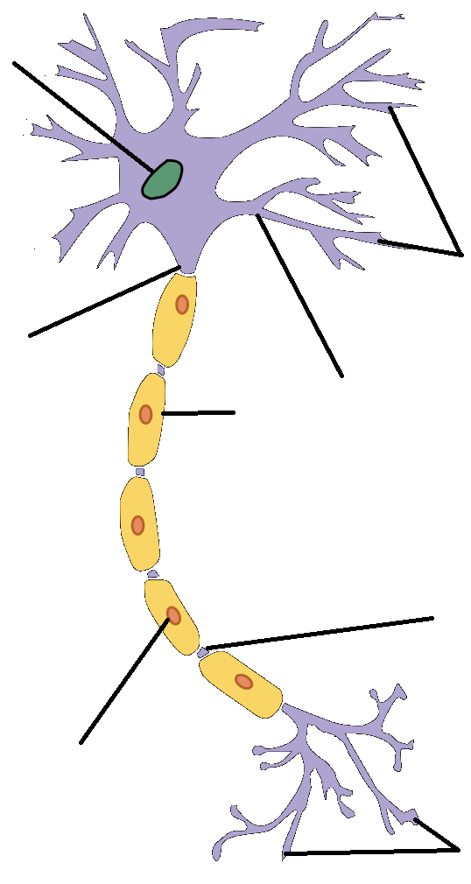
What are the 2 types of fast twitch muscle fibres?
1.
2.
How do fast twitch oxidative muscle fibres help athletes?
What are neurons?
Label the neuron below
How are fast twitch oxidative muscle fibres adapted for their function?
How do fast twitch glycolytic muscle fibres help athletes?
What does the CNS consist of?
What does the CNS consist of?
1.
2.
How are fast twitch glycolytic muscle fibres adapted for their function?
What does the CNS made up of?
1.
2.
3.
How does information travel along neurons?
How do slow twitch muscle fibres help athletes?
What is nervous tissue made up of?

Slide 14
How does information travel from one neuron to another?
What are sensory neurons?
Explain the process of depolarisation?
Explain how a cell membrane becomes polarised?
What is a resting potential?
What is myelin?
What is the purpose of Schwann cells?
What 2 ions are transported across a neuron membrane?
1.
2.
How much potential difference created by the Na/K pump?
What is an action potential?

Slide 15
What are the nodes of Ranvier?
What types of nerves does saltatory conduction occur in?
What 3 factors does the speed of conduction of a nerve impulse depend on and how does it affect the speed?
1.
2.
3.
What are synapses?
Explain the process of saltatory conduction?
What are neurotransmitters?
What is saltatory conduction?
How do neurotransmitters work?
What is the most common neurotransmitter?
What is the speed of nerve impulses in:
Myelinated nerve fibres?
Unmyelinated nerve fibres?
How do cholinergic synapses work?

Slide 16
Explain the process of chemical transmission across the synapse?
1.
2.
3.
4.
5.
6.
7.
8.
What does EEG stand for?
What is an EEG?
How do EEGs work?
What is Parkinson’s disease?
Why does Parkinson’s occur?
What are the main symptoms of Parkinson’s disease?
What is L-dopa?
What is serotonin?
What happens if the body does not produce enough serotonin?

Slide 17
Chemistry

Slide 18
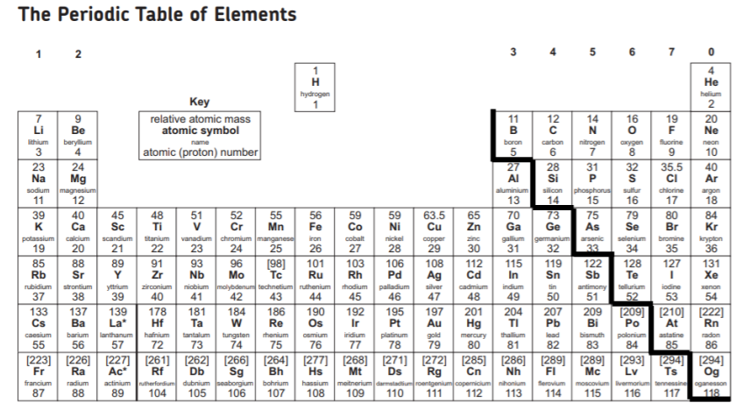

Slide 19
Structure and bonding applications in science

Slide 20
Draw and label an atom?
Complete the table below
What are orbitals?
What are electronic configuration?
Subatomic particle | Relative charge | Relative mass
Fill in the table below
Element | Number of electrons | Electron structure
Hydrogen | 1
Lithium
Boron
Carbon | 6 | 1s¹ 2s² 2p²
Magnesium
Chlorine
Calcium
Fill in the table to show the number of electrons that can fit into the shell
Sodium has an electronic configuration of 2,8,1. Draw a Bohr diagram to show this?
How many electrons can an orbital hold?
Electron shell | Maximum number of electrons
1
2
3
4
5
What is the Aufbau principle?
What is meant by the term spin?
What are the 4 different orbitals of an atom?
1. 3.
2. 4.

Slide 21
Define ionic bonding?
Draw an example of ionic bonding?
Fill in the table
Ion | Formula
Magnesium ion
Sodium ion
Calcium ion
Aluminium ion
Oxygen ion
Sulphur ion
Chlorine ion
Iodine ion
Nitrate ion
Carbonate ion
Sulphate ion
Hydroxide ion
Ammonium ion
Zinc ion
Silver ion
Copper (III) ion
Define electrostatic attraction?
NaCl and KCl are both ionic compounds. Which compound has the strongest ionic bond and why?
What is a giant ionic lattice?
What is a cation?
What is an anion?

Slide 22
How are anions formed?
What is the relationship between ionic radius and bond strength in ionic bonds? What does this mean?
Draw a labelled diagram to show the structure of sodium chloride. Your diagram should show at least eight ions.
Do ionic compounds tend to dissolve in water? Why?
How are cations formed?
What is the relationship between ionic charge and bond strength in ionic bonds? What does this mean?
Solid lead bromide does not conduct electricity, but molten lead bromide
Does. Why?
Would you expect sodium Chloride to have a high or low melting point? Why?
What type of bond is formed when an ammonia molecule reacts with a hydrogen ion?
What are the properties of a giant ionic lattice

Slide 23
How strong are the forces (intermolecular) between simple covalent
molecules?
Draw the shape of a molecule of methane? Label the angles between the hydrogen atoms
Draw an example of covalent bonding?
How strong are the forces (intramolecular) between atoms in a covalent bond?
Define covalent bonding?
What meant by the term ‘double bond’?
What is the relationship between bond length and bond strength in covalent bonds? What does this mean?
What meant by the term ‘dative covalent bond’?
What is diamond made out of?
What is an organic compound?
What meant by the term ‘lone pair’?

Slide 24
Name 3 giant covalent structures
Describe the structure of diamond
Why is graphite slippery?
Why does graphite conduct electricity but diamond does not?
Although graphite is very much softer than diamond, both substances have very high melting points. Explain why.
Describe the structure of graphite
Draw the structure of diamond
Draw the structure of graphite
Do covalent compounds tend to dissolve in water? Why?
Why do giant covalent structures have high melting points?

Slide 25
What happens to the melting point of metals as the size of the atom increases? Why?
Define metallic bonding?
Draw an example of metallic bonding?
What are the key properties of metals?
What are delocalized electrons?
Explain why metals can be hammered into thin sheets without breaking easily?
Explain why metals conduct electricity?
Describe the structure of a metal?
What happens to the melting point of metals as the number of electrons in the outer shell increases? Why?

Slide 26
Illustrate the structure of Magnesium metal using a labelled
diagram.
Describe the structure of a giant metallic lattice.
Atoms within metals have strong metallic bonds. Describe how this occurs.
What are the structural differences between a pure metal and alloy?
Why are alloys used more in construction than pure metals?
Explain why iodine ,has a much lower boiling point than
graphite.
Describe the melting and boiling points for metals and why they are this way.
How does copper conduct electricity?
How is metallic bonding different to covalent bonding?
What happens to valence (outer) electrons in metals

Slide 27
What is meant by the term electronegativity?
What is a dipole?
Complete the sentence.
The dispersion forces between molecules always become stronger as molecular size …………………………
What is the strongest type of intermolecular bond?
What type of bond is formed between atoms with similar electronegativities?
What happens to the polarity of a bond as the difference in electronegativity increases?
What are intermolecular forces?
Which intermolecular bond is caused by the temporary uneven distribution of electrons?
What is a non-polar molecule?
What happens to the electronegativity of an element as you go down a group?
The types of intermolecular forces in a substance are identical whether it is a solid, a liquid, or a gas. Why then does a substance change phase from a gas to a liquid or to a solid?
What is a polar molecule?
What happens to the electronegativity of an element as you go across a period?

Slide 28
What are van der Waal forces?
Susan states that van der Waals forces include ion-dipole forces, dipole-dipole forces and induced dipole forces. Rob states that van der Waals forces include ion-dipole forces, ion-induced dipole forces and induced dipole forces. Helen states that van der Waals forces include dipole-induced dipole forces, dipole-dipole forces and induced dipole forces.
Who is correct and why?
What is the other name for London forces?
What are London forces? Draw an example
What is the other name for van der Waal forces?
Draw an example of van der Waal forces
Explain why the boiling point of the halogens increases as you go down the group.
How does a temporary dipole form?
What is the effect of more electrons on the following in regards to London forces:
Movement of electrons?
Size of dipole?
Force of attraction?
How does an induced dipole form?

Slide 29
What are Hydrogen bonds?
A hydrogen bond will form when hydrogen is bonded to which elements?
1.
2.
3.
Explain why the boiling points increase from HCl through HBr to HI
How does each type of intermolecular bond affect the properties of a molecule?
Put all of the intermolecular forces in order from weakest to strongest.
1.
2.
3.
4. Covalent bond
Why do hydrogen bonds form with hydrogen and only 3 elements?
What properties to hydrogen bonds give water?
Draw an example of a hydrogen bond
How are hydrogen bonds different to other dipole-dipole forces?

Slide 30
Balance the following equations:
Write the balanced equation for the following reactions:
sodium chloride + lead (II) nitrate → lead (II) chloride + sodium nitrate
iron + chlorine → iron (III) chloride
barium + water → barium hydroxide + hydrogen
potassium hydroxide + sulfuric acid → potassium sulfate + water
sodium + chlorine → sodium chloride
calcium carbonate → calcium oxide + carbon dioxide
aluminium oxide + sulfuric acid ==> aluminium sulfate + water
sodium hydroxide + hydrochloric acid ==> sodium chloride + water
nitrogen + hydrogen → ammonia
1. | H₂ | + | Cl₂ | → | HCl
2. | Zn | + | O2 | → | ZnO
3. | Cl₂ | + | Al | → | AlCl₃
4. | Na | + | O₂ | → | Na₂O
5. | Mg | + | O2 | → | MgO
6. | Mg | + | HCl | → | MgCl₂ | + | H2
7. | Fe₂O₃ | + | Al | → | Fe | + | Al₂O₃
8. | CaCl₂ | + | KOH | → | Ca(OH)₂ | + | KCl
9. | HCl | + | Na₂CO₃ | → | NaCl | + | H₂O | + | CO₂
10. | HNO₃ | + | NaOH | → | NaNO₃ | + | H₂O
11. | HNO₃ | + | Ca(OH)₂ | → | Ca(NO₃)₂ | + | H₂O
12. | H₂SO₄ | + | KOH | → | K₂SO₄ | + | H₂O
13. |  |  | NaNO₃ | → | NaNO₂ | + | O₂
14. | KI | + | Pb(NO₃)₂ | → | KNO₃ | + | PbI₂
15. | CaCl₂ | + | Na₂SO₄ | → | CaSO₄ | + | NaCl
16. | HCl | + | K₂SO₃ | → | KCl | + | H₂O | + | SO₂
17. | KOH | + | MgSO₄ | → | Mg(OH)₂ | + | K₂SO₄
18. | K | + | H₂O | → | KOH | + | H₂
19. | NaOH | + | H₃PO₄ | → | Na₃PO₄ | + | H₂O
20. |  |  | Pb(NO₃)₂ | → | PbO | + | NO₂ | + | O₂

Slide 31
What is a mole?
Calculate the M_{r} for each of the following molecules.
O₂
B₂H₆
Cl₂
Na₂CO₃
CO₂
Fe₂(SO₄)₃
NH₃
Zn(OH)₂
KOH
HNO₃
Al₂O₃
Ca(HCO₃)₂
Ca(OH)₂
Fe₂O₃
CaCO₃
(NH₄)₂SO₄
Calculate the M_{r} for each of the following molecules:
O₂
B₂H₆
Cl₂
Na₂CO₃
CO₂
Fe₂(SO₄)₃
NH₃
Zn(OH)₂
KOH
HNO₃
Al₂O₃
Ca(HCO₃)₂
Ca(OH)₂
Fe₂O₃
CaCO₃
(NH₄)₂SO₄
What is molar mass?
What is Avogadro’s constant?
What is relative atomic mass?
What is the formula to calculate moles?
What is relative molecular mass?
How many cm³ in 1m³?
How many cm³ in 1dm³?
How many dm³ in 1M³?

Slide 32
Calculate the moles for each of the following:
146g of HCl
47.7g of CuO
11.2 g of KOH
20g of NaOH
192g of Br₂
6.6g of Xe
25.5g of Al₂O₃
12g of MgO
1.6g of Fe₂O₃
73.6g of NO₂
9.8g of H₂SO₄
19.2g of SiO₂
Calculate the mass for each of the following:
2 moles of Al₂O₃
1.3 moles of H₂SO₄
1.4 moles of CaSO₄
2. 5 moles of MgO
21 moles of CuO
2.1 moles of Na₂CO₃
1.5 moles of NH₃
0.6 moles of HNO₃
1.3 moles of MgCl₂
0.7 moles of Br₂
1.2 moles of NO₂
0.4 moles of Cu(NO₃)₂

Slide 33
What is empirical formula?
What is the empirical formula of a compound containing 40.0% sulfur and 60.0% oxygen?
What is the empirical formula for a compound containing 38.8% carbon, 16.2% hydrogen and 45.1% nitrogen?
How do you calculate the empirical formula?
What is the empirical formula of a compound containing 47.37% carbon, 10.59% hydrogen and 42.04% oxygen?
Sodium Hydride, in which 6.9g of sodium combine with 0.3g of hydrogen. What is empirical formula?
Nitrogen oxide, in which 0.7g of nitrogen and 1.6g of oxygen react fully. What is empirical formula?
Sodium nitrate which contains 2.3g of sodium, 1.4g of nitrogen, 4.8g of oxygen.
What is empirical formula?

Slide 34
What is molecular formula?
A hydrocarbon contains 92.3% carbon and 7.7% hydrogen. Its relative molecular mass is 26. What is its molecular formula?
A hydrocarbon is 84% carbon by mass. Its relative molecular mass is 100. Find its molecular formula
How do you calculate the molecular formula?
An oxide of phosphorus has an RMM of 220. It is 56.4% phosphorus. Find its molecular formula.
            A hydrocarbon has 80% carbon and 20 % hydrogen. When the mass of a single molecule of this compound was analysed, it was found to be 30. What must the true (molecular) formula of this substance be?

Slide 35
What is a titration?
What is meant by the molarity of a solution?
What is the formula to calculate molarity?
Define solution?
How many moles of HCl are there in 100 cm³ HCl solution?
What is the concentration of a sample of NaOH solution if 10 dm³ contains 0.5 mol?
Define standard solution?
Define solute?
What volume in cm³ of 2M sulphuric acid solution would you need to ensure you had a sample containing 0.005 mol?
Calculate the number of moles of HCl are there in 20 cm³ of a 2 mol dm⁻³ solution of HCl (aq)
Define solvent?

Slide 36
In a titration, 25.0 cm³ of 0.100 mol/dm³ sodium hydroxide solution is exactly neutralized by 20.00 cm³ of a dilute solution of hydrochloric acid. Calculate the concentration of the hydrochloric acid solution.
25.00 cm³ of 0.300 mol/dm³ sodium hydroxide solution is exactly neutralized by 0.100 mol/dm³ sulfuric acid. Calculate the volume of sulfuric acid needed.
In a titration, 25.00 cm³ of 0.200 mol/dm³ sodium hydroxide solution is exactly neutralised by 22.70 cm³ of a dilute solution of hydrochloric acid.
NaOH(aq) + HCl(aq) → NaCl(aq) + H₂O(l)
Calculate the concentration of the hydrochloric acid.
25.00 cm³ of 0.100 mol/dm³ sodium hydroxide solution is exactly neutralised by 0.125 mol/dm³ hydrochloric acid.
NaOH(aq) + HCl(aq) → NaCl(aq) + H₂O(l)
Calculate the volume of hydrochloric acid needed.

Slide 37
What is a stoichiometry?
What mass of hydrogen is produced when 192 g of magnesium is reacted with hydrochloric acid?
Mg + 2 HCl → MgCl₂ + H₂
What mass of oxygen is needed to react with 8.5 g of hydrogen sulphide (H₂S)?
2 H₂S + 3 O₂ → 2 SO₂ + 2 H₂O
How do you calculate the quantities of reactants and products using a chemical equation?
What mass of oxygen is formed when 735 g of potassium chlorate decomposes?
2 KClO₃ → 2 KCl + 3 O₂
What mass of carbon dioxide is produced when 5.6 g of butene (C₄H₈) is burnt.
C₄H₈ + 6 O₂ → 4 CO₂ + 4 H₂O

Slide 38
What is meant by theoretical mass?
Crushed calcium carbonate (CaCO₃) decomposes to give calcium oxide (CaO) and carbon dioxide. A company processes 200 tonnes of calcium carbonate daily. It collects 98 tonnes of calcium oxide each day. What is the percentage yield of the calcium oxide?
Sodium hydrogencarbonate (NaHCO₃) can be converted into sodium carbonate (Na₂CO₃) by heating. This is a thermal decomposition reaction in which water vapour and carbon dioxide are also products. A student started with 16.8g of NaHCO₃ and collected 9.2g of Na₂CO₃. Calculate the percentage yield the student obtained.
Define reversible reaction?
What is meant by percentage yield?
What is the formula for percentage yield?

Slide 39
Ethene gas (C₂H₄) reacting with steam to produce ethanol (C₂H₅OH) is a reversible reaction. If 14g of ethene reacts with excess steam to produce 17.25g of ethanol, what is the percentage yield of the reaction?
When 1 mole of oxygen reacts with excess hydrogen, 2 moles of water should be produced. When this reaction was carried out, the actual number of moles was 1.8 moles of water. Calculate the percentage yield.
Ammonia is manufactured from hydrogen and nitrogen by the Haber process.
N₂ + 3 H₂ ⇌ 2 NH₃
If 80kg of ammonia is produced from 60kg of hydrogen, what is the percentage yield?

Slide 40
Production and uses of substances in relation to properties

Slide 41
How are the elements in the periodic table arranged?
What are element blocks?
Which groups are in the s block?
Explain why Ca is an s block element
What are the columns in the periodic table known as?
What are the 3 element blocks?
1.
2.
3.
Which groups are in the p block?
Explain why Br is a p block element
What are the rows in the periodic table known as?
Explain why Cu is a d block element
Which part of the periodic table makes up the p block?
What are the characteristics of period 1?
What are the characteristics of period 2?
What are the characteristics of period 3?
What are the characteristics of period 4?

Slide 42
How can you measure the radius of an atom?
Explain the trend of atomic radius of the transition metals?
How does the ionic radius of cations change across a period and why?
Define electronegativity?
How does the atomic radius change across a period and why?
Why do group 8 elements have no electronegativity?
How does the ionic radius change down a group and why?
How does the ionic radius of anions change across a period and why?
What factors does electronegativity depend on?
How does the atomic radius change down a group and why?
How does the ionic radius of cations compare to their corresponding atom?
What is meant by the term isoelectronic

Slide 43
How does the electronegativity change across a period and why?
How does electron affinity affect the reactivity of atoms?
How does the first ionization energy change across a period and why?
What does the pattern in first ionization energy between period 2 and 3 suggest?
Define first ionization energy?
How does the first ionization energy change down a group and why?
How does the electronegativity change down a group and why?
Why does the first ionization energy not change significantly in period 4?
Evaluate the factors that affect first ionization energies of elements in a period and group
Define periodicity

Slide 44
Define electron affinity
Which element is the exception to the trend in electron affinity as you go down group 7 and why?
How does the electron affinity compare between group 6 and 7?
What is the trend in electron affinity as you go down group 7 and why?
How does the electron affinity predict the type of bonding in a compound??
What is the trend in electron affinity as you go down group 6 and why?
What does electron affinity indicate?
Which element is the exception to the trend in electron affinity as you go down group 6 and why?
Define melting point in terms of bonding
Define boiling point in terms of bonding

Slide 45
Which group has the lowest melting and boiling point?
Describe and explain the trend of melting and boiling points as you go across groups 1 to 3 in period 2
Define malleable
Define ductile
Evaluate how type of bonding, intermolecular forces and molecule size affects the melting point in elements in period 3 and groups 2 and 6
Define electrical conductivity
Define thermal conductivity
Explain the physical properties outlined above in terms of metals
Describe and explain the trend of melting and boiling points as you go across groups 1 to 3 in period 3

Slide 46
Fill in the table
Group | Element | Reaction with oxygen | Balanced equation
1 | Lithium
 | Sodium
2 | Beryllium & magnesium
3 | Aluminium
4 | Carbon
 | Silicon
5 | Nitrogen
 | Phosphorus
6 | Oxygen
 | Sulphur
7 | Most halogens react
0 | All noble gases

Slide 47
Write balanced general equations for the reaction of:
Group 1 metals + oxygen
Group 2 metals + oxygen
Group 3 metals + oxygen
Write balanced general equations for the reaction of:
Group 1 metals + water
Group 2 metals + water
Group 3 metals + water
Write balanced general equations for the reaction of:
Group 1 metals + dilute acid
Group 2 metals + dilute acid
Group 3 metals + dilute acid
What is the reactivity series?
Fill in the reactivity series from most reactive to least
K |  |  |  |  | C |  |  |  |  | H
Most reactive Least reactive
Potassium |  |  |  |  | Carbon |  |  |  |  | Hydrogen |  |  |  | Platinum

Slide 48
Define redox
Define reduction
Define oxidation
Define half equation
Identify the species being oxidized and reduced in each of the following reactions:
1. Cr⁺ + Sn⁴⁺ → Cr³⁺ + Sn²⁺
Oxidized:
Reduced:
2. 3Hg²⁺ + 2Fe (s) → 3Hg₂ + 2Fe³⁺
Oxidized:
Reduced:
3. 2As (s) + 3Cl₂ (g) → 2AsCl₃
Oxidized:
Reduced:
Complete these half equations by balancing them, and then adding electron(s) (+ e‑) or removing electron(s)(- e⁻) from the left hand side.
Cu²⁺ (aq) _______→ Cu (s) (oxidation/reduction)
O²⁻(aq) ________ → O₂(g) (oxidation/reduction)
Li⁺(l) __________ → Li(s) (oxidation/reduction)
H⁺(aq) _________→ H­₂(g) (oxidation/reduction)
Mg²⁺ (s) ________→ Mg(s) (oxidation/reduction)
Al³⁺(l) __________→ Al (s) (oxidation/reduction)
Define oxidation state
How do you assign oxidation states

Slide 49
What are the oxidation numbers of these atoms?
C in CO =
S in SO₃ =
N in N₂O =
C in CH₄ =
N in NH₃ =
C in CCl₄ =
P in PCl₃ =
N in HNO₃ =
S in H₂SO₄ =
C in CH₃Cl =
Cl in NaClO₃=
S in K₂SO₄ =
C in CO₃²⁻=
S in SO₄²⁻=
N in NH₄⁺=
P in PO₄³⁻=
Mn in MnO₄⁻ =
Cr in Cr₂O₇²⁻ =
S in S₂O₃²⁻ =
How can you tell from oxidation states if a reaction is a redox reaction?
When does a displacement reaction occur?
Name the following ions
Ion | Name
I⁻
NH₄⁺
⁻OH
F⁻
CO₃²⁻
NO₃⁻
SO₄²⁻
Li⁺
Al³⁺
Cl⁻
HCO₃⁻
Ca²⁺
Cu²⁺
H⁺
Mg²⁺
Ag⁺
PO₄³⁻
Why can transition metals have variable oxidative states?
How does the oxidising power of halogens change as you go down the group and why?
Define catalyst
Define displacement reaction
Define oxidizing agent

Slide 50
Physics

Slide 51
Working with waves

Slide 52
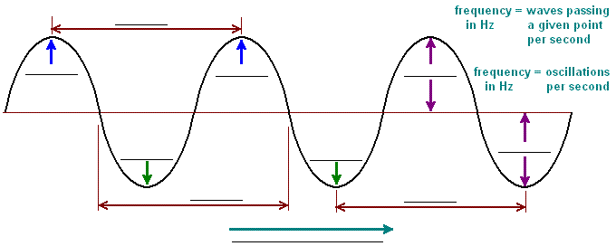
Define wave
Define oscillation
Define frequency
Define period
Define displacement
Define amplitude
Define speed
Define wavelength
Label
the
wave
How do waves transfer energy?

Slide 53
What is the formula to calculate wave speed?
What is wave speed measured in?
What is frequency measured in?
What is the frequency of a wave with a speed of 200 m/s and a wavelength of 2 m?
A wave has a speed of 30 m/s and a frequency of 10 Hz. Calculate the wavelength.
What is the frequency of a wave with a wavelength of 0.03 m and a speed of 18 m/s?
A wave has a wavelength of 8 cm and a frequency of 200 Hz. Calculate the wave speed.
What is the wavelength of a wave with a speed of 18 m/s and a frequency of 600 Hz?
A wave has a wavelength of 1 cm and a frequency of 300 Hz. Calculate the wave speed
What is the speed of a wave with a wavelength of 0.05 m and a frequency of 2000 Hz?
What is the speed of a wave with a wavelength of 2000 m and a frequency of 0.05 Hz?
A wave has a wavelength of 60 cm and a frequency of 5454 Hz. Calculate the wave speed

Slide 54
What is the formula to calculate frequency?
What is time measured in?
What is the frequency of a wave with a time period of 4 s?
What is the frequency of a wave with a time period of 3 s?
What is the time period for a wave if the frequency is 450 Hz?
What is the time period for a wave if the frequency is 62054 Hz?
What is the frequency of a wave with a time period of 0.005 s?
What is the time period for a wave if the frequency is 19,500 Hz?
What is the frequency of a wave with a time period of 2.0x10⁻¹⁸ s?
What is the frequency of a wave with a time period of 9.0x10⁻¹⁵ s?
What is the time period for a wave if the frequency is 0.01 Hz?

Slide 55
What is phase difference?
What happens to the shape of the wave if you double the frequency?
What happens to the shape of the wave if you double the amplitude?
Complete the table
Wave cycle position | Start | ¼ of a cycle | ½ of a cycle | ¾ of a cycle | 1 whole cycle | 1.5 cycles | 2 whole cycles
Phase (⁰) | 0 | 90 |  | 270
Phase (π) | 0 |  | π |  |  | 3π
Number of wavelengths | 0 |  |  |  | λ |  | 2λ
Draw a rotating vector and wave diagram?
What happens to the shape of the wave if you half the amplitude?
What happens to the shape of the wave if you half the frequency?
What type of graph can you draw in order to show the wavelength?
How can displacement be determined for water ripples?
How can displacement be determined for sound waves?

Slide 56
What are the 2 types of wave motion?
1.
2.
Draw and label a longitudinal wave
Give examples of longitudinal waves
Describe a longitudinal wave
Draw and label a transverse wave
Give examples of transverse waves
Describe a transverse wave
Why are sound waves unable to become polarized?
How do polarizing sunglasses work?

Slide 57
What is diffraction?
Explain how diffraction can be seen using a ripple tank?
What is a diffraction grating?
What is meant by transmission?
Define reflection
What factors make waves coherent?
1.
2.
3.
What is an inference pattern?
What is meant by superposition?
What is the advantage of reflection mode and why?
What is a path difference?

Slide 58
What is a photon?
Sketch two wave trains. Show them overlapping by different amounts along the horizontal axis. Think about how superposition will work and what the resultant wave form will look like.
What is meant by the term quantum?
Why do displacement-time and displacement-distance graphs have a similar shape?
What is quantum theory?
What is meant by the coherence length?
A source like an LED emits photons with very slightly differing frequencies. What effect will that have on the coherence time?
What is the Planck constant?

Slide 59
What is the formula for photon energy?
Ultraviolet radiation has a frequency of 6.8 × 10¹⁵ Hz. Calculate the energy, in joules, of the photon.
Find the energy, in joules per photon, of microwave radiation with a frequency of 7.91 × 10¹⁰ Hz
What is the unit for photon energy?
What is the frequency of UV light that has an energy of 2.39 × 10⁻¹⁸ J?
What is the energy of a light that has a frequency of 3.42 x 10¹¹ Hz?
A sodium vapor lamp emits light photons with a frequency of 5.89 × 10⁷ m. What is the energy of these photons?

Slide 60
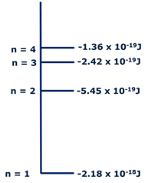
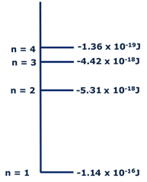
What is an emission spectrum?
What does each line in an emission spectrum show?
What is the ground state of a particle?
What is de-excitation?
What is the frequency and wavelength of the photon emitted below, when the electron drops from level n = 4 down to level n = 3?
What is the frequency and wavelength of the photon emitted below , when the electron drops from level n = 3 down to level n = 2?

Slide 61
What is a stationary wave?
When do stationary wave patterns most often occur?
Explain how the diffraction grating produces an emission spectrum. Use a labelled diagram to help your explanation.
What meant by the term resonance?
What is a node in a stationary wave?
What meant by the term forced frequency?
What meant by the term natural frequency?
How are stationary wave patterns formed by radios and TV antennas?
How are stationary wave patterns formed by microwave ovens?
What is an antinode in a stationary wave?

Slide 62
What is the formula to calculate the mass per unit length of a stretched string?
What is the formula to calculate the velocity of a stretched string?
A guitar string is plucked and has a wavelength of 70cm, it produces a frequency of 450 Hz.
What is the wave speed?
The mass per unit length of the string is 0.001kg/m. what is the tension of the string?
A violin string has a tension of 60N and a mass per unit length of 0.003 kg/m.
What is the wave speed
The wavelength of the wave produced is 5cm. What is the frequency?
A cello string is plucked and has a wavelength of 10cm. It produces a frequency of 670 Hz.
What is the wave speed?
The tension of the string is 120N. What is the mass per unit length?

Slide 63
Waves in communication

Slide 64
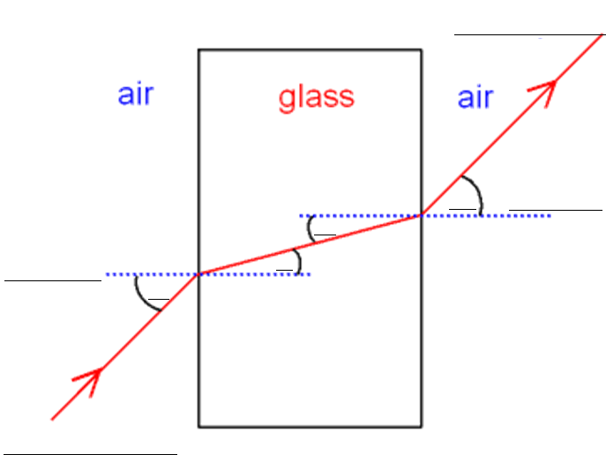
How does a light wave travel in a vacuum?
Define refractive index
Label the diagram below
Refractive index = ___
Define normal
Why can’t light waves travel through metals?
Define incidence
Refractive index = ___
What happens when a light wave passes through a transparent material?
What are the 2 formulas to calculate refractive index
Define refraction

Slide 65
What is the speed of light in a vacuum?
What should be the angle of incidence of a light ray incident through air on the boundary separating air from water so that the angle of refraction is 30 °? (refractive index of air is 1 and that of water is 1.32)
A light wave with a wavelength of 612 nm in a vacuum travels through a bit of fused quartz which has an index of refraction of n =1.458. Find the speed of light in the quartz.
What is the index of refraction in a medium where the speed of light is 1.5×10⁸ m/s?
What should be the angle of incidence of a light ray incident through air on the boundary separating air from water so that the angle of refraction is 50 °? (refractive index of air is 1 and that of water is 1.32)
What should be the angle of incidence of a light ray incident through air on the boundary separating air from water so that the angle of refraction is 70 °? (refractive index of air is 1 and that of water is 1.32)
What is the speed of light in water whose refractive index is 1.33?
What is the speed of light in zircon whose refractive index is 1.94?
Flint has a refractive index of 1.65. Find the speed of light in flint.

Slide 66
What is internal reflection?
Draw a diagram to show total internal reflection
The sparkle of diamonds is due to light being very effectively trapped in them bt total internal reflection. The critical angle for a diamond-air interface is only 24.4⁰. Calculate:
The refractive index of diamond
The speed of light in diamond
What is the critical angle?
What is the formula to calculate the critical angle?
What is total internal reflection?
What is the critical angle for light traveling from glass to water? Glass has an index of refraction of n=1.5, while water has n=1.33.
A ray of light passes from a medium with an index of refraction of 1.50 into another medium with an index of refraction of 3.33. If the incident ray is at an angle of 20⁰ with respect to the normal, what is the critical angle?

Slide 67
What are optical fibres?
What happens to the waves of light as they pass through an optical fibre?
Draw and label a diagram of an optical fibre?
Why is the glass core surrounded by a cladding material in an optical fibre?
How are permanent joints made between optical fibres?
What are endoscopes?
Optical fibres are more efficient at transmitting signals than copper cables. Evaluate this statement.
How does an endoscope work?

Slide 68
What is an analogue signal?
Give exampled of analogue signals?
What are the advantages of digitising information compared to analogue transmission?
Explain how analogue signal can be converted into digital signal
What is a digital signal?
Use the formula v=fλ to calculate the frequency of near infra-red light, wavelength = 830nm. The speed of light is 3×10⁸ m/s.
What would currently limit the bit rates at which data can be transmitted?

Slide 69
What are the advantages and disadvantages of analogue and digital signals?
What is meant by the term bandwidth?
Who installs fibre optic cables?
Give an application of multimode and single mode fibres
What is meant by the term broadband?
What does an optical amplifier do?
What is wave division multiplexing (WDM)?
How does fibre optic broadband compare the copper cable connections?
What is multimode fibre?
What is the diameter of optical cores in multimode fibres?
What is single mode fibre?
What is the diameter of optical cores in single mode fibres?
How does light travel in a single mode fibre?
What does reliability of the signal depend on?

Slide 70
Use of electromagnetic waves in communication

Slide 71
What speed do all electromagnetic waves travel in a vacuum?
Order the waves in the electromagnetic spectrum from the biggest to smallest wavelength.
Complete the table
Prefix | Symbol | X10 to the power | Factor
Exa | E | 18 | 1 000 000 000 000 000 000
Peta
Tera
Giga
Mega
Kilo
 |  | 0 | 1
Milli
Micro
Nano
Pico
Femto
atto | a | -18 | 0.000 000 000 000 000 001
What is the formula for the inverse square law in relation to the intensity of a wave?
What does the equation c = fλ tell us?
What part of the electromagnetic spectrum can we see?
How are x-rays produced?
How are γ-rays produced?

Slide 72
Complete the table
The electromagnetic spectrum |  | Frequency range | Wavelengths | Produced by |  | Used for
Radio | Long wave | 30 to 300 kHz |  |  | Thermal emission Cold → very hot
 | Medium wave
 | Short wave (HF)
 | VHF |  | 10 to 1m
 | UHF
Microwaves | SHF |  |  |  |  | Domestic ovens RADAR Satellite and terrestrial communication links
 | EHF
Infra-red (IR) | Far |  |  |  |  |  |  | Spectroscopy
 | Mid-range
 | Near
Visible light |  | 400 to 800 THz |  |  |  |  | Photosynthesis in plants
Ultra-violet (UV)
X-rays |  | 30 PHz to 30 Ehz
γ-rays |  |  | Generally < 0.01 nm

Slide 73
What is the frequency band of satellite communications?
How are satellite communications used and regulated?
What is the frequency band of mobile phones?
How are mobile phones used and regulated?
What is the frequency band of bluetooth?
How is bluetooth used and regulated?
What is the frequency band of wi-fi?
How is wi-fi used and regulated?
What is the frequency band of infrared?
How is infrared used and regulated?

