Slide 1
AS Level Paper 1 and 2. A2 Level Paper 1 and 3 - Topics 1-4
Section 3.1: Biological Molecules
3.1.1 Monomers and Polymers
3.1.2 Carbohydrates
3.1.3 Lipids
3.1.4.1 Proteins
3.1.4.2 Enzymes
3.1.5.1 Nucleic acid structure
3.1.5.2 DNA Replication
3.1.6 ATP
3.1.7 Water
3.1.8 Inorganic Ions
Section 3.3 Organisms exchange substances with their environment
3.3.1 Surface area to volume ratio
3.3.2 Gas exchange
3.3.3 Digestion and absorption
3.3.4.1 Mass transport in animals
3.3.4.2 Mass transport in plants
Section 3.4 Genetic information, variation and relationships between organisms
3.4.1 DNA, genes and chromosomes
3.4.2 DNA and protein synthesis
3.4.3 Genetic diversity - mutations and meiosis
3.4.4 Genetic diversity and adaptation – natural selection
3.4.5 Species and taxonomy
3.4.6 Biodiversity
3.4.7 Investigating biodiversity
Section 3.2: Cells
3.2.1.1 Eukaryotic cells
3.2.1.2 Prokaryotic cells and viruses
3.2.1.3 Studying cells
3.2.2 Mitosis
3.2.3 Transport across cell membranes
3.2.4 Cell recognition and the immune system

Slide 2
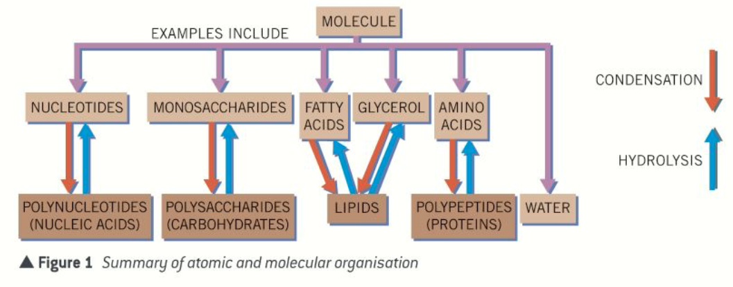
Topic 1: Biological Molecules - 3.1.1 Monomers and Polymers (p4-5)
Can you explain that all living things have a similar biochemical basis?
What is a monomer?
Can you give some examples of monomers?
Can you describe what a condensation reaction is?
What is a polymer?
Can you give some examples of polymers?
Can you describe what a hydrolysis reaction is?

Slide 3
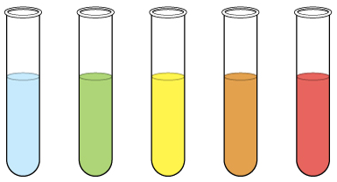
Topic 1: Biological Molecules - 3.1.2 Carbohydrates – monosaccharides and disaccharides (p8-11)
Can you describe how larger carbohydrates are made from monosaccharide monomers?
Can you list some common monosaccharides?
What are maltose, sucrose and lactose formed from?
Can you describe how disaccharides are formed?
Can you describe how glucose has two isomers and draw the two different isomers?
Explain how you would test for reducing and non-reducing sugars and the results you would expect:
Draw a diagram to show how a condensation reaction occurs between two monosaccharides to form maltose. Label the bond that forms.

Slide 4
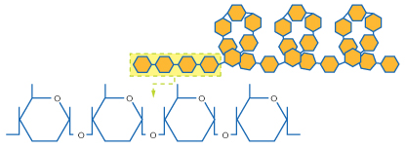
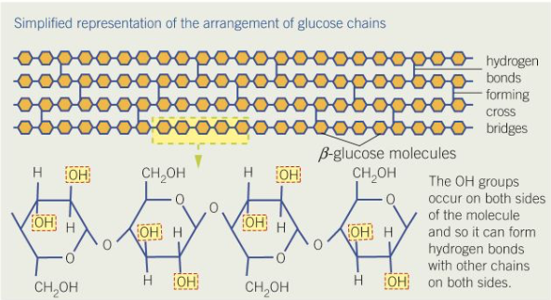
Topic 1: Biological Molecules - 3.1.2 Carbohydrates – polysaccharides (p11-15)
Can you describe how polysaccharides are formed?
Can you explain how you would test for starch and what result you would expect to see?
Can you explain how glycogen and starch are formed? Label the diagram.
Can you describe the relationship of structure to function of starch?
Can you describe the relationship of structure to function of glycogen?
Can you explain how cellulose is formed? Label the diagram.
Can you describe the relationship of structure to function of cellulose?

Slide 5
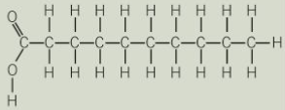
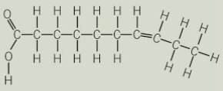
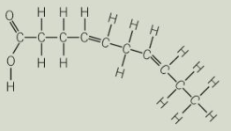
Topic 1: Biological Molecules - 3.1.3 Lipids (p16-17)
What are lipids?
Can you explain how triglycerides are formed? Draw a diagram to show this happening. Label the molecules involved, the type of reaction and the types of bonds formed.
Can you explain how the structure of triglycerides relates to their properties?
What are their roles?
Can you explain that the R-group of a fatty acid may be saturated or unsaturated? What do these terms mean?
Can you explain how phospholipids are formed? Draw a diagram to show this happening. Label the molecules involved and name the type of reaction. Label the hydrophilic and hydrophobic part of the molecule and explain what those terms mean.
Can you explain how the structure of phospholipids relates to their properties?
Can you describe how you would test for lipids?

Slide 6
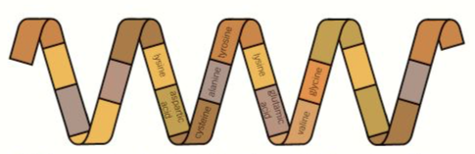

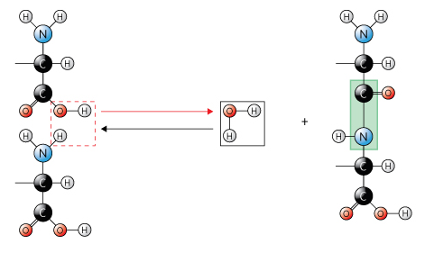
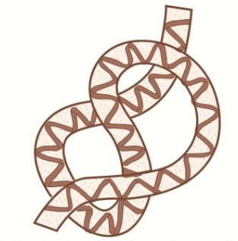
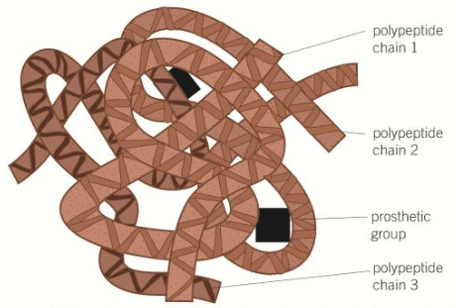
Topic 1: Biological Molecules - 3.1.4.1 Proteins (p19-22)
What is the general structure of an amino acid?
How does a polypeptide form?
Can you explain that a functional protein may contain one or more polypeptides?
How many different types of amino acid are there? How are they different?
Can you describe the relationship between primary, secondary, tertiary and quaternary structure, and protein function?
How do two amino acids form a dipeptide?

Slide 7
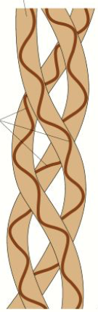
Topic 1: Biological Molecules - 3.1.4.1 Proteins (p19-22)
Can you explain that proteins have a variety of functions within all living organisms?
Can you describe the role of hydrogen bonds, ionic bonds and disulfide bridges in the structure of proteins?
Can you relate the structure of proteins to properties of a variety of proteins? Globular and fibrous proteins
Can you describe how you would test for proteins?

Slide 8
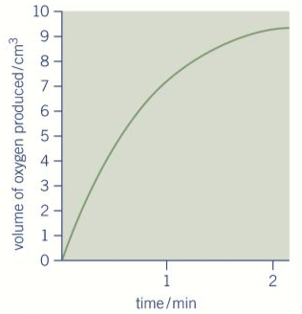
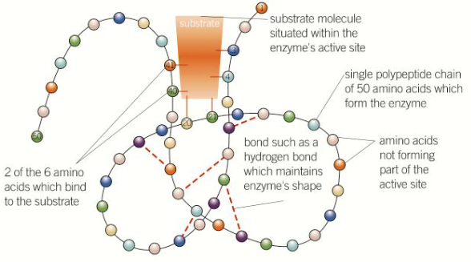
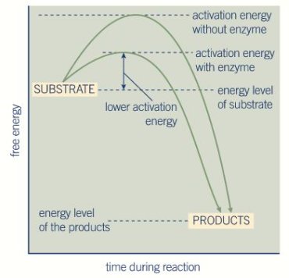
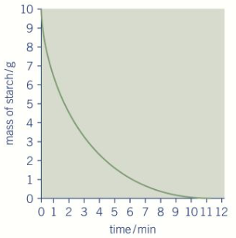
Topic 1: Biological Molecules - 3.1.4.2 Enzymes (p23-33)
Can you explain how each enzyme lowers the activation energy of the reaction it catalyses?
How does an enzyme’s structure relate to it’s function?
Describe how you could measure the rate of an enzyme-catalysed reaction and explain the results you would expect?
Can you draw a diagram to describe the induced-fit model of enzyme action ?
Can you describe how models of enzyme action have changed over time? (Hint: lock and key model)

Slide 9
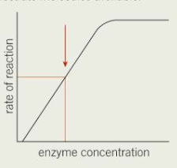
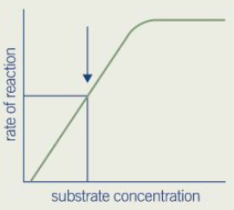
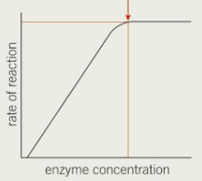
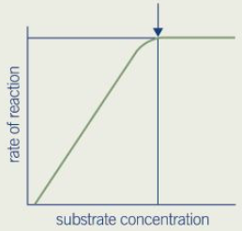
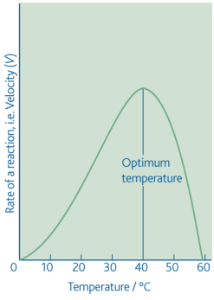
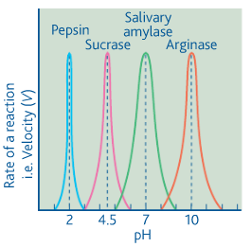
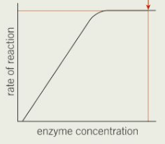
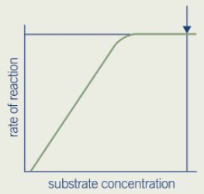
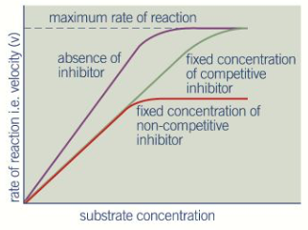
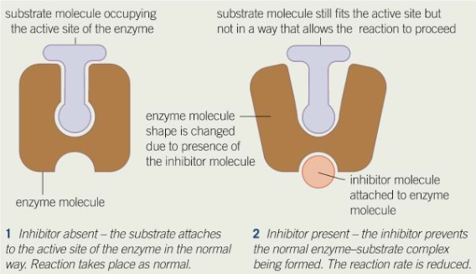
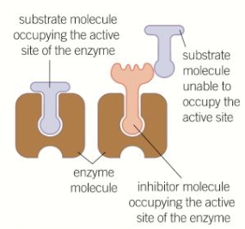
Topic 1: Biological Molecules - 3.1.4.2 Enzymes (p23-33)
How does the temperature affect the rate of an enzyme-controlled reaction?
How does the pH affect the rate of an enzyme-controlled reaction?
How does the substrate concentration affect the rate of an enzyme-controlled reaction?
How does the enzyme concentration affect the rate of an enzyme-controlled reaction?
How does the concentration of competitive inhibitor affect the rate of an enzyme-controlled reaction?
How does the concentration of non-competitive inhibitor affect the rate of an enzyme-controlled reaction?

Slide 10
Topic 1: Biological Molecules - 3.1.5.1 Nucleic acid structure (p36-41)
What are DNA and RNA and what are their functions?
Explain the complementary base pairing rules:
How is the structure of DNA related to its function?
What is the structure of a nucleotide? Draw and label a nucleotide.
What is a phosphodiester bond and how is it formed?
Can you compare and contrast the components of a DNA and RNA nucleotide:
Can you compare and contrast the structure of DNA and RNA molecules?
Can you explain how the relative simplicity of DNA led many scientists to doubt that it carried the genetic code?

Slide 11
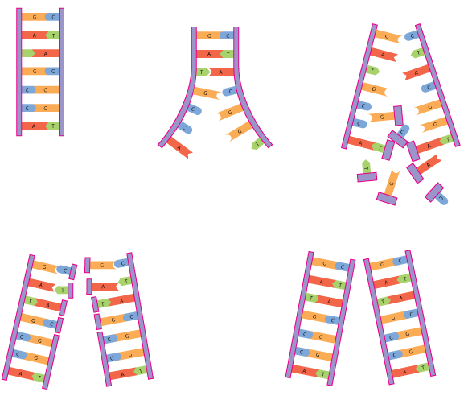
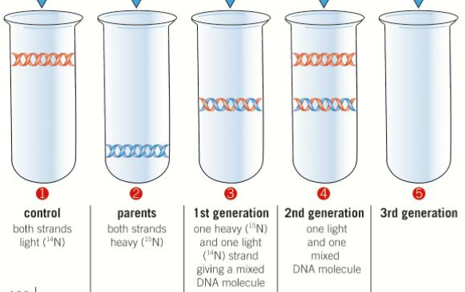
Topic 1: Biological Molecules - 3.1.5.2 DNA Replication (p42-45)
Can you describe the semi-conservative method of DNA replication?
Can you evaluate the work of scientists in validating the Watson–Crick model of DNA replication?

Slide 12
Topic 1: Biological Molecules - 3.1.6 ATP (p44-47)
Can you describe how a single molecule of adenosine triphosphate (ATP) is a nucleotide derivative?
Can you explain how ATP is converted to ADP? Include the type of reaction that it is and the enzyme that catalyses it.
Can you explain how ATP is resynthesised from ADP? Include the type of reaction that it is and the enzyme that catalyses it.
What three ways is ATP resynthesised?
Draw a labelled molecule of ATP:
Why is ATP suitable for its function?
What are the roles of ATP?

Slide 13
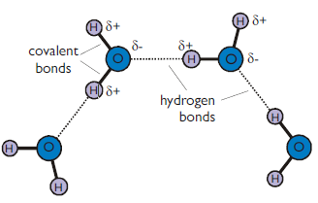
Topic 1: Biological Molecules - 3.1.7 Water and 3.1.8 Inorganic Ions (p47-48)
Draw a water molecule and explain what is meant by dipolar:
Explain how water hydrogen bonds:
Inorganic ions occur in solution in the cytoplasm and body fluids of organisms. Each ion has a specific role, depending on its properties.
Can you recognise the role of the following ions:
hydrogen ions and pH
iron ions as a component of haemoglobin
sodium ions in the co-transport of glucose and amino acids
phosphate ions as components of DNA and of ATP
What are the properties that are important in water? How are these properties linked the the polar nature of the molecule? What is the significance of these properties to living organisms and processes?
Try to use the following terms in your answer: solvent, specific heat capacity, latent heat of vaporisation, cohesion, metabolite, density, transparent.

