Slide 1
AS Level Paper 1 and 2. A2 Level Paper 1 and 3 - Topics 1-4
Section 3.1: Biological Molecules
3.1.1 Monomers and Polymers
3.1.2 Carbohydrates
3.1.3 Lipids
3.1.4.1 Proteins
3.1.4.2 Enzymes
3.1.5.1 Nucleic acid structure
3.1.5.2 DNA Replication
3.1.6 ATP
3.1.7 Water
3.1.8 Inorganic Ions
Section 3.3 Organisms exchange substances with their environment
3.3.1 Surface area to volume ratio
3.3.2 Gas exchange
3.3.3 Digestion and absorption
3.3.4.1 Mass transport in animals
3.3.4.2 Mass transport in plants
Section 3.4 Genetic information, variation and relationships between organisms
3.4.1 DNA, genes and chromosomes
3.4.2 DNA and protein synthesis
3.4.3 Genetic diversity - mutations and meiosis
3.4.4 Genetic diversity and adaptation – natural selection
3.4.5 Species and taxonomy
3.4.6 Biodiversity
3.4.7 Investigating biodiversity
Section 3.2: Cells
3.2.1.1 Eukaryotic cells
3.2.1.2 Prokaryotic cells and viruses
3.2.1.3 Studying cells
3.2.2 All cells arise from other cells
3.2.3 Transport across cell membranes
3.2.4 Cell recognition and the immune system

Slide 2
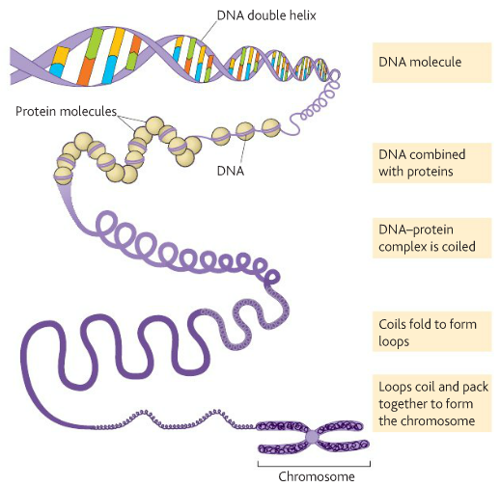
Topic 4: 3.4.1 DNA, genes and chromosomes (p202-207)
What is a gene?
What is an allele?
Can you distinguish between the DNA in prokaryotic cells and the DNA in eukaryotic cells?
Can you explain that the mitochondria and chloroplasts of eukaryotic cells also contain DNA?
What is the genetic code?
Can you describe how a DNA molecule and its associated proteins form a chromosome?
What are the features of the genetic code?
Can you explain what is meant by homologous chromosomes?

Slide 3
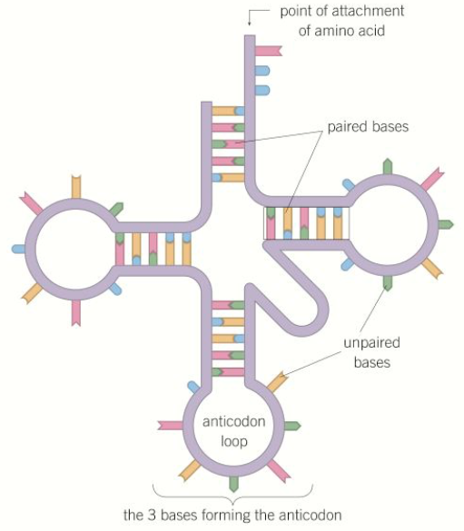
Topic 4: 3.4.2 DNA and protein synthesis (p208-216)
What is meant by the terms genome and proteome?
What is the structure of RNA?
Where would you find ribosomal RNA (rRNA)?
Can you describe the structure and function of messenger RNA (mRNA)?
Can you describe the structure and function of transfer RNA (tRNA)?

Slide 4
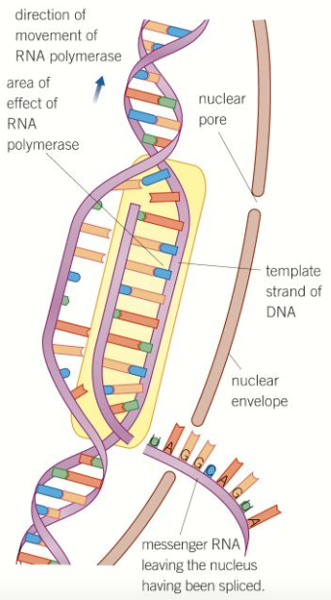
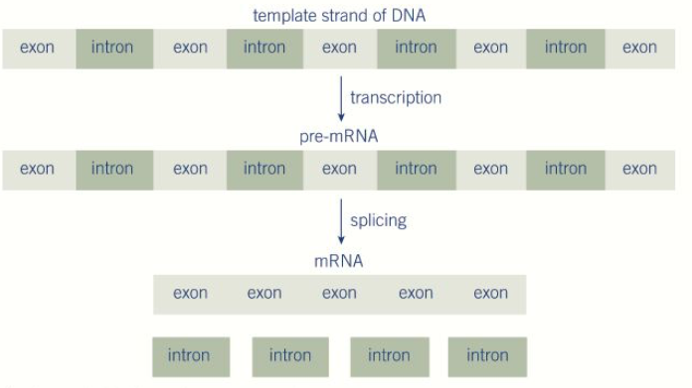
Topic 4: 3.4.2 DNA and protein synthesis (p208-216)
Can you explain what happens during transcription?
Can you explain what happens during splicing?
Remember this does not occur in prokaryotes!

Slide 5
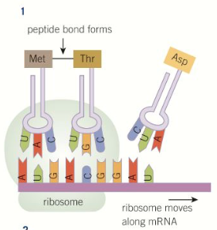
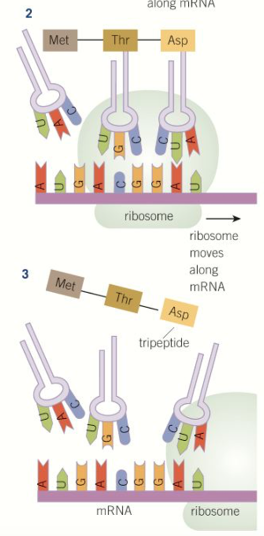
Topic 4: 3.4.2 DNA and protein synthesis (p208-216)
Can you explain what happens during translation?
How might a protein be assembled?
Can you describe the roles of ribosomes, tRNA, and ATP?

Slide 6
Topic 4: 3.4.3 Genetic diversity - mutations (p220-223)
What is a gene mutation?
What is a substitution mutation and what could the possible effects be?
How and when do gene mutations arise?
Can you describe the effect of mutagenic agents?
What is a deletion mutation and what could the possible effects be?
What is a chromosome mutation?

Slide 7
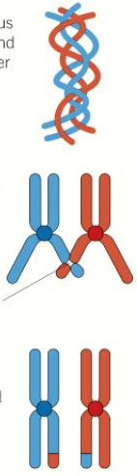
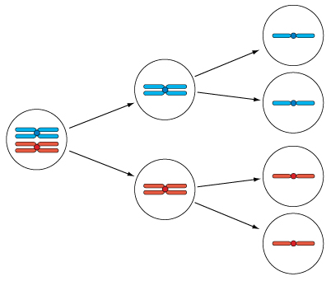
Topic 4: 3.4.3 Genetic diversity – meiosis (p224-228)
Why is meiosis necessary? What types of cells does meiosis result in?
How does meiosis create genetic variation?
Can you describe the process of meiosis?
How would you calculate the possible chromosome combinations following meiosis? And the number of possible chromosome combinations produced from the fertilisation of two gametes?
Can you explain the different outcome of mitosis and meiosis?

Slide 8
Topic 4: 3.4.4 Genetic diversity and adaptation – natural selection (p229-230)
What is genetic diversity?
Can you list the principles of natural selection in the evolution of populations?
What factors influence genetic diversity?
Explain how genetic diversity is a factor in enabling natural selection to occur:
Explain how reproductive success affects allele frequency within a gene pool:

Slide 9
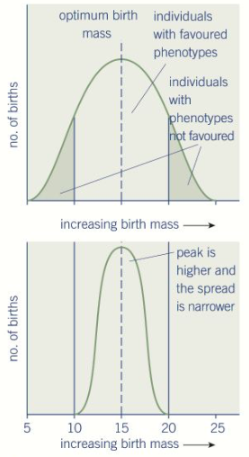
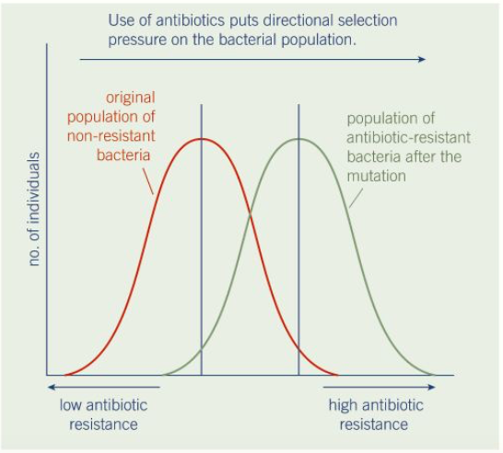
Topic 4: 3.4.4 Genetic diversity and adaptation – types of selection (p230-234)
Cab you describe directional selection, exemplified by antibiotic resistance in bacteria?
Can you describe stabilising selection, exemplified by human birth weights?
Can you describe how adaptations may be anatomical, physiological or behavioural?

Slide 10
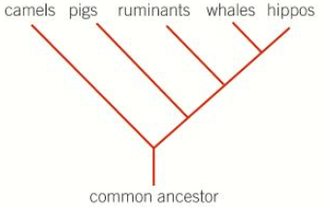
Topic 4: 3.4.5 Species and taxonomy (p237-242)
What is a species?
What is a hierarchy?
Can you explain how we organise the groups of species?
D
K
P
C
O
F
G
S
How are species named?
What are the principles of classification?
Artificial vs Phylogenetic classification:
What is phylogeny?

Slide 11
Topic 4: 3.4.5 Species and taxonomy (p237-242)
What are some difficulties of defining a species?
What is the role of courtship in ensuring successful mating?
How does courtship help members of a species recognise each other?

Slide 12
Topic 4: 3.4.6 Biodiversity (p243-248)
What is meant by biodiversity?
What is meant by species diversity?
What is meant by genetic diversity?
What is meant by ecosystem diversity?
Can you describe the impact of agriculture on species diversity?
What is a diversity index and how is it used as a measure of species diversity?
Can you explain the balance between conservation and farming?

Slide 13
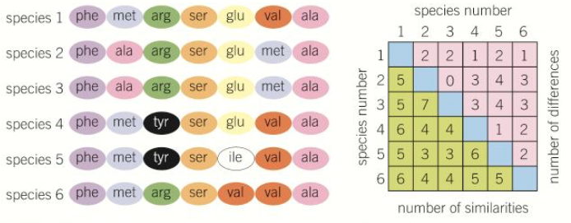
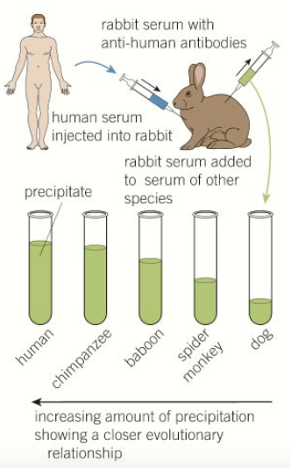
Topic 4: 3.4.7 Investigating biodiversity (p249-252)
How can you identify genetic diversity within, or between species by using the frequency of measurable or observable characteristics?
How can you identify genetic diversity within, or between species by using the amino acid sequence of the proteins encoded by DNA and mRNA?
How can you identify genetic diversity within, or between species by using the base sequence of DNA?
How can you identify genetic diversity within, or between species by using immunological comparison of proteins?
How can you identify genetic diversity within, or between species by using the base sequence of mRNA?

Slide 14
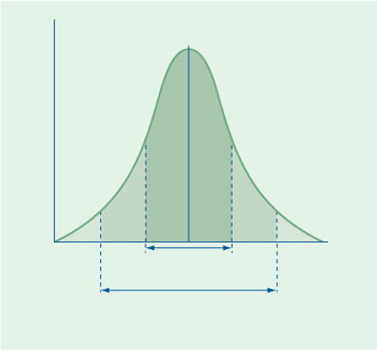
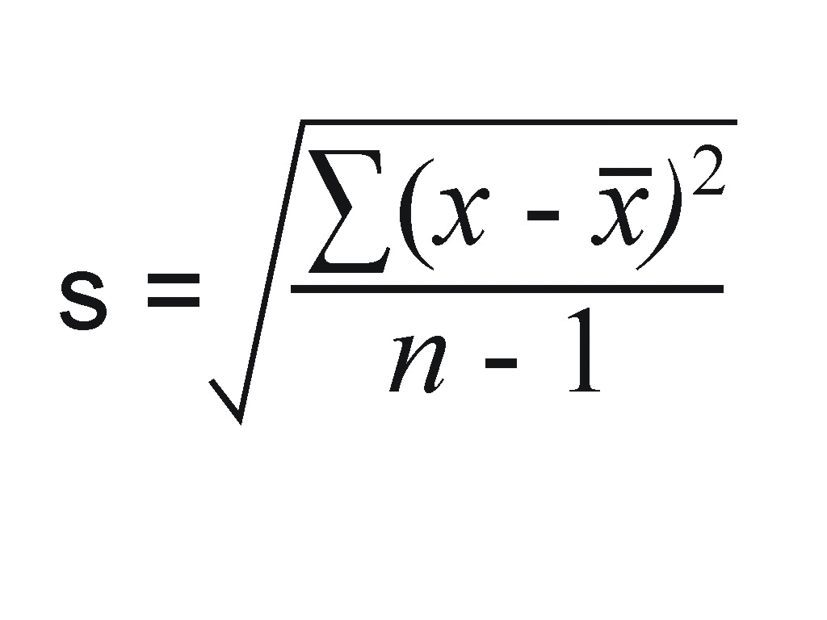
Topic 4: 3.4.7 Investigating biodiversity (p253-256)
How is variation measured?
What are the different types of variation and their causes?
What is sampling and why is it used?
How do we minimise the effect of chance when sampling?
What is the normal distribution curve?
How do we calculate the standard deviation? What does it show us?
∑ = the sum of
x = measured value (from the sample)
x̄ = mean value
n = the total number of values in the sample
How do you calculate the mean, mode and median?

