Slide 1

AQA GCSE
Year 10 SCIENCE
Knowledge Organiser

Slide 2
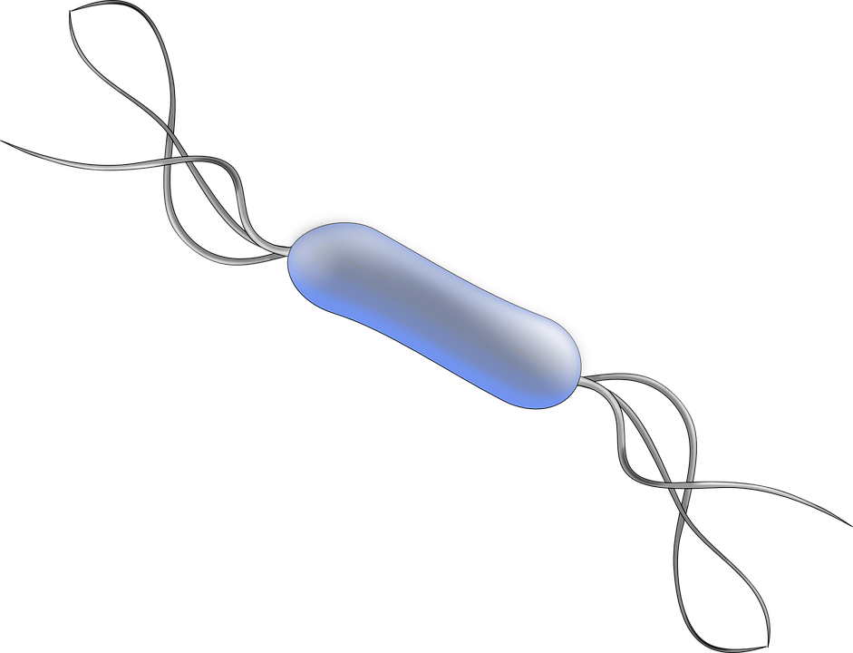
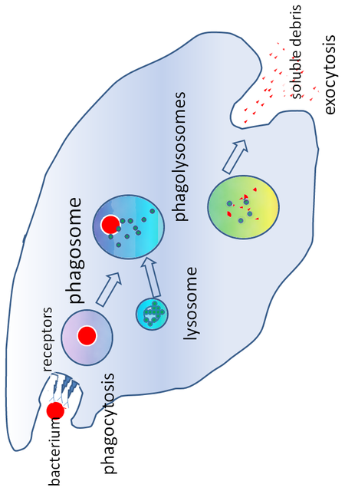
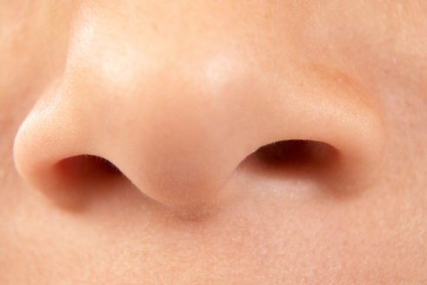
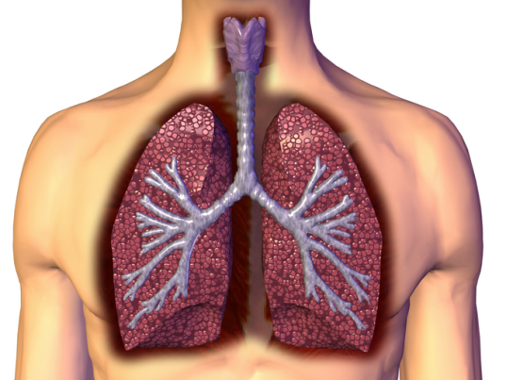
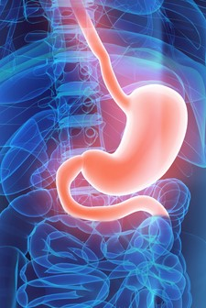
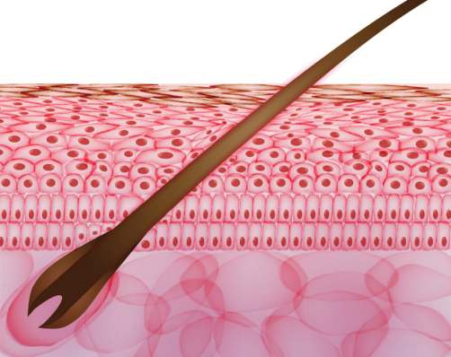
Phagocytes | Phagocytosis | Phagocytes engulf the pathogens and digest them.
Lymphocytes | Antibody production | Specific antibodies destroy the pathogen. This takes time so an infection can occur. If a person is infected again by the same pathogen, the lymphocytes make antibodies much faster.
 | Antitoxin production | Antitoxin is a type of antibody produced to counteract the toxins produced by bacteria.
Antigens (surface protein)
Pathogens are identified by white blood cells by the different proteins on their surfaces ANTIGENS.
The human body has several non specific ways of defending itself from pathogens getting in |  | Nose | Nasal hairs, sticky mucus and cilia prevent pathogens entering through the nostrils.
 |  | Trachea and bronchus (respiratory system) | Lined with mucus to trap dust and pathogens. Cilia move the mucus upwards to be swallowed.
 |  | Stomach acid | Stomach acid (pH1) kills most ingested pathogens.
 |  | Skin | Hard to penetrate waterproof barrier. Glands secrete oil which kill microbes
White blood cells are part of the immune system
Immune system
Non-specific defence systems
Detection and identification of plant diseases (bio only) | Detection | Identification
 | Stunted growth | Reference using gardening manual or website, laboratory test for pathogens, testing kit using monoclonal antibodies.
 | Spots on leaves
 | Area of decay
 | growths
 | Malformed stem/leaves
 | Discolouration
 | Presence of pests
AQA GCSE INFECTION AND RESPONSE part 1
Human defence systems
Plants have several ways of defending themselves from pathogens and animals
Physical | Mechanical
Thick waxy layers, cell walls stop pathogen entry | Thorns, curling up leaves to prevent being eaten
Chemical
Antibacterial and toxins made by plant
Pathogens may infect plants or animals and can be spread by direct contact, water or air
Pathogen | Disease | Symptoms | Method of transmission | Control of spread
Virus | Measles | Fever, red skin rash. | Droplet infection from sneezes and coughs. | Vaccination as a child.
Virus | HIV | Initially flu like systems, serious damage to immune system. | Sexual contact and exchange of body fluids. | Anti-retroviral drugs and use of condoms.
Virus | Tobacco mosaic virus | Mosaic pattern on leaves. | Enters via wounds in epidermis caused by pests. | Remove infected leaves and control pests that damage the leaves.
Bacteria | Salmonella | Fever, cramp, vomiting, diarrhoea. | Food prepared in unhygienic conditions or not cooked properly. | Improve food hygiene, wash hands, vaccinate poultry, cook food thoroughly.
Bacteria | Gonorrhoea | Green discharge from penis or vagina. | Direct sexual contact or exchange of body fluids. | Use condoms. Treatment using antibiotics.
Protists | Malaria | Recurrent fever. | By an animal vector (mosquitoes). | Prevent breeding of mosquitoes. Use of nets to prevent bites.
Fungus | Rose black spot | Purple black spots on leaves. | Spores carried via wind or water. | Remove infected leaves. Spray with fungicide.
Nitrate ions needed for protein synthesis – lack of nitrate = stunted growth.
Magnesium ions needed to make chlorophyll – not enough leads to chlorosis – leaves turn yellow.
Bacteria may produce toxins that damage tissues and make us fell ill
Viruses | Bacteria (prokaryotes) | Protists (eukaryotes) | Fungi (eukaryotes)
e.g. cold, influenza, measles, HIV, tobacco mosaic virus | e.g. tuberculosis (TB), Salmonella, Gonorrhoea | e.g. dysentery, sleeping sickness, malaria | e.g. athlete’s foot, thrush, rose black spot
DNA or RNA surrounded by a protein coat | No membrane bound organelles (no chloroplasts, mitochondria or nucleus). Cell wall. Single celled organisms | Membrane bound organelles. Usually single celled. | Membrane bound organelles, cell wall made of chitin. Single celled or multi-cellular
Communicable diseases
Pathogens are microorganisms that cause infectious disease
Pathogens
Viruses live and reproduce inside cells causing damage

Slide 3
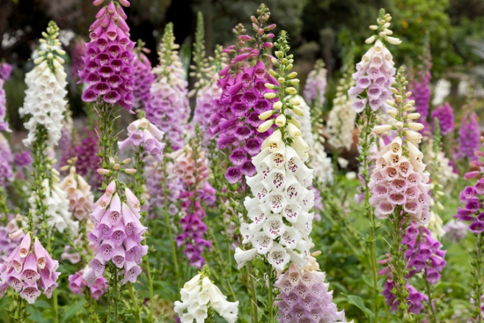

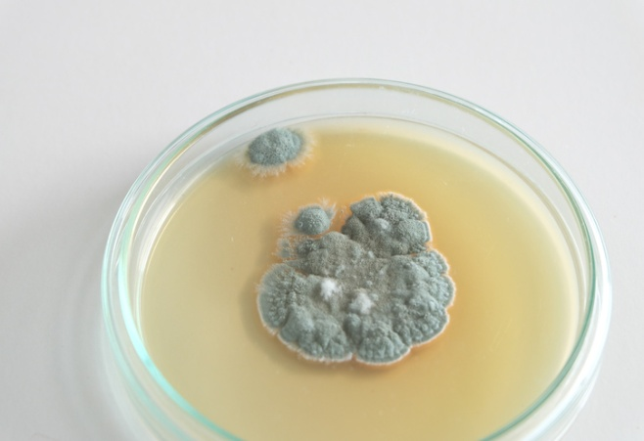
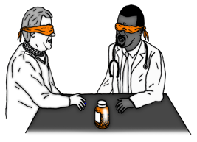
Traditionally drugs were extracted from plants and microorganisms
Digitalis | Aspirin | Penicillin
Extracted from foxglove plants and used as a heart drug | A painkiller and anti-inflammatory that was first found in willow bark | Discovered by Alexander Fleming from the Penicillium mould and used as an antibiotic
Antibiotics and painkillers
Antibiotics have greatly reduced deaths from infectious bacterial disease
antibiotics | e.g. penicillin | Kill infective bacteria inside the body. Specific bacterial infections require specific antibiotics.
Painkillers and other medicines | e.g. aspirin, paracetamol, ibuprofen | Drugs that are used to treat the symptoms of a disease. They do not kill pathogens
Antibiotics cannot be use to treat viral pathogens
Bacteria can mutate
Most new drugs are synthesised by chemists in the pharmaceutical industry.
Sometimes this makes them resistant to antibiotic drugs.
It is difficult to develop drugs to kill viruses without harming body tissues because viruses live and reproduce inside cells
Discovery and drug development
AQA
INFECTION AND RESPONSE
Vaccination
Drugs have to be tested and trialled before to check they are safe and effective
Used to immunise a large proportion of the population to prevent the spread of a pathogen
New drugs are extensively tested for: | Efficacy | Make sure the drug works
 | Toxicity | Check that the drug is not poisonous
 | Dose | The most suitable amount to take
Vaccination | Small amount of dead or inactive form of the pathogen | 1st infection by pathogen | White blood cells detect pathogens in the vaccine. Antibodies are released into the blood.
 |  | Re-infection by the same pathogen | White blood cells detect pathogens. Antibodies are made much faster and in larger amounts.
A person is unlikely to suffer the symptoms of the harmful disease and it’s spread in a population is prevented
Preclinical trials - using cells, tissues and live animals - must be carried out before the drug can be tested on humans.
Double blind trial: patients and scientists do not know who receives the new drug or placebo until the end of the trial. This avoids bias.
Clinical trials use healthy volunteers and patients
Created more side effects than expected (fatal in some cases) and are not as widely used as everybody hoped when first developed.
Stage 1 | Stage 2 | Stage 3 | Stage 4
Healthy volunteers try small dose of the drug to check it is safe record any side effects | A small number of patients try the drug at a low dose to see if it works | A larger number of patients; different doses are trialled to find the optimum dose | A double blind trial will occur. The patients are divided into groups. Some will be given the drug and some a placebo.
A placebo can look identical to the new drug but contain no active ingredients
Monoclonal antibodies can be used in a variety of ways
Diagnosis | Detecting pathogens | Detecting molecules | Treatment
e.g. pregnancy test – measure the level of hormones | Can detect very small quantities of chemicals in the blood | Fluorescent dye can be attached so it can be seen inside cells or tissues | Bound to radioactive substance, toxic drug or chemical Cancer cells are targeted to normal body cells are unharmed
Monoclonal antibodies | Identical copies of one types of antibody produced in laboratory | 1. A mouse is injected with pathogen
 |  | 2. Lymphocytes produce antibodies
 |  | 3. Lymphocytes are removed from the mouse and fused with rapidly dividing mouse tumour cells
 |  | 4. The new cells are called hybridomas
 |  | 5. The hybridomas divide rapidly and release lots of antibodies which are then collected
Monoclonal antibodies (Biology only HT)
Specific to one binding site on the antigen. Can target specific chemicals or cells in the body

Slide 4
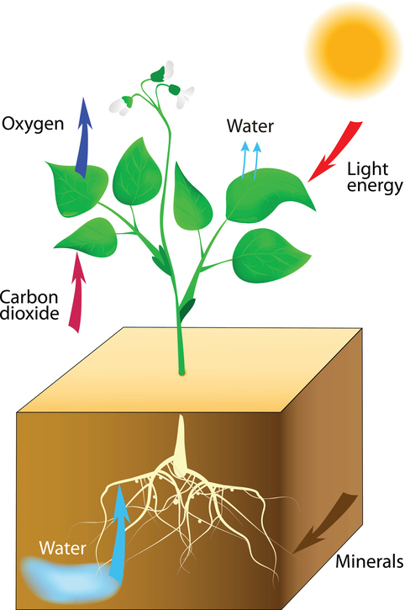
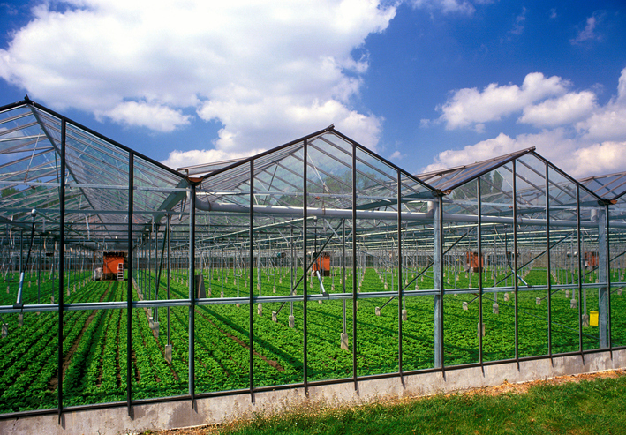
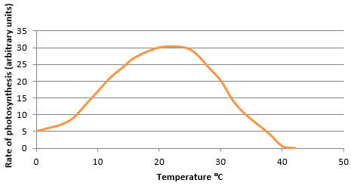
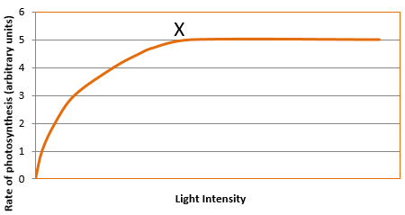
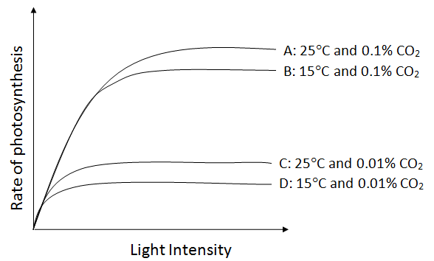
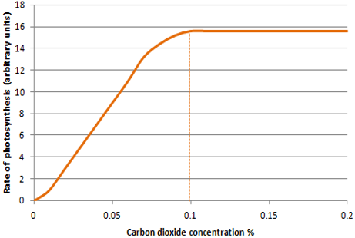
Respiration, stored as insoluble starch, fats or oils for storage, cellulose for cell walls, combine with nitrates from the soil to form amino acids for protein synthesis
Control conditions in greenhouses to reduce limiting factors can improve crop yields | Heating | Used to provide optimum temperatures for maximum plant growth.
 | Artificial lighting | Enhances the natural sunlight especially overnight and on cloudy days.
 | Extra carbon dioxide | Gas can be pumped into the air inside the greenhouse.
Growers must balance the economics of additional costs of controlling the conditions to maximise photosynthesis with making a profit.
permanent vacuole
Plants use the glucose produced in photosynthesis in a variety of ways
nucleus
chloroplasts
cytoplasm
cell membrane
cell wall
Photosynthetic reaction
The plant manufactures glucose from carbon dioxide and water using energy transferred from the environment to the chloroplasts by light
Photosynthesis | Plants make use of light energy from the environment (ENDOTHERMIC) to make food (glucose) | Carbon dioxide + Water Oxygen + Glucose
 |  | CO₂ + H₂O O₂ + C₆H₁₂O₆
AQA GCSE BIOENERGETICS part 1
light
Rate of photosynthesis
Rate of photosynthesis HT Only
light
Graph lines C and D: If temperature is increased by 10ºC then a slight increase in rate of photosynthesis occurs.
The rate of photosynthesis is affected by temperature, light intensity, carbon dioxide concentration, and the amount of chlorophyll
Explain graphs of two or three factors and decide which is the limiting factor
Factors affecting the rate of photosynthesis | Factor | How the rate is affected | Limiting factors (why the rate stops going up)
 | Temperature | As the temperature of the environment the plant is in increases rate of photosynthesis increases (up to a point) as there is more energy for the chemical reaction. | Photosynthesis is an enzyme controlled reaction. If the temperature increases too much, then the enzymes become denatured and the rate of reaction will decrease and stop
 | Light intensity | Light intensity increases as the distance between the plant and the light sources increases. As light intensity increases so does the rate of photosynthesis (up to a point) as more energy is available for the chemical reaction. | At point X another factor is limiting the rate of photosynthesis. This could be carbon dioxide concentration, temperature or the amount of chlorophyll
 | Carbon dioxide concentration | Carbon dioxide is needed for plants to make glucose. The rate of photosynthesis will increase when a plant is given higher concentrations of carbon dioxide (up to a point). | At point X another factor is limiting the rate of photosynthesis. This could be light intensity, temperature or the amount of chlorophyll
 | Amount of chlorophyll | Chlorophyll is a photosynthetic pigment that absorbs light and allows the reaction between water and carbon dioxide to occur (photosynthesis) | Another factor could limit the rate of photosynthesis. This could be light intensity, temperature or the carbon dioxide concentration
Graph Lines A and B: If carbon dioxide concentration is increased from 0.01% to 0.1% then a large increase in rate occurs up to a point.
Graph lines A and D: If carbon dioxide concentration and temperature are increased the rate of photosynthesis increases significantly up to a point.
Light intensity obeys the inverse square law. This means that if you double the distance between the plant and the light source you quarter the light intensity
x
Graph line A: Rate could be limited by temperature and/or amount of chlorophyll. Plant tissue can be damaged when carbon dioxide concentrations exceed 0.1%

Slide 5
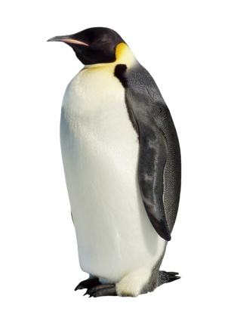


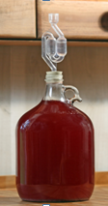
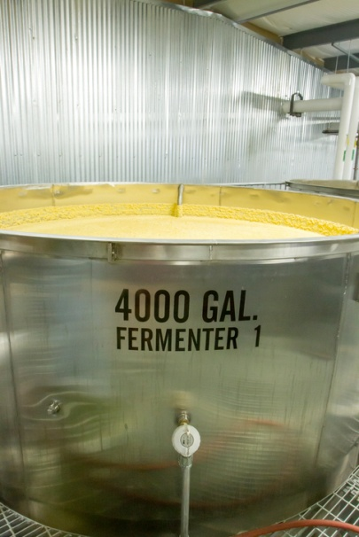
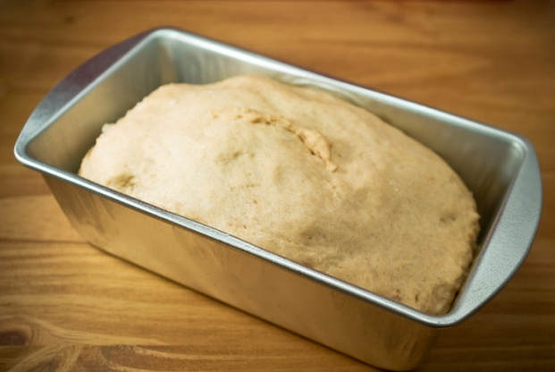
An organism will receive all the energy it needs for living processes as a result of the energy transferred from respiration | For movement |  | To enable muscles to contract in animals.
 | For keeping warm |  | To keep a steady body temperature in a cold environment.
 | For chemical reactions |  | To build larger molecules from smaller one.
During long periods of vigorous activity muscles become fatigued and stop contracting efficiently
cytoplasm
mitochondria
Electron micrograph of a mitochondrion
animal cell
plant cell
Response to exercise
Respiration
Anaerobic respiration
Respiration when oxygen is in short supply. Occurs during intensive exercise
During hard exercise, muscle cells are respiring so fast that blood cannot transport enough oxygen to meet their needs. Glucose is partially oxidised to produce lactic acid which builds up in muscle tissue causing them to become painful and fatigued.
glucose lactic acid
Aerobic respiration
Respiration with oxygen. Occurs inside the mitochondria continuously
Glucose is oxidised by oxygen to transfer the energy the organism needs to perform it’s functions.
C₆H₁₂O₆ + O₂ CO₂ + H₂O | glucose + oxygen carbon dioxide + water
During exercise the human body reacts to increased demand for energy | Heart rate increases | Top pump oxygenated blood faster to the muscle tissues and cells.
 | Breathing rate and breath volume increase | This increases the amount of oxygen entering the blood stream.
AQA GCSE BIOENERGETICS part 2
Cellular respiration is an exothermic reaction which is continuously occurring in all living cells
Metabolism is the sum of all the reactions in a cell or the body
Metabolism
Metabolism | The energy transferred by respiration in cells is used by the organism for the continual enzyme controlled processes of metabolism. | Conversion of glucose to starch, glycogen and cellulose.
 |  | The formation of lipid molecules from a molecule of glycerol and three molecules of fatty acid.
 |  | The use of glucose and nitrate ions to form amino acids which in turn are used to synthesise proteins.
 |  | Respiration
 |  | Breakdown of excess proteins to form urea for excretion.
Anaerobic respiration in plant and yeast cells
The end products are ethanol and carbon dioxide. Anaerobic respiration in yeast cells is called fermentation
glucose ethanol + carbon dioxide
This process is economically important in the manufacture of alcoholic drinks and bread.
Anaerobic respiration releases a much smaller amount of energy than aerobic respiration.
The extra amount of oxygen required to remove all lactic acids from cells is called the oxygen debt
Lactic acid builds up in the muscles cells during exercise
Blood flows through the muscle cells and transports the lactic acid to the liver
The liver oxidises the lactic acid and converts it back to glucose
Response to exercise HT only
The incomplete oxidation of glucose causes a build up of lactic acid and creates an oxygen debt
Aerobic respiration releases a large amount of energy from each glucose molecule

Slide 6
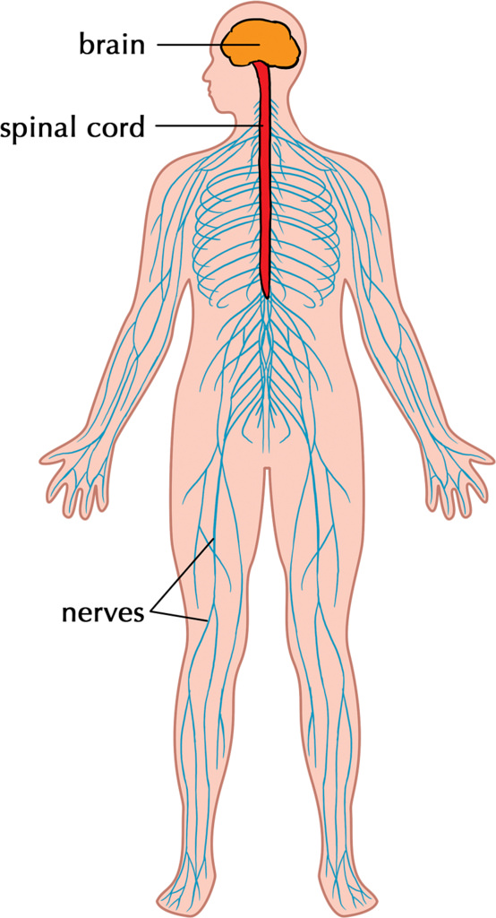
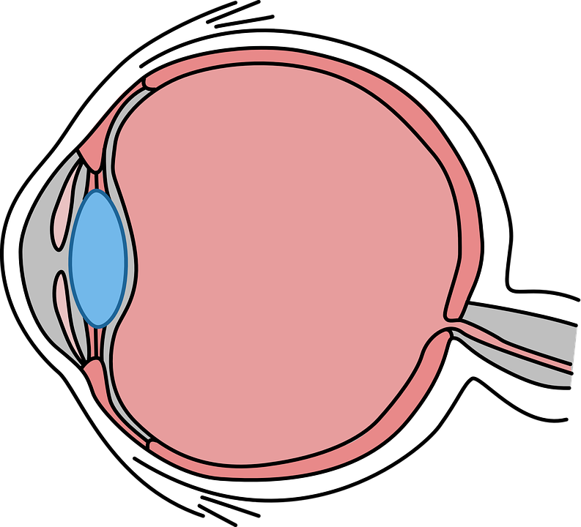
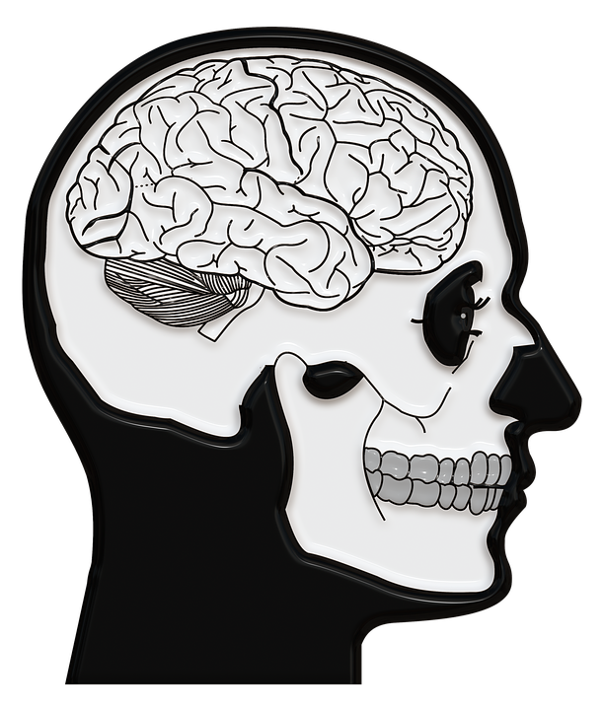
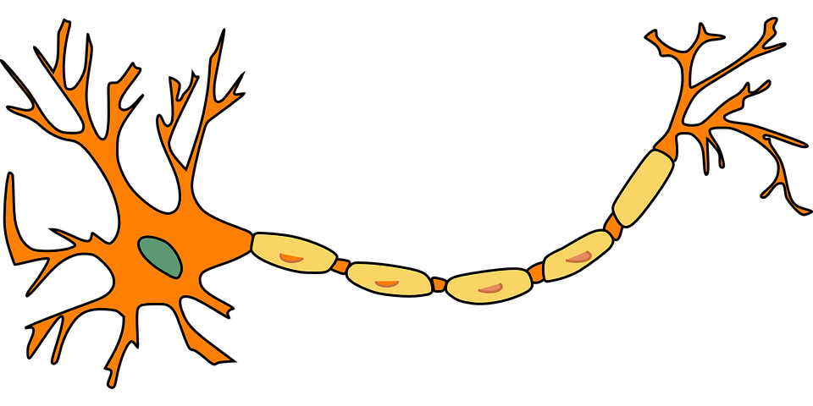
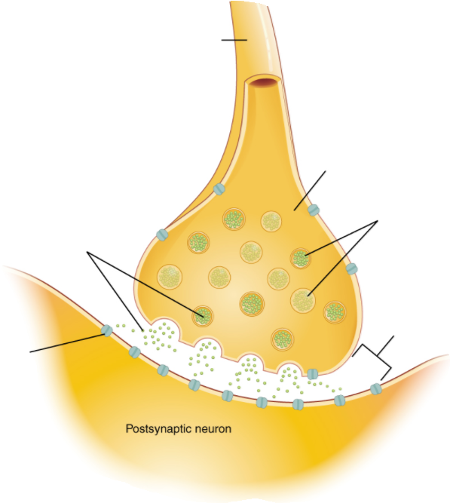
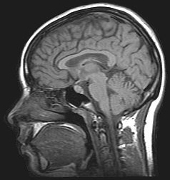
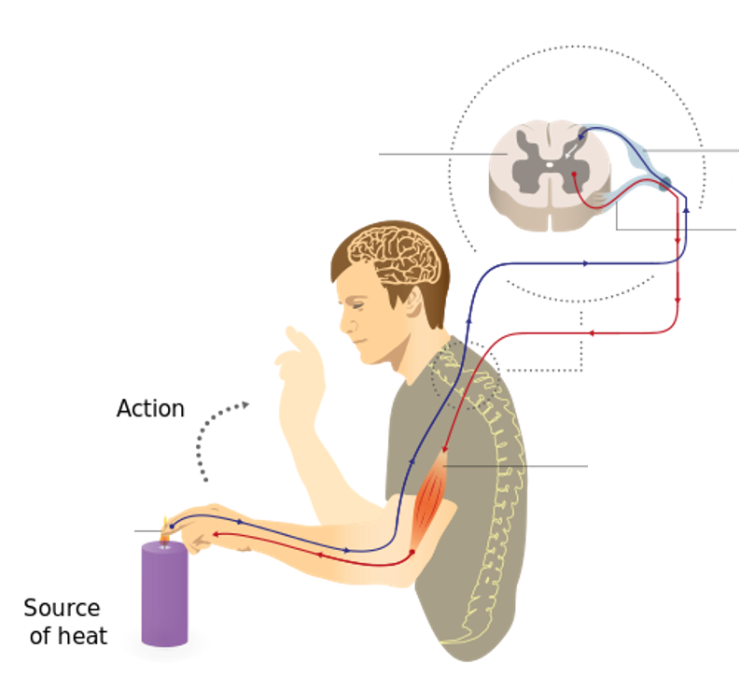
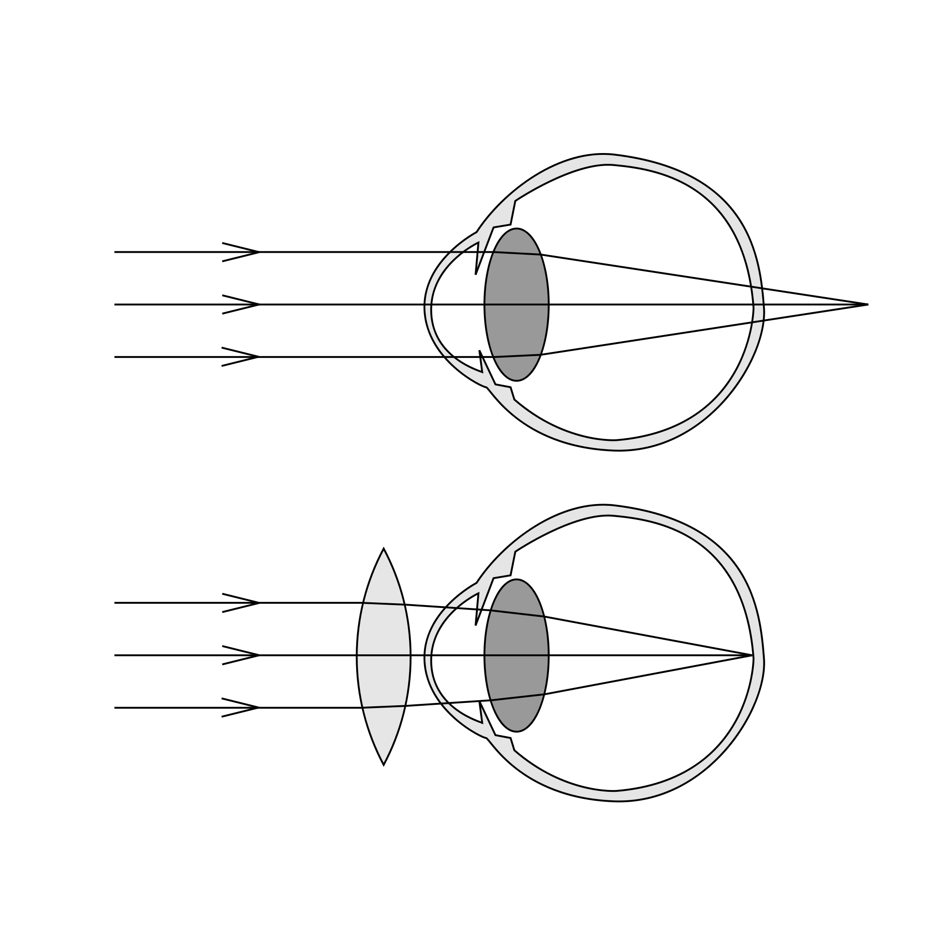
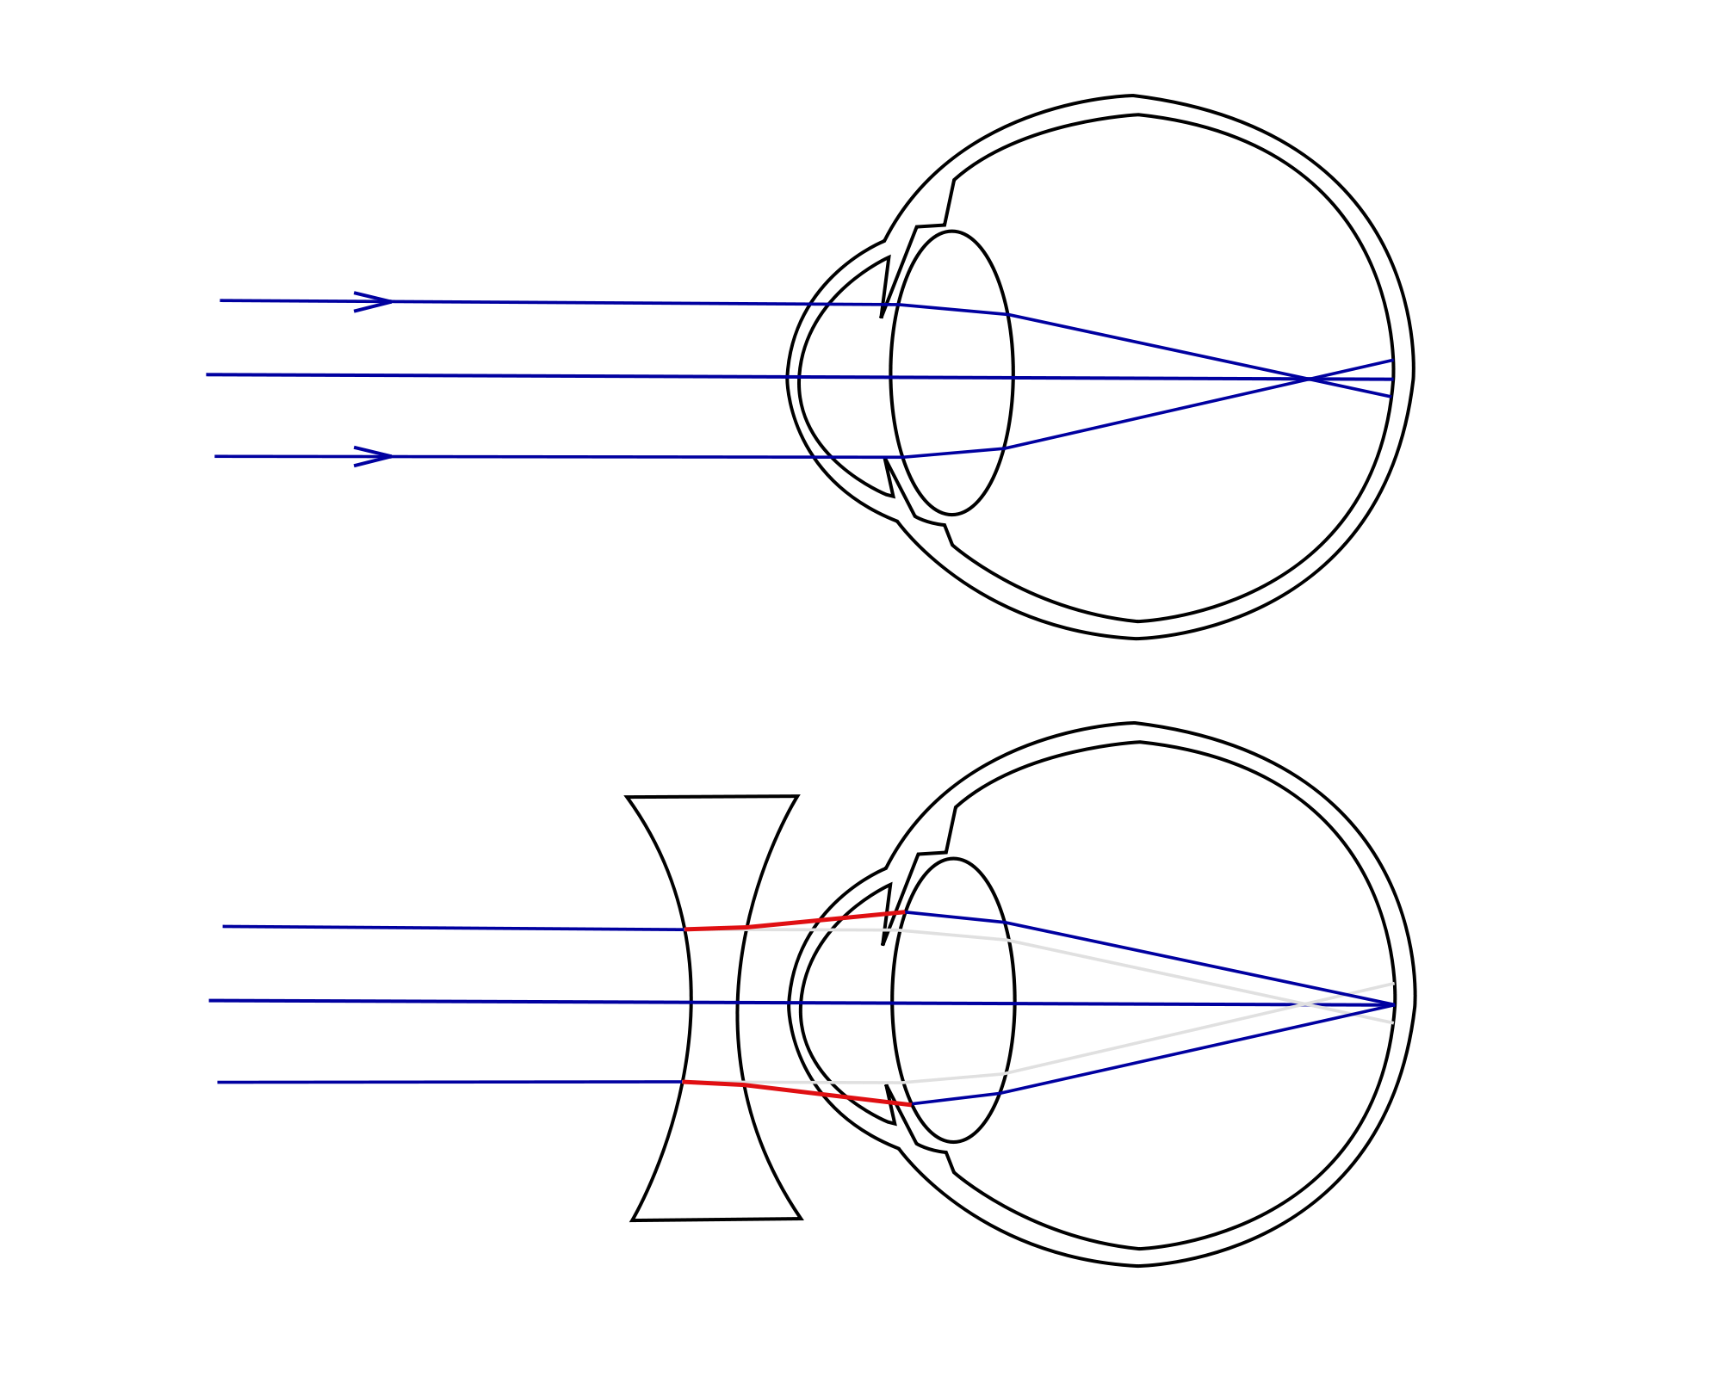
The iris can dilate the pupil (aperture) to let in more light in dim conditions
Sense organ containing receptors sensitive to light intensity and colour
Human control systems include | Cells called receptors | Detect stimuli (changes in environment).
 | Coordination centres | e.g. brain, spinal cord and pancreas that receive information from receptors.
 | Effectors | Muscles or glands, which bring about responses to restore optimum levels.
Enables humans to react to their surroundings and to co-ordinate their behaviour
Structures of the eye | Retina | Light sensitive cell layer.
 | Optic nerve | Carries impulse to brain.
 | Sclera | Protects the eye.
 | Cornea | Transparent layer that covers the pupil and iris.
 | Iris | Pigmented layer, controls size of pupil.
 | Ciliary muscles | Controls thickness of lens.
 | Suspensory ligaments | Connects lens to ciliary muscles.
Information from receptors passes along cells (neurones) as electrical impulses to the central nervous system (CNS)
The CNS is the brain and the spinal cord.
Coordinates the response of effectors; muscles contracting or glands secreting hormones
Stimulus | Lights switch on
Receptor | Cells in retina
Coordinator | CNS
Effector | Muscles connected to iris
Response | Pupils get smaller
The Eye (Bio only)
AQA GCSE HOMEOSTASIS AND RESPONSE part 1
The human nervous system
suspensory ligament
sclera
cornea
retina
optic nerve
cerebral cortex
The Brain
(Bio only)
iris
dendrites
ciliary muscles
cerebellum
The brain controls complex behaviour. It is made of billions of interconnected neurones.
cell body
Accommodation is the process of changing the shape of the lens to focus
Near object | Far object
Ciliary muscles contract, suspensory ligaments loosed, lens get thicker, light is more refracted. | Ciliary muscles relax, suspensory ligaments pulled tight, lens pulled thin, light is only slightly refracted.
Neuroscientists have been able to map regions of the brain by studying patients with brain damage, electrical stimulation and MRI.
axon terminal
medulla
nucleus
axon with insulating sheath
The brain has different regions that carry out different functions. | Cerebral cortex | Largest part of the human brain. Higher thinking skills e.g. speech, decision making.
 | Cerebellum | Balance and voluntary muscle function e.g. walking, lifting.
 | Medulla | Involuntary (automatic) body functions e.g. breathing, heart rate.
Typical motor neurone
Synapse (gap where two neurones meet).
(HT) The complexity and delicacy of the brain makes investigating and treating brain disorders very difficult
axon
direction of impulse
axon terminal
neurotransmitter
vesicles
Hyperopia (long sightedness) | Myopia (short sightedness)
Treated using a convex lens so the light is focused on the retina. | Treated using a concave lens so light is focused on the retina.
Synaptic cleft
neurotransmitter
receptors
spinal cord
sensory neurone
Treating brain damage and disease | e.g. Lobotomy – cutting part of the cerebral cortex | Benefit: thought to alleviate the symptoms of some mental illnesses.
 |  | Risks: bleeding in the brain, seizures, loss of brain function. Procedure was abandoned in the 1950s due to risk.
Reflex arc | Receptor | Detect stimuli.
 | Sensory neurone | Long axon carries impulse from receptor to spinal cord.
 | Synapse | Gap where neurones meet. Chemical message using neurotransmitter.
 | Relay neurone | Allows impulses to travel between sensory and motor neurones in the spinal cord.
 | Motor neurone | Long axon carries impulse from receptor to effector.
 | Effector | Muscle or gland that carries out response.
motor neurone
pain receptors
muscle (effector)
New technologies now include hard/soft contact lens, laser surgery to change the shape of the cornea and a replacement lens in the eye.
Reflex actions are automatic and rapid; they do not involve the conscious part of the brain and can protect humans from harm.

Slide 7
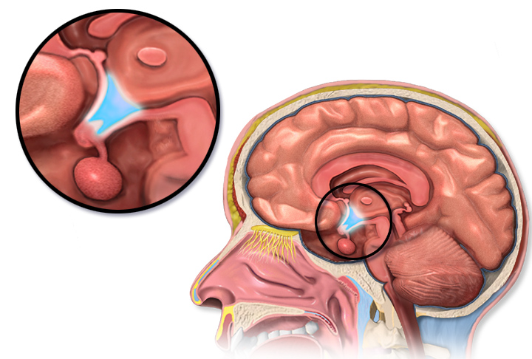


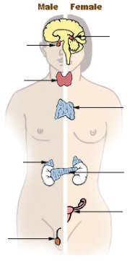
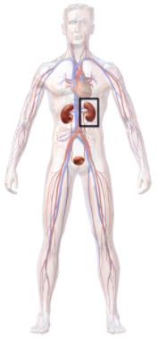
Monitoring body temperature | Thermoregulatory centre | Contains receptors sensitive to the temperature of the blood.
 | Skin | Contains temperature receptors, sends nervous impulses to the thermoregulatory centre.
Controls in the human body | Blood glucose concentration | These automatic control systems may involve nervous responses or chemical responses.
 | Body temperature
 | Water levels
Body temperature | Too high | Blood vessels dilate (vasodilation), sweat produced from sweat glands.
 | Too low | Blood vessels constrict (vasoconstriction), sweating stops, muscles contract (shivering).
Thermoregulatory centre (hypothalamus)
(HT) Thermal energy is lost from blood near the surface of the skin, sweat evaporates transferring thermal energy.
Response to internal and external change
The regulation of internal conditions of a cell or organism to maintain optimum conditions for function.
Control of body temperature
(Biology only)
(HT) Thermal energy loss at the surface of the skin is reduced, respiring muscles cells transfer chemical to thermal energy.
Homeostasis maintains optimal conditions for enzyme action and all cell functions.
Human endocrine system
Endocrine system | Composed of glands which secrete chemicals called hormones directly into the bloodstream. | The blood carries the hormone to a target organ where is produces an effect. Compared to the nervous system effects are slower but act for longer.
AQA GCSE HOMEOSTASIS AND RESPONSE PART 2
Pituitary
gland
Pineal
gland
Homeostasis
Thyroid
Water and nitrogen balance
(Biology only)
Thymus
Adrenal
gland
Pituitary gland | ‘Master gland’; secretes several hormones into the blood | Stimulates other glands to produce hormones to bring about effects.
If body cells lose or gain too much water by osmosis they do no function efficiently. | Uncontrolled water/ion urea loss | Water exhaled in lungs, water, ions and urea in sweat.
 | Controlled water/ion/urea loss | Via the kidneys in urine.
Control of blood glucose concentration
Pancreas
Ovaries
Testes
Blood glucose concentration
Monitored and controlled by the pancreas
Too high | (HT only) Too low
Pancreas produces the hormone insulin, glucose moves from the blood into the cells. In liver and muscle cells excess glucose is converted to glycogen for storage. | Pancreas produces the hormone glucagon that causes glycogen to be converted into glucose and released into the blood.
Negative feedback (HT only) | Adrenaline | Produced in adrenal glands, increases breathing/heart rate, blood flow to muscles, conversion glycogen to glucose. Prepares body for ‘fight or flight’.
 | Thyroxine | Produced in the thyroid gland, stimulates the basal metabolic rate. Important in growth and development.
Kidney failure is treated by organ transplant or dialysis.
(HT only) digestion of proteins results in excess amino acids. In the liver they are de-aminated to form toxic ammonia which is converted to urea
Kidney function | Maintain water balance of the body. | Produce urine by filtration of the blood and selective reabsorption of glucose, ions and water.
A dialysis machine removes urea from the blood by diffusion while maintaining ion and glucose levels.
(HT) Rising glucose levels inhibit the release of glucagon in a negative feedback system. Insulin is released to reduce glucose levels and which cause the pancreas to release glucagon
Increasing thyroxine levels prevent the release of thyroid stimulating hormone which stops the release of thyroxine.
Diabetes
Type 1 | Type 2
Pancreas fails to produce sufficient insulin leading to uncontrolled blood glucose levels. Normally treated by insulin injection. | Obesity is a risk factor. Body cells no longer respond to insulin. Common treatments include changing by diet and increasing exercise.
(HT only) ADH | Acts on kidney tubules to control water levels. | Released by pituitary gland when blood is too concentrated. Water is reabsorbed back into the blood from the kidney tubules (NEGATIVE FEEDBACK).

Slide 8
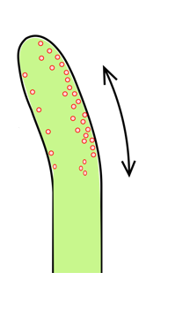

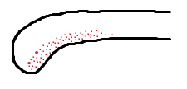
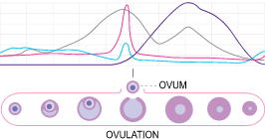
FSH and LH are used as ‘fertility drugs’ to help someone become pregnant in the normal way
Plant responses using hormones (auxins) | Light (phototropism) | Light breaks down auxins and they become unequally distributed in the shoot. The side with the highest concentration of auxins has the highest growth rate and the shoot grows toward the light.
 | Gravity (geotropism or gravitropism) | Gravity causes an unequal distribution of auxins. In roots the side with the lowest concentration has the highest growth rate and the root grows in the direction of gravity.
 |  | In new shoots from a seedling the unequal distribution of auxins causes the shoot to grow away from gravity.
In Vitro Fertilisation (IVF) treatment.
Involves giving a mother FSH and LH to stimulate the maturation of several eggs
The eggs are collected from the mother and fertilised by sperm from the father in a laboratory.
The fertilised eggs develop into embryos.
At the stage when they are tiny balls of cells, one or two embryos are inserted into the mother’s uterus (womb).
Plants produce hormones to coordinate and control growth
Hormones are used in modern reproductive technologies to treat infertility
Light
gravity
(HT only) Gibberellins are important in initiating seed germination.
(HT only) Ethene controls cell division and ripening of fruits.
The use of hormone to treat infertility (HT only)
Plant hormones
Plant growth hormones are used in agriculture and horticulture | Auxins | Weed killers, rooting powders, promoting growth in tissue culture.
 | Ethene | Control ripening of fruit during storage and transport.
 | Gibberellins | End seed dormancy, promote flowering, increase fruit size.
Use of plant hormones (HT only)
Potential disadvantages of IVF | Emotional and physical stress.
 | Success rates are not high.
 | Multiple births risk to mother and babies.
AQA GCSE HOMEOSTASIS AND RESPONSE PART 3
Hormones in human reproduction
Pituitary
gland
Pineal
gland
Contraception
During puberty reproductive hormones cause secondary sexual characteristics to develop
Oestrogen (main female reproductive hormone) | Testosterone (main male reproductive hormone)
Produced in the ovaries. At puberty eggs being to mature releasing one every 28 days – ovulation. | Produced in the testes stimulation sperm production.
Thyroid
Fertility can be controlled by hormonal and non hormonal methods | Oral contraceptives | Contain hormones to inhibit FSH production so that no eggs mature.
 | Injection, implant, skin patch | For slow release of progesterone to inhibit the maturation and release of eggs for months or years.
 | Barrier methods | Condoms or diaphragms which prevent sperm reaching the egg.
 | Intrauterine devices | Prevent implantation of an embryo or release a hormone.
 | Spermicidal agents | Kill or disable sperm.
 | Abstaining | Avoiding intercourse when an egg may be in the oviduct.
 | Surgery | Male or female sterilisation.
Thymus
Adrenal
gland
Pancreas
Ovaries
(HT only) a graph of hormone levels over time
Testes
oestrogen
progesterone
Menstrual cycle | Follicle stimulating hormone (FSH) | Causes maturation of an egg in the ovary. | (HT) FSH stimulates ovaries to produce oestrogen.
 | Luteinising hormone (LH) | Stimulates release of an egg. | (HT) Oestrogen stops FSH production and stimulates LH production in pituitary gland.
 | Oestrogen and progesterone | Maintain uterus lining.
FSH
LH

Slide 9
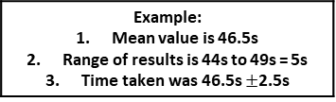
M_{r} | The sum of the relative atomic masses of the atoms in the numbers shown in the formula | The sum of the M_{r} of the reactants in the quantities shown equals the sum of the M_{r} of the products in the quantities shown. | 2Mg + O₂ → 2MgO 48g + 32g = 80g 80g = 80g
The reactant that is completely used up | Limits the amount of product that is made | Less moles of product are made.
Whenever a measurement is taken, there is always some uncertainty about the result obtained | Can determine whether the mean value falls within the range of uncertainty of the result | Calculate the mean Calculate the range of the results Estimate of uncertainty in mean would be half the range
Mass appears to increase during a reaction | One of the reactants is a gas | Magnesium + oxygen → magnesium oxide
Mass appears to decrease during a reaction | One of the products is a gas and has escaped | Calcium carbonate → carbon dioxide + calcium oxide
Limiting reactants
(HT only)
Relative formula mass (M_{r})
Chemical measurements
Concentration of solutions
Example: Mean value is 46.5s Range of results is 44s to 49s = 5s Time taken was 46.5s $±$2.5s
Mass changes when a reactant or product is a gas
Conservation of mass | No atoms are lost or made during a chemical reaction | Mass of the products equals the mass of the reactants.
AQA GCSE
QUANTITATIVE CHEMISTRY 1
Measured in mass per given volume of solution (g/dm³) | Conc. = mass (g) . volume (dm³) | HT only Greater mass = higher concentration. Greater volume = lower concentration.
Balanced symbol equations | Represent chemical reactions and have the same number of atoms of each element on both sides of the equation | H₂ + Cl₂ → 2HCl Subscript numbers show the number of atoms of the element to its left. Normal script numbers show the number of molecules.
Amounts of substances in equations (HT only)
Subscript Normal script
Conservation of mass and balanced symbol equations
Using moles to balance equations (HT only)
The balancing numbers in a symbol equation can be calculated from the masses of reactants and products | Convert the masses in grams to amounts in moles and convert the number of moles to simple whole number ratios.
Moles (HT only)
Chemical amounts are measured in moles (mol) | Mass of one mole of a substance in grams = relative formula mass | One mole of H₂O = 18g (1 + 1 + 16) One mole of Mg = 24g
Chemical equations show the number of moles reacting and the number of moles made | Mg + 2HCl → MgCl₂ + H₂ One mole of magnesium reacts with two moles of hydrochloric acid to make one mole of magnesium chloride and one mole of hydrogen | If you have a 60g of Mg, what mass of HCl do you need to convert it to MgCl₂? A_{r} : Mg =24 so mass of 1 mole of Mg = 24g M_{r} : HCl (1 + 35.5) so mass of 1 mole of HCl = 36.5g So 60g of Mg is 60/24 = 2.5 moles Balanced symbol equation tells us that for every one mole of Mg, you need two moles of HCl to react with it. So you need 2.5x2 = 5 moles of HCl You will need 5 x 36.5g of HCl= 182.5g
Avogadro constant | One mole of any substance will contain the same number of particles, atoms, molecules or ions. | 6.02 x 10²³ per mole One mole of H₂O will contain 6.02 x 10²³ molecules One mole of NaCl will contain 6.02 x 10²³ Na⁺ ions
Number of moles = mass (g) or mass (g) A_{r} M_{r} | How many moles of sulfuric acid molecules are there in 4.7g of sulfuric acid (H₂SO₄)? Give your answer to 1 significant figure. 4.7 = 0.05 mol 98 (M_{r} of H₂SO₄)

Slide 10
A measure of the amount of starting materials that end up as useful products | Atom economy = Relative formula mass of desired product from equation x 100 Sum of relative formula mass of all reactants from equation | High atom economy is important or sustainable development and economic reasons
Calculate the atom economy for making hydrogen by reacting zinc with hydrochloric acid: Zn + 2HCl → ZnCl₂ + H₂ M_{r} of H₂ = 1 + 1 = 2 M_{r} of Zn + 2HCl = 65 + 1 + 1 + 35.5 + 35.5 = 138 Atom economy = ²∕₁₃₈ × 100 = ²∕₁₃₈ × 100 = 1.45% This method is unlikely to be chosen as it has a low atom economy.
Concentration of a solution is the amount of solute per volume of solution | Concentration = amount (mol) (mol/dm³) volume (dm³) | What is the concentration of a solution that has 35.0g of solute in 0.5dm³ of solution? 35/0.5 = 70 g/dm³
Using concentrations of solutions in mol/dm³
(HT only, chemistry only)
Titration | If the volumes of two solutions that react completely are known and the concentrations of one solution is known, the concentration of the other solution can be calculated. | 2NaOH(aq) + H₂SO₄(aq)→ Na₂S0₄(aq) + 2H₂O(l) It takes 12.20cm³ of sulfuric acid to neutralise 24.00cm³ of sodium hydroxide solution, which has a concentration of 0.50mol/dm³. Calculate the concentration of the sulfuric acid in mol/dm³: 0.5 mol/dm³ x (24/1000) dm³ = 0.012 mol of NaOH The equation shows that 2 mol of NaOH reacts with 1 mol of H₂SO₄, so the number of moles in 12.20cm³ of sulfuric acid is (0.012/2) = 0.006 mol of sulfuric acid Calculate the concentration of sulfuric acid in mol/ dm³ 0.006 mol x (1000/12.2) dm³ =0.49mol/dm³
Atom economy
AQA
QUANTITATIVE CHEMISTRY 2
HT only: 200g of calcium carbonate is heated. It decomposes to make calcium oxide and carbon dioxide. Calculate the theoretical mass of calcium oxide made. CaCO₃ → CaO + CO₂ M_{r} of CaCO₃ = 40 + 12 + (16x3) = 100 M_{r} of CaO = 40 + 16 = 56 100g of CaCO₃ would make 56 g of CaO So 200g would make 112g
Percentage yield
Use of amount of substance in relation to volumes of gases
(HT only, chemistry only)
Calculate the concentration of sulfuric acid in g/ dm³: H₂SO₄ = (2x1) + 32 + (4x16) = 98g 0.49 x 98g = 48.2g/dm³
Yield is the amount of product obtained | It is not always possible to obtain the calculated amount of a product | The reaction may not go to completion because it is reversible.
 |  | Some of the product may be lost when it is separated from the reaction mixture.
 |  | Some of the reactants may react in ways different to the expected reaction.
Equal amounts of moles or gases occupy the same volume under the same conditions of temperature and pressure | The volume of one mole of any gas at room temperature and pressure (20°C and 1 atmospheric pressure) is 24 dm³ | No. of moles of gas = vol of gas (dm³) 24dm³
Percentage yield is comparing the amount of product obtained as a percentage of the maximum theoretical amount | % Yield = Mass of product made x 100 Max. theoretical mass | A piece of sodium metal is heated in chlorine gas. A maximum theoretical mass of 10g for sodium chloride was calculated, but the actual yield was only 8g. Calculate the percentage yield. Percentage yield = 8/10 x 100 =80%
What is the volume of 11.6 g of butane (C₄H₁₀) gas at RTP? M_{r} : (4 x 12) + (10 x 1) = 58 11.6/58 = 0.20 mol Volume = 0.20 x 24 = 4.8 dm³
6g of a hydrocarbon gas had a volume of 4.8 dm³. Calculate its molecular mass. 1 mole = 24 dm³, so 4.8/24 = 0.2 mol M_{r} = 6 / 0.2 = 30 If 6g = 0.2 mol, 1 mol equals 30 g

Slide 11
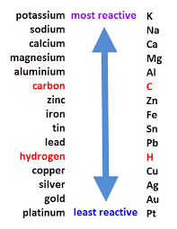
Oxidation Is Loss (of electrons) Reduction Is Gain (of electrons)
HT ONLY: Reactions between metals and acids are redox reactions as the metal donates electrons to the hydrogen ions. This displaces hydrogen as a gas while the metal ions are left in the solution.
Ionic half equations (HT only)
For displacement reactions | Ionic half equations show what happens to each of the reactants during reactions | For example: The ionic equation for the reaction between iron and copper (II) ions is: Fe + Cu²⁺ → Fe²⁺ + Cu The half-equation for iron (II) is: Fe → Fe²⁺ + 2e⁻ The half-equation for copper (II) ions is: Cu²⁺ + 2e⁻ → Cu
Reactions with acids | metal + acid → metal salt + hydrogen | magnesium + hydrochloric acid → magnesium chloride + hydrogen zinc + sulfuric acid → zinc sulfate + hydrogen
Acids react with some metals to produce salts and hydrogen.
Extraction using carbon
Metals less reactive than carbon can be extracted from their oxides by reduction. | For example: zinc oxide + carbon → zinc + carbon dioxide
Reactions of acids and metals
Reactions of acids
Acid name | Salt name
Hydrochloric acid | Chloride
Sulfuric acid | Sulfate
Nitric acid | Nitrate
Oxidation and reduction in terms of electrons (HT ONLY)
Extraction of metals and reduction
Unreactive metals, such as gold, are found in the Earth as the metal itself. They can be mined from the ground.
AQA Chemical Changes 1
 | Reactions with water | Reactions with acid
Group 1 metals | Reactions get more vigorous as you go down the group | Reactions get more vigorous as you go down the group
Group 2 metals | Do not react with water | Observable reactions include fizzing and temperature increases
Zinc, iron and copper | Do not react with water | Zinc and iron react slowly with acid. Copper does not react with acid.
Neutralisation of acids and salt production
Reactivity of metals
sodium hydroxide + hydrochloric acid → sodium chloride + water
calcium carbonate + sulfuric acid → calcium sulfate, + carbon dioxide + water
The reactivity series
Neutralisation | Acids can be neutralised by alkalis and bases | An alkali is a soluble base e.g. metal hydroxide. A base is a substance that neutralises an acid e.g. a soluble metal hydroxide or a metal oxide.
Metal oxides
Metals form positive ions when they react | The reactivity of a metal is related to its tendency to form positive ions | The reactivity series arranges metals in order of their reactivity (their tendency to form positive ions).
Carbon and hydrogen | Carbon and hydrogen are non-metals but are included in the reactivity series | These two non-metals are included in the reactivity series as they can be used to extract some metals from their ores, depending on their reactivity.
Displacement | A more reactive metal can displace a less reactive metal from a compound. | Silver nitrate + Sodium chloride → Sodium nitrate + Silver chloride
Metals and oxygen | Metals react with oxygen to form metal oxides | magnesium + oxygen → magnesium oxide 2Mg + O₂ → 2MgO
Reduction | This is when oxygen is removed from a compound during a reaction | e.g. metal oxides reacting with hydrogen, extracting low reactivity metals
Oxidation | This is when oxygen is gained by a compound during a reaction | e.g. metals reacting with oxygen, rusting of iron

Slide 12
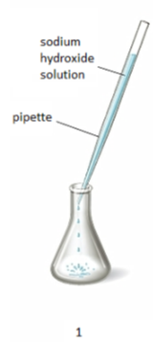
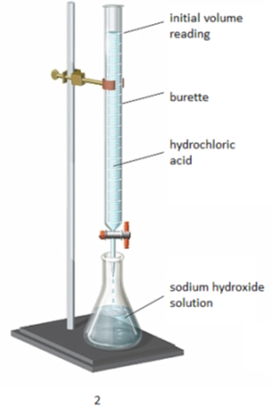
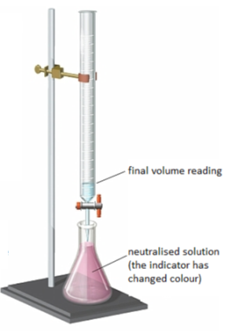
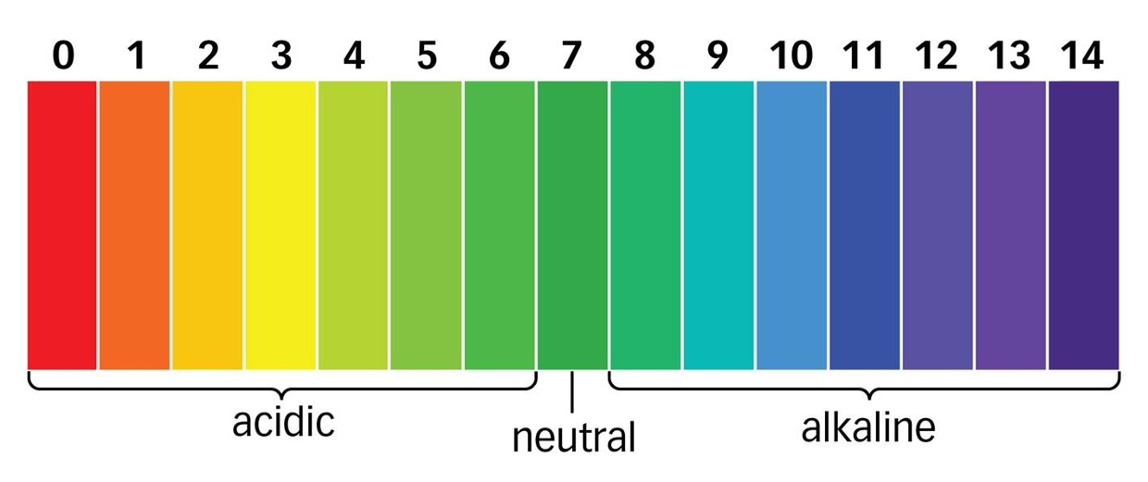
The ions discharged when an aqueous solution is electrolysed using inert electrodes depend on the relative reactivity of the elements involved.
Process of electrolysis | Splitting up using electricity | When an ionic compound is melted or dissolved in water, the ions are free to move. These are then able to conduct electricity and are called electrolytes. Passing an electric current though electrolytes causes the ions to move to the electrodes.
Electrode | Anode Cathode | The positive electrode is called the anode. The negative electrode is called the cathode.
Where do the ions go? | Cations Anions | Cations are positive ions and they move to the negative cathode. Anions are negative ions and they move to the positive anode.
Extracting metals using electrolysis | Metals can be extracted from molten compounds using electrolysis.
 | This process is used when the metal is too reactive to be extracted by reduction with carbon.
 | The process is expensive due to large amounts of energy needed to produce the electrical current. Example: aluminium is extracted in this way.
At the negative electrode | Metal will be produced on the electrode if it is less reactive than hydrogen. Hydrogen will be produced if the metal is more reactive than hydrogen.
At the positive electrode | Oxygen is formed at positive electrode. If you have a halide ion (Cl⁻, I⁻, Br⁻) then you will get chlorine, bromine or iodine formed at that electrode.
Electrolysis of aqueous solutions
Electrolysis
Higher tier: You can display what is happening at each electrode using half-equations:
At the cathode: Pb²⁺ + 2e⁻ → Pb
At the anode: 2Br⁻ → Br₂ + 2e⁻
Strong acids | Completely ionised in aqueous solutions e.g. hydrochloric, nitric and sulfuric acids.
Weak acids | Only partially ionised in aqueous solutions e.g. ethanoic acid, citric acid.
Hydrogen ion concentration | As the pH decreases by one unit (becoming a stronger acid), the hydrogen ion concentration increases by a factor of 10.
AQA Chemical Changes 2
Strong and weak acids (HT ONLY)
Reactions of acids
 | 1. Use the pipette to add 25 cm³ of alkali to a conical flask and add a few drops of indicator.
 | 2. Fill the burette with acid and note the starting volume. Slowly add the acid from the burette to the alkali in the conical flask, swirling to mix.
 | 3. Stop adding the acid when the end-point is reached (the appropriate colour change in the indicator happens). Note the final volume reading. Repeat steps 1 to 3 until you get consistent readings.
Titrations (Chemistry only)
Soluble salts | Soluble salts can be made from reacting acids with solid insoluble substances (e.g. metals, metal oxides, hydroxides and carbonates).
Production of soluble salts | Add the solid to the acid until no more dissolves. Filter off excess solid and then crystallise to produce solid salts.
Titrations are used to work out the precise volumes of acid and alkali solutions that react with each other.
Soluble salts
Calculating the chemical quantities in titrations involving concentrations in mol/dm³ and in g/dm³ (HT ONLY): 2NaOH(aq) + H₂SO₄(aq)→ Na₂S0₄(aq) + 2H₂O(l) It takes 12.20cm³ of sulfuric acid to neutralise 24.00cm³ of sodium hydroxide solution, which has a concentration of 0.50mol/dm³. Calculate the concentration of the sulfuric acid in g/dm³ 0.5 mol/dm³ x (24/1000) dm³ = 0.012 mol of NaOH | The equation shows that 2 mol of NaOH reacts with 1 mol of H₂SO₄, so the number of moles in 12.20cm³ of sulfuric acid is (0.012/2) = 0.006 mol of sulfuric acid Calculate the concentration of sulfuric acid in mol/ dm³ 0.006 mol x (1000/12.2) dm³ =0.49mol/dm³ Calculate the concentration of sulfuric acid in g/ dm³ H₂SO₄ = (2x1) + 32 + (4x16) = 98g 0.49 x 98g = 48.2g/dm³
You can use universal indicator or a pH probe to measure the acidity or alkalinity of a solution against the pH scale.
The pH scale and neutralisation
Acids | Acids produce hydrogen ions (H⁺) in aqueous solutions.
Alkalis | Aqueous solutions of alkalis contain hydroxide ions (OH⁻).
In neutralisation reactions, hydrogen ions react with hydroxide ions to produce water:
H⁺ + OH⁻ → H₂O

Slide 13
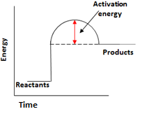
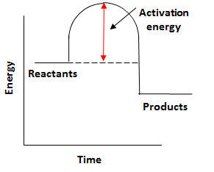
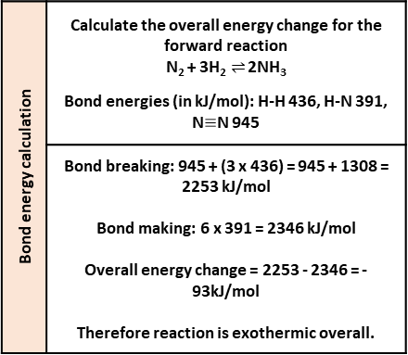
Endothermic | Energy is taken in from the surroundings so the temperature of the surroundings decreases | Thermal decomposition Sports injury packs
Exothermic | Energy is transferred to the surroundings so the temperature of the surroundings increases | Combustion Hand warmers Neutralisation
Ionic half equations | Negative electrode: 2H₂ (g) + 4OH⁻ (aq) → 4H₂O (l) + 4e⁻ | Positive electrode: O₂ (g) + 2H₂O (l) + 4e⁻ → 4OH⁻ (aq)
Hydrogen fuel cells | Word equation: hydrogen + oxygen → water | Symbol equation: 2H₂ + O₂ → 2H₂O
 | Advantages: No pollutants produced Can be a range of sizes | Disadvantages: Hydrogen is highly flammable Hydrogen is difficult to store
Reaction profiles | Show the overall energy change of a reaction
Types of reaction
Fuel cells (Chemistry only)
Breaking bonds in reactants | Endothermic process
Making bonds in products | Exothermic process
The energy change of reactions
(HT only)
AQA GCSE
Energy changes
Activation energy | Chemical reactions only happen when particles collide with sufficient energy | The minimum amount of energy that colliding particles must have in order to react is called the activation energy.
Reaction profiles
Overall energy change of a reaction | Exothermic | Energy released making new bonds is greater than the energy taken in breaking existing bonds.
 | Endothermic | Energy needed to break existing bonds is greater than the energy released making new bonds.
Cells and batteries
(Chemistry only)
Simple cell | Make a simple cell by connecting two different metals in contact with an electrolyte | Increase the voltage by increasing the reactivity difference between the two metals.
Batteries | Consist of two or more cells connected together in series to provide a greater voltage.
Endothermic |  | Products are at a higher energy level than the reactants. As the reactants form products, energy is transferred from the surroundings to the reaction mixture. The temperature of the surroundings decreases because energy is taken in during the reaction.
Exothermic |  | Products are at a lower energy level than the reactants. When the reactants form products, energy is transferred to the surroundings. The temperature of the surroundings increases because energy is released during the reaction.
Bond energy calculation | Calculate the overall energy change for the forward reaction N₂ + 3H₂ $⇌$ 2NH₃ Bond energies (in kJ/mol): H-H 436, H-N 391, N$≡$N 945
 | Bond breaking: 945 + (3 x 436) = 945 + 1308 = 2253 kJ/mol Bond making: 6 x 391 = 2346 kJ/mol Overall energy change = 2253 - 2346 = -93kJ/mol Therefore reaction is exothermic overall.
Non-rechargeable cells | Stop when one of the reactants has been used up | Alkaline batteries
Rechargeable cells | Can be recharged because the chemical reactions are reversed when an external electrical current is supplied | Rechargeable batteries

Slide 14
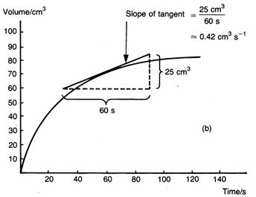
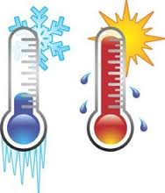
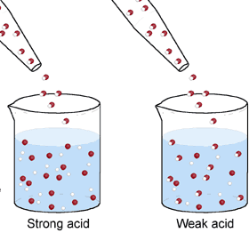
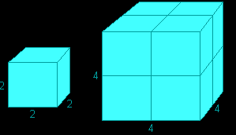
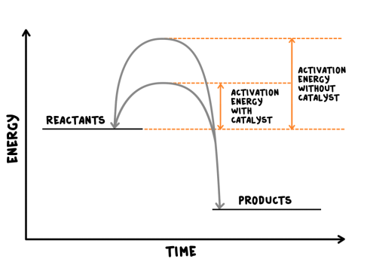
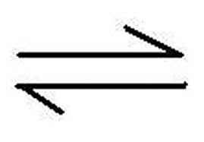
Rate of chemical reaction | This can be calculated by measuring the quantity of reactant used or product formed in a given time. | Rate = quantity of reactant used time taken Rate = quantity of product formed time taken
Factors affecting the rate of reaction
Temperature | The higher the temperature, the quicker the rate of reaction.
Concentration | The higher the concentration, the quicker the rate of reaction.
Surface area | The larger the surface area of a reactant solid, the quicker the rate of reaction.
Pressure (of gases) | When gases react, the higher the pressure upon them, the quicker the rate of reaction.
Quantity | Unit
Mass | Grams (g)
Volume | cm³
Rate of reaction | Grams per cm³ (g/cm³) HT: moles per second (mol/s)
Calculating rates of reactions
Factors affecting rates
Rate of reaction
Collision theory and activation energy
AQA GCSE
The rate and extent of chemical change
Catalyst | A catalyst changes the rate of a chemical reaction but is not used in the reaction.
Enzymes | These are biological catalysts.
How do they work? | Catalysts provide a different reaction pathway where reactants do not require as much energy to react when they collide.
Collision theory | Chemical reactions can only occur when reacting particles collide with each other with sufficient energy. | Increasing the temperature increases the frequency of collisions and makes the collisions more energetic, therefore increasing the rate of reaction. Increasing the concentration, pressure (gases) and surface area (solids) of reactions increases the frequency of collisions, therefore increasing the rate of reaction.
Activation energy | This is the minimum amount of energy colliding particles in a reaction need in order to react.
Catalysts
If a catalyst is used in a reaction, it is not shown in the word equation.
Reversible reactions and dynamic equilibrium
Reversible reactions
Reversible reactions | In some chemical reactions, the products can react again to re-form the reactants.
Representing reversible reactions | A + B C + D
The direction | The direction of reversible reactions can be changed by changing conditions: heat A + B C + D cool
Changing conditions and equilibrium (HT)
Le Chatelier’s Principles | States that when a system experiences a disturbance (change in condition), it will respond to restore a new equilibrium state.
Changing concentration | If the concentration of a reactant is increased, more products will be formed . If the concentration of a product is decreased, more reactants will react.
Changing temperature | If the temperature of a system at equilibrium is increased: Exothermic reaction = products decrease Endothermic reaction = products increase
Changing pressure (gaseous reactions) | For a gaseous system at equilibrium: Pressure increase = equilibrium position shifts to side of equation with smaller number of molecules. Pressure decrease = equilibrium position shifts to side of equation with larger number of molecules.
Equilibrium
The relative amounts of reactants and products at equilibrium depend on the conditions of the reaction.
Equilibrium in reversible reactions | When a reversible reaction occurs in apparatus which prevents the escape of reactants and products, equilibrium is reached when the forward and reverse reactions occur exactly at the same rate.
Energy changes and reversible reactions
If one direction of a reversible reaction is exothermic, the opposite direction is endothermic. The same amount of energy is transferred in each case.
For example: _{endothermic}
Hydrated copper Anhydrous copper + Water
sulfate ^{exothermic} sulfate

Slide 15
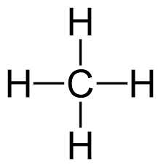




Display formula for first four alkanes
Fractions | The hydrocarbons in crude oil can be split into fractions | Each fraction contains molecules with a similar number of carbon atoms in them. The process used to do this is called fractional distillation.
Using fractions | Fractions can be processed to produce fuels and feedstock for petrochemical industry | We depend on many of these fuels; petrol, diesel and kerosene. Many useful materials are made by the petrochemical industry; solvents, lubricants and polymers.
Crude oil | A finite resource | Consisting mainly of plankton that was buried in the mud, crude oil is the remains of ancient biomass.
Hydrocarbons | These make up the majority of the compounds in crude oil | Most of these hydrocarbons are called alkanes.
General formula for alkanes | C_{n}H_{2n+2} | For example: C₂H₆ C₆H₁₄
Crude oil, hydrocarbons and alkanes
Methane (CH₄)
Ethane (C₂H₆)
Propane (C₃H₈)
Butane (C₄H₁₀)
Carbon compounds as fuels and feedstock
AQA GCSE
Organic chemistry 1
Fractional distillation and petrochemicals
Alkanes to alkenes | Long chain alkanes are cracked into short chain alkenes.
Alkenes | Alkenes are hydrocarbons with a double bond (some are formed during the cracking process).
Properties of alkenes | Alkenes are more reactive that alkanes and react with bromine water. Bromine water changes from orange to colourless in the presence of alkenes.
Hydrocarbon chains | In oil | Hydrocarbon chains in crude oil come in lots of different lengths.
 | Boiling points | The boiling point of the chain depends on its length. During fractional distillation, they boil and separate at different temperatures due to this.
Carbon compounds as fuels and feedstock
Cracking and alkenes
Properties of hydrocarbons
Combustion | During the complete combustion of hydrocarbons, the carbon and hydrogen in the fuels are oxidised, releasing carbon dioxide, water and energy.
Cracking | The breaking down of long chain hydrocarbons into smaller chains | The smaller chains are more useful. Cracking can be done by various methods including catalytic cracking and steam cracking.
Catalytic cracking | The heavy fraction is heated until vaporised | After vaporisation, the vapour is passed over a hot catalyst forming smaller, more useful hydrocarbons.
Steam cracking | The heavy fraction is heated until vaporised | After vaporisation, the vapour is mixed with steam and heated to a very high temperature forming smaller, more useful hydrocarbons.
Decane → pentane + propene + ethane
C₁₀H₂₂ → C₅H₁₂ + C₃H₆ + C₂H₄
Complete combustion of methane:
Methane + oxygen → carbon dioxide + water + energy
CH₄ (g) + 2O₂ (g) → CO₂ (g) + 2 H₂O (l)
Alkenes and uses as polymers | Used to produce polymers. They are also used as the starting materials of many other chemicals, such as alcohol, plastics and detergents.
Why do we crack long chains? | Without cracking, many of the long hydrocarbons would be wasted as there is not much demand for these as for the shorter chains.
Boiling point (temperature at which liquid boils) | As the hydrocarbon chain length increases, boiling point increases.
Viscosity (how easily it flows) | As the hydrocarbon chain length increases, viscosity increases.
Flammability (how easily it burns) | As the hydrocarbon chain length increases, flammability decreases.

Slide 16










Functional group | Alkenes are hydrocarbons in the functional group C=C. | The functional group of an organic compound determined their reactions.
Alkene reactions | Alkenes react with oxygen in the same way as other hydrocarbons, just with a smoky flame due to incomplete combustion. | Alkenes also react with hydrogen, water and the halogens. The C=C bond allows for the addition of other atoms.
Alkenes | Hydrocarbons with a double carbon-carbon bond.
Unsaturated | Alkenes are unsaturated because they contain two fewer hydrogen atoms than their alkane counterparts.
General formula for alkenes | C_{n}H_{2n}
Ethene C₂H₄
Methanol
Ethanol
Propene C₃H₆
Structure and formula of alkenes
Propanol
Butanol
Reactions of alkenes
Functional group | -OH For example: CH₃CH₂OH | Methanol, ethanol, propanol and butanol are the first four of the homologous series.
Alcohol reactions | Alcohols react with sodium, air and water. | Alcohols and sodium: bubbling, hydrogen gas given off and salt formed. Alcohols and air: alcohols burn in air releasing carbon dioxide and water. Alcohols and water: alcohols dissolve in water to form a neutral solution.
Fermentation | Ethanol is produced from fermentation. | When sugar solutions are fermented using yeast, aqueous solutions of ethanol are produced. The conditions needed for this process include a moderate temperature (25 – 50⁰C), water (from sugar solution) and an absence of oxygen.
Butene C₄H₈
Reactions of alkenes and alcohols
Alcohols
Pentene C₅H₁₀
AQA GCSE Organic chemistry 2
(CHEMISTRY ONLY)
Functional group | -COOH For example: CH₃COOH | Methanoic acid, ethanoic acid, propanoic acid and butanoic acid are the first four of the homologous series.
Carboxylic acid reactions | Carboxylic acids react with carbonates, water and alcohols. | Carboxylic acids and carbonates: These acids are neutralised by carbonates
 |  | Carboxylic acids and water: These acids dissolve in water.
 |  | Carboxylic acids and alcohols: The acids react with alcohols to form esters.
Strength (HT only) | Carboxylic acids are weak acids | Carboxylic acids only partially ionise in water. An aqueous solution of a weak acid with have a high pH (but still below 7).
Carboxylic acids
Synthetic and naturally occurring polymers
Amino acids
Amino acids have two functional groups in a molecule. They react by condensation polymerisation to produce peptides.
Addition polymerisation
DNA | Deoxyribonucleic acid is a large molecule essential for life. DNA gives the genetic instructions to ensure development and functioning of living organisms and viruses.
DNA structure | Most DNA molecules are two polymer chains made from four different monomers, called nucleotides. They are in the double helix formation.
Natural polymers | Other naturally occurring polymers include proteins, starch and cellulose and are all important for life.
Condensation polymerisation (HT only)
DNA and naturally occurring polymers
Polymers | Alkenes are used to make polymers by addition polymerisation. | Many small molecules join together to form polymers (very large molecules).
Displaying polymers | In addition polymers, the repeating unit has the same atoms as the monomer. | It can be displayed like this:
Glycine
Condensation polymerisation | Condensation polymerisation involves monomers with two functional groups | When these types of monomers react they join together and usually lose small molecules, such as water. This is why they are called condensation reactions.

Slide 17







State | Particle arrangement | Properties
Solid | Packed in a regular structure. Strong forces hold in place so cannot move. | Difficult to change shape.
Liquid | Close together, forces keep contact but can move about. | Can change shape but difficult to compress.
Gas | Separated by large distances. Weak forces so constantly randomly moving. | Can expand to fill a space, easy to compress.
 | Units
Density | Kilograms per metre cubed (kg/m³)
Mass | Kilograms (kg)
Volume | Metres cubed (m³)
Energy needed | Joules (J)
Specific latent heat | Joule per kilogram (J/kg)
Change in thermal energy | Joules (J)
Specific heat capacity | Joule per kilogram degrees Celsius (J/kg°C)
Temperature change | Degrees Celsius ( °C)
Pressure | Pascals (Pa)
Pressure of a fixed volume of gas increases as temperature increases (temperature increases, speed increases, collisions occur more frequently and with more force so pressure increases).
Temperature of gas is linked to the average kinetic energy of the particles.
Kinetic theory of gases
Particle model
If kinetic energy increases so does the temperature of gas.
PHYSICS ONLY: when you do work the temperature increases e.g. pump air quickly into a ball, the air gets hot because as the piston in the pump moves the particles bounce off increasing kinetic energy, which causes a temperature rise. | Reducing the volume of a fixed mass of gas increases the pressure.
 | Halving the volume doubles the pressure.
PV = constant.
Pressure
No kinetic energy is lost when gas particles collide with each other or the container.
P₁V₁ = P₂V₂
AQA
PARTICLE MODEL OF MATTER
Gas particles are in a constant state of random motion.
Specific Heat Capacity | Energy needed to raise 1kg of substance by 1°C | Depends on: Mass of substance What the substance is Energy put into the system.
Change in thermal energy = mass X specific heat capacity X temperature change.
P = m ÷ V
Density = mass ÷ volume.
∆E= m X c X ∆θ
Density | Mass of a substance in a given volume
Internal energy and energy transfers
Internal energy | Energy stored inside a system by particles | Internal energy is the total kinetic and potential energy of all the particles (atoms and molecules) in a system.
 | Heating changes the energy stored within a system | Heating causes a change in state. As particles separate, potential energy stored increases. Heating increases the temperature of a system. Particles move faster so kinetic energy of particles increases.
Change of state
Freezing | Liquid turns to a solid. Internal energy decreases.
Melting | Solid turns to a liquid. Internal energy increases.
Boiling / Evaporating | Liquid turns to a gas. Internal energy increases.
Condensation | Gas turns to a liquid. Internal energy decreases.
Sublimation | Solid turns directly into a gas. Internal energy increases.
Conservation of mass | When substances change state, mass is conserved.
Physical change | No new substance is made, process can be reversed.
Specific Latent Heat | Energy needed to change 1kg of a substance’s state
Specific Latent Heat of Fusion | Energy needed to change 1kg of solid into 1 kg of liquid at the same temperature
Specific Latent Heat of Vaporisation | Energy needed to change 1kg of liquid into 1 kg of gas at the same temperature
Energy needed = mass X specific latent heat.
∆E= m X L

Slide 18













Radius of an atom 1 X 10⁻¹⁰m
Electrons gained
Electrons lost
Decay | Range in air | Ionising power | Penetration power
Alpha | Few cm | Very strong | Stopped by paper
Beta | Few m | Medium | Stopped by Aluminium
Gamma | Great distances | Weak | Stopped by thick lead
Negative ion
Positive ion
Atom | Same number of protons and electrons
Ion | Unequal number of electrons to protons
Mass number | Number of protons and neutrons
Atomic number | Number of protons
Radioactive decay | Unstable atoms randomly emit radiation to become stable
Detecting | Use Geiger Muller tube
Unit | Becquerel
Ionisation | All radiation ionises
Decay | Emitted from nucleus | Changes in mass number and atomic number
Alpha (α) | Helium nuclei (${}_{2}^{4}{He}$) | -4 | -2
Beta (β) | Electron (${}_{−1}^{0}e$) | 0 | +1
Gamma (γ) | Electromagnetic wave | 0 | 0
Neutron | Neutron | -1 | 0
Particle | Charge | Size | Found
Neutron | None | 1 | In the nucleus
Proton | + | 1
Electron | - | Tiny | Orbits the nucleus
Atom structure
$${}_{92}^{238}U→ {}_{90}^{234}{Th+ {}_{2}^{4}{He}}$$
$${}_{6}^{14}C→ {}_{7}^{14}{N+ {}_{−1}^{0}e}$$
Atoms and Nuclear Radiation
$${}_{43}^{99}{Tc}→ {}_{43}^{99}{Tc+ γ}$$
Isotope
Different forms of an element with the same number of protons but different number of neutrons
Atoms and Isotopes
Contamination | Unwanted presence of radioactive atoms
Irradiation | Person is in exposed to radioactive source
AQA
ATOMIC STRUCTURE
PHYSICS ONLY: Hazards and uses of Radioactive emissions and of background radiation
Half life | The time taken to lose half of its initial radioactivity
Discovery of the nucleus
Democritus | Suggested idea of atoms as small spheres that cannot be cut.
J J Thomson (1897) | Discovered electrons– emitted from surface of hot metal. Showed electrons are negatively charged and that they are much less massive than atoms.
Thomson (1904) | Proposed ‘plum pudding’ model – atoms are a ball of positive charge with negative electrons embedded in it.
Geiger and Marsden (1909) | Directed beam of alpha particles (He²⁺)at a thin sheet of gold foil. Found some travelled through, some were deflected, some bounced back.
Rutherford (1911) | Used above evidence to suggest alpha particles deflected due to electrostatic interaction between the very small charged nucleus, nucleus was massive. Proposed mass and positive charge contained in nucleus while electrons found outside the nucleus which cancel the positive charge exactly.
Bohr (1913) | Suggested modern model of atom – electrons in circular orbits around nucleus, electrons can change orbits by emitting or absorbing electromagnetic radiation. His research led to the idea of some particles within the nucleus having positive charge; these were named protons.
Chadwick (1932) | Discovered neutrons in nucleus – enabling other scientists to account for mass of atom.
Sievert | Unit measuring dose of radiation
Background | Constant low level environmental radiation, e.g. from nuclear testing, nuclear power, waste
Nuclear fission and fusion
Uses | Different isotopes have different half lives | Short half-lives used in high doses, long half lives used in low doses.
Tracers | Used within body | Isotope with short half life injected, allowed to circulate and collect in damaged areas. PET scanner used to detect emitting radiation. Must be beta or gamma as alpha does not penetrate the body.
Radiation therapy | Used to treat illnesses e.g. cancer | Cancer cells killed by gamma rays. High dose used to kill cells. Damage to healthy cells prevented by focussed gamma ray gun.
Fuel rods | Made of U-238, ‘enriched’ with U-235 (3%). Long and thin to allow neutrons to escape, hitting nuclei.
Control rods | Made of Boron. Controls the rate of reaction. Boron absorbs excess neutrons.
Concrete | Neutrons hazardous to humans – thick concreate shield protects workers.
PHYSICS ONLY: Nuclear energy
Nuclear fission | One large unstable nucleus splits to make two smaller nuclei | Neutron hits U-235 nucleus, nucleus absorbs neutron, splits emitting two or three neutrons and two smaller nuclei. Process also releases energy. | Process repeats, chain reaction formed
 |  |  | Used in nuclear power stations
Nuclear fusion | Two small nuclei join to make one larger nucleus | Difficult to do on Earth – huge amounts of pressure and temperature needed. | Occurs in stars

