Slide 1

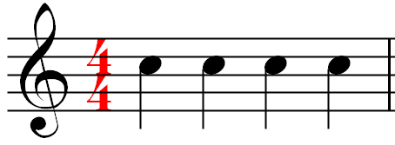



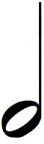
MUSIC Year 8 ‘LET THE MUSIC BEGIN’ Name: ………………………………………………….
1. Elements of Music
Keyword | Meaning
Beat
Rhythm
Tempo
Dynamics
Pitch
Tone/Timbre
Duration
Structure
Silence
3. Musical Notation (Reading Music)
Below is an extract taken from a score sheet. Look carefully at the sheet and answer the four questions below:
How many beats are in this bar?
What is the name of the note on the starve?
What is the length of each note?
Can write what key you would play this in on a keyboard?
3. Listening
Describe the music which is being played a) What instruments can you hear? b) Is this fusion music? If yes, what genres does this song that it’s fusions from? c) How fast or slow is the tempo? Does this affect the mode of the piece, if so how? c) Can you identify some of the key elements within the music?
...............................................................................................................................................................................................................................................................................................................................................................................................................................
2. Notation & Duration
Below are four different notes. Can you write the name of each note and the length of beats each note represents.
 | Name:
 | Length:
 | Name:
 | Length:
 | Name:
 | Length:
 | Name:
 | Length:

Slide 2
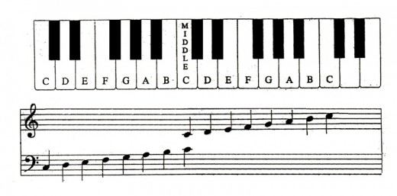
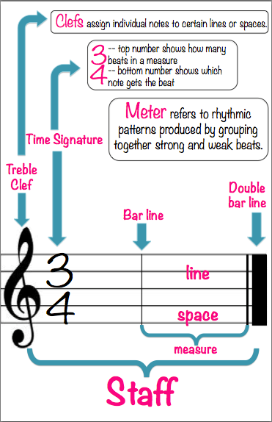
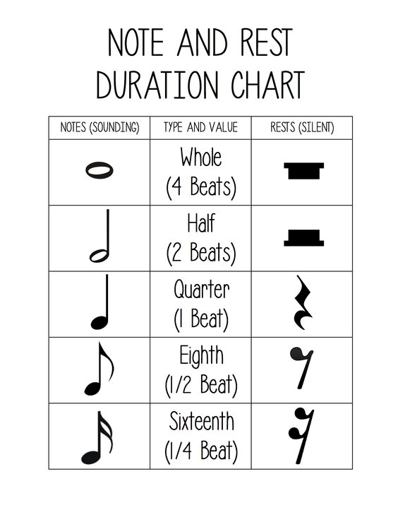
MUSIC Year 8 ‘LET THE MUSIC BEGIN’ Name: ………………………………………………….
1. Elements of Music
Keyword | Meaning
Beat | A regular interval of rhythm, the steady sounds that are equal and repeated over time. It’s the regular pulse that you hear within a piece of music.
Rhythm | A combination of long and short sounds over a length of time. They are not equal in length.
Tempo | Tempo is how “FAST”or “SLOW” sounds are played, or whether they get faster or slower.
Dynamics | How LOUD or QUIET the sounds are played
Pitch | A pitch is how “HIGH” or “LOW” a note sounds.
Tone/Timbre | Timbre or Tone Colour is a term used to describe the particular sound quality or an instrument or a voice.
Duration | How long or short a note is held for.
Structure | Structure is the overall plan of a piece of music
Silence | The silence is the gaps, breaks and rest within a piece of music.
3. Musical Scale (Piano/Keyboard)
Below is a Musical scale on a grand staff lined up with the keys on a piano or keyboard
1
2
4. Reading Music
Task
1) Listen to a piece of music of your choice. Write a paragraph of what elements of music stand out to you. You must include the composer and the year in which the piece was composed.
2) Based on task 1 –Name the genre of the music. What are the defining features of this genre.
3) There are 7 different Italian terms we use to describe tempo. Write these Italian terms in order of slow to very fast.
4) Looking at the notes in Box 2 (Duration and Notation). Can you copy the note shapes inside your book and write down the correct musical name.
5) Looking at box 3 (Musical Scale). Draw out both diagrams. Diagram 1 –can you name the black notes? 6) In modern music, what are the 4 clefs often used?
2. Duration & Notation
The shape of each note indicates their time value, i.e. the length of time a note should last in relation to others.
Starve

