Slide 1
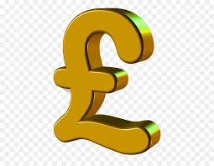
Finance Education
Income | Money received, usually on a regular basis from work or investments
Expenditure | Money that is spent
Budget | An estimate of income and expenditure for a set period of time.
Interest | Money charged/paid regularly at the rate of money that is lent, or for delaying repayment.
Direct tax | Paid directly to government (e.g: income tax)
Indirect tax | Collected by someone else (e.g: retailer) and then paid to government.
Insurance | A contract in which an individual receives financial protection against losses (e.g: car insurance)
Pension | A retirement plan to provide an individual with steady income during retirement.
Committed spending | Essential spending (e.g: bills)
Discretionary spending | Non-essential spending (e.g: gym)
What types of taxes are there? Direct taxes – Income tax, corporate tax, inheritance tax. Indirect taxes – VAT (value added tax), customs duties, excise duties.
Credit card | A card that allows you to Borrow money against a line of credit, otherwise known as the card’s credit limit.
Debit Card | A payment card that deducts money directly from a consumer’s checking account to pay for a purchase. Debit cards mean you don’t have to carry cash around.
Types of credit | Explanation
Revolving credit | Given a max. borrowing limit and can make charges up to that limit (e.g: credit cards). Must make minimum repayment every month.
Service credit | Contracts with services providers (e.g: gas, electric) that provide a service with the understanding of payment being made after the fact.
Instalment credit | A loan for a specific sum of money that is agreed to be repaid, plus interest and fees, in a series of equal instalment payments for a period of time (e.g: student loan, mortgage)
Charge cards | Provided by retailers which allows purchases on charge card to be made with understanding that full payment is made at the end of every month. Less commonly used now.

