Slide 1
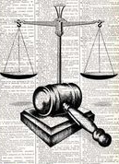
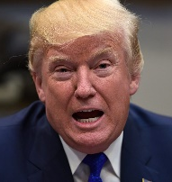

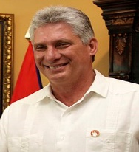
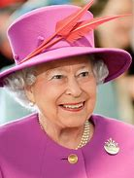
Governance
Citizenship
Government | The group of people with the authority to govern a country or state; a particular ministry in office.
Parliament | The highest legislature, consisting of the Sovereign, the House of Lords, and the House of Commons.
Executive branch | To executes the laws, and makes sure that they are being followed.
Legislative branch | Having the power to make new laws and reform old laws.
Judicial branch | The authority granted to courts and judges and laws, to interpret and decide, based on sound legal principles, and rule accordingly.
Foreign Governance
The Representation of the People Act 1969
Republic | A form of government in which the country is considered a "public matter", not the private concern or property of the rulers.
Absolute Monarchy | A country with only one party in power. Also referred to as a communist country.
Constitutional Monarchy | A country with a monarch as its Head of the State. The monarch reigns with the support of Parliament.
How do I vote? | To vote in a general election or a referendum, you need to be on the electoral register.
What are the different ways to vote? | There are three options for placing your vote: in person at a polling station, by post or by choosing someone to vote on your behalf (by proxy).
What is a referendum? | A method of referring a question or set of questions to the entire electorate directly.
How do I get in touch with the MP in my constituency? | Find the contact details of your local MP and get in touch! Visit the website below, for more information: https://members.parliament.uk/FindYourMP?SearchText

