Slide 1

Year 8 Summer 2 Science Cycle 12 Chemical Reactions
No. | Key word(s) | Definition
1 | chemical reaction | A change in which atoms are rearranged to create new substances.
2 | physical change | A change that is reversible, in which new substances are not made. Examples of physical changes include changes of state, and dissolving.
3 | reversible reaction | A chemical reaction where the reactants form products that, in turn, react together to give the reactants back.
4 | catalyst | A substance that speeds up a chemical reaction, but is not consumed by the reaction.
5 | effervescence | The formation of gas bubbles in a liquid by a chemical reaction.
6 | reactant | A starting substance in a chemical reaction.
7 | product | A substance that is made in a chemical reaction.
8 | word equation | A way of representing a chemical reaction simply. The reactants are on the left of an arrow, and the products are on the right. The arrow means reacts to make.
9 | hazard | A possible source of danger.
10 | risk | The chance of damage or injury from hazard.
11 | combustion | A chemical reaction in which a substance reacts quickly with oxygen and gives out light and heat.
12 | complete combustion (word equation) | hydrocarbon (fuel) + oxygen → carbon dioxide + water
Acids and alkalis
13 Acid | A chemical that has a pH value below 7
14 Base | A chemical that has a pH value above 7
15 Alkali | A base that dissolves in water.
16 Neutralisation | When a neutral solution is formed from reacting an acid and alkali.
17pH | A scale that shows how acidic or alkaline a solution is.
18 Strong acid | A strong acid has a very low pH value. The lower the pH value, more acidic the solution is
19 Weak acid | A weak acid has a higher pH, usually around pH 5-6.
1 Read, cover write 1-12
2 Read, cover write 13 -19
3 Read, cover write 20-25
4 Compare exothermic and endothermic reactions and give examples.
5 Write about the history and life of Arrhenius.
Extension: Create a pH scale and describe the various parts with examples for each part of the scale.
Making a Soluble Salt
20 | Add solid metal, metal carbonate, metal oxide or metal hydroxide to an acid.
21 | Add solid until no more reacts.
22 | Filter off excess solid.
23 | Evaporate to remove some of the water.
24 | Leave to crystallise.
25 | Remove all water in a desiccator/ oven.

Slide 2
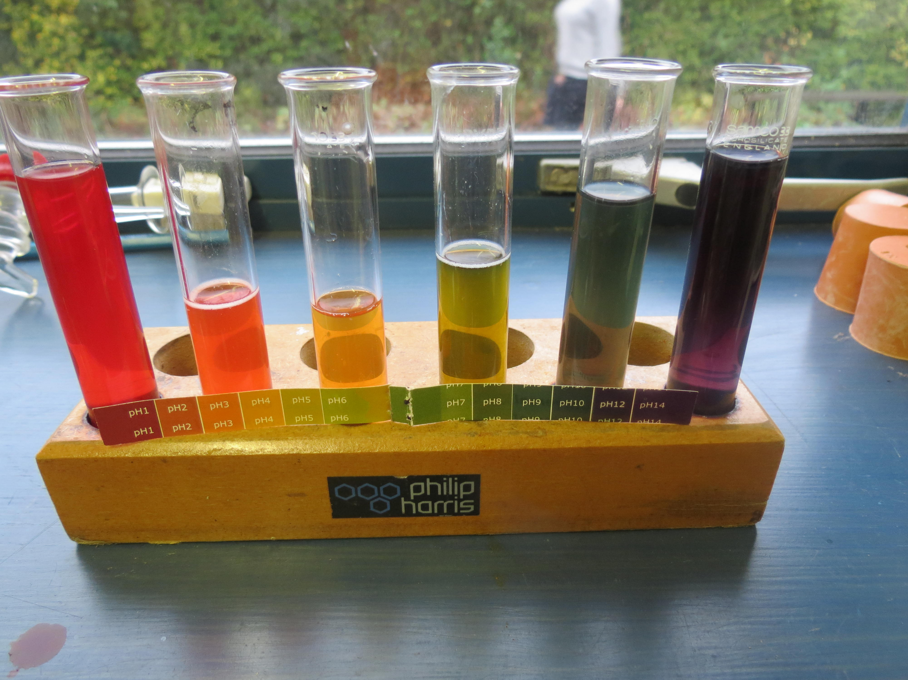
Arrhenius theory. Written By: Arrhenius theory, theory, introduced in 1887 by the Swedish scientist Svante Arrhenius, that acids are substances that dissociate in water to yield electrically charged atoms or molecules, called ions, one of which is a hydrogen ion (H+), and that bases ionize in water to yield hydroxide ions (OH−).
Skills
Equipment
Naming and handling the apparatus, drawing accurately
Risk
Hazard, prevention, action
Conclusion
PEEL-Point, Evidence, Explain, Link
Exothermic and endothermic reactions
The term endothermic was coined by Marcelin Berthelot (25 October 1827 – 18 March 1907). The concept is frequently applied in chemical reactions , where thermal energy (heat) is converted to chemical bond energy.
In exothermic reactions thermal energy is given out to the surroundings.
Examples
Making of ice-cube- an endothermic reaction.
Snow formation in clouds- an exothermic reaction.
3. Burning of a candle – an exothermic reaction.
4.Using tooth paste to kill germs (neutralisation) -an exothermic reaction.
5.Sports injury cold packs- an endothermic reaction.
Neutralisation Experiment (test tube rainbow)
1. Take six test tubes and place 5cm3 of water in each test tube.
2. Place 5 drops of universal indicator to each test tube.
3. Try to make a nice rainbow by using these equipment.
TIPS: You may need to shake the test tubes occasionally to make the colours
Neutralisation in everyday life
Toothpaste contains bases that neutralise the acid
produced by bacteria in our mouth.
Baking powder is usually used to help the cakes
rise.
Conditioner is used with shampoo to prevent small
scales on hair which make you hair unmanageable.

