Slide 1
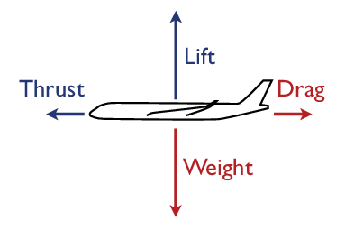

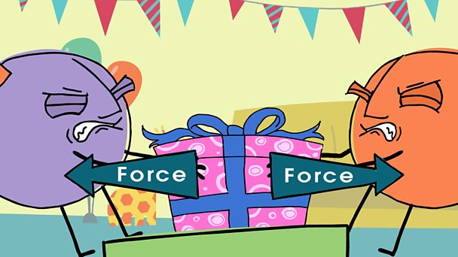
Year 8 Science Knowledge Organiser Cycle 11 Forces
Force | A push or pull on an object which can cause it to move, change speed, direction or shape. Measured in Newton's (N).
Magnet | A material or object that produces a magnetic field. It attracts or repels magnetic objects, including iron.
Contact force | A force that requires physical contact to occur e.g. kicking a ball.
Attract | To pull towards. Opposite of repel
Repel | To push away. Opposite of attract
Propel | The act of driving or pushing forward.
Friction | The resistance of motion when one object rubs against another. Friction causes objects to slow down and the energy becomes heat.
Weight | The force due to gravity on objects. This force pulls on all objects near the earth. Measured in Newton's (N).
Mass | The amount of matter contained in an object. Measured in units such as g, kg.
Gravity | The area around a large object when a weight can be felt. The sun’s gravity keeps the planets orbiting around it.
Air resistance | The frictional force of air against a moving object. The faster an object moves, the greater the air resistance.
Water resistance | The frictional force of water against a moving object. The faster an object moves, the greater the water resistance.
Acceleration | Increase in the rate or speed of something.
Balanced force | Two forces of equal size acting in opposite directions on an object so that it will stay still or continue to move in the same
Unbalanced force | Two forces of unequal size acting in opposite directions causing an object to move, change speed, direction or shape.
Homework
Read, cover write the key definitions
Use the internet to find the mass of a car in kilograms, using the world’s meanest gangsters equation to calculate its weight. Remember the units.
Find three interesting facts about Sir Isaac Newton. Did an apple really land on his head?
Memorise all the equations for this topic. Give an example for each equation
Design the ultimate safe car.

Slide 2
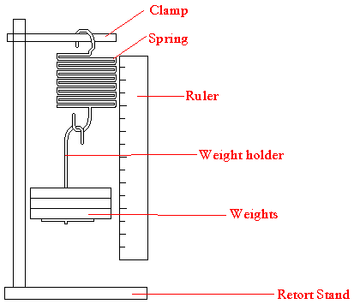
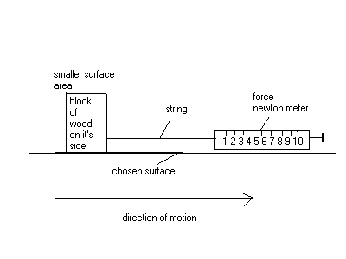
Isaac Newton
Occupation: Scientist, mathematician, and astronomer
Born: January 4, 1643 in Woolsthorpe, England
Died: March 31, 1727 in London, England
Best known for: Defining the three laws of motion and universal gravitation
Isaac Newton is considered one of the most important scientists in history. Even Albert Einstein said that Isaac Newton was the smartest person that ever lived. During his lifetime Newton developed the theory of gravity, the laws of motion (which became the basis for physics), a new type of mathematics called calculus, and made breakthroughs in the area of optics such as the reflecting telescope
Skills
Hypothesis- prediction with a reason
Method- plan written as a set of instructions- Firstly, secondly, subsequently, finally
Results table- headed table with units in heading and not next to each result, highlight anomalies and repeat as necessary, calculate mean to appropriate number of significant figures
Friction Experiment
Method
Attach the force meter to the block.
Gently pull the block along the bench surface. Read the force meter, and write down the force needed to pull it.
Pull the block twice more, and write the results in the table.
Put a 100 g mass on the block and repeat steps
Repeat steps A to C with the other masses shown in the results table.
Hooke's law
Method
Set up the apparatus as in the diagram
Add a 10 g mass to the holder and record the spring length.
Add another 10 g mass and record the new spring length.
Take away the previous spring length from the new length to calculate the extension (the difference).
Repeat by adding 10 g masses until 100 g is reached.
Variables
The independent variable is the mass.
The dependent variable is the extension.
Controlled variables include using the spring and masses used.
Some applications of force in everyday life
The use of force in our everyday life is very common. We use force to walk on the road, to lift the objects, to throw a cricket ball, or to move a given body by some particular speed or direction. We are very familiar with the various effects of force. We can exert pull and push. We must apply a push through something rigid, while pull can act through a non-rigid connector such as a rope or a string or a wire.

