Slide 1
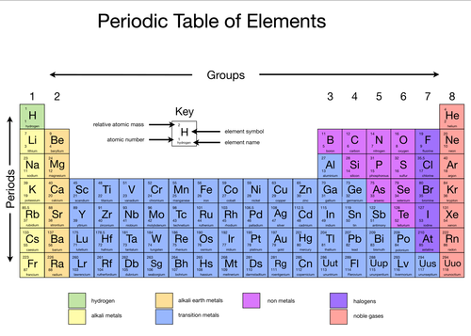
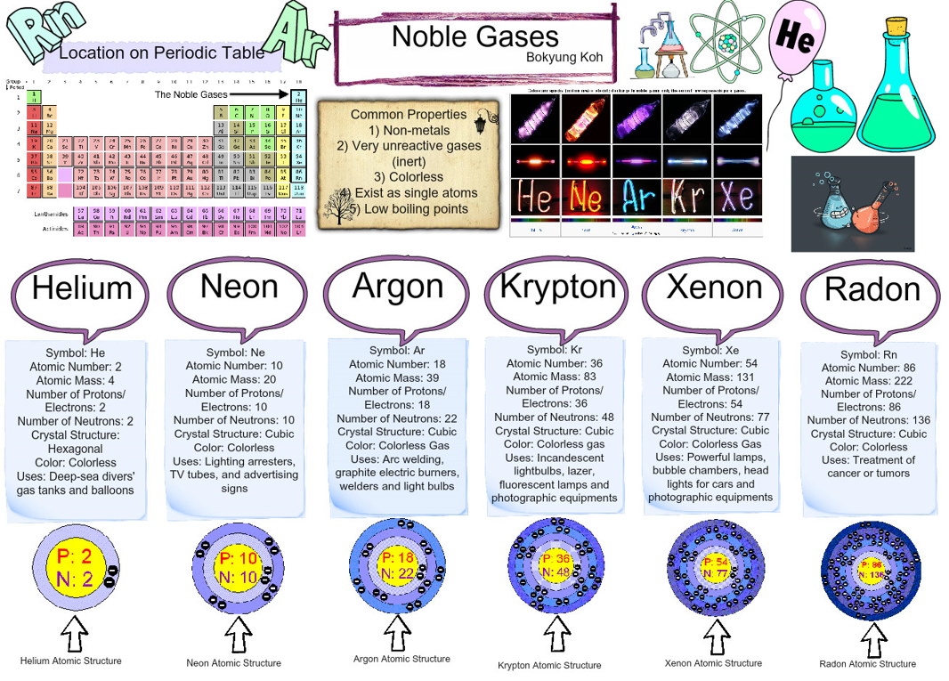
Homework
Read, cover write the key definitions.
Use the internet to find out how Group 1 metals react with water.
watch: https://www.bing.com/videos/search?q=brainiac+alkali+metals&&view=detail&mid=5C17187F1F7E22492C835C17187F1F7E22492C83&&FORM=VRDGAR)
Find three interesting facts about Dimitri Mendeleev
Memorise the names of the first 20 elements of the periodic table – make up a song/rap/rhyme to help you.
Design a neon lighting system to be used at home for children – think about the elements in group 0/8 and the colours they produce.
Periods | Elements are arranged in rows, called periods, in order of increasing atomic number.
Groups | Elements with similar properties are placed in vertical columns, called groups.
Dmitri Mendeleev | His periodic table: -had gaps in it -showed elements with similar chemical properties lined up in groups
Alkali metals | The elements in group 1 are called the alkali metals.
Sodium hydroxide | The alkali metals react with water to produce a metal hydroxide and hydrogen. For example, sodium reacts with water: sodium + water → sodium hydroxide + hydrogen 2Na(s) + 2H2O(l) → 2NaOH(aq) + H2(g)
Halogens | The elements in group 7 are called the halogens.
Salts | The halogens react with metals to produce salts. sodium + chlorine → sodium chloride 2Na(s) + Cl₂(g) → 2NaCl(s)
Noble Gases | The elements in group 0 are called the noble gases.

Slide 2
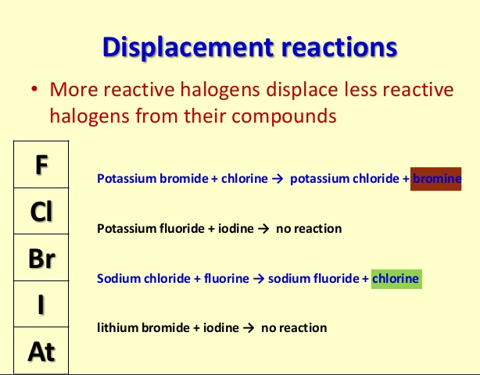
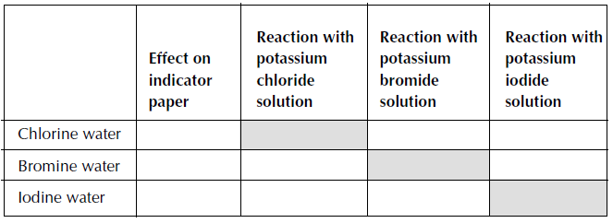
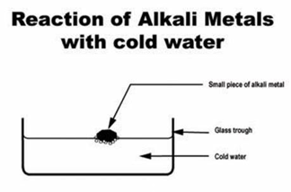
Connect the circuit as shown in the diagram above.
Connect the crocodile clips to the resistance wire, 100 centimetres (cm) apart.
Record the reading on the ammeter and on the voltmeter.
Move one of the crocodile clips closer until they are 90 cm apart.
Record the new readings on the ammeter and the voltmeter.
Repeat the previous steps reducing the length of the wire by 10 cm each time down to a minimum length of 10 cm.
Use the results to calculate the resistance of each length of wire by using R = V/I, where R is resistance, V is voltage and I is current.
Dimitri Mendeleev
Occupation: Russian chemist who developed the periodic classification of the elements.
Born: 8 February 1834, Russia
Died: 2 February 1907
Best known for: his greatest contribution to the field of chemistry to formulate the Periodic Law and to create the first predictive periodic table of elements. Many of the predictions made in his periodic table (such as the properties of elements undiscovered at the time) were later proved correct by experiments. Chemical element 101 was named Mendelevium.
Skills
Equipment Naming and handling the apparatus, drawing accurately
Risk assessment- Risk, Hazard, prevention, action
Conclusion PEEL-Point, Evidence, Explain, Link
Displacement reactions of halogens
Method:
1. Put a piece of Universal Indicator paper onto a white tile.
2. Use a glass stirring rod to transfer a few drops of the first solution onto the indicator
paper.
3. Repeat this with a fresh piece of paper and the different solutions.
4. In a test-tube, add some chlorine solution to a solution of potassium bromide.
5. Add some chlorine solution to a solution of potassium iodide.
6. Now try mixing solutions of bromine and potassium iodide. If there is time, mix the
other combinations of solutions to complete the table.
Reactions of the Alkali metals with water
Method:
Fill the trough about half full of water.
Place a piece of metal (free of oil) about the size of a rice grain on the water surface.
Place the glass lid on the trough as the metals often ‘spit’.
Results:
a) Lithium will float and fizz quietly producing hydrogen.
b) Sodium will float and fizz rapidly, moving around on the surface.
c)Potassium will float, fizz , move around and set on fire, burning with a lilac flame.
4) This experiment gives the clearest indication of the order of reactivity of the metals.
5) After each reaction, test the water by adding a little universal indicator solution.
6) The water will be alkaline.
Some applications of halogens in everyday life
All of the elements of the halogen family are found in common use in everyday life.
Fluorine is used in compounds to strengthen the enamel of your teeth against decay. It is also used in acid form to etch glass.
Chlorine is used in our drinking water and in swimming pools to inhibit bacterial growth. It is also used in the form of chlorine dioxide to bleach wood pulp in the manufacture of very white paper. We also use chlorine in everyday laundry bleach. Chlorine compounds are used in insecticides, fireworks, and matches.

