Slide 1

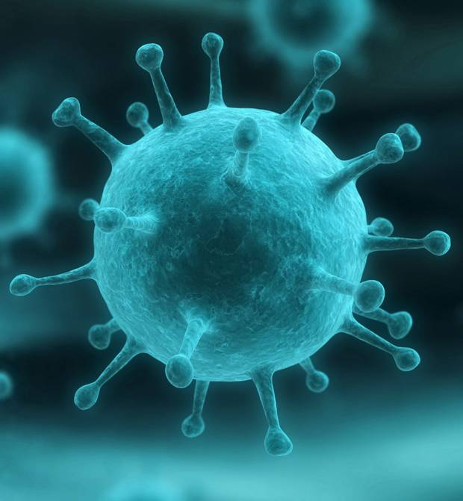
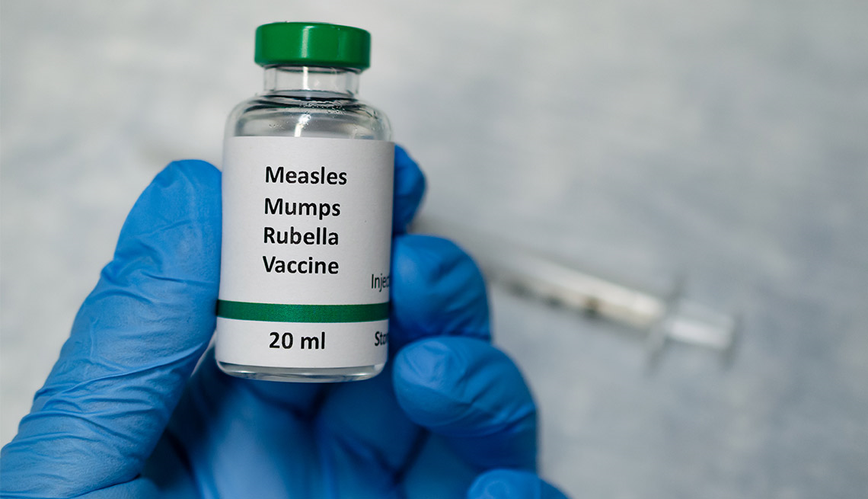

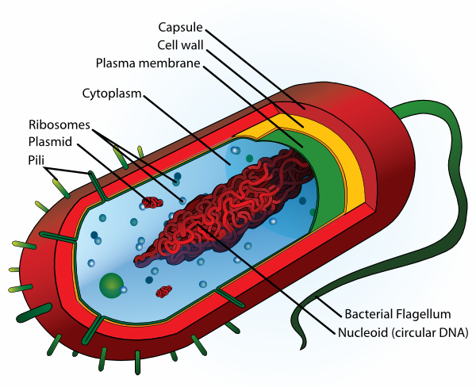
Respiration & Disease Knowledge Organiser Autumn 1
1 | The word equation for aerobic respiration is: Glucose + Oxygen → Carbon dioxide + Water + Energy
2 | The word equation for anaerobic respiration (without oxygen) is: Glucose → Lactic acid + Energy
3 | During exercise, the heart beats faster, to pump blood carrying oxygen and glucose to cells for respiration, releasing energy
4 | A drug is a chemical that alters the way your brain works
5 | A recreational drug is one that taken for pleasure e.g. alcohol
6 | A pathogen is a microbe that causes disease
7 | Bacteria make you feel ill by reproducing in the bloodstream and releasing toxins
8 | Viruses make you feel ill by invading cells, reproducing and then bursting out to infect other cells
9 | Communicable diseases are usually caused by pathogens and can be spread
10 | Non-communicable diseases can not spread e.g. asthma
11 | A vaccine is a dead or inactive pathogen
12 | Immunity is when your body is protected against catching a disease so even when the pathogen is present, you don’t get ill.
13 | Edward Jenner came up with the idea of vaccines to get rid of smallpox
14 | A benign tumour is a growth of abnormal cells, whereas a malignant tumour also invades surrounding tissues
15 | Aseptic technique means using practices and procedures to prevent contamination from pathogens.
16 | To calculate the heart rate per minute, check the pulse, calculate the beats for 15 seconds and then multiply by four.
Read, cover write 1-16
Draw and label a diagram of bacteria
Describe the difference between a benign and malignant tumour
Draw a story board to show how vaccines work
What are the advantages and disadvantages of the aseptic method?
Measure the pulse rate for a full minute and then compare to method given in 16.

Slide 2
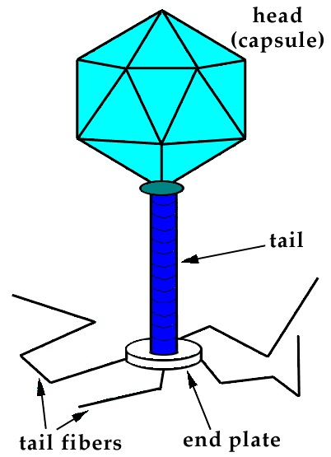
Image of a virus
Robert Koch
Occupation: Microbiologist.
Born, December 1843
Died: May 1910
Nationality: German
Best known for: isolating pure bacterial cultures including anthrax and tuberculosis
Robert Koch is widely known for his work with anthrax, discovering the causative agent of the fatal disease to be anthrax.
He discovered the formation of spores in anthrax bacteria, which could remain dormant under specific conditions.
However, under optimal conditions, the spores were activated and caused disease.
Skills
Method- plan written as a set of instructions- Firstly, secondly, subsequently, finally
Numeracy -Calculating mean, mode median. Calculating percentage (percentage change)
Results table- headed table with units in heading and not next to each result, highlight anomalies and repeat as necessary, calculate mean to appropriate number of significant figures.
Anaerobic respiration Experiment
1. Record your pulse rate at rest, by counting pulse beats on the wrist for 1 minute.
Run around outside or do star jumps for 1 minute.
Immediately record pulse rate again
Rest for 1 minute.
5. Record pulse rate again..
Reaction time experiment
Work with a partner.
2. Person A holds out their hand with a gap between their thumb and first finger.
3. Person B holds the ruler with the zero at the top of person A's thumb.
4. Person B drops the ruler without telling Person A and they must catch it.
5. The number level with the top of person A's thumb is recorded in a suitable table. Repeat this five times.
6. Swap places, and record another five attempts.
The importance of studying diseases
Studying diseases is important in understanding the structure and functions of pathogens.
Understanding the structure of pathogens then enable scientists to develop treatment or cure for diseases. They may develop vaccines that help the body to acquire immunity
Studying diseases may also provide important information about disease trends and risk factors, outcomes of treatment or public health interventions, functional abilities, patterns of care, and health care costs and use.

