Slide 1




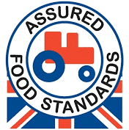






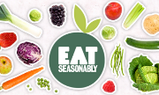












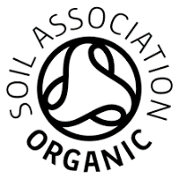


Year 8 Food - Choice & Provenance
Food Miles - The distance food travels from Farm To Fork
Task 2
Task 1
Different Types of Food Production
Locally Sourced Foods – A way of reducing food miles is to buy locally sourced foods, these are also seasonal and can sometimes be organic too.
Where does our food come from, how is it produced and why do we need to know?
Red Tractor is a food assurance scheme showing the food has been farmed, processed and packed in the UK. It is traceable, safe to eat and has been produced responsibly.
Local and Seasonal Foods
Foods:
Milk, cheese, yoghurt, poultry
Seasonal Foods - Foods that are harvested and eaten in the season they are naturally ready to eat.
The animals have access to outdoor space and can live naturally. The welfare standards are high.
Foods:
Eggs, meat
Most UK-grown fruit and vegetables are not available all year round.
Foods that have this label mean the animals have had a good life and have been treated with respect
Foods:
Eggs, meat & fish
http://eatseasonably.co.uk/what-to-eat-now/calendar/
This means the food has been produced without using any chemicals. Only natural fertilisers and pesticides are used to help the crops grow.
Foods:
Eggs, chicken, fruit and vegetables
Spring
Summer
Autumn
Winter
Task 3
Other Factors Affecting Food Choice
Many people follow ‘special diets’. They have to choose or avoid foods carefully for a range of different reasons.
The farmer gets a fair price for his produce and fair working and living conditions.
Foods:
Sugar, bananas, coffee, tea
Cost
Age Groups
Health Reasons
Vegetarian/Vegan
Religion
Intolerances
Allergies
Some families have to budget due to low incomes.
Different age groups have different nutritional needs.
E.g. obesity, type 2 diabetes, anaemia, osteoporosis.
Don’t eat meat/Don’t eat or use ANY animal products.
E.g. Hindu, Muslim, Kosher, Buddhist, Rastafarian etc.
E.g. intolerance to wheat/gluten, dairy/lactose etc.
E.g. nuts, shellfish, fish, eggs, wheat, dairy etc.
Using sustainable methods of fishing to prevent the decline in number of fish in our seas.
Foods:
Fish, seafood
Task: 1-3 Learn/cover/write and self-check, different types of food production, Local &seasonal foods and other factors affecting food choice.

