Slide 1

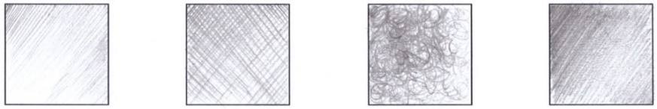
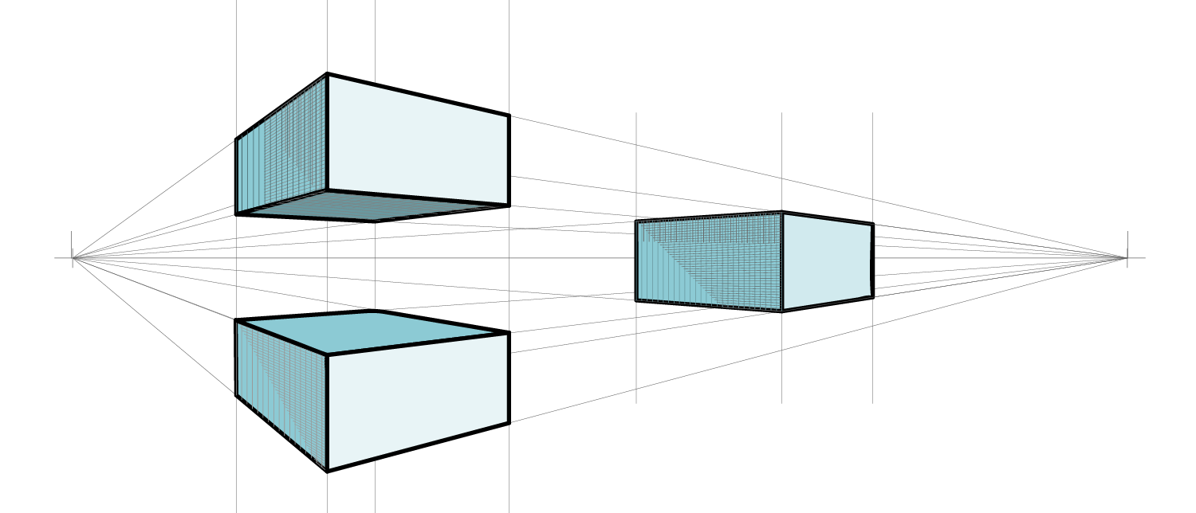
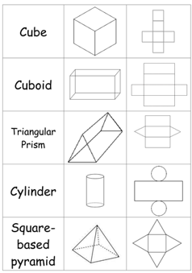
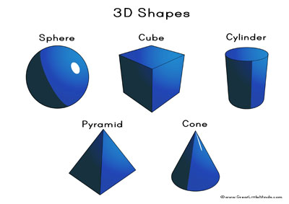
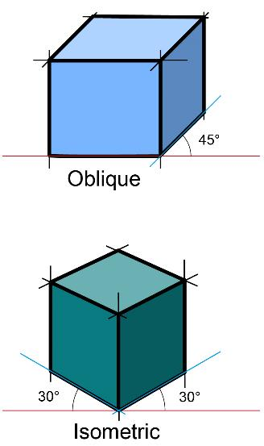
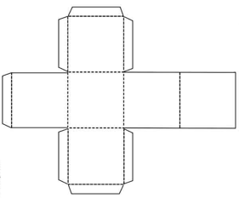

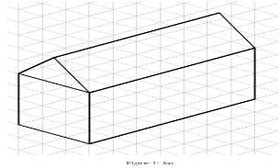
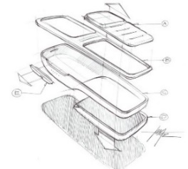
DESIGN AND TECHNOLOGY Year 8 Designing through sketching and modelling
1.
4.
Drawing and Shading Technique's
Key information | Images
A plan is a 2D drawing. It shows the different views of an object; the front, the side and the plan view. | Plan view side view Front view
Isometric, oblique, trimetric, plan metric, one-point or two-point perspective are all different styles of three-dimensional drawings
Oblique is drawn at 45 degrees Isometric is drawn at 30 degrees
The line that represents the eye level of the onlooker is known as the Horizon line
Hatching Crossing Hatching Scribbling Back and Forth
2.
3D shapes and their nets
Tab
Dotted lines for folding
5.
Key information
1. Pencils are graded according to their hardness, softness and darkness.
HB 2B 3B 4B 5B 6B the higher the softer and darker.
2H 3H 4H the higher the harder and thinner.
2. A Prototype is the name for an original working model that is often produced to
show clients.
3. Design ideas can be drawn using CAD. CAD stand for Computer Aided Design.
Lines for cutting
3.
The lines on isometric grid paper are drawn at 30 degrees.
An exploded view shows how components of an object are put together.
This type of 3D drawing is best when creating assembly instructions for putting flat pack furniture together.
Task
1. Learn/cover/write and practice the different shading skills in section 1
2. Learn /study/draw and self-check the different 3D shapes and their nets , section 2
3. Learn /practice drawing using isometric paper/ practice exploded drawing of any object in see example in section 3
4. Learn/cover/write and self-check information section 4.
5. Learn/cover/write and self-check information section 5.

Slide 2
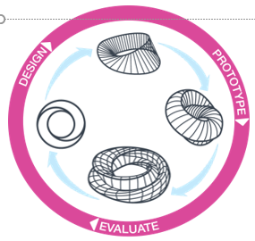
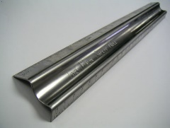
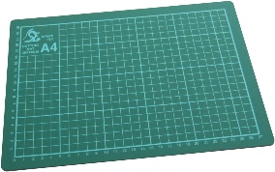
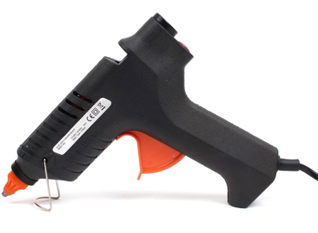
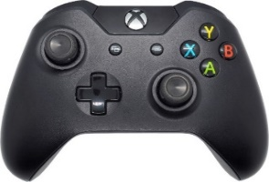
DESIGN AND TECHNOLOGY Year 8 Innovation Through Iterative Design
A. Iterative design is a cycle of designing, prototyping and testing to develop an idea and achieve the best possible outcome
Key word | Meaning
Design | Work out the structure or form of something, by making a sketch or plans. Plan and make artistically.
Prototype | The original working model. Example of the final idea.
Evaluation | To test, make judgement or give an assessment.
B. Tools and Equipment
Tools | Uses/safety
 | Safety rule Used cut cutting modelling material. Must be used on top of a safety mat. Fingers must be placed in the grooves while cutting when holding down the rule
 | Cutting Mat Used a board for cutting modelling material using a craft knife and safety rule. Used to prevent scratching table surfaces.
 | Craft Knife Used for cutting modelling material. Must be used on a safety mat with a safety rule.
 | Glue gun This is a hand held tool used for gluing most modelling materials together. It is used with a glue stick which melts when heated.
D. A good design Study the controller below: Four design features have been ergonomically designed. Each one has been labelled. | 1. Coloured buttons: Helps distinguish between the different buttons easily. | 2. Textured joy sticks: Increase friction so users thumbs are less likely to slip.
 | 3. Size of buttons: Suitable for the size of a finger. | 4. Shape/form of the controller: Fits the shape of the users hands.
C. What makes a good design?
Keyword | Meaning/ explanation
Aesthetics | How a product feels and looks
An ergonomic design | Comfortable and easy to use
Components | All the parts that make up the product.
User | The person who buys and uses the final product
Form | Its shape and style of the product
A design brief | A short description of what the product.
1
2
3
4
Tasks
1. Learn/cover/write and self-check words and meanings in section A
2. Learn /cover/write the names and uses of the tools and equipment in Section B
3. Learn/cover/write and self-check words and their meanings in section C
4. Learn /cover/write the features and reasons why they are ergonomically designed in section E

