Slide 1

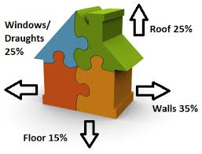
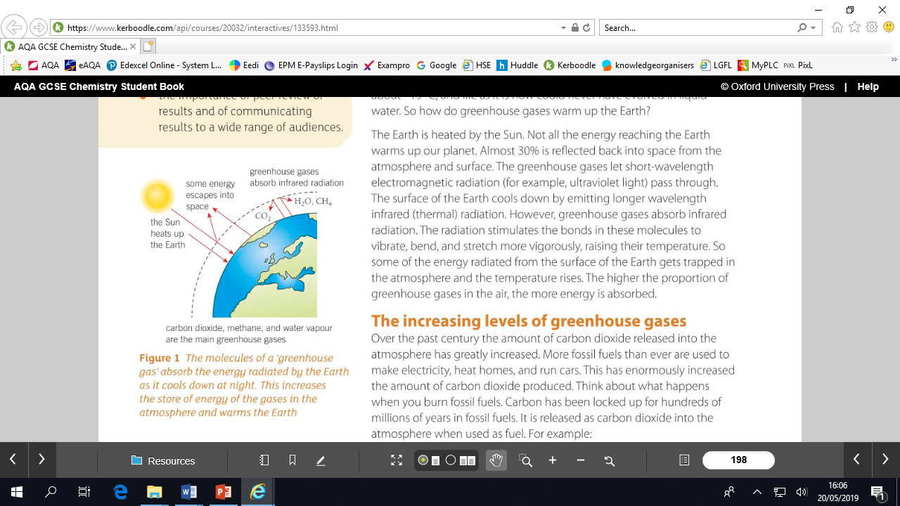
Energy Knowledge Organiser Autumn 1
1 | Energy s measured in Joules, J.
2 | Whenever energy is transferred, some is usefully transferred, the rest is dissipated (spreads out) and may be stored in less useful ways (wasted)
3 | Chemical energy stores include fuels, foods or the chemicals found in batteries. The energy is transferred during chemical reactions.
4 | Kinetic energy stores describe the energy an object has because it is moving. It depends on its mass and speed.
5 | Gravitational potential energy stores are used to describe the energy stored in an object because of its position, such as an object above the ground.
6 | Elastic potential energy stores describe the energy stored in a springy object which you can stretch or squash.
7 | Thermal energy stores describe the energy a substance has because of its temperature.
8 | Energy can be transferred from one store to another.
9 | Conservation of energy- Energy cannot be created or destroyed
10 | Work done to overcome friction is mainly transferred to thermal energy stores by heating.
11 | When an object is moved upwards, the energy in its gravitational potential energy store increases.
12 | input energy= useful output energy + wasted energy
13 | Efficiency= useful output energy/total input energy, decimal answer OR Efficiency= useful output energy / total input energy x100, (answer as %).
14 | No device can be more than 100% efficient because you can never get more energy from a machine than you put into it.
15 | The more powerful an appliance is, the faster the rate at which it transfers energy.
Homework
Read, cover write
1-7
2 Read, cover write
8-15
3 Describe how the % in the house can be reduced.
4 Draw a picture and describe the greenhouse effect
5 List ways of using less electricity at home or school
Extension: Evaluate three renewable energy sources

Slide 2
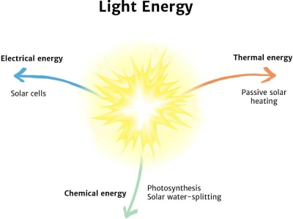
Isaac Newton
Occupation: Scientist, mathematician, astronomer and theologian.
Born, December1642
Died: March, 1726
Nationality: English
Best known for: being the first to build reflecting telescopes.
Newton built the first practical reflecting telescope and developed a sophisticated theory of colour based on the observation that a prism separates white light into the colours of the visible spectrum.
His work on light was collected in his highly influential book Optics, published in 1704
Skills
Method- plan written as a set of instructions- Firstly, secondly, subsequently, finally
Numeracy -Calculating mean, mode median. Calculating percentage (percentage change)
Results table- headed table with units in heading and not next to each result, highlight anomalies and repeat as necessary, calculate mean to appropriate number of significant figures.
Infrared Experiment
Place a Leslie cube on a heat-resistant mat.
Fill it, almost to the top, with boiling water and replace the lid.
Leave for one minute. This is to enable the surfaces to heat up to the temperature of the water.
Use the infrared detector to measure the intensity of infrared radiation emitted from each surface, or the temperature of the surface.
Make sure that the detector is the same distance from each surface for each reading.
Insulation experimentl
Place a small beaker into a larger beaker.
2. Fill the small beaker with hot water from a kettle.
3. Put a piece of cardboard over the beakers as a lid. The lid should have a hole suitable for a thermometer
.
3. Place a thermometer into the smaller beaker through the hole.
4. Record the temperature of the water in the small beaker and start the stopwatch.
5. Record the temperature of the water every 2 minutes for 20 minutes.
Some applications of energy in everyday life
All aspects of life depend on energy. Most living things obtain chemical energy from photosynthetic plants. Light energy from the sun is the primary source of energy.
Everyday activities such as lighting and heating our homes, driving cars and industry require various forms of energy. The manufacturing of the products we rely on all require energy.
Energy is used in the following ways in households: space heating (41%), lighting and appliances (26%), water heating (20%), air conditioning (8%), and refrigeration (5%).

