Slide 1

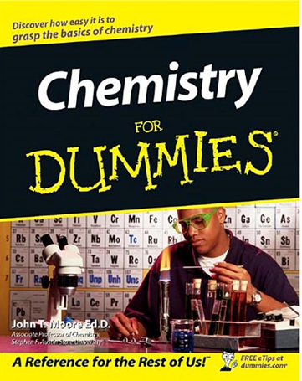
Summer 2 – Fundamentals of Chemistry Knowledge Organiser
 | Key word(s) | Definition
Distillation Distillation is the process used to separate dissolved solutes from solvents. There are two stages involved in distillation. These are evaporation followed by condensation. The mixture needs to be heated to be evaporated and then condensed. This separates the solvent.
What is Rf value? |  | Distance travelled by solute /distance travelled by the solvent | Elements |  | A substance which contain same type of atoms
What is filtrate? |  | Soluble substance that passes through a filter paper. | Compounds |  | Substance made of two or more elements chemically joined together
What does residue mean? |  | Insoluble substance that is separated on a filter paper | Mixtures |  | Substance which contains two or more elements physically joined together
What is a solvent? |  | Solvent is a substance in which solute is dissolved. | Solute |  | The substance which is dissolved in a solvent
A solution is a mixture of a solute and a solvent
Homework
Read, cover write the key definitions
Use the internet to find out how chromatography is used in Forensics.
Find three interesting facts about Mikhail Tesvet.
Memorise all the keywords .
What equipment is needed to carry out filtration?
Compounds : | When two or more elements chemically joined together.
Distillation | This is a separating technique to separate two liquids
chromatography | This technique is used to separate coloured compounds.
Atoms | The tiniest particles in an element.
Molecules | When two or more than two atoms joined together.
Elements | A substance that contain the same type of atoms.
Filtration | Separating technique used to separate insoluble substance from a solvent.
Crystallisation | When crystals are formed by evaporation of water.
Create a Chemistry for Dummies booklet on all the separation techniques: Including –
Include a glossary to explain what these keywords mean:
Mixtures, Compounds
Pure, Impure
Solvent, Solute, Solution
Solubility, Soluble, Saturated solution
Ssedimentary rocks | Rocks made up of lots of other pieces of rock. Eventually, layers of soil and mud help the little pieces to form 1 whole rock.
Metamorphic rocks | Rocks that have been changed over time with extreme heat and pressure underground.
Igneous rocks | Rocks that are made from hot molten lava, found deep down below the earth’s crust.

Slide 2
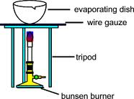
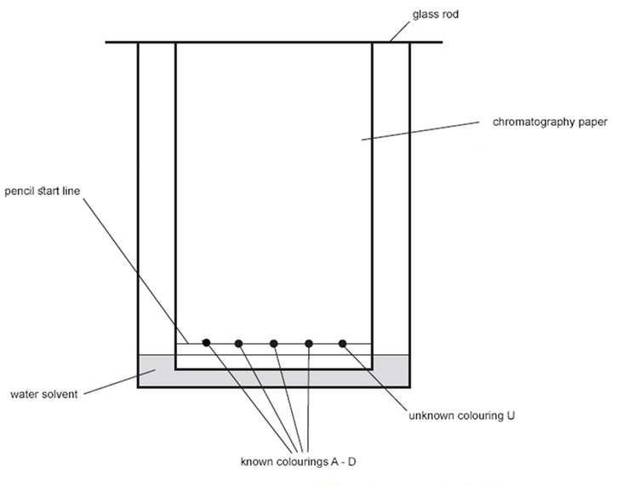
Connect the circuit as shown in the diagram above.
Connect the crocodile clips to the resistance wire, 100 centimetres (cm) apart.
Record the reading on the ammeter and on the voltmeter.
Move one of the crocodile clips closer until they are 90 cm apart.
Record the new readings on the ammeter and the voltmeter.
Repeat the previous steps reducing the length of the wire by 10 cm each time down to a minimum length of 10 cm.
Use the results to calculate the resistance of each length of wire by using R = V/I, where R is resistance, V is voltage and I is current.
M Mikhail Semyonovich Tsvet
ikhail Semyonovich Tsvet was a Russian-Italian botanist who invented chromatography. His last name is Russian for both "colour" and "flowering.“
Born: 14 May 1872 · Asti, Italy
Died: 26 Jun 1919 · Voronezh, Russia
Mikhail invented chromatography during 1900 during his research on pigments. It was Mikhail Tsvet’s research into plant pigments which led him to invent chromatography in 1903.
Born in Italy of Russian descent in 1872, Mikhail Semyonovish Tsvet spent his early life studying Botany.
Skills
Equipment
Naming and handling the apparatus, drawing accurately
Risk
Hazard, prevention, action
Conclusion
PEEL-Point, Evidence, Explain, Link
Chromatography
Method
1. Use a ruler to draw a horizontal pencil line 2 cm from the edge of the chromatography paper.
2. Mark five pencil spots at equal intervals across the line. Keep at least 1 cm away from each end.
3. Use a glass capillary tube to put a small spot of each of the known colourings on four of the pencil spots. Then use the glass capillary tube to put a small spot of the unknown mixture on the 5th pencil spot.
4. Pour water into the beaker to a depth of no more than 1 cm.
5. Tape the edge of the chromatography paper to the glass rod. Rest the rod on the top edge of the beaker.
Required Practical: Chromatography
Filtration practical:
Method
An example method is shown below.
Set up apparatus as shown in diagram.
Fold filter paper and place into the funnel.
Mix the crushed salt and rock mixture with water, ensuring that the salt dissolves.
Slowly pour the mixture through the filter paper.
Collect the filtrate.
Remove the filter paper and allow to dry if the residue is needed.
Place the filtrate in an evaporating basin and evaporate the water to obtain salt.
Some applications of chromatography in everyday life
Chromatography is commonly used in food processing industry and in crime scene investigations. The process can be used to separate the components of food dye and also the components of ink in linking criminals to evidence such as written notes collected from a crime scene.

