Slide 1

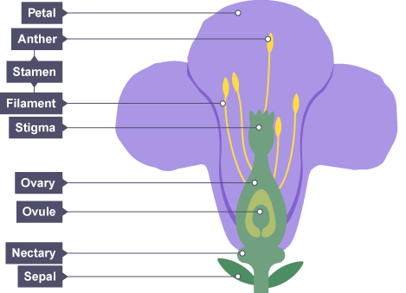
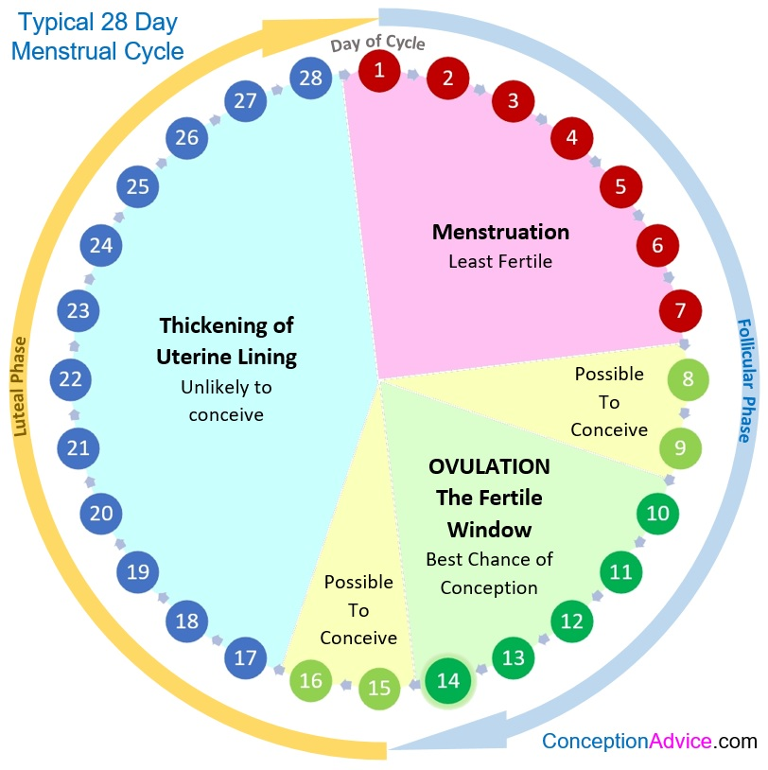
Amniotic fluid | Liquid that protects the fetus in the uterus.
Embryo | An organism in the early stages of development.
Fertilisation | The joining of a male and female gamete.
Fetus (foetus) | An unborn baby. Usually eight weeks after conception.
Gamete | Sex cell (sperm in males and ova/eggs in females).
Gestation | The time during which a fertilised egg develops into a baby ready to be born.
Hormone | Chemical messenger produced in glands and carried by the blood to specific organs in the body.
Menstrual cycle | Recurring series of events in the human female reproductive system.
Menstruation | Also called a 'period'. The loss of blood and tissue from the lining of the uterus through the vagina during the menstrual cycle.
Ovulation | The process of releasing an egg from an ovary.
Placenta | The organ in the uterus of pregnant mammals that allows the transfer of nutrients and waste products between the mother and the fetus through the umbilical cord.
Competition | The interaction between organisms after the same limited resources.
Pollen grain | The structure produced in the anthers of a flower that contains the male gamete.
Pollination | The fertilisation of flowers by passing on their pollen.
Chlorophyll | The green chemical inside the chloroplast of plant cells. It enables photosynthesis to take place
Chloroplast | Contains the green pigment chlorophyll; the site of photosynthesis.
Photosynthesis | A chemical process used by plants to make glucose and oxygen from carbon dioxide and water, using light energy. Oxygen is produced as a by-product of photosynthesis. Algae subsumed within plants and some bacteria are also photosynthetic.
Stomata | Tiny holes in the epidermis (skin) of a leaf. They control gas exchange by opening and closing and are involved in loss of water from leaves. Singular is stoma.
Summer 1 - Reproduction and Photosynthesis
Knowledge Organiser
Homework
1 Read, cover write 1-9
2 Read, cover write 10-18
3 Explain the functions of each of the parts of the male and female reproductive system labelled on the opposite page
4 Explain the functions of each of the parts of the plant reproductive system labelled above
5 Write about the history and life of Mirian Menkin.
Ionic compounds | Covalent compounds
Non-metal + metal | Non-metal + Non-metal
Transfer of electrons (metal to non-metal) | Sharing electrons
Positive and negative charges | No charges
High melting and boiling points | Low melting and boiling points
High attraction between the particles | Weak attraction between the molecules
Solid at room temperature | Solid, liquid or gas at room temperature

Slide 2
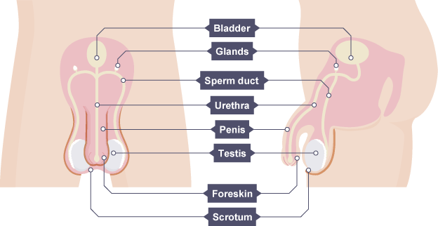
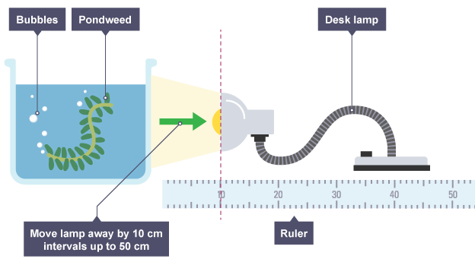
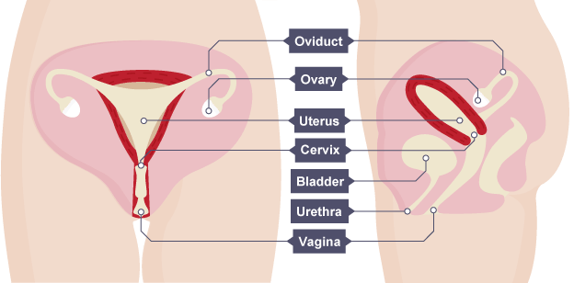
Miriam Menkin
Occupation: Scientist and science technician
Born: 8th August 1908 in Riga, Latvia
Died: 8th June 1992 in Boston, USA
Best known for: Miriam Menkin invented reproduction through IVF (In-Vitro-Fertilisation). One Tuesday in February 1944, the 43-year-old lab technician went into her lab, just as she had every week for the past six years. Wednesdays were when she introduced a newly washed egg to a cloud of sperm solution in a glass dish and prayed that two would become one.
As a technician for Harvard fertility expert John Rock, Menkin’s goal was to fertilise an egg outside the human body. This was the first step in Rock’s plan to cure infertility, which remained a scientific mystery to doctors. Miriam Menkin and John Rock eventually invented fertilisation by IVF
Skills
Hypothesis - prediction with a reason
Variables - independent variable, dependent variable, control variable
Result - headed table with units in heading and not next to each result, highlight anomalies and repeat as necessary, calculate mean to appropriate number of significant figures
Rate of Photosynthesis Experiment
Method
Set up the apparatus as in the diagram.
Leave for five minutes for the pondweed to acclimatise to the new light intensity.
Count the number of bubbles given off in one minute.
Move the light 10 cm further back.
Leave for five minutes for the pondweed to acclimatise again.
Count the number of bubbles given off in one minute.
Repeat by moving the lamp away by 10 cm intervals until 50 cm is reached.
The effect of light on growing cress seeds Experiment
Method
Put cotton wool into two petri dishes and add the same volume of water to each dish.
Add ten seeds to each dish and make sure they are evenly spaced.
Place one of the petri dishes in a dark place and the other in a bright area.
Allow the seeds to geminate for one week and record your observations
Some applications of photosynthesis and reproduction in everyday life
The energy derived from photosynthesis is used to supply energy to most living organisms on earth. The concept of the reaction allows students to understand that processes in living organisms are driven from biochemical reactions. Learning about the leaf embeds the idea that structures in Biology are always related to their function e.g. stomata for gas exchange.
Learning about reproduction will give learners the opportunity to understand changes in their own bodies and therefore manage themselves and their relationships in a healthy manner. It is important for students to learn about sexual, birth, maternal health and the sex organs so that they can make informed choices about sex, and relationships.

