Slide 1

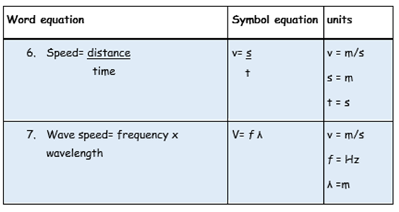

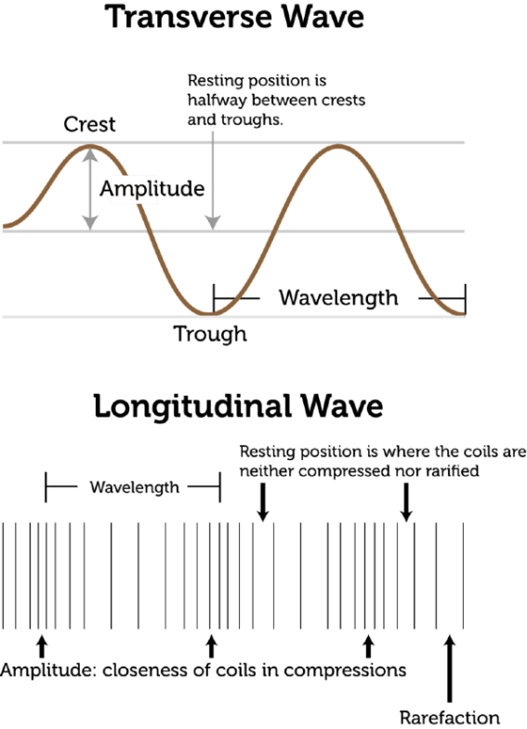

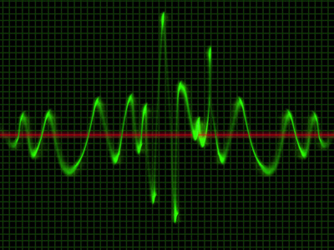
Keywords
Mechanical waves
EM Waves
Refraction
Reflection
Normal
Definition
A wave that travels through a medium or substance.
Electric and magnetic disturbances that transfer energy from one place to another (can travel through a vacuum).
The change in direction of a ray when it passes a boundary to a transparent medium of a different density.
The change of direction of a wave at a boundary when the wave stays in the incident medium.
Straight line through a boundary perpendicular to the boundary.
Keywords
13) Wavelength
14) Time Period , (T)
15) Frequency
16) The eye
17) The retina
Definition
This is the length of one complete wavelength
1 /Frequency (seconds). Time period is the time taken for one complete wave to pass a point when travelling.
The number of wave crests passing a fixed point every second.
A biological sensor that is able to look at objects and convert the image into colours that the brain interprets as an object or pattern.
The retina is a photosensitive material that contains cells that respond to light. They are called photoreceptors.
Colour coded Home learning tasks
Read/Cover/Write and check the keywords and their meanings. [1 to 6]
Read/Write and check the equations for speed. [6 to 7]
Read/Cover/Write the keywords and their meaning. [8 to 12]
Read/Cover/Write the keywords and their meaning. [13 to 17 ]
Extension: What does RADAR stand for? Who invented it and when was it first used?
Waves
Keywords
8) Wavelength
9) Time Period , (T)
10) Frequency
11) The eye
12) The retina
Definition
This is the length of one complete wavelength
1 /Frequency (seconds). Time period is the time taken for one complete wave to pass a point when travelling.
The number of wave crests passing a fixed point every second.
A biological sensor that is able to look at objects and convert the image into colours that the brain interprets as an object or pattern.
The retina is a photosensitive material that contains cells that respond to light. They are called photoreceptors.

Slide 2
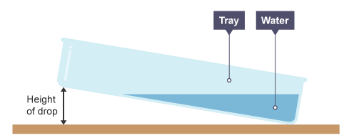
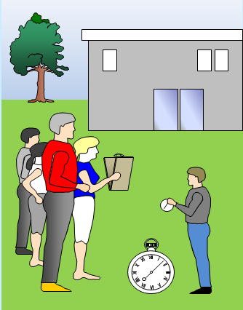
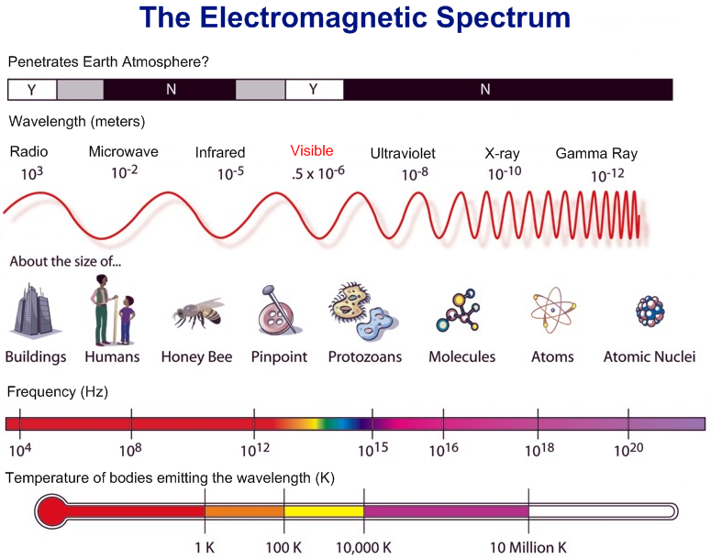
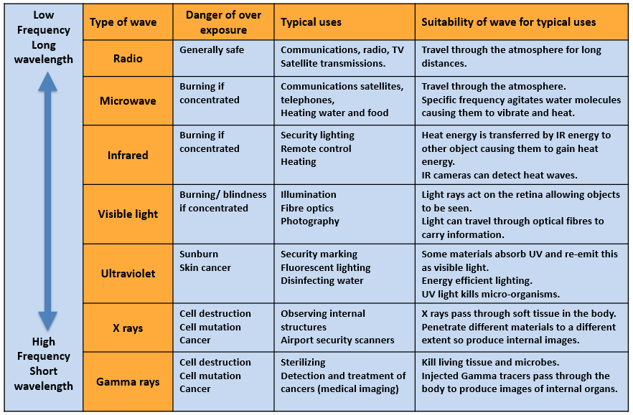

Measuring the speed of sound in air using an echo method.
Equipment: A pair of wooden blocks to make a clap sound, a measuring tape (50m if possible), two or three stopwatches or stop clocks.
Method:
Measure out a distance from a tall building – around 50m if possible.
Snap the blocks together outside in front of the building and record the time it takes for the echo to return. To reduce error, time how long it takes for 20 claps in one go.
Repeat the experiment and find an average time.
Calculate the speed of sound from the formula:
Speed = distance/time
Isaac Newton performed experiments on light towards the end of the 17th century. Perhaps the most famous was his experiment with sunlight and prisms where he showed that white light is composed of many colours, and that each individual colour could not be used to recreate white light or be broken down further. He also performed rather frightening experiments on himself to study the perception of light by his eyes.
In November 1886 Heinrich Hertz became the first person to transmit and receive controlled radio waves. However, as he had not considered the practical uses for it and so didn’t pursue it. Radio waves gave us the radio and the first version of radar!
On 14 September 2015, almost exactly a century after they were predicted by Albert Einstein, the first detection of gravitational waves (produced via the collision and subsequent merger of two black holes) was made by the Laser Interferometer Gravitational-wave Observatory (LIGO) detectors in the US.
Measuring the speed of a wave in water.
Equipment:
Method:
Measure the length of the tray and record the result.
Add water to the tray to give a depth of e.g. 0.5 cm and note the volume of water used.
Lift one end of the tray by a few cm and gently drop onto the table.
Start the timer when the wave in the tray hits one end of the tray.
Record how long it takes for the waves to travel eg four lengths of the tray.
Repeat steps 3 to 5 four more times.
Repeat steps 2 to 6, adding more water each time to increase the depth by 0.5 cm up to e.g. 3 cm.
Uses of waves in everyday life

