Slide 1

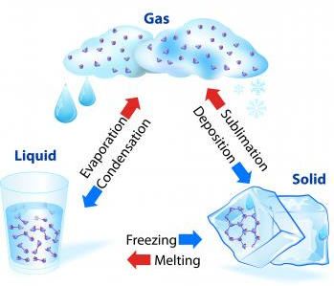
Boiling | When all of a liquid changes into a gas.
Capacity | Amount of something that a container can hold.
Collide | When different things crash into each other.
Condensation | When a gas becomes a liquid by cooling.
Container | Object used to store things.
Definite | Fixed and specific.
Energy | Ability to do work; energy comes in different forms such as light, heat and motion.
Evaporation | When the particles at liquid's surface change into a gas.
Mass | Amount of matter that an object contains.
Matter | Physical substance that everything in the universe consist of.
Melting | When a solid becomes a liquid by heating.
Mobile | Able to move from one place to another.
Particle | Very small piece of matter.
Pressure | The amount of force exerted by a gas or liquid in a container.
Shape | External form of something.
State | Specific physical form that matter has and that can change.
Substance | Specific type of solid, liquid or gas.
Vapour | Substance that is made of liquid particles floating in the air and that is formed when a liquid is boiled or heated.
States of Matter knowledge organiser 3
Ionic compounds | Covalent compounds
Non-metal + metal | Non-metal + Non-metal
Transfer of electrons (metal to non-metal) | Sharing electrons
Positive and negative charges | No charges
High melting and boiling points | Low melting and boiling points
High attraction between the particles | Weak attraction between the molecules
Solid at room temperature | Solid, liquid or gas at room temperature
Homework
1 Read, cover write 1-9
2 Read, cover write 10-18
3 Describe how particles are arranged in a solid, liquid and gas
4 What is potable water and what is its importance?
5 Write about the history and life of Robert Boyle.

Slide 2
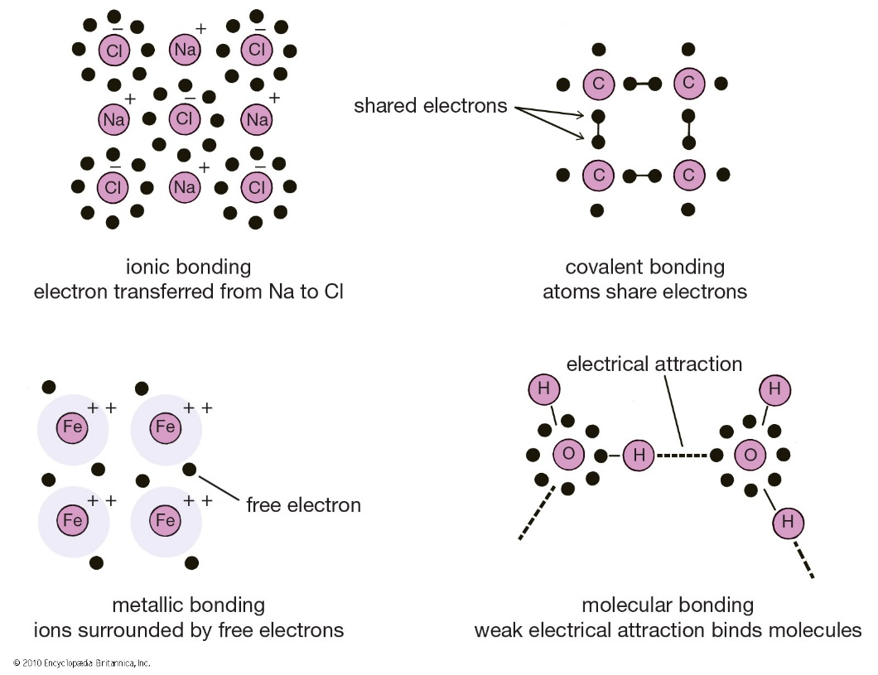
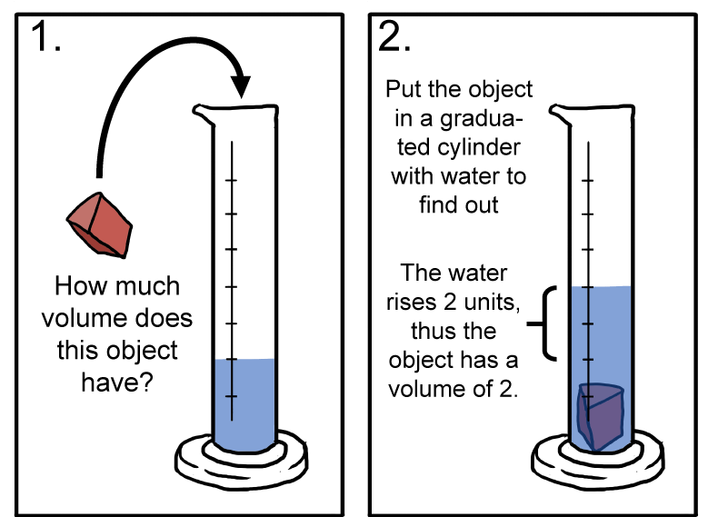
Robert Boyle
Occupation: Scientist, philosopher, chemist, physicist and inventor
Born: January 25th 1627 in County Waterford, Ireland
Died: 31st December 1691 in London, England
Best known for: Boyle’s Law
In 1661, Robert Boyle published The Sceptical Chymist. The book rejected the then prevalent Aristotelian theory of the four elements (earth, air, fire, and water) and Paracelsian notions about the composition of matter. It presented Boyle’s hypothesis that everything was composed of minute particles (atoms) of a single universal matter and that every phenomenon was the result of collisions of particles in motion. It is due to this book that Robert Boyle is often called the founder of modern chemistry.
Skills
Hypothesis- prediction with a reason
Graph- bar charts, line graphs
Evaluation- compare results to other groups and suggest. Improvements. Evaluate risks both in the wider societal context, including consequences. Are the results valid, repeatable, and reproducible?
Cooling Curve Experiment
Method
Put about 150 cm³ water into the beaker.
2) Heat it on a tripod and gauze until the water just starts to boil.
3) Set up the apparatus as shown in the diagram and start the timer. Keep the water boiling, but not boiling vigorously.
4) Using a suitable results table, record the temperature of the stearic acid every minute until it reaches about 70C. Note on your results table the point at which you see the solid start to melt.
5) Use the clamp stand to lift the tube from the hot water. Record the temperature every minute as the stearic acid cools down until it reaches about 50C. Note on your results table the temperature at which you see the stearic acid begin to solidify.
How to calculate the density of an object
Some applications of particle theory in everyday life
Particle theory is used in day to day life whether cooking using boiling water or removing impurities from clothes. We will learn about the makeup of materials and this will help them in making decisions. For example a flat basketball can temporarily be used if left in the Sun due to ideal behaviour of gas molecules.
Why should tyre pressure in a car be checked before a long journey whilst the tyres are relatively cold?
How can crushing spices in a pestle and mortar increase the flavouring when cooking?

