Slide 1

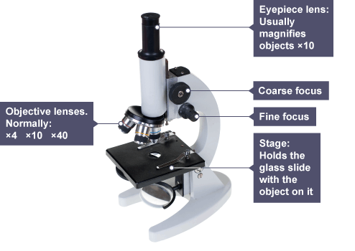
Cells and digestion knowledge organiser
Cells | Building block that all living things are made up of.
Chloroplasts | Found in plant cells and contain a chemical called chlorophyll. The chloroplasts trap light to help the plant photosynthesise.
Concentration | How many particles there are in a certain amount of space.
Cytoplasm | Is a jelly-like substance found in cells where chemical reactions take place.
Diffusion | The spreading out of particles in a liquid or gas. The particles move from where there is a lot of them to where there is less. They move from an area of high concentration to an area of low concentration.
Euglena | Unicellular organism that can photosynthesise
Flagellum | Looks a tail and allows the unicellular organism to move around.
Leaf cells | Cells in plants that have chloroplasts and can photosynthesise.
Mitochondria | The part of the cell where respiration happens and energy is released.
Multicellular | An organism made up of more than one cell.
Nerve cells | A very long cell found in animals. It carries messages to and from the brain from other parts of the body.
Nucleus | Part of a cell that controls the cell and is where the DNA is found.
Digestion | The breaking down of large food molecules into smaller food molecules.
Protease | Catalyses the digestion of proteins.
Lipase | Catalyses the digestion of lipids.
Carbohydrase | Catalyses the digestion of carbohydrates.
Bile | Breaks down lipids into smaller droplets that are easier for lipase to work on.
Enzymes | Enzymes speed up chemical reactions. Enzymes are catalysts.
Villi | These are tiny structures that cover the inner part of the small intestine.
Observing Cells
1 Cut open an onion cell
2. Use forceps to peel a thin layer of skin from the inside
3. Lay the layer of epidermis on a microscope slide
4. Add a drop of iodine solution to the layer
5. Carefully place a cover slip over the layer.
Magnification
To work out the total magnification of specimen you would need to find the eyepiece lens magnification (usually 10) and then the objective lens that you have selected (usually 4, 10 or 40 times magnified). Here is an example of how to set out the calculation:-
Total magnification = eyepiece lens magnification x Objective lens magnification
= 10 x 20 = 200
Homework
1 Read, cover write 1-7
2 Read, cover write 8-15
3 Describe how cells can be observed under the microscope
4 Compare light microscope to the electron microscope
5 Write about the history and life of Robert Hooke.

Slide 2
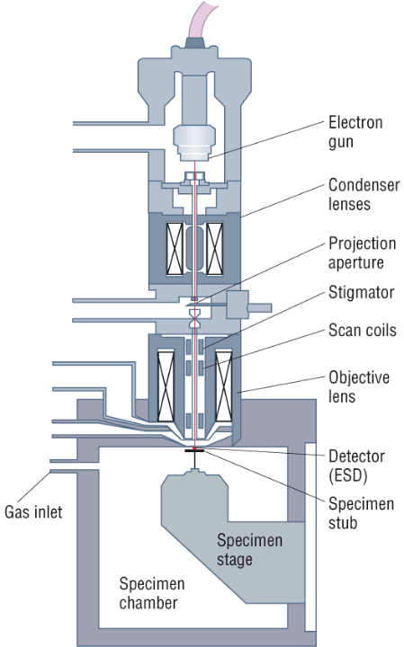
Robert Hooke
Occupation: Scientist, mathematician, and astronomer
Born: July 18, 1635 in Freshwater, the Isle of Wight,
Died: March 3, 1703 in London, England
Best known for: being the first use microscope to view cells.
He is known for identifying the cellular structure of plants. When he looked at a sliver of cork through his microscope, he noticed some "pores" or "cells" in it.
Hooke believed the cells had served as containers for the "noble juices" or "fibrous threads" of the once-living cork tree.
Skills
Method- plan written as a set of instructions- Firstly, secondly, subsequently, finally
Numeracy -Calculating mean, mode median. Calculating percentage (percentage change)
Results table- headed table with units in heading and not next to each result, highlight anomalies and repeat as necessary, calculate mean to appropriate number of significant figures.
Energy in food Experiment
Method
Half-fill the test tube with water and measure its temperature (write this down in your table – temp. before)
Place the test tube in a clamp at an angle. Keep the thermometer in.
Use the needle to securely pierce through a food sample
Hold your sample over the blue flame of Bunsen burner until set alight
Place burning sample under the tube and hold there until it burns out
Measure the temperature again
Some applications of force in everyday life
At a cellular level, Stem Cell Research is changing the possibilities of biological engineering. Research in Britain has been at the cutting edge of developing stem cell research as demonstrated by Dr Stephen Minger at King’s college London.
The possibility of understanding human health and disease at the cellular level of the organism is important.
Light Microscope | Electron Microscope
Illuminating source is the Light. | Illuminating source is the beam of electrons.
Specimen preparation takes usually few minutes to hours. | Specimen preparation takes usually takes few days.
Live or Dead specimen may be seen. | Only Dead or Dried specimens are seen.

