Slide 1
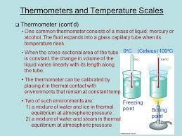
Unit 5 :Learning Aim C Thermal Physics, materials and fluids
Write down the units for the following:
Energy
Power
Temperature
Pressure
Work Done
Force
Absolute Zero
Thermodynamic Temperature
What is meant by the term work?
Write down the equation for work and work done by a gas expanding.
Describe the law of conservation of energy.

Slide 2
Unit 5 : Learning Aim C Thermal Physics
Complete the table :
What do the terms `system` and `surroundings`?
Type of Energy | Name a device that uses and another example that produces
Mechanical Energy
Electrical Energy
Chemical Energy
Nuclear Energy
Thermal Energy
Describe the principle of energy conservation.

Slide 3
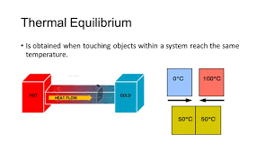
Unit 5: Learning Aim C : Thermal Physics
What is Thermal Equilibrium?
What is Zeroth Law of Thermodynamics?
Define Thermal contact.
Define the following terms:
Heat
Temperature
Thermometer

Slide 4
Unit 5: Learning Aim C
Describe the term ` Thermal efficiency`.
Write down the equation for calculating efficiency.
What do we mean by the following terms:
Heat engines
Energy efficiency
Outline the method for calculating efficiency of a heat engine.

Slide 5
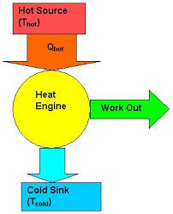
Unit 5 : Learning Aim C
Describe how does a heat engine work?
What is the equation for efficiency of a heat engine?
Why is electricity such a useful form of energy? Why is it so expensive to produce?
Explain how thermometry works.

Slide 6
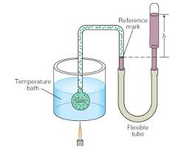
Unit 5 : Learning Aim C Ideal Gas Equation
Explain` kinetic theory`.
Write down the equation .
What does ideal gas mean?
How does constant volume gas thermometer work?
Outline the key points that explain ideal gas equation.
What is Boltzmann constant?
Describe equation of state.

Slide 7
Unit 5: Learning Aim C Changes of state
Describe what condensation is
Define saturated vapour.
Define the following terms:
Freezing
Latent heat of fusion
Critical point
Describe vaporization is
Explain what is latent heat.
Explain what is triple point.

Slide 8
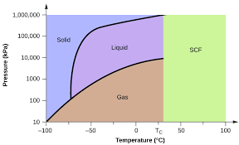
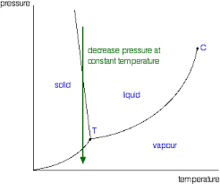
Unit 5: Learning Aim C Changes of state
By using a container of gas as a thermometer how can we measure its changes of volume .
Explain the following terms:
Latent heat
Vapor
Vaporization
Condensation
Phase
Explain the first Law of Thermodynamics.

Slide 9
Unit 5: Learning Aim C Internal Energy and First Law of Thermodynamics
What is internal energy?
How can you measure the amount of energy transferred into or out of the system during any process?
What is second aw of thermodynamics?
Define the following terms:
Natural process
Entropy
Why second Law of thermodynamics is very important?

Slide 10
Unit 5:Learning Aim C Laws of thermodynamics
How First and second Laws of thermodynamics work together to explain what happens in the world around you?
Hint: One system (e.g our Sun) increasing in entropy may release energy to drive another system(e.g plant leaves) which then creates some more ordered, lower entropy structures. But what happens overall to the order and entropy of the universe?

Slide 11
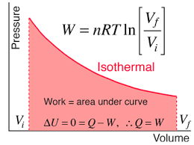
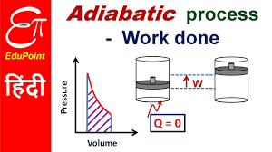
Unit 5 :Learning Aim C Reversible processes
Explain the following terms
Reversible process
Isothermal process
Adiabatic process
Define the tem Isothermal process and explain how does heat transfer at constant temperature.
Why in adiabatic process there is no heat transfer?

Slide 12
Unit 5: Learning Aim C Idealized engine cycles
What do the following terms mean :
Heat capacity
Adiabatic compression
Isothermal Expansion
Adiabatic Expansion
Isothermal compression
Explain maximum theoretical efficiency of an ideal carnot cycle engine.
What is the equation for maximum thermal efficiency?
Why the equation for carnot cycle engine important ?
Write down the equation for carnot cycle engine?

Slide 13
Unit 5 : Learning Aim C Heat Engines , refrigerators and pumps
`Laws` apply generally and can be used in real situations`. Ideals are simplified ideas and equations that only almost work under specified conditions . Use examples from thermodynamics to help explain this difference between `Laws and Ideals`.
Examples of Ideals include : Gas equation of state; Adiabatic changes; Isothermal changes. Explain why each of these is never exactly true.
How does steam turbine engine work?
Explain why each of those Ideals in nevertheless a useful idea.

Slide 16
:

