Slide 1
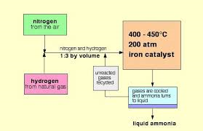
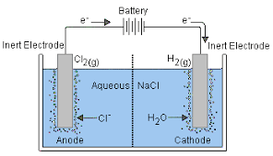
Unit 5 : Leaning Aim A- Properties and uses of substances
How does the use of iron in the Haber process lower environmental and financial costs?
Define the following terms:
Complex ions
Ligand
Catalyst
Activation energy
What are transition metals?
What are the products of the electrolysis?
write down the method for Haber process.

Slide 2
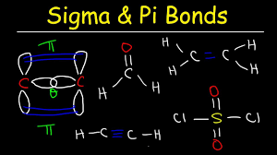
Unit 5 : Learning Aim A –structures , reactions and properties of organic compounds
Define the following terms:
Amphoteric , acid , base and salt
What are aliphatic , Alicyclic and aromatic compounds?
Draw the table for homologous series for alkanes.
Draw the structure of propanol.
What are Halo alkanes?
Define the term isomers.
Write out the three steps for the free radical substitution of ethane by Bromine.
write the molecular formulae for the following in the table :
Ethane
Butane
Octane
Heptane
Pentane
What are sigma and Pi bonds?
What are Cis/Trans/Isomers?
Can you explain what is meant by homologous series?

Slide 3
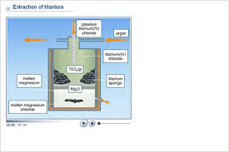
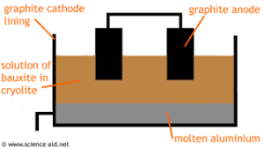
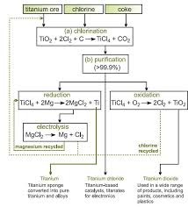
Unit 5:Learning Aim A –purification,extraction and manufacture of useful substances
Draw a mind map of titanium extraction from Titanium Oxide.
Write the method for the extraction of Aluminium from Bauxite.

Slide 4
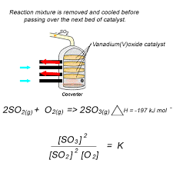
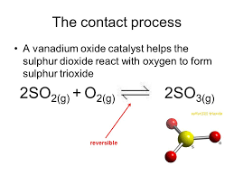
Unit 5 : Learning Aim A –purification , extraction and manufacture of useful substances
Describe how Vanadium (V) Oxide acts as a catalyst in the contact process . Include any relevant equations.
Define the following terms:
Refractory materials
Bauxite
Slurry
Flocculants
Sedimentation
Condensate
Calcination
Write down the equations for the following reactions:
Conversion of Titanium(IV) Oxide to Titanium (IV) Chloride.
Reduction of Titanium Chloride using Magnesium to produce Titanium.

Slide 5
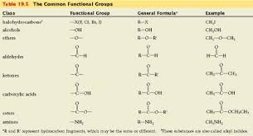
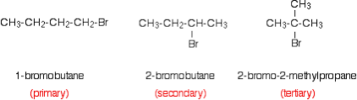
Unit 5 : Learning Aim A –Important organic compounds
Define the following key terms:
Aliphatic, Alicyclic
Aromatic, IUPAC nomenclature
Saturated compound
Write own the functional groups for Alcoholsf,Aldehydes,Esters and Haloalkanes.
What is homologous series?
Write the molecular formulae for the following compounds:
Butane
Heptene
Pentane
Octene
Define the term Haloalkanes.
How do you name an organic compound?

Slide 6
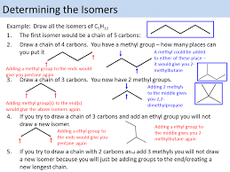
Unit 5 :Aim A structures ,reactions and properties of organic compound
What are structural Isomers ?
Draw the structure of 2-methylpopan-2-ol
What are isomers?
Draw the structure of Butane and 2-methylpropane.
Define the following:
Chain isomers
Positional isomers
Functional isomers

Slide 7
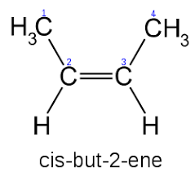
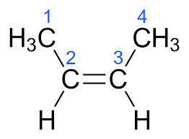
Important organic compound Unit 5: Aim A
What ae stereoisomers?
What are Cis and Trans isomers?
What are sigma and Pi bonds?
Why the bonding in the double bond in alkenes is different?
What is Hybridisation?

Slide 8
Unit 5 : Aim A Reactions of organic compounds
Choose two different organic molecular formulas and draw out all the isomers for each.
Why does the boiling point increases as the chain length of alkanes increases?
Write down the balanced chemical equation for combustion reaction of Methane.
Write out the three steps for the free radical substitution of ethane by Bromine.
Define the terms :
Homolytic fission
Heterolytic Fission
Free radical

Slide 9
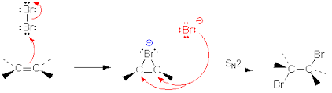
Unit 5 :Aim A Reactions of Alkenes
What does Electrophilic addition reactions mean in alkenes?
Write down all the definitions :
Electrophile
Mean Bond Enthalpy
Addition reaction
What is halogenation reaction?
:Copy and complete the following table to show the reaction mechanism for the addition of HB to Ethene.
Stage | Mechanism | Explanation

Slide 10
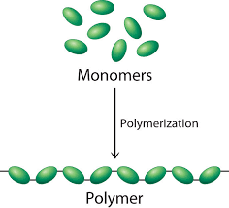
Unit 5 : Aim A polymer Formation
What are polymers?
What is free radical polymerisation?
What is addition polymerisation?
Write out all the steps for the reaction of addition polymerisation of Ethene to make polythene.

Slide 11
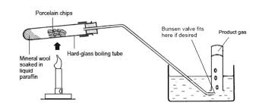
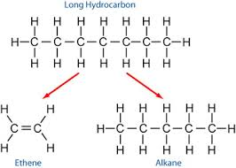
Unit 5 : Aim A Cracking
What are fossil fuels?
Why do we do cracking for crude oil?
Name two types of cracking?
What does cracking mean?
Write down the method used for catalytic cracking?

Slide 12
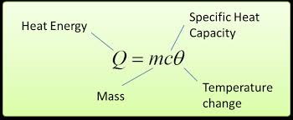
Unit 5 : Aim A Energy changes in industry
What are exothermic and endothermic reactions?
What is specific heat capacity?
Define the following terms:
Enthalpy
Surroundings
Kelvin Scale
Write down the meaning of enthalpy changes , combustion ,formation and hydration.
Write down the equation for calculating Enthalpy.

Slide 13
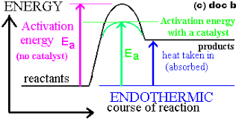
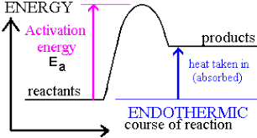
Unit 5: Aim A Measurement of enthalpy changes
What factor affect the hydration enthalpy ?
Why do we use calorimeter for?
Draw a step by step guide showing how you would calculate the molar enthalpy change of a burning fuel.
Draw the reaction profile diagrams for exothermic and endothermic reactions
What is activation energy?
Define specific heat capacity.

