Slide 1
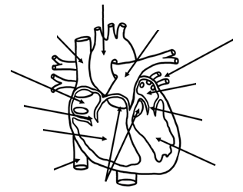
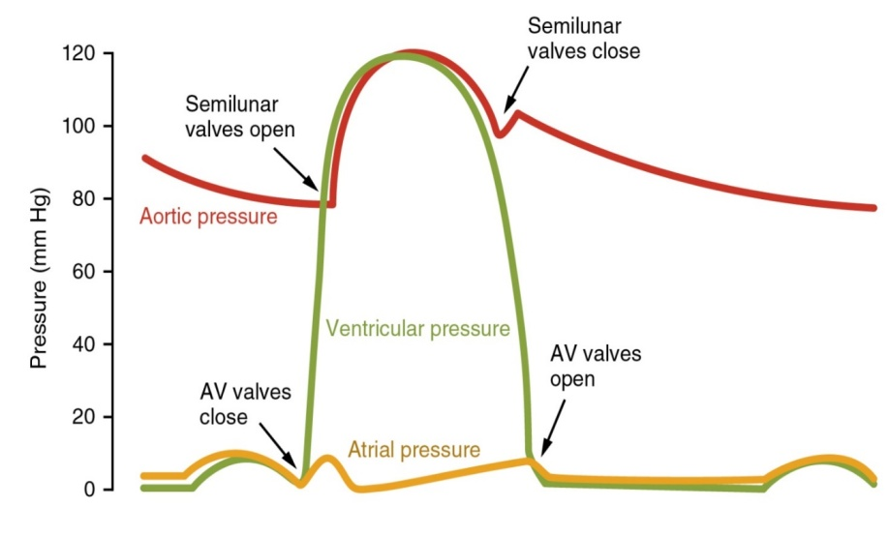
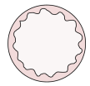
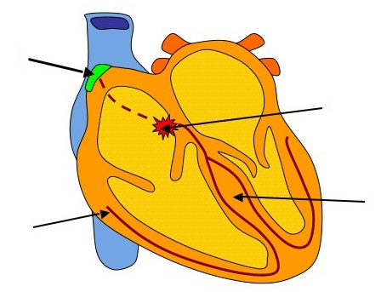


The heart
Label the structures of the heart
Annotate what is happening on this graph
C
B
A
D
Label the structures of the heart which are involved in making the heart beat.
Describe the journey of the impulse through the heart.
What are these blood vessels? Why do they have such structures?
Describe the flow of blood through the heart

Slide 2
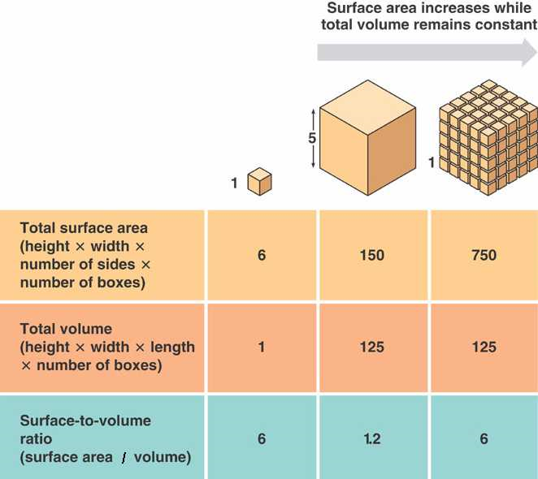
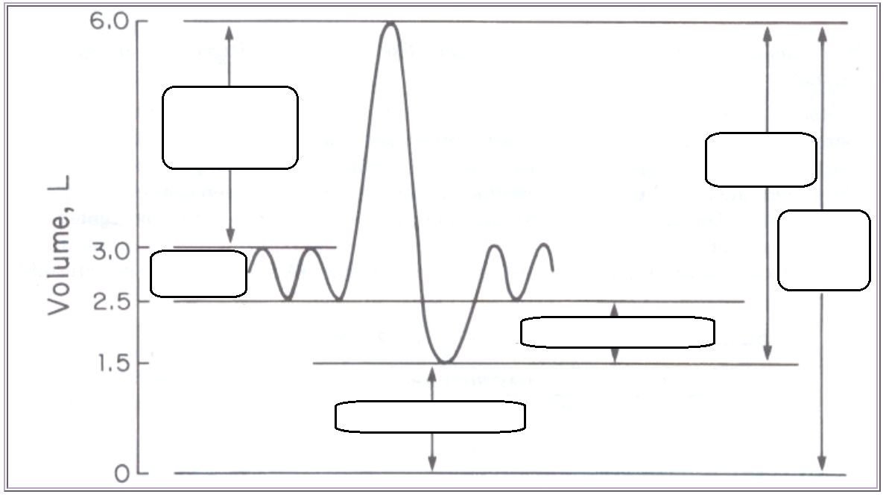
Plan an investigation into how caffeine affects the heart rate of Daphnia. Include, the IV, DV, controlled variables, etc.

Slide 3
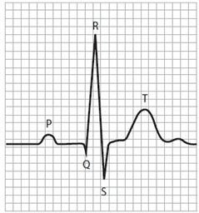
Annotate these:
Explain how a spirometer works:
What is the purpose of soda lime in a spirometer?
How is heart rate calculated using a graph?
ECG | Description
Normal
Tachycardia
Bradycardia
Sinus arrhythmia
Ventricular fibrillation
Flat line
 | Definition
Respiratory minute ventilation
Forced expiratory volume (FEV1)
Forced vital capacity (FVC)
What is the equation for calculating percentage change?
A woman’s heart rate is 75 at rest but after exercise it is 100. Calculate the percentage change.

Slide 4
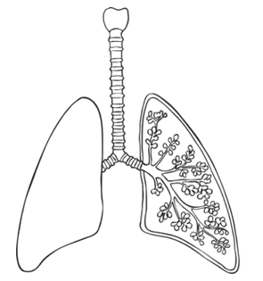
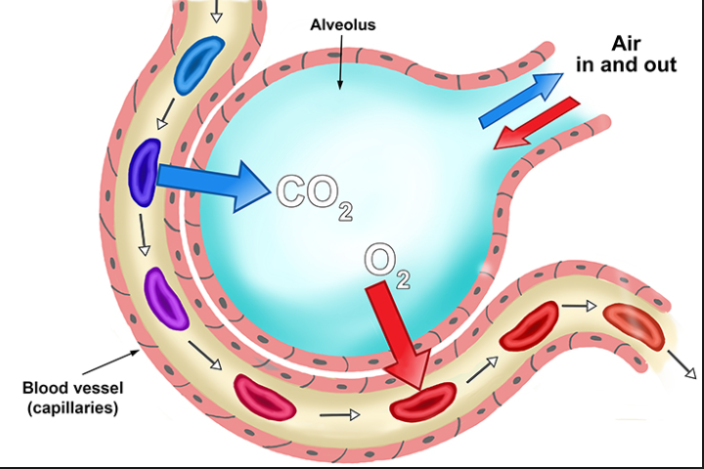
Label the structures of the lungs
Explain how lungs are adapted for efficient gas exchange
The lungs
 | Movement of air? | Diaphragm and intercostal muscles? | Volume in lungs? | Pressure in lungs?
Inspiration
Expiration
 | Definition
Respiratory minute ventilation
Forced expiratory volume (FEV1)
Forced vital capacity (FVC)

Slide 5
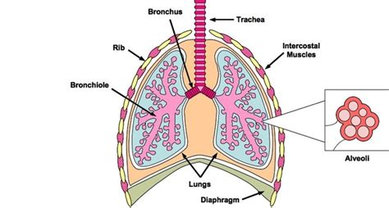
Structure & Function of Gas Exchange System
Can you describe and explain the functions of the main parts of the system? Include glandular tissue, smooth muscle, and elastic tissue found in the trachea.

Slide 6
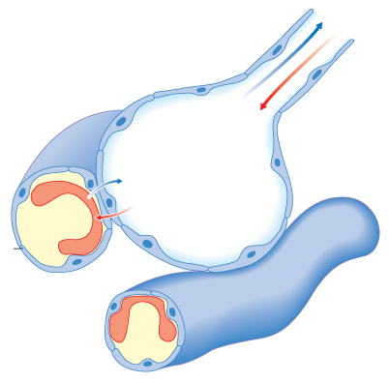
Alveoli
How are the alveoli adapted for efficient gas exchange?
What is the pleural membrane?
What are some risk factors for lung disease?
Could you interpret information relating to the effects of lung disease on gas exchange and/or ventilation?
E.g. Pulmonary fibrosis is a lung disease that causes the epithelium of the lungs to become irreversibly thickened and leads to reduced elasticity of the lungs. Suggest what symptoms would arise and why.

Slide 7
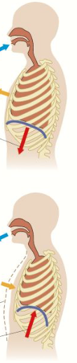
Gas exchange in lungs
Can you describe what happens during inhalation?
Can you describe what happens during exhalation?
How can you use a kymograph to calculate the following? What units would you use?
Tidal Volume
Breathing Rate
Respiratory minute Ventilation
Oxygen Consumption

Slide 8
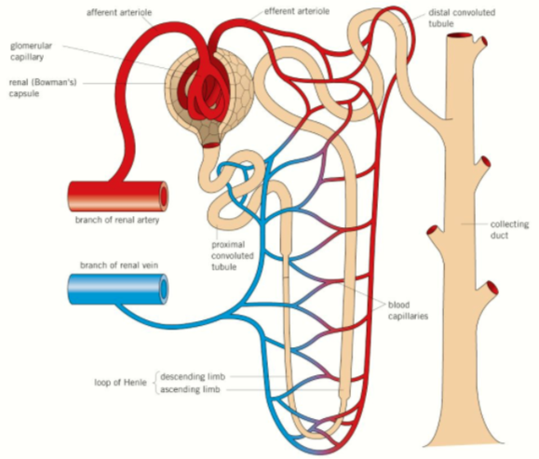
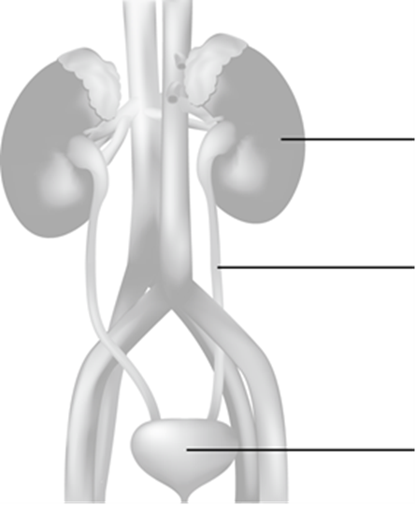
Structure & Function of the Kidney
Outline the gross structure of the kidney, and link to its function.
Outline, in detail, the gross structure of the nephron, and explain its function.

Slide 9
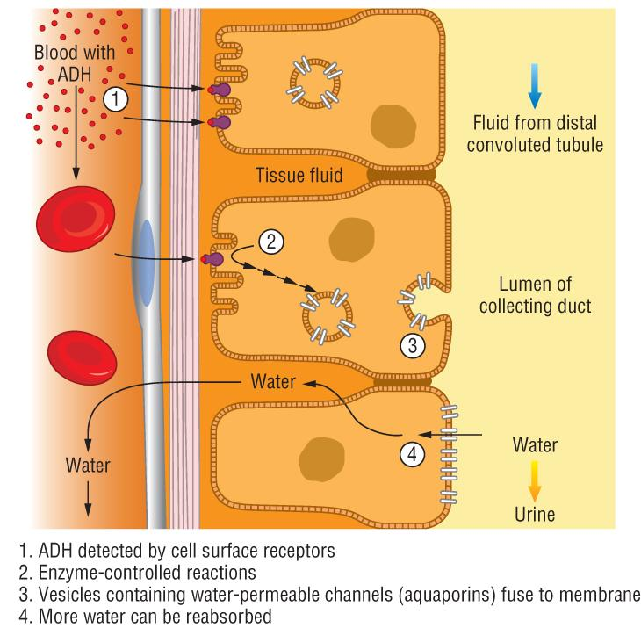
Osmoregulation
How is the water potential of the blood regulated?
What is the role of the hypothalamus, posterior pituitary and antidiuretic hormone (ADH) in osmoregulation?
Hypothalamus:
Posterior pituitary:
Antidiuretic hormone (ADH):
Draw a diagram to summarise how water potential of the blood is regulated:

Slide 10
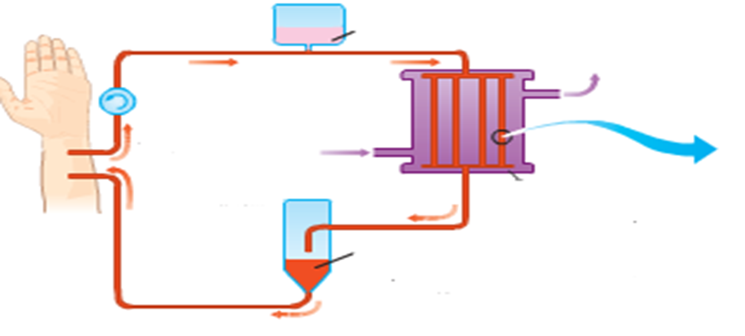
Treating Kidney Disease & Aldosterone-Angiotensin-Renin System
Annotate the diagram to explain the steps taken in dialysis.
Draw a diagram to summaries the Angiotensin – Aldosterone – Renin System and explain how it brings about changes in water levels.
What are the advantages and disadvantages of kidney transplants?
+
-

Slide 11
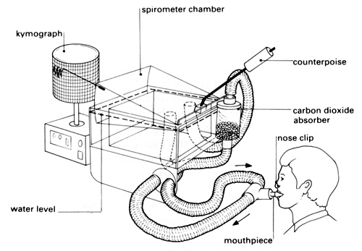
Measuring Lung Function
Explain how a spirometer is used to measure lung function.
Annotate and label the a kymograph to show the 6 elements of lung volume.
How do medics use results from peak expiratory flow and forced vital capacity to detect for diseases?

Slide 12
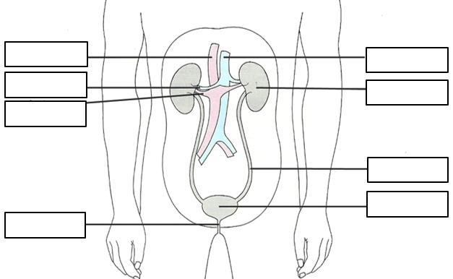
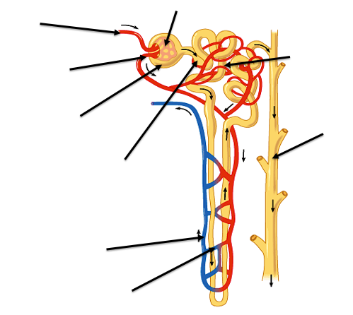
Explain the process of ultrafiltration
Explain the function of the loop of Henle in regulating water balance
 | Too much water | Too little water
Detected by
How much ADH released?
How does ADH affect collecting duct
Amount of water reabsorbed
Concentration of urine
The kidneys
Explain how the collecting duct can be made more permeable to water

Slide 13
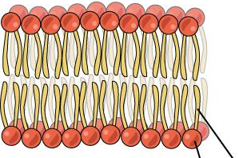
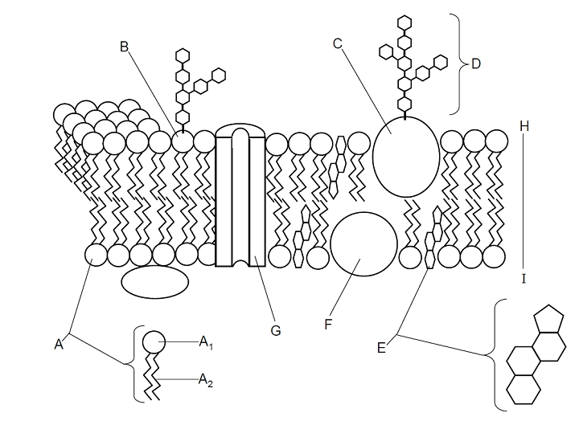
Describe the fluid mosaic model
What is a saturated fatty acid?
What is an unsaturated fatty acid?
How does the type of fatty acid affect fluidity of the membrane?
Define osmosis
Plasma membrane and transport across the membrane
Define diffusion
Define facilitated diffusion
Define active transport
Define exocytosis
Define endocytosis
Examples of molecules crossing membranes in this way
Examples of molecules crossing membranes in this way
Examples of molecules crossing membranes in this way
Examples of molecules crossing membranes in this way
Examples of molecules crossing membranes in this way

