Slide 1
BTEC Applied Sciences
Unit 1
Knowledge Organiser

Slide 2
Physics

Slide 3
Working with waves

Slide 4
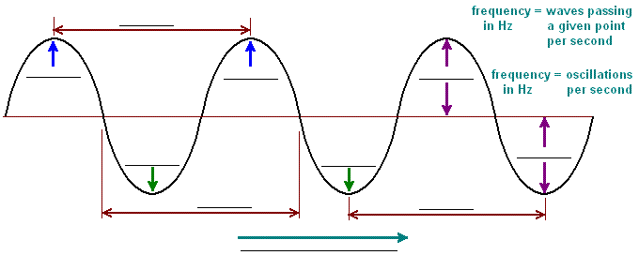
Define wave
Define oscillation
Define frequency
Define period
Define displacement
Define amplitude
Define speed
Define wavelength
Label
the
wave
How do waves transfer energy?

Slide 5
What is the formula to calculate wave speed?
What is wave speed measured in?
What is frequency measured in?
What is the frequency of a wave with a speed of 200 m/s and a wavelength of 2 m?
A wave has a speed of 30 m/s and a frequency of 10 Hz. Calculate the wavelength.
What is the frequency of a wave with a wavelength of 0.03 m and a speed of 18 m/s?
A wave has a wavelength of 8 cm and a frequency of 200 Hz. Calculate the wave speed.
What is the wavelength of a wave with a speed of 18 m/s and a frequency of 600 Hz?
A wave has a wavelength of 1 cm and a frequency of 300 Hz. Calculate the wave speed
What is the speed of a wave with a wavelength of 0.05 m and a frequency of 2000 Hz?
What is the speed of a wave with a wavelength of 2000 m and a frequency of 0.05 Hz?
A wave has a wavelength of 60 cm and a frequency of 5454 Hz. Calculate the wave speed

Slide 6
What is the formula to calculate frequency?
What is time measured in?
What is the frequency of a wave with a time period of 4 s?
What is the frequency of a wave with a time period of 3 s?
What is the time period for a wave if the frequency is 450 Hz?
What is the time period for a wave if the frequency is 62054 Hz?
What is the frequency of a wave with a time period of 0.005 s?
What is the time period for a wave if the frequency is 19,500 Hz?
What is the frequency of a wave with a time period of 2.0x10⁻¹⁸ s?
What is the frequency of a wave with a time period of 9.0x10⁻¹⁵ s?
What is the time period for a wave if the frequency is 0.01 Hz?

Slide 7
What is phase difference?
What happens to the shape of the wave if you double the frequency?
What happens to the shape of the wave if you double the amplitude?
Complete the table
Wave cycle position | Start | ¼ of a cycle | ½ of a cycle | ¾ of a cycle | 1 whole cycle | 1.5 cycles | 2 whole cycles
Phase (⁰) | 0 | 90 |  | 270
Phase (π) | 0 |  | π |  |  | 3π
Number of wavelengths | 0 |  |  |  | λ |  | 2λ
Draw a rotating vector and wave diagram?
What happens to the shape of the wave if you half the amplitude?
What happens to the shape of the wave if you half the frequency?
What type of graph can you draw in order to show the wavelength?
How can displacement be determined for water ripples?
How can displacement be determined for sound waves?

Slide 8
What are the 2 types of wave motion?
1.
2.
Draw and label a longitudinal wave
Give examples of longitudinal waves
Describe a longitudinal wave
Draw and label a transverse wave
Give examples of transverse waves
Describe a transverse wave
Why are sound waves unable to become polarized?
How do polarizing sunglasses work?

Slide 9
What is diffraction?
Explain how diffraction can be seen using a ripple tank?
What is a diffraction grating?
What is meant by transmission?
Define reflection
What factors make waves coherent?
1.
2.
3.
What is an inference pattern?
What is meant by superposition?
What is the advantage of reflection mode and why?
What is a path difference?

Slide 10
What is a photon?
Sketch two wave trains. Show them overlapping by different amounts along the horizontal axis. Think about how superposition will work and what the resultant wave form will look like.
What is meant by the term quantum?
Why do displacement-time and displacement-distance graphs have a similar shape?
What is quantum theory?
What is meant by the coherence length?
A source like an LED emits photons with very slightly differing frequencies. What effect will that have on the coherence time?
What is the Planck constant?

Slide 11
What is the formula for photon energy?
Ultraviolet radiation has a frequency of 6.8 × 10¹⁵ Hz. Calculate the energy, in joules, of the photon.
Find the energy, in joules per photon, of microwave radiation with a frequency of 7.91 × 10¹⁰ Hz
What is the unit for photon energy?
What is the frequency of UV light that has an energy of 2.39 × 10⁻¹⁸ J?
What is the energy of a light that has a frequency of 3.42 x 10¹¹ Hz?
A sodium vapor lamp emits light photons with a frequency of 5.89 × 10⁷ m. What is the energy of these photons?

Slide 12
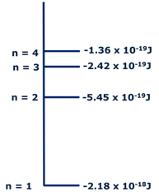
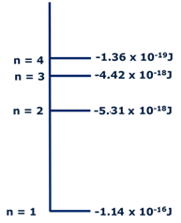
What is an emission spectrum?
What does each line in an emission spectrum show?
What is the ground state of a particle?
What is de-excitation?
What is the frequency and wavelength of the photon emitted below, when the electron drops from level n = 4 down to level n = 3?
What is the frequency and wavelength of the photon emitted below , when the electron drops from level n = 3 down to level n = 2?

Slide 13
What is a stationary wave?
When do stationary wave patterns most often occur?
Explain how the diffraction grating produces an emission spectrum. Use a labelled diagram to help your explanation.
What meant by the term resonance?
What is a node in a stationary wave?
What meant by the term forced frequency?
What meant by the term natural frequency?
How are stationary wave patterns formed by radios and TV antennas?
How are stationary wave patterns formed by microwave ovens?
What is an antinode in a stationary wave?

Slide 14
What is the formula to calculate the mass per unit length of a stretched string?
What is the formula to calculate the velocity of a stretched string?
A guitar string is plucked and has a wavelength of 70cm, it produces a frequency of 450 Hz.
What is the wave speed?
The mass per unit length of the string is 0.001kg/m. what is the tension of the string?
A violin string has a tension of 60N and a mass per unit length of 0.003 kg/m.
What is the wave speed
The wavelength of the wave produced is 5cm. What is the frequency?
A cello string is plucked and has a wavelength of 10cm. It produces a frequency of 670 Hz.
What is the wave speed?
The tension of the string is 120N. What is the mass per unit length?

Slide 15
Waves in communication

Slide 16
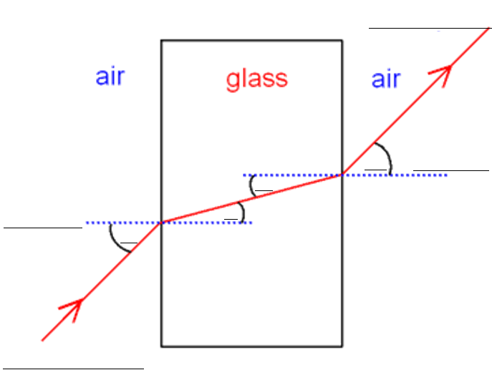
How does a light wave travel in a vacuum?
Define refractive index
Label the diagram below
Refractive index = ___
Define normal
Why can’t light waves travel through metals?
Define incidence
Refractive index = ___
What happens when a light wave passes through a transparent material?
What are the 2 formulas to calculate refractive index
Define refraction

Slide 17
What is the speed of light in a vacuum?
What should be the angle of incidence of a light ray incident through air on the boundary separating air from water so that the angle of refraction is 30 °? (refractive index of air is 1 and that of water is 1.32)
A light wave with a wavelength of 612 nm in a vacuum travels through a bit of fused quartz which has an index of refraction of n =1.458. Find the speed of light in the quartz.
What is the index of refraction in a medium where the speed of light is 1.5×10⁸ m/s?
What should be the angle of incidence of a light ray incident through air on the boundary separating air from water so that the angle of refraction is 50 °? (refractive index of air is 1 and that of water is 1.32)
What should be the angle of incidence of a light ray incident through air on the boundary separating air from water so that the angle of refraction is 70 °? (refractive index of air is 1 and that of water is 1.32)
What is the speed of light in water whose refractive index is 1.33?
What is the speed of light in zircon whose refractive index is 1.94?
Flint has a refractive index of 1.65. Find the speed of light in flint.

Slide 18
What is internal reflection?
Draw a diagram to show total internal reflection
The sparkle of diamonds is due to light being very effectively trapped in them bt total internal reflection. The critical angle for a diamond-air interface is only 24.4⁰. Calculate:
The refractive index of diamond
The speed of light in diamond
What is the critical angle?
What is the formula to calculate the critical angle?
What is total internal reflection?
What is the critical angle for light traveling from glass to water? Glass has an index of refraction of n=1.5, while water has n=1.33.
A ray of light passes from a medium with an index of refraction of 1.50 into another medium with an index of refraction of 3.33. If the incident ray is at an angle of 20⁰ with respect to the normal, what is the critical angle?

Slide 19
What are optical fibres?
What happens to the waves of light as they pass through an optical fibre?
Draw and label a diagram of an optical fibre?
Why is the glass core surrounded by a cladding material in an optical fibre?
How are permanent joints made between optical fibres?
What are endoscopes?
Optical fibres are more efficient at transmitting signals than copper cables. Evaluate this statement.
How does an endoscope work?

Slide 20
What is an analogue signal?
Give exampled of analogue signals?
What are the advantages of digitising information compared to analogue transmission?
Explain how analogue signal can be converted into digital signal
What is a digital signal?
Use the formula v=fλ to calculate the frequency of near infra-red light, wavelength = 830nm. The speed of light is 3×10⁸ m/s.
What would currently limit the bit rates at which data can be transmitted?

Slide 21
What are the advantages and disadvantages of analogue and digital signals?
What is meant by the term bandwidth?
Who installs fibre optic cables?
Give an application of multimode and single mode fibres
What is meant by the term broadband?
What does an optical amplifier do?
What is wave division multiplexing (WDM)?
How does fibre optic broadband compare the copper cable connections?
What is multimode fibre?
What is the diameter of optical cores in multimode fibres?
What is single mode fibre?
What is the diameter of optical cores in single mode fibres?
How does light travel in a single mode fibre?
What does reliability of the signal depend on?

Slide 22
Use of electromagnetic waves in communication

Slide 23
What speed do all electromagnetic waves travel in a vacuum?
Order the waves in the electromagnetic spectrum from the biggest to smallest wavelength.
Complete the table
Prefix | Symbol | X10 to the power | Factor
Exa | E | 18 | 1 000 000 000 000 000 000
Peta
Tera
Giga
Mega
Kilo
 |  | 0 | 1
Milli
Micro
Nano
Pico
Femto
atto | a | -18 | 0.000 000 000 000 000 001
What is the formula for the inverse square law in relation to the intensity of a wave?
What does the equation c = fλ tell us?
What part of the electromagnetic spectrum can we see?
How are x-rays produced?
How are γ-rays produced?

Slide 24
Complete the table
The electromagnetic spectrum |  | Frequency range | Wavelengths | Produced by |  | Used for
Radio | Long wave | 30 to 300 kHz |  |  | Thermal emission Cold → very hot
 | Medium wave
 | Short wave (HF)
 | VHF |  | 10 to 1m
 | UHF
Microwaves | SHF |  |  |  |  | Domestic ovens RADAR Satellite and terrestrial communication links
 | EHF
Infra-red (IR) | Far |  |  |  |  |  |  | Spectroscopy
 | Mid-range
 | Near
Visible light |  | 400 to 800 THz |  |  |  |  | Photosynthesis in plants
Ultra-violet (UV)
X-rays |  | 30 PHz to 30 Ehz
γ-rays |  |  | Generally < 0.01 nm

Slide 25
What is the frequency band of satellite communications?
How are satellite communications used and regulated?
What is the frequency band of mobile phones?
How are mobile phones used and regulated?
What is the frequency band of bluetooth?
How is bluetooth used and regulated?
What is the frequency band of wi-fi?
How is wi-fi used and regulated?
What is the frequency band of infrared?
How is infrared used and regulated?

