Slide 1
BTEC Applied Sciences
Unit 1
Knowledge Organiser

Slide 2
Biology

Slide 3
B1 - Cell structure and function

Slide 4
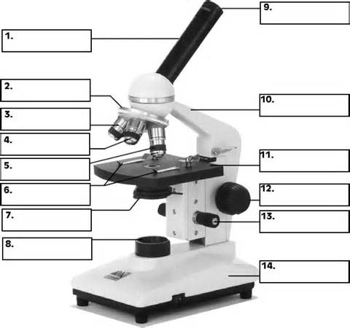
What is cell theory?
Outline the main events that occurred during the development of cell theory
Compare and contrast the light and electron microscope
Label this microscope
What are the different types of microscopes?
What is the formula for calculating magnification?

Slide 5
What is resolution?
What is the purpose of the following:
cytoplasm?
Rough ER?
Golgi apparatus?
Lysosomes?
Draw and label an animal cell
What are the different types of cells?
What are eukaryotic cells?
What are prokaryotic cells?

Slide 6
Draw and label a plant cell
What is the purpose of the following:
Chloroplast?
Tonoplast?
Amyloplast?
Plasmodesmata?
Pits?
Draw and label a bacterial cell

Slide 7
1 kilometre (km) = __________ metres (m)
1 m = __________ centimetres (cm)
1 cm = __________ millimetres (mm)
1 mm = __________ micrometre (um)
1 um = __________ nanometre (nm)
1 nm = ____________________ m
What is the purpose of the following:
Cell wall?
Ribosome?
Plasmid?
Capsule?
Nucleoid?
How can bacteria be classified?
What is meant by the term complementary base pairing?
What are the similarities between a prokaryotic and a eukaryotic cell?
Why do the different types of bacteria react differently to some antibiotics?
What stains are used to distinguish between the 2 groups of bacteria?
What are the differences between a prokaryotic and a eukaryotic cell?
Define exocytosis
What are the results of these stains?

Slide 8
B2 - Cell specialisation

Slide 9
How are multicellular oganisms organised?
Explain how a root hair cell is specialised to carry out its function
Explain how a palisade mesophyll cell is specialised to carry out its function
Explain how egg cell is specialised to carry out its function
Explain how a white blood cell is specialised to carry out its function
Explain how a sperm cell is specialised to carry out its function
Explain how a red blood cell is specialised to carry out its function

Slide 10
B3 - Tissue structure and function

Slide 11
What are the 4 main types of tissue in animals?
1.
2.
3.
4.
How is squamous epithelial tissue adapted for a fast rate of diffusion?
How does smoking damage squamous epithelial tissue?
What are the main symptoms associated with COPD?
What are the 3 types of epithelial tissue in animals?
1.
2.
3.
What substances need to pass through endothelial tissue?
Where is squamous epithelial tissue found?
What is atherosclerosis?
Where is epithelial tissue found?
How is endothelial tissue adapted for a fast rate of diffusion?
How is ciliated columnar epithelial tissue adapted for to protect from infection?
Where is ciliated columnar epithelial tissue found?
How is gas exchange affected by COPD?
What are goblet cells?

Slide 12
What do muscles contain?
What are the 3 types of muscle tissue in animals?
1.
2.
3.
Describe the structure of muscle tissue?
Where is skeletal muscle found?
Explain what happens to the protein filaments during muscle contraction?
What are the 2 types of muscle fibres?
1.
2.
How are slow twitch muscle fibres adapted for their function?
Where is cardiac muscle found?
What is ATP?
Where is smooth muscle found?
How is ATP released by slow twitch muscle fibres?
What is a sarcolemma?
What is a myofibril?
What is a sarcomere?

Slide 13
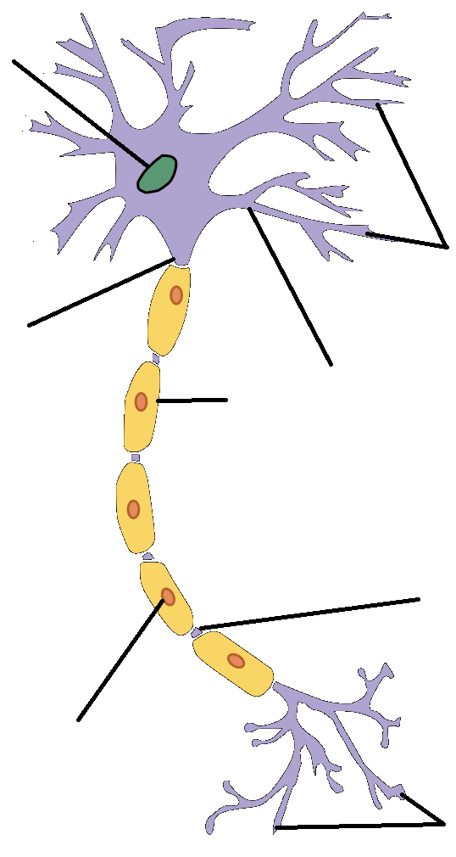
What are the 2 types of fast twitch muscle fibres?
1.
2.
How do fast twitch oxidative muscle fibres help athletes?
What are neurons?
Label the neuron below
How are fast twitch oxidative muscle fibres adapted for their function?
How do fast twitch glycolytic muscle fibres help athletes?
What does the CNS consist of?
What does the CNS consist of?
1.
2.
How are fast twitch glycolytic muscle fibres adapted for their function?
What does the CNS made up of?
1.
2.
3.
How does information travel along neurons?
How do slow twitch muscle fibres help athletes?
What is nervous tissue made up of?

Slide 14
How does information travel from one neuron to another?
What are sensory neurons?
Explain the process of depolarisation?
Explain how a cell membrane becomes polarised?
What is a resting potential?
What is myelin?
What is the purpose of Schwann cells?
What 2 ions are transported across a neuron membrane?
1.
2.
How much potential difference created by the Na/K pump?
What is an action potential?

Slide 15
What are the nodes of Ranvier?
What types of nerves does saltatory conduction occur in?
What 3 factors does the speed of conduction of a nerve impulse depend on and how does it affect the speed?
1.
2.
3.
What are synapses?
Explain the process of saltatory conduction?
What are neurotransmitters?
What is saltatory conduction?
How do neurotransmitters work?
What is the most common neurotransmitter?
What is the speed of nerve impulses in:
Myelinated nerve fibres?
Unmyelinated nerve fibres?
How do cholinergic synapses work?

Slide 16
Explain the process of chemical transmission across the synapse?
1.
2.
3.
4.
5.
6.
7.
8.
What does EEG stand for?
What is an EEG?
How do EEGs work?
What is Parkinson’s disease?
Why does Parkinson’s occur?
What are the main symptoms of Parkinson’s disease?
What is L-dopa?
What is serotonin?
What happens if the body does not produce enough serotonin?

