Slide 1
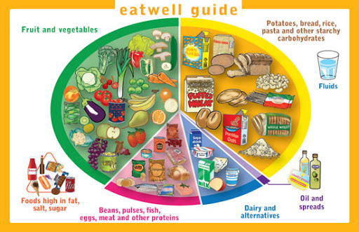
Health Education
Lifestyle Diseases: | Explanation
Heart disease | Also known as cardiovascular disease, refers to narrowed or blocked blood vessels that can lead to a heart attack.
Type 2 diabetes | A condition that causes the level of sugar (glucose) in the blood to become too high.
Obesity | The state of being severely overweight.
Benefits of exercise: | Examples
Physical | -Good fitness -Strong organs and bones -Lower risk of health problems
Social | -Develops social and teamwork skills -Spend time with friends
Mental | -Boosts self-esteem and confidence -Relaxing feeling after exercising -Enjoyment
Health is defined as… a state of complete mental, physical and social well-being. (WHO – World Health Organisation)
Organ/blood donation | To voluntarily give an organ/blood to someone else in need.
Donor | Someone who donates an organ or blood.
Transplant | To move/transfer an organ from one person to another.
Homework | What to do…
1. Benefits of exercise | Complete the worksheet on benefits of exercise.
2. Healthy eating | Create an information poster on healthy eating.
3. Poor diet | Create two examples of a good diet and a bad diet.

