Slide 1


Subject: Y8 English | Topic: ‘Small Island’ by Andrea Levy | Term: Autumn
Plot Summary | Grammar definitions:
1 | Hortense, a Jamaican woman, sails to Britain to join her husband, Gilbert, and start her teaching career there.
2 | She finds Gilbert renting a room in Queenie’s house, which doesn’t meet her expectations of British life.
3 | Queenie is married to Bernard, who is fighting in India as soldier in WW2.
4 | Before Gilbert and Hortense arrived, Queenie met the Jamaican soldier Michael Roberts, who Hortense once held affection for, and had an affair before he left to fight in the war.
5 | At the novel’s conclusion, Bernard returns, Queenie gives birth to Michael’s son and gives him to Gilbert and Hortense to raise.
Andrea Levy
Andrea Levy (1956-2014) was born in London to Jamaican parents. Her father came to Britain on the HMT Empire Windrush in 1948, with her mother following later that year. She grew up on a council estate and had a typical working-class upbringing. Her work explores racial and cultural identities. She wrote ‘Small Island’ in 2004.
Adaptation
Andrea Levy wrote the story as a novel in 2004. It was then adapted into a play by Helen Edmundson in 2019.
Themes
Racism | As black people in societies controlled by white institutions, Hortense and Gilbert’s daily interactions and the possibilities of their lives are framed by racism. The stories ending creates many questions about race and prejudice in Britain.
War | World War 2 causes characters to move across the world and interact with people they may never have encountered otherwise. War can also be seen in the conflicts which arrive in the different relationships in the story.
Hope | Levy depicts several characters in her novel as having optimistic thoughts for the future. These hopes are sometimes proved to be more dreams than realistic expectations.
Love | Love is one of the strongest forces in the story. Levy shows many different kinds of love as well as the difficulties of love.
Displacement | Feelings of displacement plague all the novel’s main characters. None of the main characters feel truly at home in either British or Jamaican society.
Play
Novel
Key Quotations
‘Hortense is hurrying to prepare the classroom for the hurricane’s arrival’.
‘This place is disgusting! You make me come here to live like an animal!’
‘They say I would have to train all over again…They speak to I like I am a fool’.
‘Your white skin. You think it give you the right to lord it over a black man. But you know what it makes you? White. That is all, man.’
‘The lights fade down until there is only a spotlight on this baby – made by all of us – floating into an uncertain world.’

Slide 2
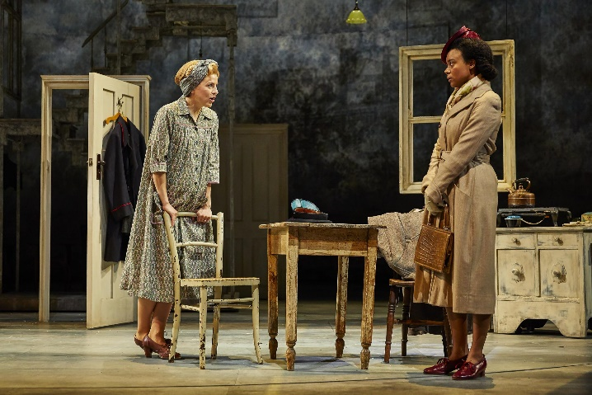
Subject: Y8 English | Topic: ‘Small Island’ by Andrea Levy | Term: Autumn
Hortense
A very well-mannered woman who looks down her nose at other people. She comes from Jamaica and has moved to England with hopes of becoming a teacher, but she is naïve about what to expect when she arrives. It becomes quite ironic as she turns out to be more polite and well spoken than anyone she meets.
Key Words
Pathé | The company that invented newsreels shown in cinemas.
Colonialism | When a powerful country controls less powerful countries and uses their resources to increase their own power and wealth.
Windrush | A word used to describe people who emigrated from the Caribbean to the UK between 1948 and 1971. Named after the ship Empire Windrush, which brought the first group to the UK in 1948.
Maternal | Motherly actions.
Paternal | Fatherly actions.
Sophisticated | A sophisticated person knows a lot about the society they live in. A sophisticated object is more complex than other similar objects.
Ignorant | Ignorant people do not know things that they should know.
Sardonic | Sardonic humous is funny but critical or sarcastic.
Bewildered | If you are bewildered, you are confused.
Prejudiced | The unreasonable dislike of a particular group of people or things.
Gilbert
A lovable and funny character who is always trying his hardest to please everyone. He is quite laid back, but extremely intimidated by Hortense, his wife. Gilbert has dreams and hopes, but hides his disappointment in his current reality through humour.
Queenie Bligh
She is open-minded and has a very big and kind heart. After her husband, Bernard, left for the war she opened her house for servicemen. Her name is a pun on ‘The Queen of England’, with Bligh coming from ‘Blighty’ (a dated word for England).
Bernard Bligh
Bernard is extremely reserved and has very poor relationships with most people in the narrative. He is very intolerant and old fashioned. He is racist towards Gilbert and Hortense and very controlling over Queenie. In some ways, he seems to be made a better person through his experiences in WW2. Unlike his father, Arthur, who suffers from shell shock as a result of WW1.
Michael Roberts
A Jamaican Air Force serviceman who grows up alongside Hortense. When he leaves for the Air Force he stays at Queenie's boarding house in England and begins a relationship with her. Neither Queenie or Hortense ever find out that they both know Michael.

Slide 3
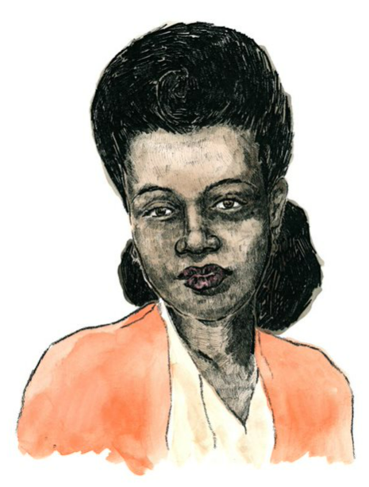
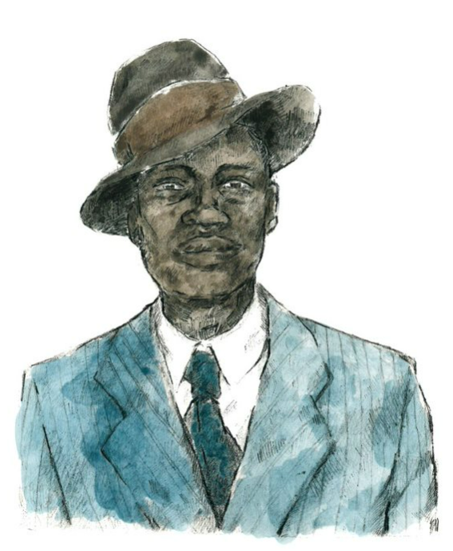
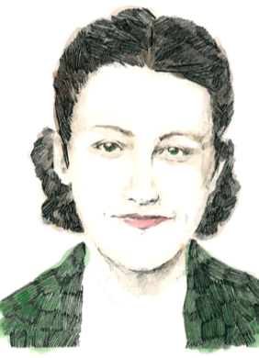
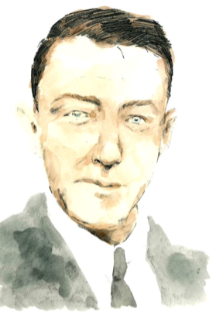
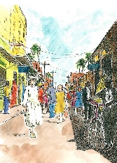
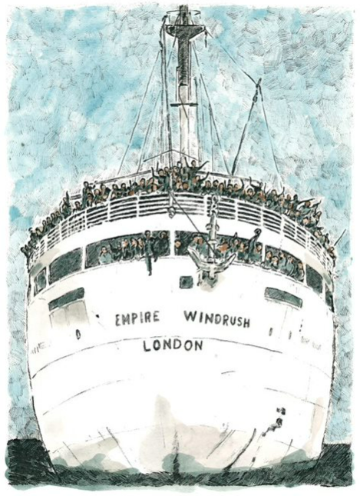
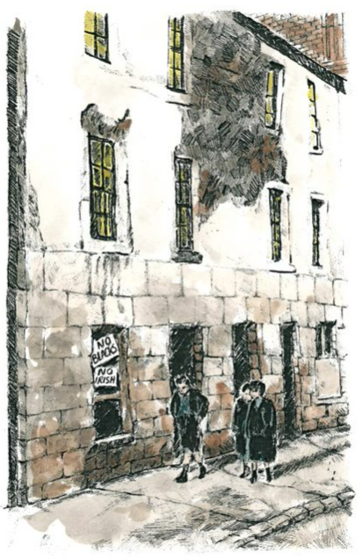
‘Small Island’ by Andrea Levy: Knowledge Organiser
About the play
Small Island is a novel written by Andrea Levy. In 2019, it was adapted into a play by Helen Edmunson. Although a work of fiction, Small Island takes place in the 1920s - 1940s. It tells the story of Hortense and Michael who emigrated from the Caribbean to England on the Empire Windrush in 1948. It shows the relationships they form, and the challenges they face starting a new life in a new country.
Characters
 | Hortense is a Jamaican woman. As a child she is given away by her mother in the hope that she has a better life. She is clever and proud. At the beginning of the play, Hortense has strong views about morality and the world. Hortense marries Gilbert not because she loves him, but so that she can go to England and fulfil her ambition of becoming a teacher in a country where she will be respected - ‘no-one will feel sorry for I’. Hortense struggles to adjust to the reality of life in England as her dreams of being a teacher are rejected. At the end of the play, Hortense’s feelings for Gilbert transform into love and pride at the end of the play when he addresses Bernard after his racist outburst.
 | Gilbert is a Black Jamaican man.​ His ambition is to become a lawyer in England.​ Gilbert is intelligent, charming and kind. Like Michael, he joins the RAF during The Second World War. Gilbert is a positive character who, like Hortense, has to adapt to the adverse situations he finds himself in. At the end of the play, Gilbert becomes mature and responsible by adopting baby Michael as his own with Hortense. He also realises that Hortense is worth ‘more than the price of a ticket’ to England. He ends the play with dignity and Hortense’s admiration.
 | Queenie is a British woman. At the start of the play, Queenie dreams of romance and having her own family. Queenie marries Bernard, but she is unhappy in her marriage. She says ‘It’s not what I imagined for myself’. Queenie is overwhelmed by the stigma of raising a black child. At the end of the play, she gives baby Michael away saying, ‘You know what? I don’t think I’ve got the guts for it’.
 | Bernard is an English man.​ Bernard is quiet, nervous and old-fashioned.​ His ambition is to impress Queenie. Bernard is hostile to anyone who’s not of his own race or class. Bernard typifies the racist attitudes that were prevalent in post-war Britain. His unwillingness to change his attitude makes him an unsympathetic character.
Key words
adversity - an extremely difficult situation adverse – extremely difficult
ambition – an ambition is something you want to achieve in life
Colony - A country that is ruled by a foreign nation is called a colony.
Dignified – if you are dignified, you are worthy of honour and respect.
Discriminate - to treat someone or a group of people unfairly because of their sex, race, religion or disability.
Euphemism – a euphemism is any phrase that hides another meaning.
Stigma - a set of negative and often unfair beliefs that a society or group of people have about something.
Stagecraft
A play is written to be performed in front of an audience.
A play is divided into acts and scenes.
A change in scene shows a change in place or a change in time.
The end of an act is more significant than other moments in a play.
Stage Directions tell us a lot about a character’s feelings and motives.
Characters can talk to the audience to reveal their thoughts, feelings, and memories.
Tableau – A tableau is when some of the actors freeze in the middle of the action. It reveals a character’s thoughts or feelings at a particular moment.
Events in the play: Act One |  |  | Events in the play: Act Two
 | The play opens in Jamaica - 1939. Hortense prepares for the arrival of a hurricane and tells her story. The hurricane hits. Michael appears, shoving Hortense out of the way and rushing to passionately kiss Mrs Ryder. | We then move to England – 1941. Queenie rents out rooms in Bernard’s house to soldiers. There is an instant attraction between Queenie and Michael. Hortense says she will lend Gilbert the money for the passage to England, if he marries her and sends for her once he has a place to live in England. |  | The play ends in London- 1948. Gilbert and Hortense are discriminated against by colleagues, neighbours and Bernard. Queenie gives birth to Michael’s baby. Queenie hands her baby to Hortense and Gilbert. They promise they will be proud of the child and he will be loved.

Slide 4
‘Small Island’ by Andrea Levy: Knowledge Organiser
About the play
Characters
 | Hortense
 | Gilbert
 | Queenie
 | Bernard
Key words
adversity -
ambition –
Colony -
Dignified –
Discriminate -
Euphemism –
Stigma -
Stagecraft
A play is written to be performed in front of an audience.
A play is divided into acts and scenes.
A change in scene shows a change in place or a change in time.
The end of an act is more significant because
Stage Directions
Characters can talk to the audience to reveal their thoughts, feelings, and memories.
Tableau –
Events in the play: Act One |  |  | Events in the play: Act Two

