Slide 1

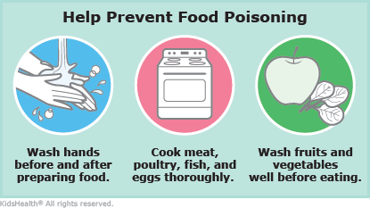
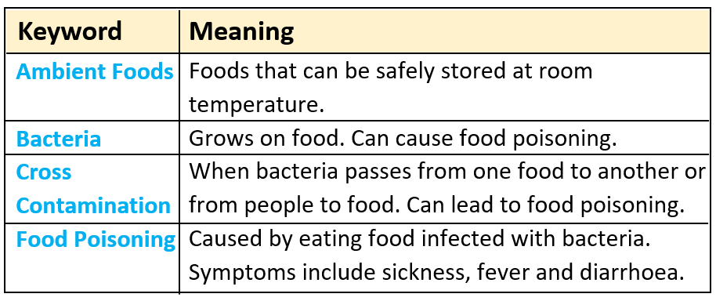
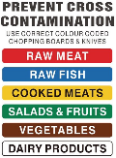
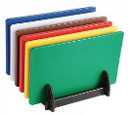

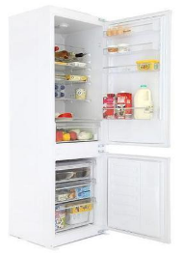




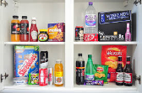
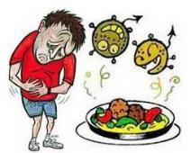
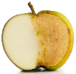

Y7 Food Safety
Task: 1-3 Learn/cover/write and self-check, basic safety and hygiene, colour coded chopping boards/keywords and food storage/bacteria.
Task 1
Task 2
Basic Safety and Hygiene Rules
Colour Coded Chopping Boards
Wash hands before handling food.
Store food in the correct place.
Use the correct colour chopping boards to avoid cross contamination.
Cover cuts with a blue plaster.
Tie back hair and wear a clean apron.
Stops bacteria spreading & causing food poisoning.
Task 3
Fruit – Should be stored in a fruit bowl to ripen.
Fridge (dairy foods, meat, fish, salad) – A fridge temperature should be between 0 and 5°C
What Conditions Do Bacteria Need To Grow?
Signs of Bacteria Growing on Food
Warmth, Moisture, Food, Time and PH Balance.
This is why storing food in the correct place is so important. If food is not stored correctly bacteria will grow and cause food poisoning.
Food Storage
Different foods need to be stored in different places to slow down the growth of bacteria.
Mould
Bad Smells
Sourness
Enzymic Browning
Ambient foods (bread, cereals, pasta etc) – should be stored in a cool, dry, dark place (cupboard or bread bin)
Freezer – A freezer should be -18°C or below.
Foods such as apples, pears and potatoes will turn brown when peeled, because oxygen reacts with the enzymes in the food. They are still safe to eat but you can prevent this by using an acid like lemon juice or covering in water.

